Slide 1
Anti-Racism Response: Racial Slurs & Hierarchies of Power PART 1
Anti-Racism Unit
Office of Equity, Diversity, Inclusion, and Anti-Racism
February 2024

Slide 2
What is racism?
Racism includes ideas or practices that establish, maintain or perpetuate the racial superiority or dominance of one group over another.
Racism is different from just racial prejudice, hatred, or discrimination. It involves one group having the power to carry out systematic discrimination through the institutional policies and practices of the society and by shaping the cultural beliefs and values that support those racist policies and practices.
Sources:
Government of Ontario Glossary
“What Is Racism?” − Dismantling Racism Works (dRworks) web workbook.
Notes:
For the purpose of this presentation, racism includes ideas or practices that establish, maintain, or perpetuate the racial superiority or dominance of one group over another.
Racism is different from racial prejudice, hatred, or discrimination, as it involves one group having the power to carry out systematic discrimination through the institutional policies and practices of the society and by shaping the cultural beliefs and values that support those racist policies and practices.
Many anti-racism thought leaders note that racism is political and the constant reinforcement of power and oppression over those seen as racially inferior.
It is important that we acknowledge in this context how society, has a foundation of whiteness and white supremacy, leading to systemic barriers and racism for many Black, Indigenous, and Racialized folx partaking in various institutions.

Slide 3
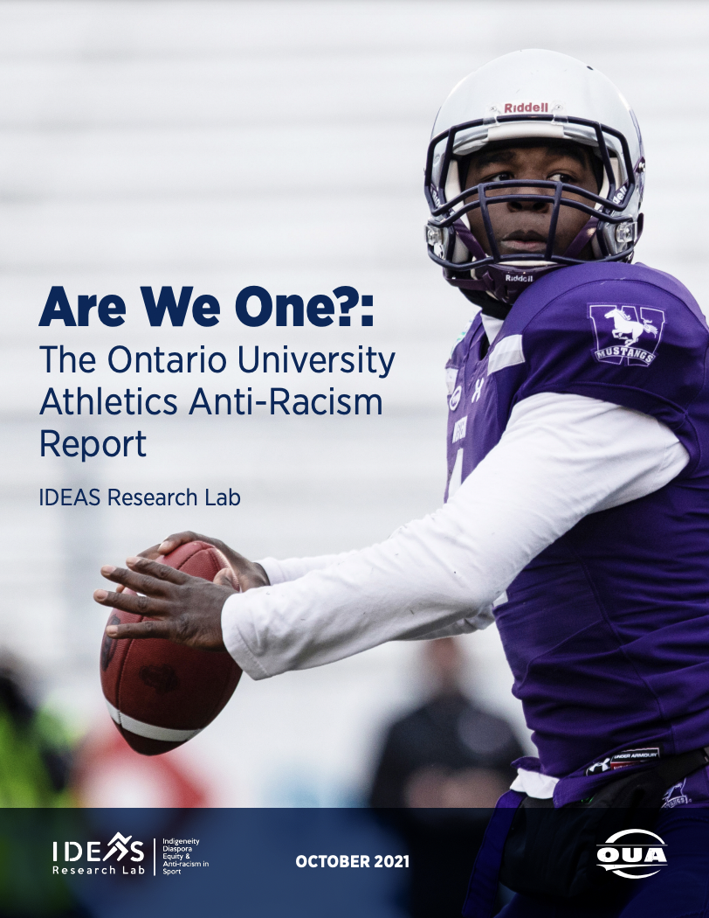
Racism in Sports
Have you read/reviewed the OUA report on Anti-Racism? If not, you can find it here.
There is no denying that racism is real and actively impacts Black, Indigenous and racialized Athletes.
In 2021, Ontario University Athletics (OUA) reported anti-racism in sports across Canadian Universities. Some findings from this report include:
Black athletes report being stereotyped as having low intelligence and high durability by authorities. This is all based on assumptions that they are not academically talented enough to succeed at university and/or that they are more resilient and physically strong than other athletes on their teams. ​
48% of athletes in the Ontario University Athletics community have experienced occurrences of racism, such as having their hair pet by other white athletes and administration, as well as hearing oppressive statements and racial slurs.
Due to barriers, Black and Racialized athletes often do not utilize onsite offices to assist with race related incidents, with only 62 of the 3818 responses ever utilizing these supports. ​
Notes:
One of the various institutions that racism shows up in is the institution of sports and athletics, which we will be using as an example for this presentation. This is also reflected within university-level athletics, and in 2021, the Ontario University Athletics (OUA) reported anti-racism in sports across Canadian Universities. Some findings of this report are listed here on this slide. For more information, you can read the entire OUA report on Anti-racism, which is also linked on this slide.
It is important to note that racism in sports, including microaggressions, stereotypes, racial barriers, etc. do not just show up in professional athletics but are also present in recreational sports such as intramurals, gym facilities, studio spaces, and other athletic spaces.

Slide 4
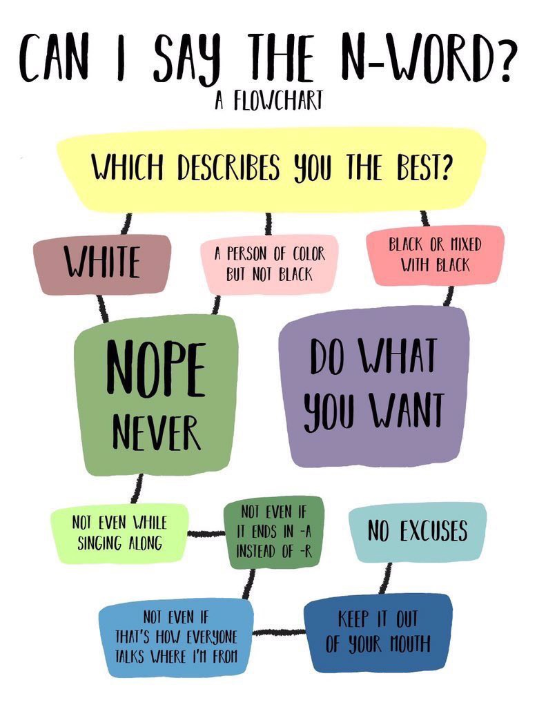
What is a racial slur?
A racial slur is a word or a phrase that refers to members of a specific racial group in a derogatory, demeaning, and dehumanizing manner. For example, the N-word is a racial slur that targets Black people.
Sources/Learn more
Social Media:
Language Matters: Everyday Words and Sayings Rooted in Racism (The Winters Group, Inc.)
Common Terms/Phrases with Racist Histories
Reclamation of Racial Slurs
Articles:
Racial Slurs | Encyclopedia
Videos:
What The N-Word Feels Like
The n-word discussion: How pop culture normalized the racial slur
Image: https://twitter.com/jaleesajohnson_/status/1140726465295781888
Notes:
A racial slur is a word or a phrase that refers to members of a specific racial group in a derogatory, demeaning, and dehumanizing manner. For example, the N-word is a racial slur that targets Black people.
I want to make it clear that I am not suggesting that racial slurs such as the N-word are words that nobody, including Black people should say. It is not my place, nor anyones to make this call. However, I am also not saying it is okay to say and be used by everyone. I am trying to bridge two currents of information so that folx understand that these dynamics are not as straightforward as we think. Speaking from my own experience, throughout my life it has not been uncommon for the Black community around me, including my family and friends, to say the N-word, not to offend, demean, or be hostile towards each other, but as a term of endearment. The thing is, unless you are from the Black community, these nuances and understandings are lost in translation. Using our example of racism in sports, let’s say a Black athlete uses the N-word during a sporting event. The lack of diversity in sporting officials and coaches, the presence of power hierarchies, and the lack of understanding of the complexities of Black Culture may contribute to a misunderstanding, and punitive action may unjustly taken towards that Black athlete .

Slide 5
Video: The N-Word "Double Standard" by Chescaleigh!|
Video: https://www.youtube.com/watch?v=_LK-j8ZED44&ab_channel=chescaleigh

Slide 6
N-Word History & Sports
The use of the N-Word historically has been used and continues to be used to dehumanize and express power over Black bodies
The white supremacy and power hierarchies of sport
Stemmed from racial segregation in both professional and amateur sports.
"Animalistic" connotations and stereotypes reinforced in sport
"Natural ability to run", "natural instincts to hit"
Notes:
History informs us that the N-word has and continues to be used by non-Black people to dehumanize and express power over Black bodies, which has also been evident in sports. Sport itself was developed to reinforce white supremacy and power hierarchies. Stemming from racial segregation that separated white and Black athletic participation, Black athletes have consistently been identified first by the colour of their skin during their engagement in both professional and amateur sports.
This can be seen directly in statements that comment on Black athletes “natural ability to run” or “natural instincts to hit”, which consistently reinforce the “animalistic” connotations that follow racial slurs such as the N-word that are rooted in the desire to devalue and dehumanize the Black community. These are the same stereotypes white people used and continue to use to portray and stereotype Black men as lazy, undisciplined, vocal, arrogant, angry, physically strong, animalistic, and/or ignorant and Black women as childlike and neglectful of their families.

Slide 7
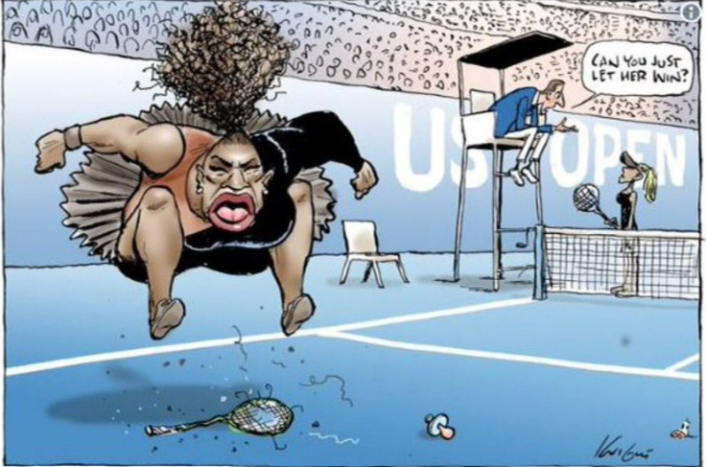
N-Word History & Sports Example
Cartoon drawn of Serena Williams following accusations during her 2018 US Open game against Naomi Osaka
Image from the Herald Sun newspaper, drawn by Mark Knight
Notes:
For example, during a game against Naomi Osaka at the US Open in 2018, Serena Williams was accused of a series of false accusations. Many of these accusations were given as a result of behavior that the umpire deemed “aggressive” and “childlike”, though it was behavior that had previously been regularly demonstrated by many white male players in the league. Following this game, Williams was fined $17,000, and was drawn as a cartoon – as can be seen on this slide - that many perceived depicted her as an angry child.
Similar to minstrel shows where white “actors” would paint their faces black and demonstrate “animalistic” behaviors, this cartoon reinforced not one, but two of the primary stereotypes - angry and childlike - that often follow Black athletes in the sporting community.

Slide 8
Video: Every Serena Williams win comes with a side of racism and sexism
Video: https://www.youtube.com/watch?v=VF5OdUTT6Ro&ab_channel=Vox

Slide 9
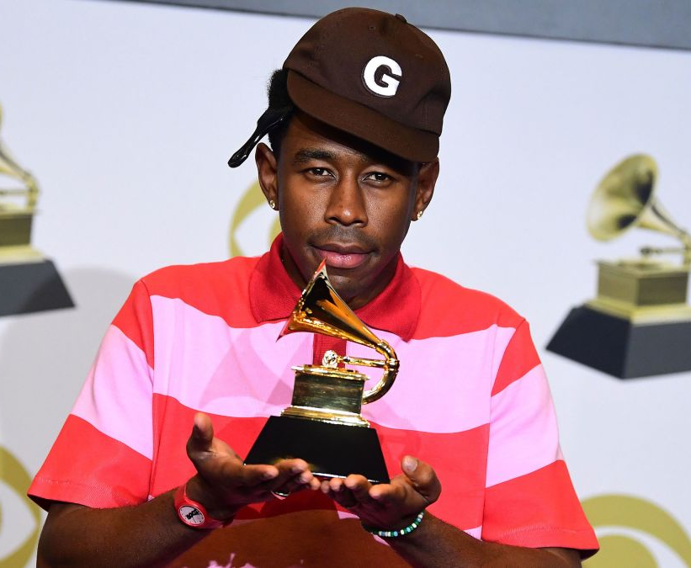
N-Word History & the Media
After winning a Grammy for Best Rap Album in 2020, Tyler the Creator criticized the Grammys for only putting guys that “look like him” in only “rap” and “urban” categories, stating that to him, the word “urban” is just a “politically-correct way of saying the n-word.”
Image: https://www.cnn.com/2020/01/27/entertainment/tyler-the-creator-grammys-intl-scli/index.html
Notes:
The examples on the previous slides show how Black people have and continue to be called the N-word without having the word verbally said to them. This exists not only in sports, but in other institutions such as music.
For example, after winning a Grammy for Best Rap Album in 2020, Tyler the Creator criticized the Grammys for only putting guys that “look like him” in only “rap” and “urban” categories, stating that to him, the word “urban” is just a “politically-correct way of saying the n-word.”
This is another way that Black people are institutionally grouped and stereotyped.

