Slide 1

Food Advisory Board:
Environmental Promotions
Eddie Chan & Chris Tran

Slide 3

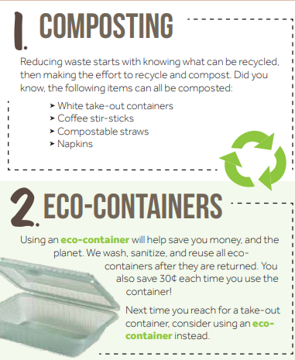

Slide 4
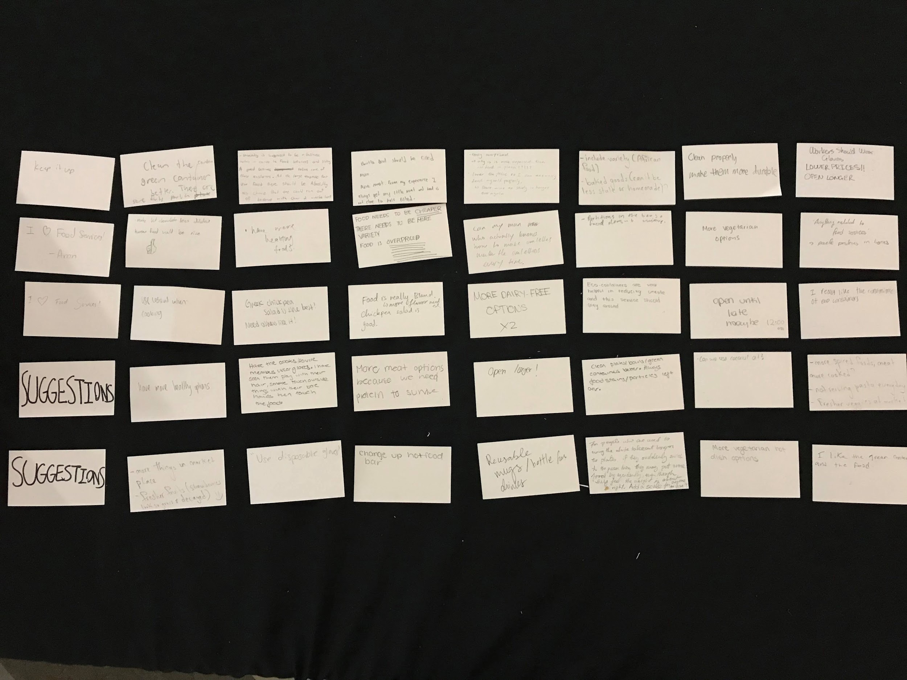
Suggestion Box ~ 38 Comments and Suggestions

Slide 5
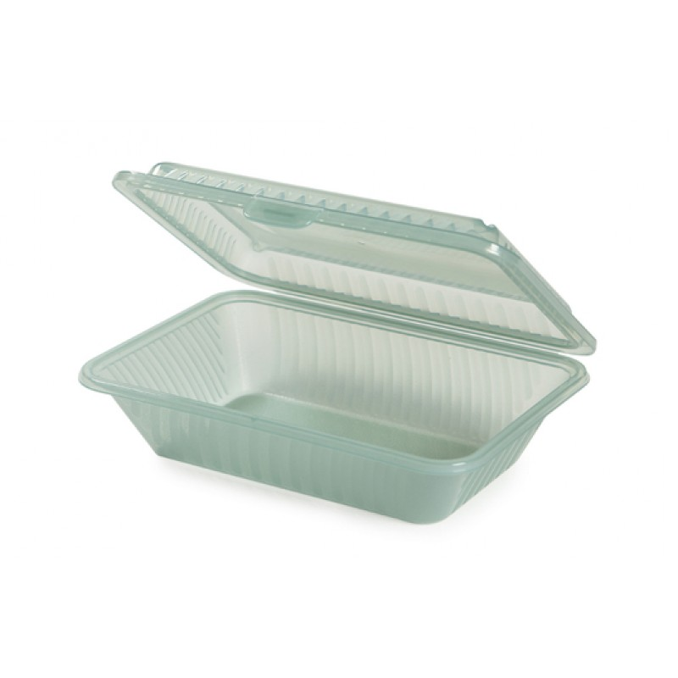
Main Themes: Eco-Container Program
Comments:
“ I like the green container”
“ I really like the convenience”
“ Helpful in reducing waste
“ This service should stay around”
Suggestions:
“Clean green containers better”
“Make them more durable”
“Always food stains/particles left”

Slide 6
Eco-Container Program
~Discussion~

Slide 7

Main Themes: Food and Services
Comments:
“Keep it up”
“I Love Food Services”
“I like the food”
Suggestions:
“Have more healthy options”
“Use less oil when cooking”
“Food need to be cheaper”
“There needs to be more variety”
“More dairy-free options”
“Open until late maybe 12:00am”

Slide 8
Food and Services
~Discussion~

