Slide 1
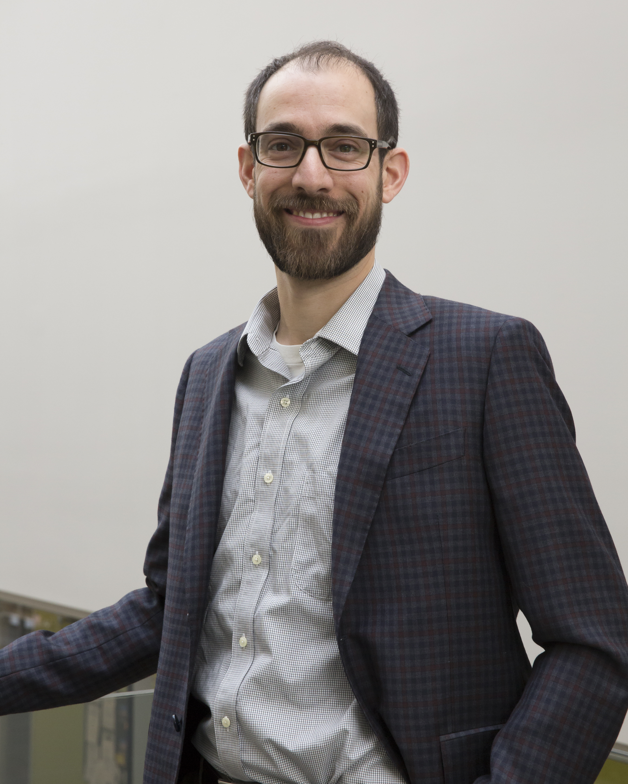
Graduate Studies: Geography & Environmental Management (GEM)
Dr Chris Fletcher
Associate Professor &
Associate Chair for Graduate Studies.
Email: gemgrad@uwaterloo.ca

Slide 2
1. Grad studies and programs in GEM 2. Finding a thesis supervisor 3. Funding and Scholarships 4. Q&A with the panel
Today’s Agenda

Slide 3
1. Grad Studies in Geography at the University of Waterloo

Slide 4
Master’s research programs in GEM
*
*
MSc
MES
MA
+Water
Thesis option:
Research paper option:
6 terms
4 courses (2 required, 2 electives)
Thesis proposal
Thesis (“novel” research, document + oral defence)
*
3 terms
6 courses (2 required, 4 electives)
MRP (document only)

Slide 5
2. Finding a thesis supervisor
Course instructor
Faculty web profiles
Research seminar
Undergraduate honour’s thesis
Social media
Mailing lists

Slide 6
3. Funding and Scholarships

Slide 7
Master’s Research Funding
Minimum for thesis students: $15,000 domestic, $22,000 int’l.
Funding is provided in three main ways:
Scholarships:
External (federal and provincial government)
Many other smaller scholarships (GSPA database + ask Alan Anthony)
Research funding:
Industry funding (e.g. MITACs)
International field funding (IDRC doctoral, UW Int’l awards)
Advisor’s research funds (GRA/GRS)
Teaching Assistantships (TAs)

Slide 8
Federal tri-agency scholarships
GSPA offers resources, workshops etc. here.
Timeline for CGS-M here (deadlines Nov 19 & Dec 1)
Will I be competitive?
Impossible to predict exactly, but:
Academic: GPA ~ 85%+, compet. awards
Scholarship: research experience/potential
Evidence of leadership/community service
$17.5k/yr + PGS + UWGS = $26.5k.
Every year is different & GPA is not the only criterion.

Slide 9
Ontario provincial scholarships (OGS/QEII-GSST)
$15k/yr + PGS + UWGS = $24k.
GSPA competition website here.
Timelines here (deadlines: Int’l = Oct 8, Domestic = Feb 1)

Slide 10
Teaching Assistantships
Grad students are employed by the Faculty of Environment to support undergraduate teaching:
Front-row seat to “try out” academia
Teaching skills development & future reference letters
Mentor undergraduate students in labs, tutorials, providing feedback.
Max 160 hours per term (on average, 10 hours/wk)
~$8,500 per term (TA + GEA)
Outstanding TAs are rewarded: Lorne H. Russwurm Memorial Award

Slide 11
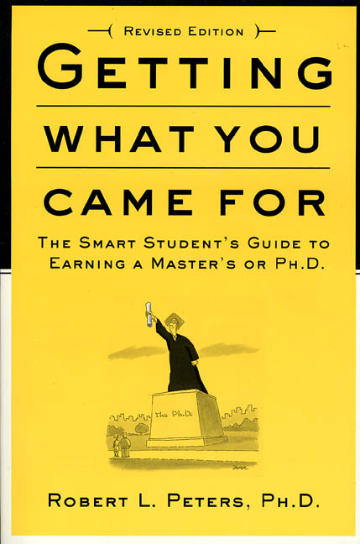
Further reading…
This document summarises the roles and responsibilities for graduate students and advisors at the University of Waterloo (link).
https://uwaterloo.ca/graduate-studies-postdoctoral-affairs/faculty-and-staff/guide-graduate-research-and-supervision

