Slide 1
Graduate Studies Endowment Fund (GSEF)
Matthew Robbins
GSEF Coordinator

Slide 2
Purpose of gsef
To fund an on-going commitment to enhance the learning, research, and overall experience of graduate students at the University

Slide 3
About GSEF
Established in the 2001-2002 academic year
Enables students to have the power to enhance their graduate experience
Comprised of a Project Review Committee and Board
Project Review Committee: 2 representatives from each faculty
Board: 1 representative from each faculty
Notes:
PRC recommends funding and Board approves funding/oversees GSEF

Slide 4
How does GSEF work?
GSEF Program
$20 refundable contribution from each graduate student per term
50% Endowment Fund
-to gain interest for the future
50% Trust Account
-to spend on graduate students

Slide 5
GSEF Funding Breakdown (2020-2021)
Student Projects
$24,000
COVID-19 Thesis Completion Award
$30,000
Research Travel Awards
$100,000
3 Minute Thesis
$5,000
Orientation
$5,000

Slide 6
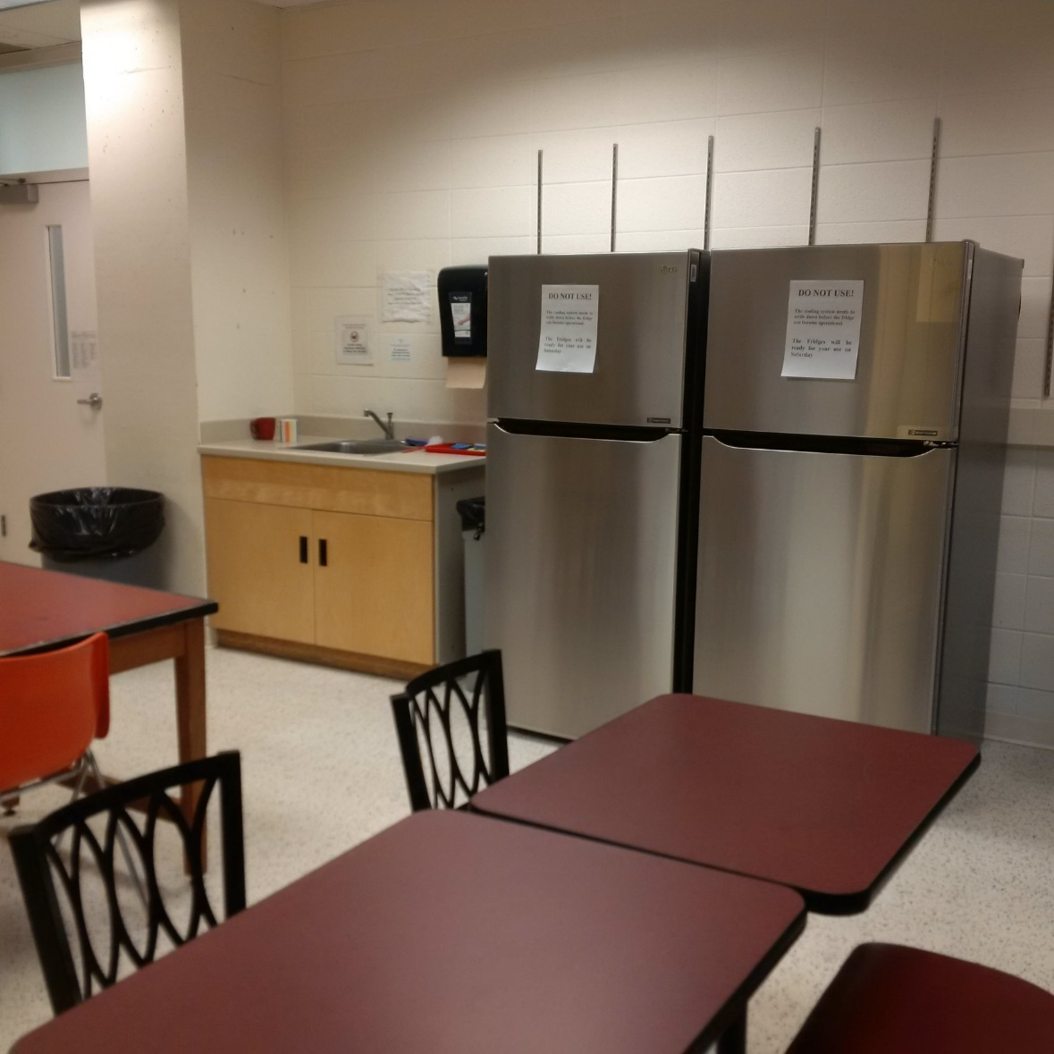
Notes:
Electrical and Computer Engineering - fridges

Slide 7
Notes:
Engineering (Architecture) - publication of a UW-created periodical

Slide 8
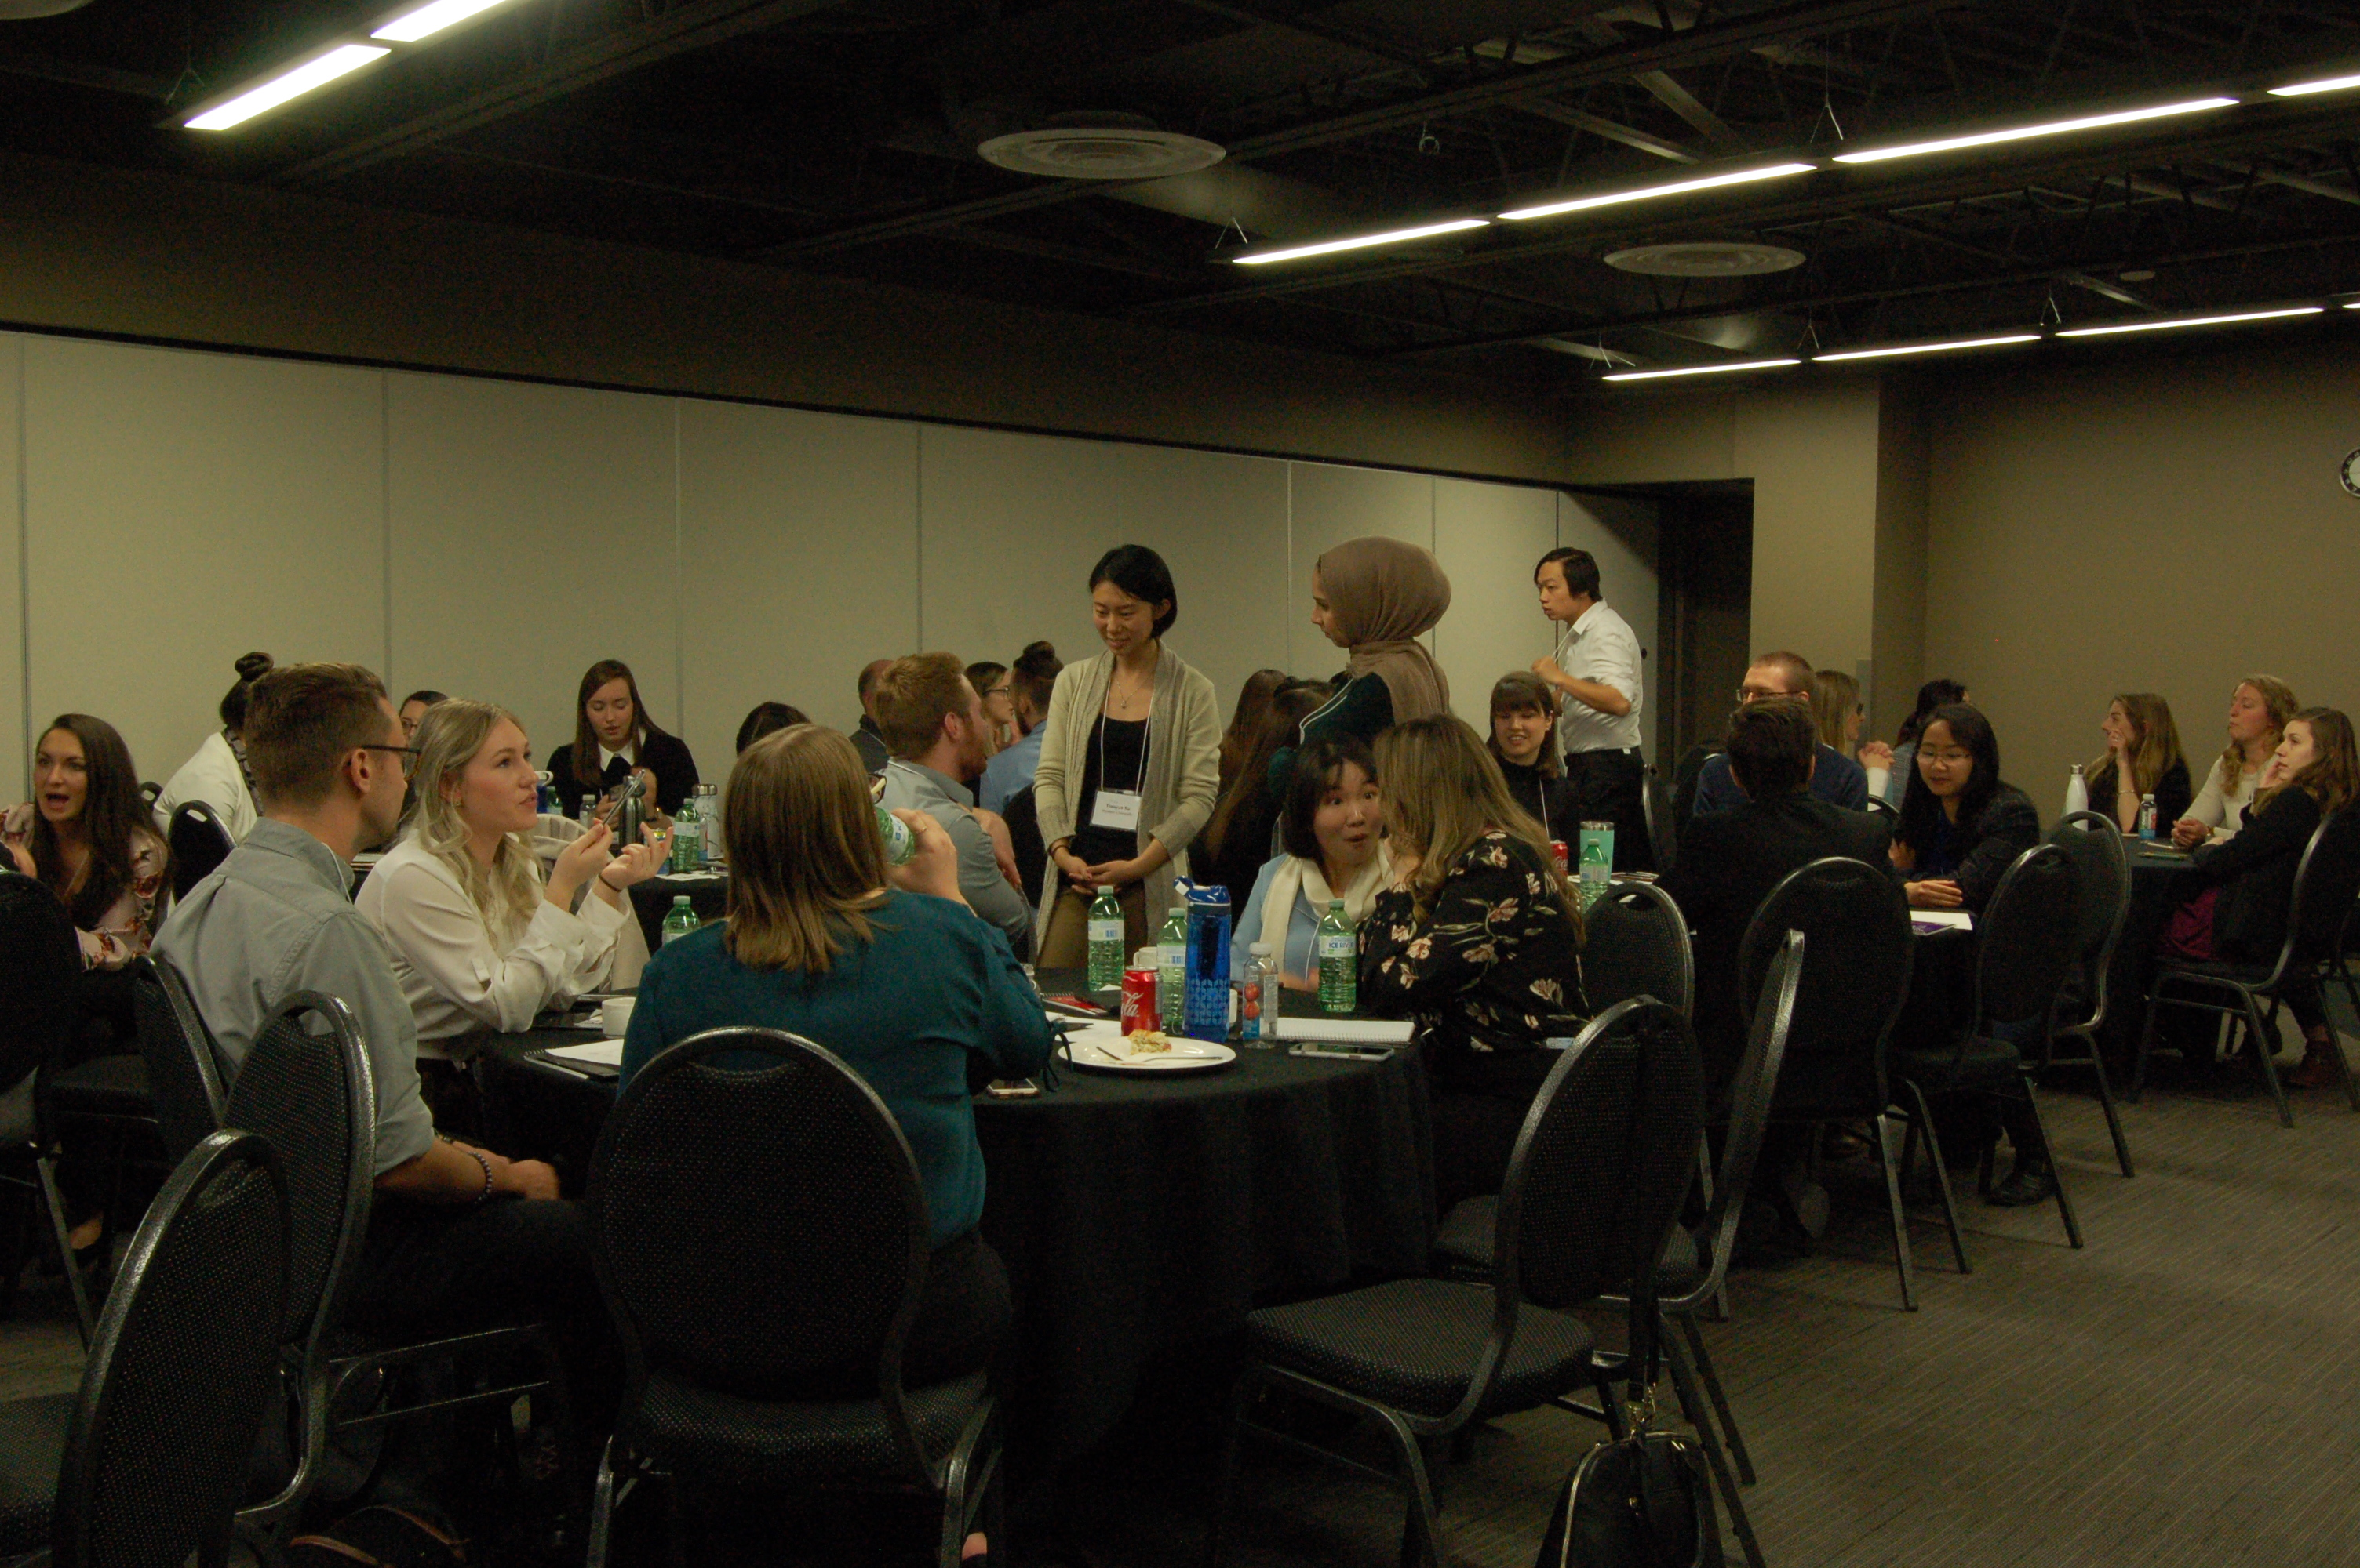
Notes:
Psychology – I/O & OB conference

Slide 9
Graduate Student Projects
Application deadlines
Sixth Friday of the term (October 16 for Fall 2020): large project funding award (>$600)
1st of every month: small project funding award (<$600)
Applications judged on aspects like quality, value, departmental support, and urgency
Total funded in the 2019-2020 FY: >$25000
Number of projects: 26
Number of students benefiting: hundreds
Notes:
Examples of projects:
Putting on conferences
Social events
Anything that would benefit grad students

Slide 10
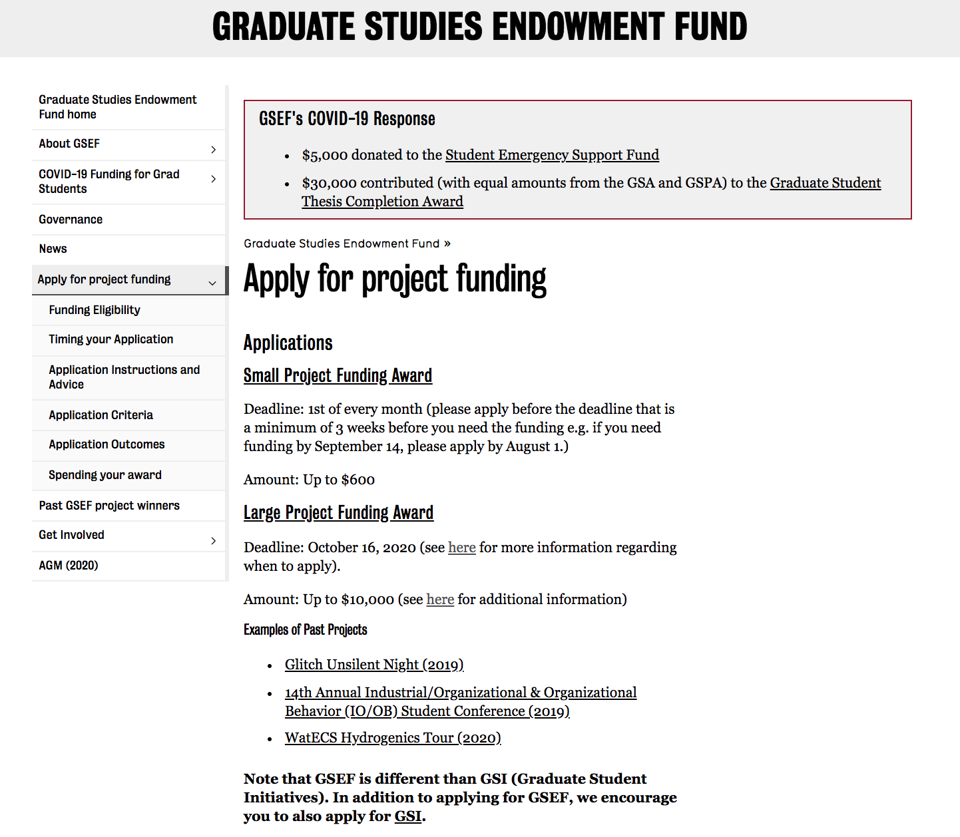
www.gsef.uwaterloo.ca

Slide 11
What do you need to provide?
Description of project
Benefits to UW grad students
How many will benefit?
Budget
Include multiple quotes!
Support from a faculty member
Think about financial sustainability!
Only for >$600 award

Slide 12
How is your project evaluated?
Small projects (<$600)
Send application to gsef@uwaterloo.ca
I forward it to Project Review Committee
Based on the information provided, Project Review Committee recommends the amount of funding
I send it to the Board for final approval

Slide 13
How is your project evaluated?
Large projects (<$600)
Send application to gsef@uwaterloo.ca
I forward it to Project Review Committee
We meet with you 2-4 weeks after you submit your application
Presentation/discussion
Based on the information provided, Project Review Committee recommends the amount of funding
I send it to the Board for final approval

Slide 14
Spending your award
The Project Review Committee will either recommend full funding, partial funding, or no funding
You will receive an acceptance letter (with any conditions on your funding)
You can go and make your purchases
GSEF will reimburse you for the expenditures
Notes:
Only able to spend funds on what is indicated in Acceptance Letter

Slide 15
Comments
Be as specific as possible!
Keep all receipts!
Let me know if your funding needs change after you submit the application
Department financial support is encouraged, but not absolutely required
Any application that provides benefit
to graduate students will be considered!

Slide 16
October 2020 Deadline
Application deadlines
Sixth Friday of the term (October 16 for Fall 2020): large project funding award (>$600)
1st of every month: small project funding award (<$600)

Slide 18
Resources
GSEF:
A channel to communicate students’ needs
A source of funding for those needs
Apply! Apply! Apply!
Project Review Committee/Board applications: October 7
GSEF Project Funding: October 16
Find out more information
gsef.uwaterloo.ca
Contact us!
gsef@uwaterloo.ca
Notes:
We are currently recruiting for the PRC and Board

