Slide 1
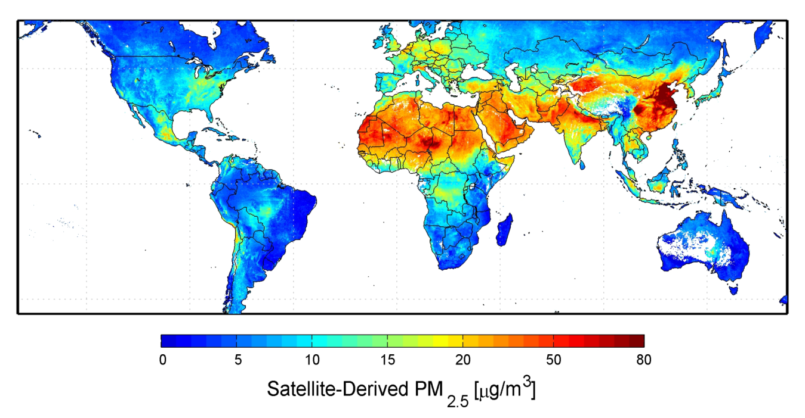
Figure 1-2. Global particulate air pollution (PM_{2.5}) profile (NASA website accessed in April 2012; Credit: Aaron van Donkelaar, Canada)

