Slide 1
AHS Computing Activities October 2012
Terry Stewart
IT Director
Applied Health Sciences

Slide 2
IT Strategic Plan
Initiated by Dave Wallace, CIO
Lead by Andrea Chappell (IST) and Dave Wallace
All aspects of IT on campus, not just IST

Slide 3
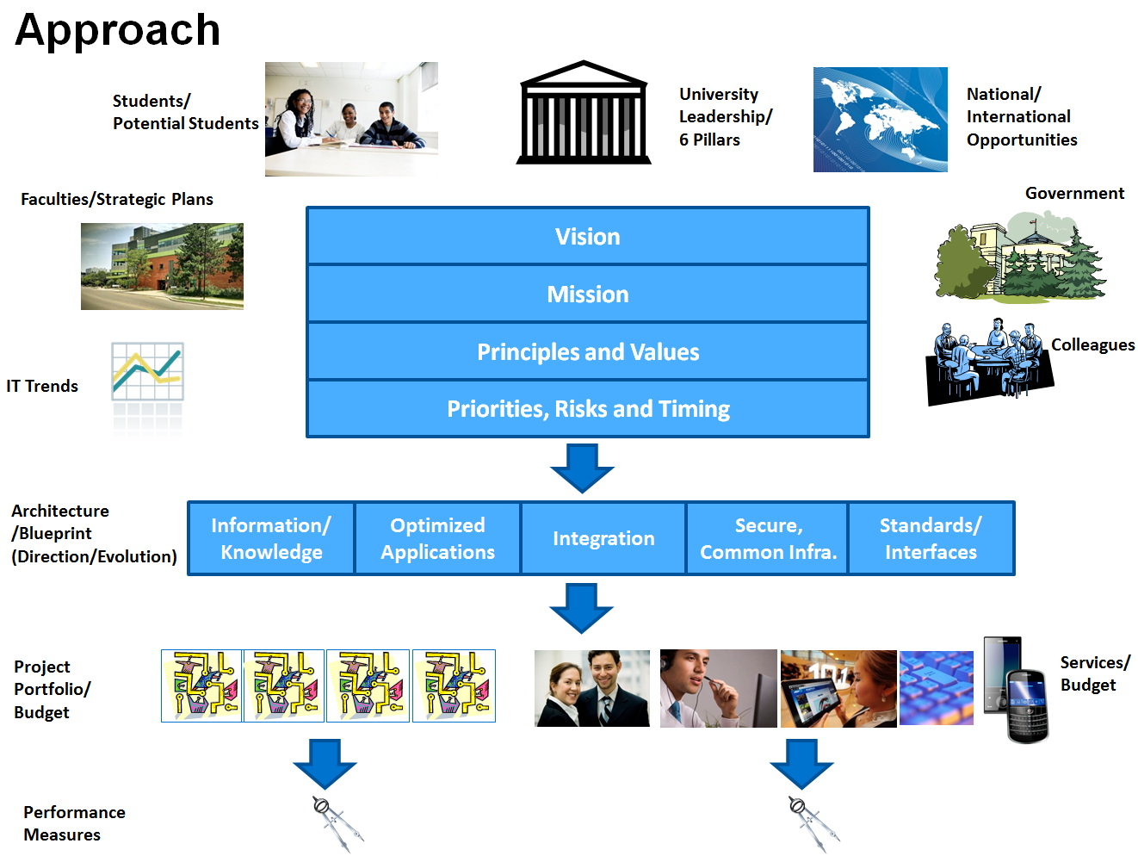
IT Strategic Plan

Slide 4
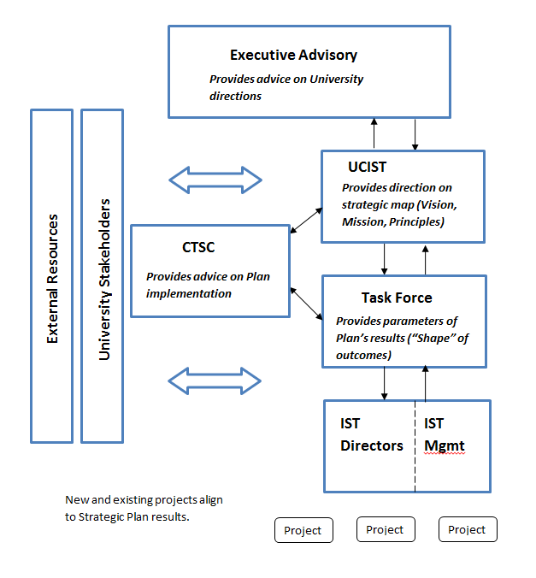
IT Strategic Plan

Slide 5
IT Strategic Plan
Terry
Ian
Terry

Slide 6
IT Strategic Plan
Other Influences:
Faculty Strategic Plans
IST Reorganization for Success
Sixth Decade MCR (6 pillars)
3 Goals from the MCR
Strategic Mandate Agreement
IT Audits

Slide 7
IST Reorg for Success
CIO Initiative
IST only
External consultant
Intent is to re-organize IST (both IT and IS functions) to better serve the University
Concomitant with IT Strategic Plan but not dependent on it

Slide 8
Nexus Migration
Almost complete
Sharepoint yet to go
Hardware needs to be relocated to IST
In the end: 1 userid / 1 password

Slide 9
Campus Firewall Project
Firewall at the front door to UW
Hardware in place (not blocking)
Will require some renumbering of servers
May impact some projects
Underscores the importance of VPN

Slide 10
Waterloo CMS
Migration of AHS web site to CMS
Faculty
SPHHS
CIW
Kinesiology (in progress)
Recreation and Leisure Studies (planning)

Slide 11
Waterloo CMS
Migration of AHS web site to CMS
Faculty
SPHHS
CIW
Kinesiology (in progress)
Recreation and Leisure Studies (planning)

Slide 12
Request Tracking
Campus Project
Automated ticketing system for IT work
Current system antiquated
New system being investigated
AHS currently does not use one
Should we?

Slide 13
Audit System
Campus Project
Tracking hardware for the life cycle of the equipment
Integrated with Request system
AHS currently use home-grown system http://audit.uwaterloo.ca

Slide 14
Mass Communications
Campus project
Investigation both technical
What software/hardware
Capabilities, price, etc.
And logistics
How, Who, What
Procedures, policies, esp. wrt to moderation

Slide 15
Research
Interraidata SAS appliance
Mobile Data Collection (Flowfinity)
Revitalized Health Systems Performance Research Network (HSPRN) project
Various Kin Projects
Bill’s Wii project
Biomechanics Teaching Lab Upgrade

Slide 16
Other Projects
Zero Administration Network Implementa-tion
Schedule, Timetable and Exam Project
WATITIS
Green IT
Security Working Group

