Slide 1
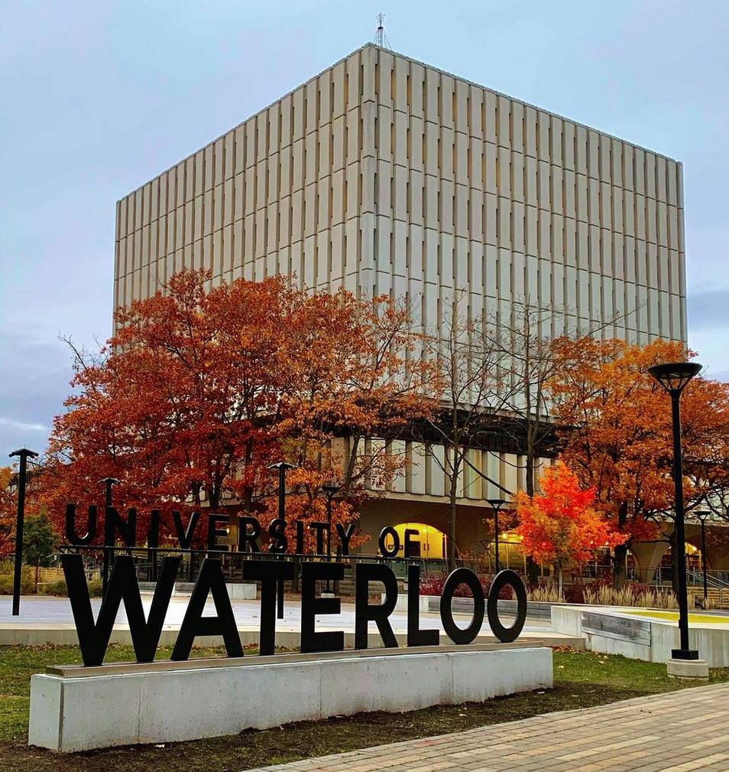
Working effectively with teaching assistants (tas)
Natalie Chow, Centre for Teaching Excellence
Karmvir Padda, Centre for Teaching Excellence
Photo credit: @bruce.digital
Notes:
Lunch and learn description:
We will present strategies for offering constructive feedback and tips for effective communication with your TAs. An overview of relevant policies for TA employment and rapport-building strategies that you can adapt as an instructor will also be reviewed.

Slide 2
Territorial Acknowledgement
The University of Waterloo acknowledges that much of our work takes place on the traditional territory of the Neutral, Anishinaabeg, and Haudenosaunee peoples. Our main campus is situated on the Haldimand Tract, the land granted to the Six Nations that includes six miles on each side of the Grand River. Our active work toward reconciliation takes place across our campuses through research, learning, teaching, and community building, and is co-ordinated within the Office of Indigenous Relations.

Slide 3
Intended Learning Outcomes
Identify important attributes of building rapport and positive relationships between TAs and instructors.
Gain strategies for giving effective feedback to TAs.
Discuss strategies for effective communication between TAs and instructors.
Review Policy 30 (Employment of Graduate Student Teaching Assistants) to explain key roles and responsibilities, the GTA Agreement, and the dispute resolution process.

Slide 4
Reflection
What does “working effectively with TAs” mean to you?
Have you ever had a TA that stood out? What did they do that made them an exceptional TA?
Have you ever had a negative experience with a TA? What did they do/what didn’t they do that made this experience negative?
Notes:
Personal reflection, invitation to share (1 min reflect, 1 min volunteer sharing)
Jot down thoughts on a piece of paper or on your laptop. Online participants can share thoughts in chat if they like.

Slide 5
Situating Scenarios
Scenario 1 The TA is not responding or coming to meetings. They are generally unavailable and seem to be struggling with balancing studies with TA responsibilities. | Scenario 2 The TA does not complete grading on time (or at all) or requires multiple grading reminders. | Scenario 3 The TA is giving the same grade and feedback to all students.
Scenario 4 The TA is consistently unprepared for lectures, labs, tutorials, etc. (e.g., they do not complete the required readings or review lab procedures in advance). | Scenario 5 The TA is not following up with students’ questions and concerns when students reach out to them directly. | Scenario 6 The TA does not seem to collaborate well with other TAs in the course.
Notes:
During today’s lunch and learn, choose one of these scenarios to get situated. Perhaps you’ve experienced the same (or similar) scenario in previous experiences, or perhaps you’ll choose a scenario that you think you’ll likely encounter in the future. As we progress through today’s session, consider what strategies might be appropriate to use in your chosen scenario.

Slide 6
Building rapport

Slide 7
What is Rapport?
“Rapport is the positive relationship between teacher and student, with professor immediacy as one way to create that positive relationship. Additional ways include fair grading practices, treating all students with dignity, and numerous other ways to enhance the classroom milieu.”
  (Wilson, Ryan, & Pugh, 2010)
Notes:
What is rapport? Merriam-Webster dictionary defines it as a “friendly relationship”
In the context of a TA-instructor relationship, friendly does not mean friend. So, you need to remember that you are in a professional role as an instructor’s TA, so you should be friendly and approachable, but you need to maintain that professional buffer.
Ok, so then what does friendly mean? Serving a beneficial or helpful purpose, which seems to align with the role of an instructor.
What we DO want to do is develop a positive relationship between ourselves as the educator and the TAs (http://www.educ.ualberta.ca/). We will be exploring several techniques you can use to develop rapport. Some are better used at the beginning of the course, others can be done on a day-to-day basis, and some can be used at the end of the course.

Slide 8
Why Is Rapport Important?
Rapport helps you to:
  Better understand the backgrounds of your TAs
  Build trust
  Manage your course/classroom environment(s)
  Increase TAs’ and students’ overall learning experience
  Raise TAs’ and students’ motivation and emotional connection
Especially important in certain courses and contexts
Notes:
Building a rapport with TAs can make a big difference when teaching. Developing rapport by doing things like building trust, using humor, and getting to know the TAs as "whole people", can not only help to better understand the background of TAs but can also help with classroom management and instruction. TAs are more likely to meet or exceed responsibilities of the role when they have good rapport with the instructor, and it can also improve TAs’ motivation and their emotional connection to the course content.
Building rapport with TAs is particularly important in:
-courses that have sensitive or controversial content (e.g., talking about health and wellness, religion, ethnicity, politics)
-disciplinary contexts (e.g., female students in male-dominated fields)
-discussion-heavy courses (for example, seminar courses where individuals are sharing a lot of information about their opinions)
Note that rapport-building may be difficult in language courses if the TA is teaching and learning in a second language.
We know that getting to know the TAs is important. At the same time however, there can sometimes be challenges in building rapport, and today we’ll be sharing some strategies.

Slide 9
Common Tasks of a Teaching Assistant
Attending class
Leading tutorials
Leading (or supporting) labs
Supporting/maintaining the LEARN site
Monitoring online discussion boards
Grading
Supporting assignment and/or marking scheme development, proctoring exams
Holding office hours and/or exam review sessions
Communicating with students (via email or discussion board)
Unless otherwise specified in the Letter of Appointment, TAs work 10 hours per week, on average (full TA-ship).
  Some departments award half-TA positions which are 5 hours per week.
  Waterloo TAs became part of CUPE, January 2024.
Notes:
Keep in mind – context – experience will be very different between an instructor working with a large group of TAs (e.g., 7) compared with an instructor working with 1-2 TAs

Slide 10
Giving effective feedback

Slide 11
Formative Feedback can:
“provide a window on how students are learning to enable us to respond to learning challenges in real time, and – most importantly – to support students more effectively in their learning” (Jeffs & Piera, 2016, p. 6)

Slide 12
What Does Formative Feedback Look Like?
Informal or formal data and information
Quick, immediate (real-time) or retrospective comments and reflections
Impromptu or scheduled feedback and input from others
(Smith, 2001)

Slide 13
Giving Feedback
As the instructor: What capacity do you have to participate in giving feedback? Will the feedback be written or verbal?
  Be specific, clear, and direct
  Show empathy
  Provide suggestions for improvement
  Cushion the negative – frame as developmental and future-focused
  Check for understanding
  Control emotions
  Be aware of facial expressions, body posture, gestures, and tone of voice
(Jeffs & Piera, 2016; adapted from Piccinin, 2003)
Notes:
FOH TA Evaluations Process

Slide 14
Receiving Feedback
We all have room to improve, develop, and grow
Feedback can be accepted, rejected, or used (it is ultimately up to the receiver to use or adapt as they wish)
Listen or read the feedback carefully
Indicate how you will respond to the feedback and if there is a further opportunity to participate in the feedback process
Reflect on the feedback and how it may impact your teaching and learning practices
(Jeffs & Piera, 2016; adapted from Piccinin, 2003)
Notes:
Draw from additional CTE resources

Slide 15
Feedback Strategies
Provide informal/formal feedback both during and at the end of term
Set up regular check-ins to discuss course-related concerns or issues, discuss time management strategies, and give feedback on TA performance
Offer list of open-ended questions with TAs to answer and return via email or discuss at regularly scheduled meeting
  What support do you need to do your job well?
  What has been the most challenging aspect of your TAship so far?
  How might I (the instructor) adjust my communication style to benefit the teaching team?
Notes:
Draw from additional CTE resources

Slide 16
Feedback Strategies Cont’d
Ask TAs to develop teaching goals for the term (e.g., articulating intended learning outcomes of the lesson before class begins, creating rubrics for assignments)
Observe and give feedback to TAs responsible for giving lectures, laboratory sessions, or tutorials (if applicable)
Consider asking TAs to engage in peer review (e.g., exchange classroom visits with one another)
Suggest TAs to seek formative student feedback (e.g., ask students to write a Minute Paper at the end of class where they answer one or more short questions, facilitate “stop, start, continue” activity)
Notes:
Important to balance constructive feedback with positive feedback

Slide 17
Example of Effective Feedback
Tutorial TA:
“I thought the way you incorporated a debate into the class was
very useful in helping the students see both sides of the issue. You may want to
consider expanding your introduction and the description of what you expect
students to do during the debate. Commenting throughout the debate will help to
keep students focused and on time.”

Slide 18
Example of Effective Feedback
Marking TA:
“I am pleased with the effort you put into providing written
feedback on students’ assignments. I know that written feedback can be time
consuming and it is important to me that you use your time as efficiently as
possible. Rather than editing an entire assignment, it is okay to indicate on just one
page that spelling corrections are needed throughout the paper.”

Slide 19
Example of Effective Feedback
Laboratory TA:
“I noticed that you have a great rapport with your students
and that they seem comfortable working with you in the lab. If you take a few more
minutes at the start of the lab to go over the procedures in greater detail, there will
be fewer follow-up clarification questions and you will be able to move more freely
around the lab to help students’ progress.”

Slide 20
Summative Feedback
What were your TA’s greatest strengths?
How did you see your TA grow over the term/year? What evidence can you draw on that demonstrates their growth?
What areas do you think your TA could improve in?
What actions would you suggest that your TA take to develop their teaching abilities?

Slide 21
Setting expectations

Slide 22
TA Role & Responsibilities
Schedule a beginning of term meeting
  Encourage your TAs to review CTE’s Teaching Assistant Checklist: Questions to Ask and bring their questions to the meeting
  Get to know your TAs (previous teaching experience, content expertise/gaps, potential scheduling constraints)
  Outline expectations (e.g., attending lectures, responding to instructor emails, responding to student emails/discussion posts, facilitating tutorials or labs, updating LEARN, attending meetings, holding office hours) and go over GTA-Instructor Agreement
  Go over syllabus and key assessments in the course
  Provide TAs with an opportunity to ask questions

Slide 23
Grading
Identify expectations and roles from the course outset
  Using rubrics/marking schemes, providing feedback
  “Marking meetings” or examples marked by instructor
  Scheduling, turnaround time
  Accommodation/extension requests
  Academic integrity issues
Seeking feedback
  How much/often should TAs seek instructor feedback?
Notes:
One of the major components of most TA roles is grading. It’s important to establish clear expectations around grading as early as possible. Expectations should be discussed at the beginning of term meeting as well as throughout the term, when assessments are being marked.
The discussion could include things like:
Establishing whether you’ll be using rubrics or grading schemes (and who will create them) and expectations around providing feedback
Scheduling “Marking meetings” for the teaching team to enhance consistency or providing examples marked by instructor
Establishing expectations for scheduling and turnaround time for grading
And expectations around accommodations, late submissions, extension requests, and who handles them?
It’s also important to let TAs know when/how much feedback they should seek from the instructor throughout the term.

Slide 24
Communication
How do you expect the TAs to communicate with you (and students, other TAs)?
Establish expectations for:
  Frequency/modality
    Email? Teams? In-person communication?
    Expected to be available on evenings? Weekends?
    Available for regular meetings OR meetings around key assessment/grading times?
  Tone and content
    Sharing feedback vs. only contact for clarification
  Autonomy as a TA
    Make judgement calls vs. deferring to instructor
Notes:
The third area you should set expectations for is communication.
We want to establish expectations for communications between TA and instructor, and TA and students (and other TAs if necessary).
Let your TAs know the best mode of communication for you (Teams chat, email, in person). Also establish when TAs are expected to be available and if that communication is outside of normal business hours like evenings and weekends.
What are your expectations for TAs communicating with you in terms of tone of communication?
You may want to establish how often you expect communication from them (and how frequently they should expect communication from you). It could be weekly, monthly, before and after assignments, or something different depending on the class and your experience level.
Lastly, indicate your expectations regarding when TAs should make their own judgement call on vs. what they should defer to you for
Section 5 in Policy 30: “Collegial, frequent, and recurring communication is key to a successful TA, and includes constructive feedback from GTAs, Instructors, students and peers during and at the completion of the TA.”

Slide 25
Maintaining Contact Throughout the Term
Do your best to respond promptly to emails from TAs
Check in before and after major assessments, grading times
Check in on number of hours worked, make suggestions/reallocate hours if TAs are working more than allotted time

Slide 26
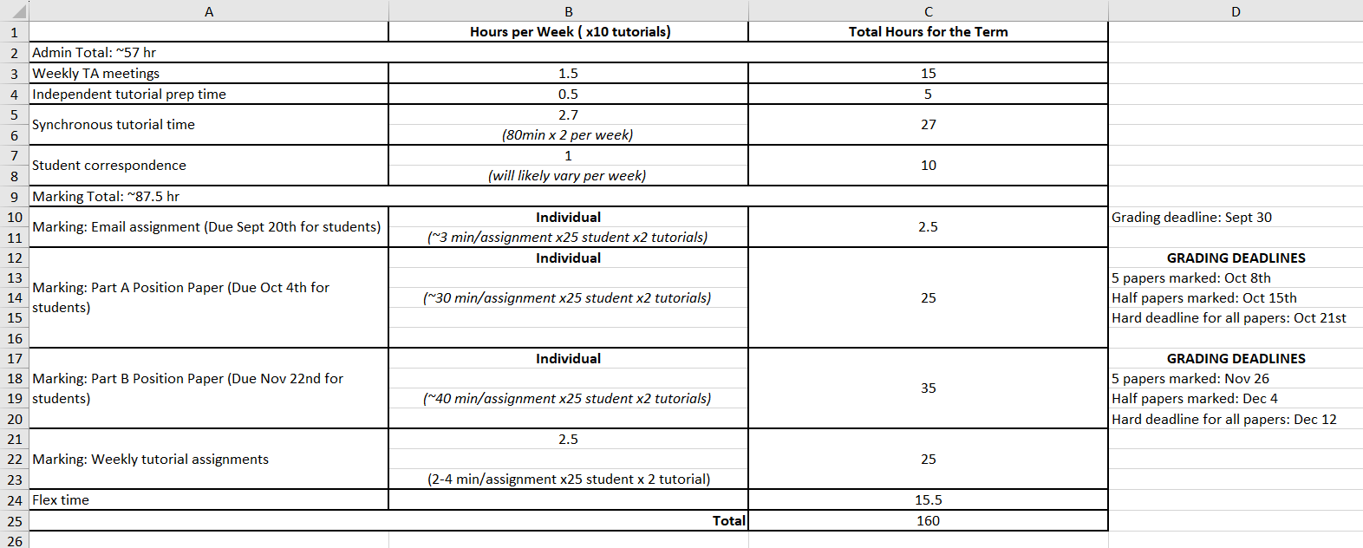
Sample Tracking Tool for TA Hours
TA tracking hours tool, HEALTH 107, courtesy of Michelle Ogrodnik

Slide 27
Other Ways to Engage TAs
Invite TAs to engage in teaching development opportunities. Examples:
Prepare a guest lecture or lead a class activity
Proofread course documents (syllabus, assignments)
Co-design assessments, marking schemes, future iterations of course
Provide feedback on their performance
  Informal
  Formal (e.g., TA Evaluations in Health, including mid-term check-in and end-of-term final evaluation and self-reflection)
  Award nominations (department, Faculty, or University)

Slide 28
Reviewing Policy 30
Policy 30: Employment of Graduate Student Teaching Assistants is the key policy informing instructor and Teaching Assistant roles and responsibilities
6.2
TA Administrator, 6.3 Graduate Teaching Assistant
6.4 Instructor/
Instructional Coordinators
8.1-8.3 Agreement between GTA and Instructor
9.3.1 to 9.3.4 Dispute Resolution Phases
9.3.5 Submission of Documents & 9.3.6 Outcomes
Notes:
TA perspective – exposure to contract, policy (many TAs are not aware that this policy actually exists)

Slide 29
Reviewing Policy 30
6.3 Graduate Teaching Assistants (GTAs)
GTAs have the following responsibilities (selected relevant highlights):
to seek feedback regularly on their performance from the Instructor and take steps necessary to improve;
to provide timely feedback to the Instructor related to the agreed upon expectations including time dedicated to completing GTA responsibilities;
to manage their time, balancing these responsibilities with sufficient attention to their own academic progression towards degree completion; and
to reflect upon and review their performance as a GTA and the feedback they have received and, when necessary, develop and implement strategies for improvement where necessary.

Slide 30
Reviewing Policy 30
6.4 Instructors or Instructional Coordinators
Instructors or Instructional Coordinators have the following responsibilities (selected relevant highlights):
to ensure that the GTA has sufficient resources to complete their duties;
to evaluate the GTA’s performance during the term, providing ongoing, timely, and constructive feedback; and
to provide a summative evaluation of the GTA’s performance at the end of the term.

Slide 31
Resources for Working with TAs
CTE Teaching Tip: Receiving and Giving Effective Feedback
Faculty of Health Teaching Assistant Evaluations
Amit & Meena Chakma Award for Exceptional Teaching by a Student (University-wide award – note the upcoming nomination deadline is February 7, 2025)
Berkeley Graduate Student Instructor Teaching & Resource Centre. Teaching with GSIs: A Checklist for Faculty
Berkeley Graduate Student Instructor Teaching & Resource Centre. Teaching with GSIs

Slide 32
Additional TA Resources
Centre for Teaching Excellence TA Handbook
Teaching Assistant Checklist: Questions to Ask
Associate Deans/Faculty Administrative Assistants, Graduate Studies
Occupational Health (workplace accommodations for TAs, as employees)
AccessAbility Services (academic accommodations for TAs, as students)
Graduate Studies and Postdoctoral Affairs. Health and well-being

Slide 33
References
Fraser, E. E., Morse, K., Hannon, N., Olsen, K. & Dimitrov, N. “Western Guide to Working with Teaching Assistants.” (2017). Purple Guides. 1. https://ir.lib.uwo.ca/tsc-purple-guides/1
Jeffs, C., & Piera, Y. “Focus on formative feedback for teaching development: A guide.” Taylor Institute for Teaching and Learning Guide Series, No. 3. Calgary, AB: Taylor Institute for Teaching and Learning at the University of Calgary, July 2016.
Piccinin, S. (2003). Feedback: Key to learning. Green guide No 4, (4th printing). London, ON: STLHE
Rolheiser, C., Seifert, T., McCloy, C., Gravestock, P., Stewart, G., Greenleaf, E., Burnett, M., Carpenter, S., Pottruff, B., & McKean, S. (2013). Developing Teaching Assistants as Members of the University Teaching Team. Toronto: Higher Education Quality Council of Ontario.
Smith, R. (2001). Formative evaluation and the scholarship of teaching and learning. New Directions for Teaching and Learning, 88, 51-62.
Wilson, J., H., Ryan, R. G., & Pugh, J. L. (2010). Professor-student rapport scale predicts student outcomes. Teaching of psychology, 37(4), 246-251.

Slide 34
Thank you! Time for questions & Discussion
Natalie Chow – natalie.chow@uwaterloo.ca
Karmvir Padda – kkpadda@uwaterloo.ca

