Slide 1
LASER
Operation mode

Slide 2
Instructions: Laser Mode
Draw a random photon polarization state
Draw a random object card for the laser to pass through
Label it as TRANSMITTED, ABSORBED, or PARTIAL
If any of the laser light is transmitted, find the right card to represent its polarization state after the polarizer
Draw another action card and repeat until all light is lost

Slide 3
Setup
Setup the STATE cards as desired
  For introductory levels, remove Unpolarized Light as an option
Set up the OBJECT cards as desired
  For introductory levels, only include the polarizers (remove blue cards)
  For advanced levels, include the polarization rotators
Shuffle the OBJECT cards
Place OUTCOME cards face-up
Select what kind of light to use (LASER or PHOTON),
refer to the instructions card to start the demonstration

Slide 4
Follow-up questions
How are the laser and photon modes similar and different?
Under what circumstances is the photon’s behaviour after a polarizer predictable? Under what circumstances is it random?
Draw a random polarization state and all four distinct polarizers
  Can you order the four polarizers to allow for some probability of the photon to make it through them all?
  What is the optimal way to order the polarizers to maximize the probability that the photon survives? What is the probability?

Slide 5
Instructions: Photon Mode
Draw a random photon polarization state
Draw a random object card for the photon to pass through
Label it as TRANSMITTED, ABSORBED, or RANDOM
If RANDOM, flip a coin to determine the outcome
If the photon survives, find the right card to represent its polarization state after the polarizer
Draw another object card and repeat until the photon is lost

Slide 6
PHOTON
Operation mode

Slide 7
FOLLOW-UP QUESTIONS

Slide 8
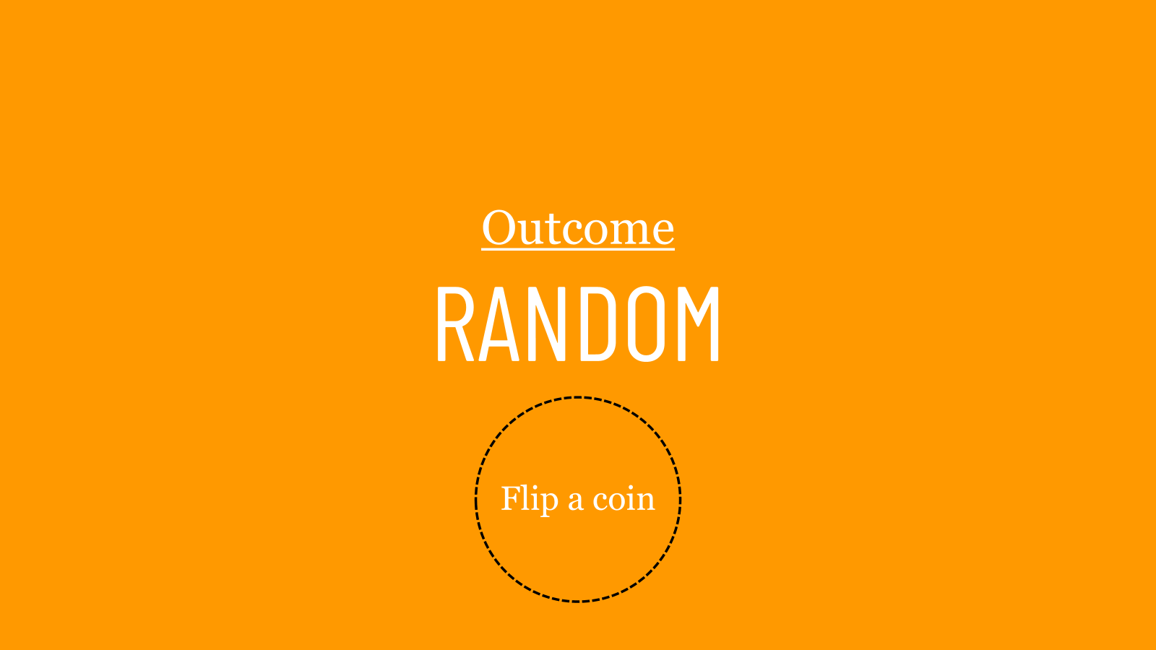
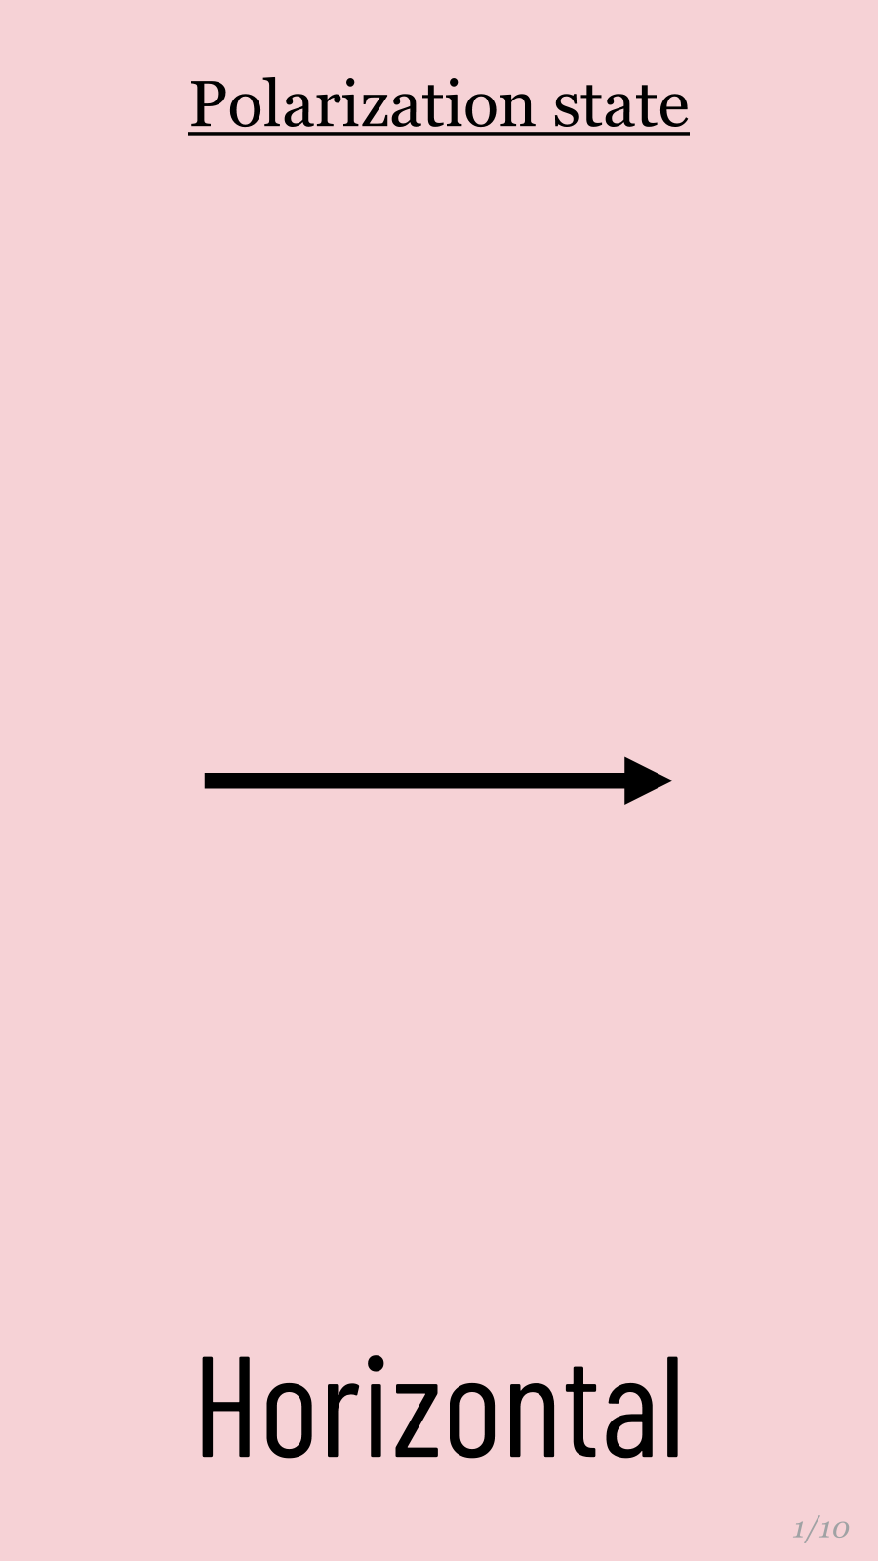
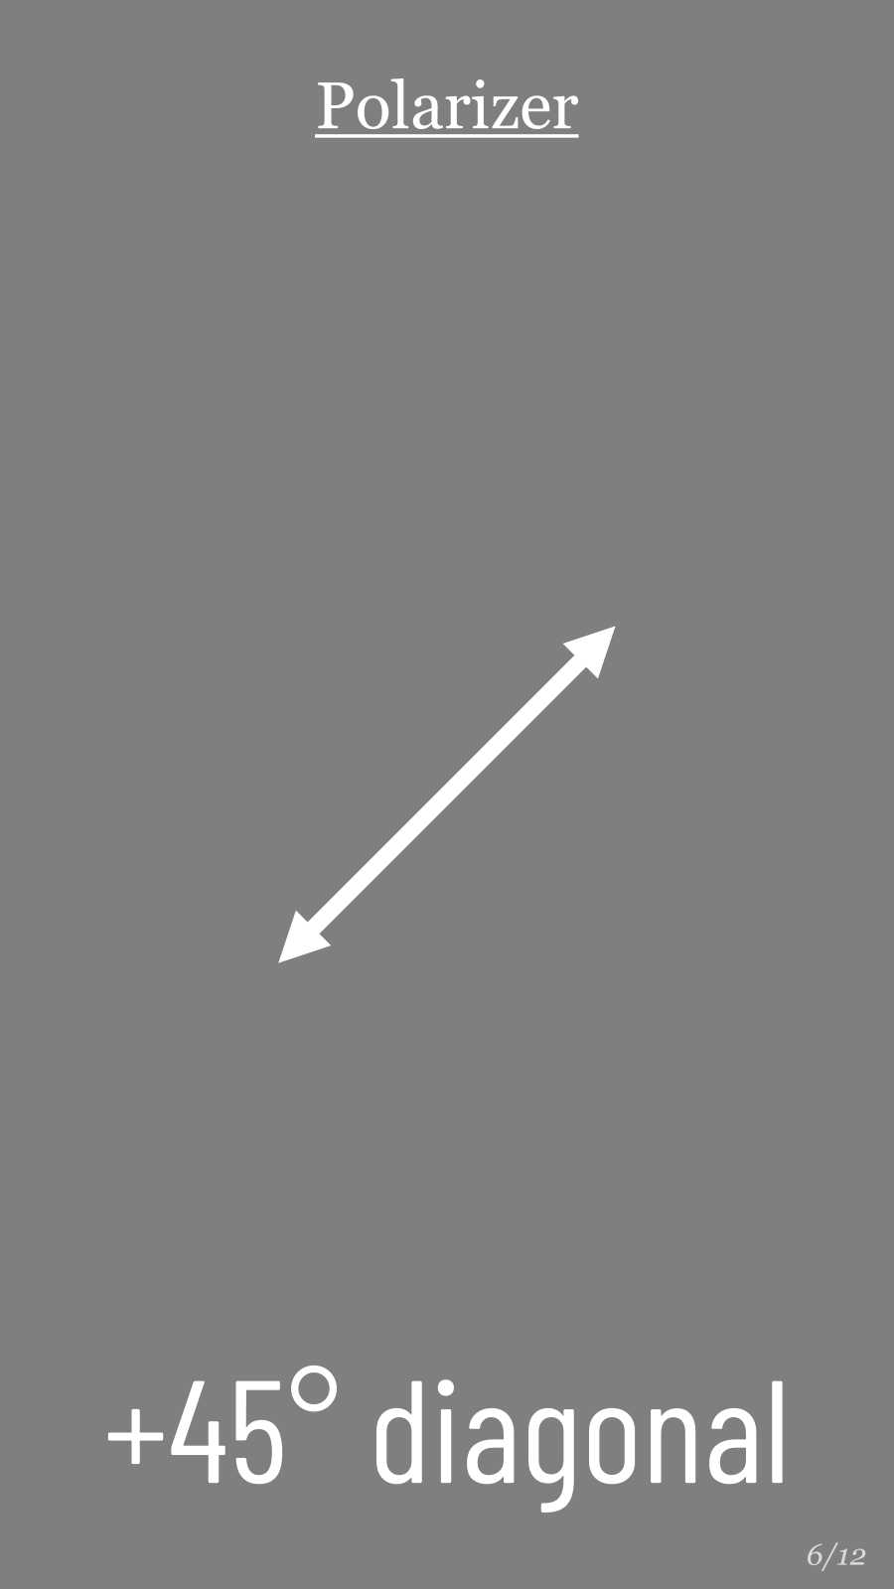
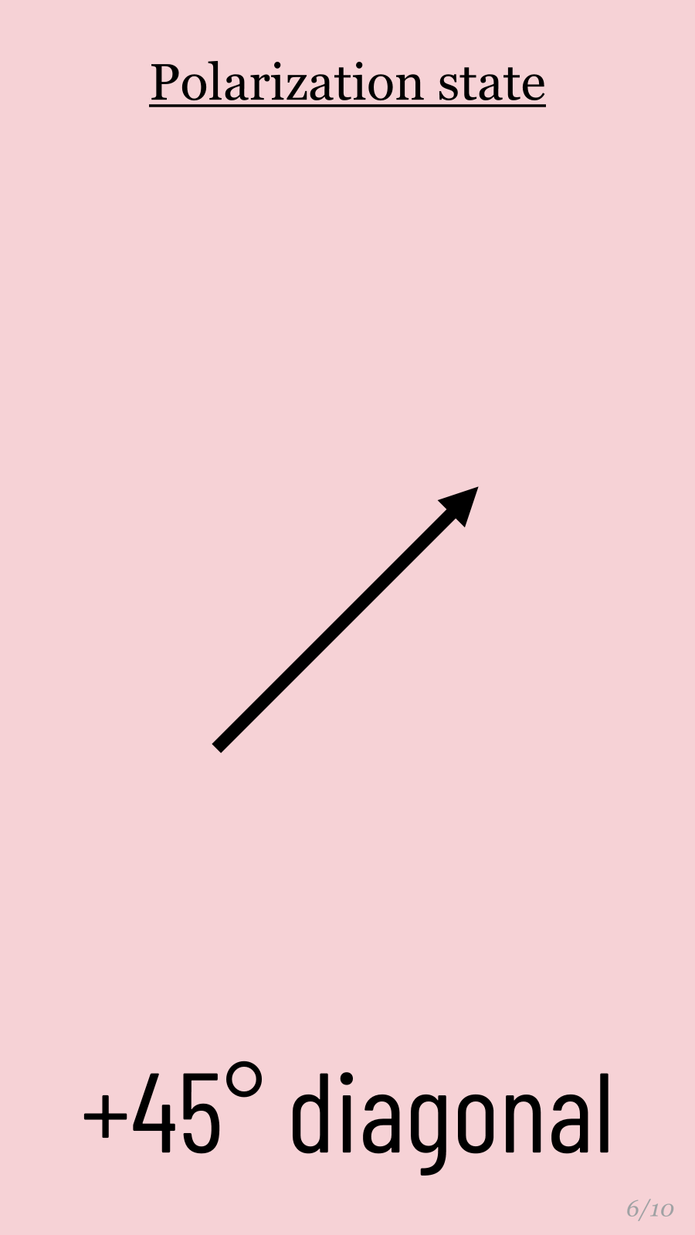
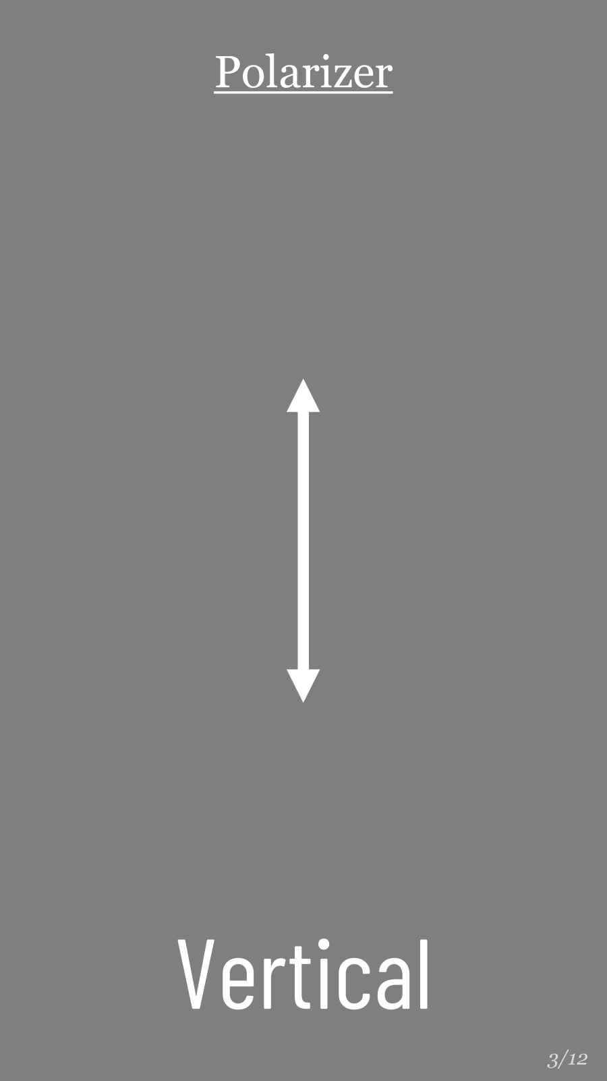
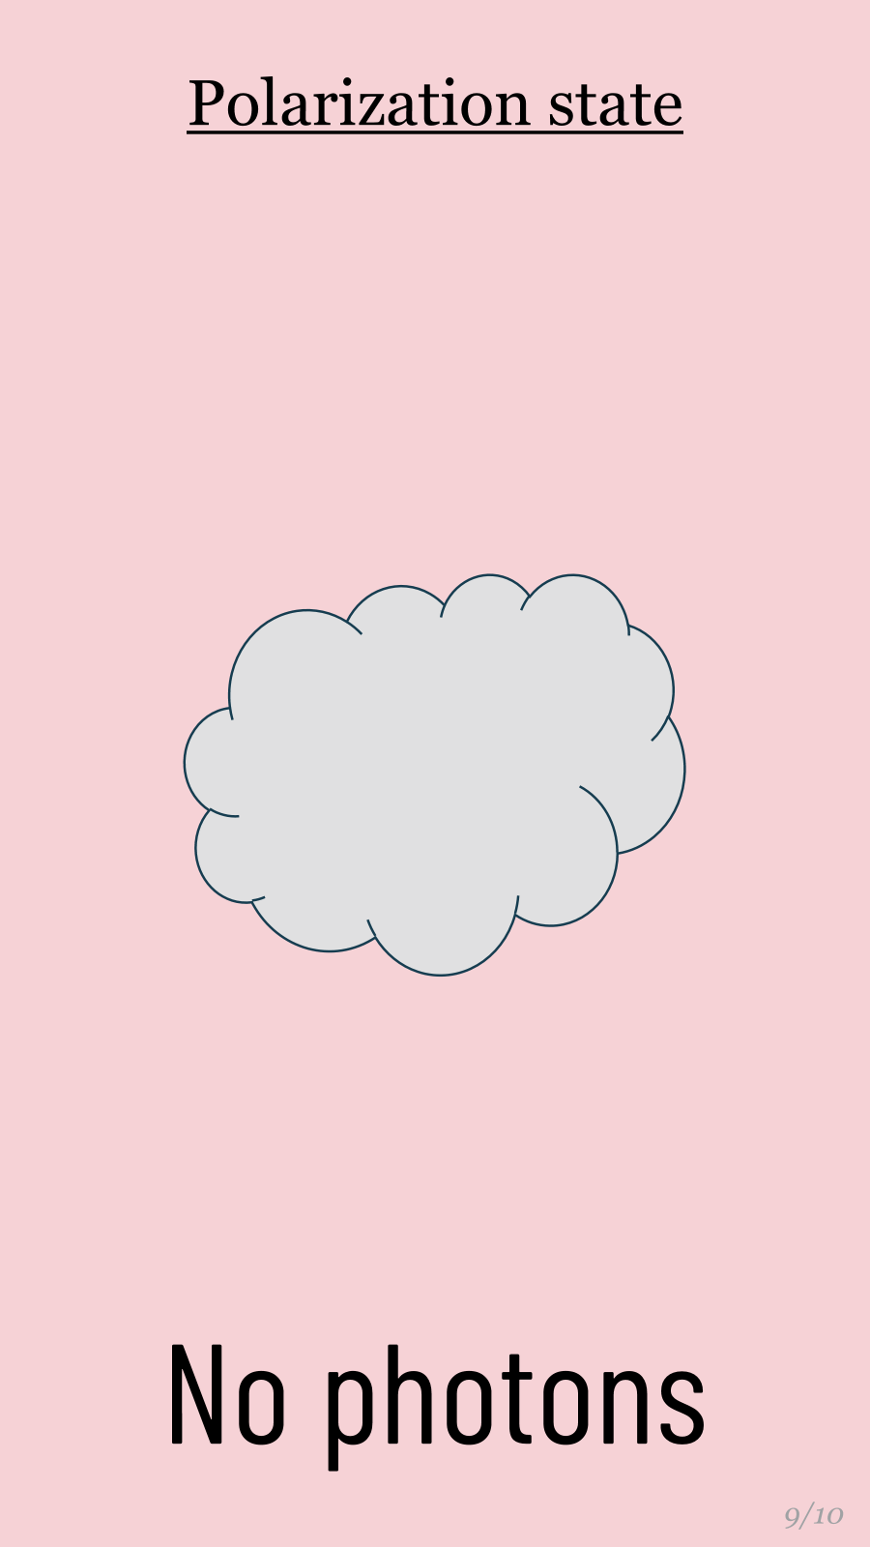
3. Play the correct OUTCOME
4. If needed,
flip a coin
TRANSMIT
ABSORB
1. Draw a random
STATE card
2. Draw a random
OBJECT card
5. Play the correct state
6. If there’s still photons, draw more objects!
Keep going until the photon is absorbed.

Slide 9
Horizontal
1/10
Polarization state

Slide 10
Vertical
3/10
Polarization state

Slide 11
+45° diagonal
5/10
Polarization state

Slide 12
-45° diagonal
7/10
Polarization state

Slide 13
STATE

Slide 14
STATE

Slide 15
STATE

Slide 16
STATE

Slide 17
Horizontal
2/10
Polarization state

Slide 18
Vertical
4/10
Polarization state

Slide 19
+45° diagonal
6/10
Polarization state

Slide 20
-45° diagonal
8/10
Polarization state

Slide 21
STATE

Slide 22
STATE

Slide 23
STATE

Slide 24
STATE

Slide 25
Horizontal
1/12
Polarizer

Slide 26
Vertical
3/12
Polarizer

Slide 27
+45° diagonal
5/12
Polarizer

Slide 28
-45° diagonal
7/12
Polarizer

Slide 29
OBJECT

Slide 30
OBJECT

Slide 31
OBJECT

Slide 32
OBJECT

Slide 33
Horizontal
2/12
Polarizer

Slide 34
Vertical
4/12
Polarizer

Slide 35
+45° diagonal
6/12
Polarizer

Slide 36
-45° diagonal
8/12
Polarizer

Slide 37
OBJECT

Slide 38
OBJECT

Slide 39
OBJECT

Slide 40
OBJECT

Slide 41
Clear glass
9/12
Object

Slide 42
Basis changer
(Hadamard)
10/12
Output |  |  | ➢ | 
Input |  |  |  | ➢
Rotator

Slide 43
Flip +45 and -45
(Z gate)
11/12
Output |  | ➢ |  | 
Input |  |  |  | ➢
Rotator

Slide 44
Flip H and V
(X gate)
12/12
Output |  |  |  | ➢
Input |  |  |  | ➢
Rotator

Slide 45
OBJECT

Slide 46
OBJECT

Slide 47
OBJECT

Slide 48
OBJECT

Slide 49
100% TRANSMITTED
Outcome

Slide 50
100% ABSORBED
Outcome
(0% TRANSMITTED)

Slide 51
PARTIALLY TRANSMITTED
Outcome
(50% TRANSMITTED)

Slide 52
RANDOM
Outcome
Flip a coin

Slide 53
OUTCOME

Slide 54
OUTCOME

Slide 55
OUTCOME

Slide 56
OUTCOME

Slide 57
No photons
9/10
Polarization state

Slide 58
Unpolarized light
10/10
Polarization state

Slide 59
PARTIALLY TRANSMITTED
Outcome
(50% TRANSMITTED)

Slide 60
RANDOM
Outcome
Flip a coin

Slide 61
STATE

Slide 62
STATE

Slide 63
OUTCOME

Slide 64
OUTCOME

Slide 65
Printing Instructions
Ensure this slide remains hidden and does NOT print.
Print four slides per sheet, landscape orientation.
Print double-sided, flip on short edge.
Cardstock recommended.
Coin must be obtained separately.

