Slide 1

Hadamard’s Hoard
A Quantum Search Game
iqc-outreach@uwaterloo.ca

Slide 2
Hadamard’s Hoard Facilitator Instructions
This activity pits two players against each other to try to find stars as quickly as possible
One player will mimic a classical search, which can only turn over elements one-by-one. This will be demonstrated by placing cards face-down and turning them over one per turn.
The other player will mimic a quantum search, where the outcome of a measurement is random but other operations are allowed. On each turn, they may either roll a dice to make a quantum measurement or iterate Grover’s Algorithm, changing the probability of success on their next turn.
There are different database sizes, with the quantum player’s advantage growing stronger with the size of the database
The classical tiles must be shuffled after each round
You may either use custom 3D-printed dice for the quantum player or standard six-sided dice with the specified number of stars
To make the probabilities work with six-sided dice, some “half-star” dice are required. Players claim a star if they roll two half-stars at the same time

Slide 3
Hadamard’s Hoard Game setup
This game is for two players (or teams).
The goal of the game is to be the first collect 3 points at each stage.
Each player searches for stars in a different way:
The Classical Player searches by turning over cards until they see a point.
The Quantum Player searches using a quantum machine, with the probability of winning a point changing as they use the machine more.
At the end of each turn, players turn over an event card, which could affect one or both of them.
Once used, the card goes to the Discard pile and is re-shuffled once the last card has been turned over.
You may choose to not include event cards for your first game.
Each stage is a database of a different size, either 4, 12, or 30.
When starting a new stage, the classical player must shuffle one point into the specified number of “dot” cards while the quantum player uses dice.
The arrow token for the quantum player starts on the left-most tile.
The recommended play order is to complete 4, then 12, and finally 30.

Slide 4
Hadamard’s Hoard Turn order
Each turn starts with the classical player, then the quantum player.
Classical player: Turn over one card from your deck.
If the card has a point, collect a token and re-shuffle your entire deck.
Quantum Player: Choose to either run the algorithm or measure.
Measure: Roll the dice that the arrow currently points to.
If the roll is a success, collect a token. If not, do not collect a token.
Regardless of the outcome, move the arrow back to the left-most tile after measuring.
If the arrow points to the final tile, you may measure to collect a point without rolling any dice.
Run the algorithm: Move the arrow one tile to the right.
If you move the arrow to the final tile, you must wait for your next turn to collect a point. This counts as a measurement.
Event: Turn over the top event card and follow the instructions.
If this is your first game, you may choose to not include Event cards.
Events may affect the Classical Player, Quantum Player, or both.

Slide 5
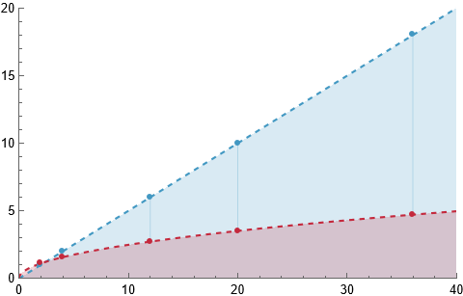
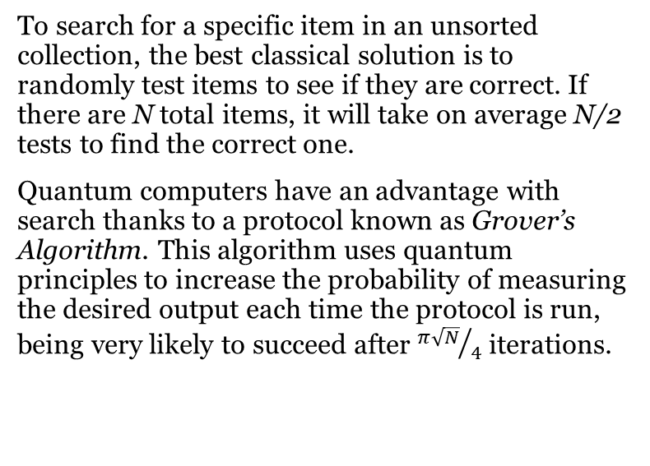
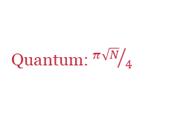
Quantum Search A Quantum Advantage?
Average number of
iterations needed
To search for a specific item in an unsorted collection, the best classical solution is to randomly test items to see if they are correct. If there are N total items, it will take on average N/2 tests to find the correct one.
Quantum computers have an advantage with search thanks to a protocol known as Grover’s Algorithm. This algorithm uses quantum principles to increase the probability of measuring the desired output each time the protocol is run, being very likely to succeed after ${π\sqrt{N}}/4$ iterations.
Classical: N/2
Quantum: ${π\sqrt{N}}/4$
Number of items, N
Does this mean that quantum computers can search large databases more efficiently? The search task is very relevant to many real-world problems, but for this algorithm to be effective, the database must first be encoded on a quantum computer. Not only are large-scale quantum computers difficult to build, but the task of importing the database would take longer than simply searching classically. The scale of the advantage is also not as revolutionary as the exponential speed-up to other problems like factoring. Grover’s Algorithm is, however, an important part of the quantum toolbox and a part of many proposed quantum applications in optimization.

Slide 6
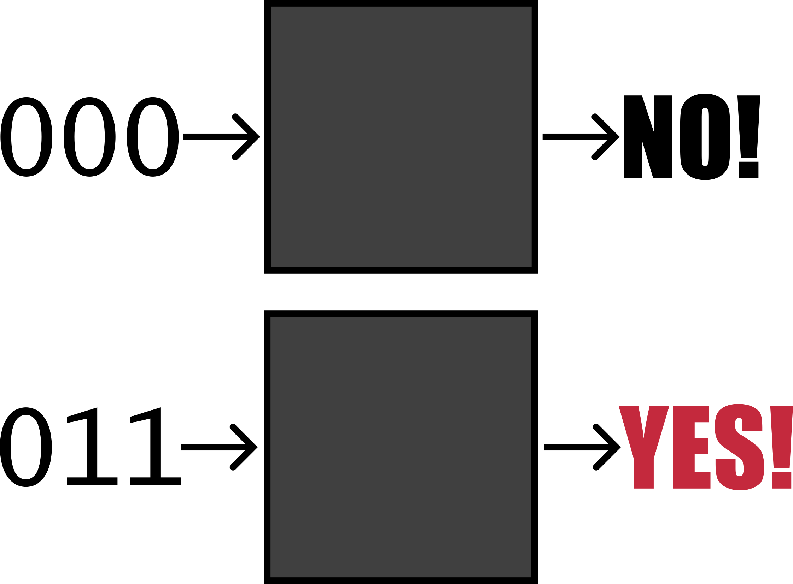
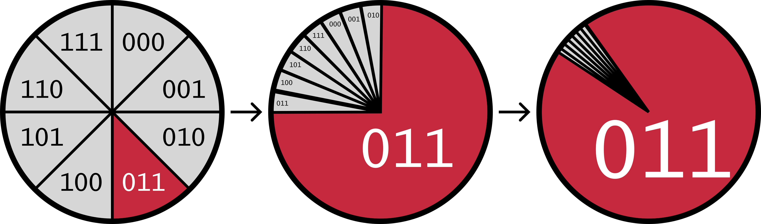
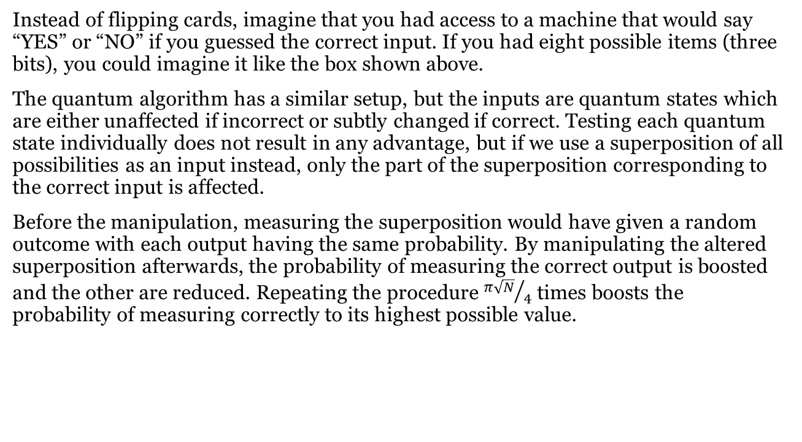
Quantum Search How it works
Instead of flipping cards, imagine that you had access to a machine that would say “YES” or “NO” if you guessed the correct input. If you had eight possible items (three bits), you could imagine it like the box shown above.
The quantum algorithm has a similar setup, but the inputs are quantum states which are either unaffected if incorrect or subtly changed if correct. Testing each quantum state individually does not result in any advantage, but if we use a superposition of all possibilities as an input instead, only the part of the superposition corresponding to the correct input is affected.
Before the manipulation, measuring the superposition would have given a random outcome with each output having the same probability. By manipulating the altered superposition afterwards, the probability of measuring the correct output is boosted and the other are reduced. Repeating the procedure ${π\sqrt{N}}/4$ times boosts the probability of measuring correctly to its highest possible value.
For a situation with eight possible answers, the initial probability of randomly guessing correctly is 12.5%. After applying the quantum protocol once, that probability is boosted to over 75%. One more application boosts the probability to 94.5%. But be careful: further applications will actually reduce the probability of measuring the correct outcome.

Slide 7
Hadamard’s Hoard Follow-Up Questions
Which player has an advantage for a database of 2 or 4 elements?
Which player has an advantage for a database of 20 or 30 elements?
If the quantum player has an advantage, are they guaranteed to win? Why or why not?
If the classical player can play twice as quickly (take two turns at a time), who has an advantage for searching 4 elements? What about 12, 20, or 36 elements? What about if they can play 4 times as quickly instead?

Slide 8
Hadamard’s Hoard Comparisons to Grover’s algorithm
The game is designed such that the probabilities of finding a point roughly correspond to the probabilities of success by running Grover’s algorithm with the correct number of iterations. The actual probabilities are shown below, assuming a perfect implementation. Notice that applying the algorithm too many times reduces your probability of success.
 | Probability of success after X iterations
N | 0 | 1 | 2 | 3 | 4 | 5 | 6 | 7 | 8
4 | 25% | 100% | 25% | 100% | 25% | 100% | 25% | 100% | 25%
12 | 8% | 59% | 99% | 79% | 24% | 1% | 38% | 90% | 93%
30 | 3% | 27% | 63% | 92% | 99% | 81% | 47% | 14% | 0%
100 | 1% | 9% | 23% | 42% | 62% | 80% | 93% | 99% | 98%

Slide 9
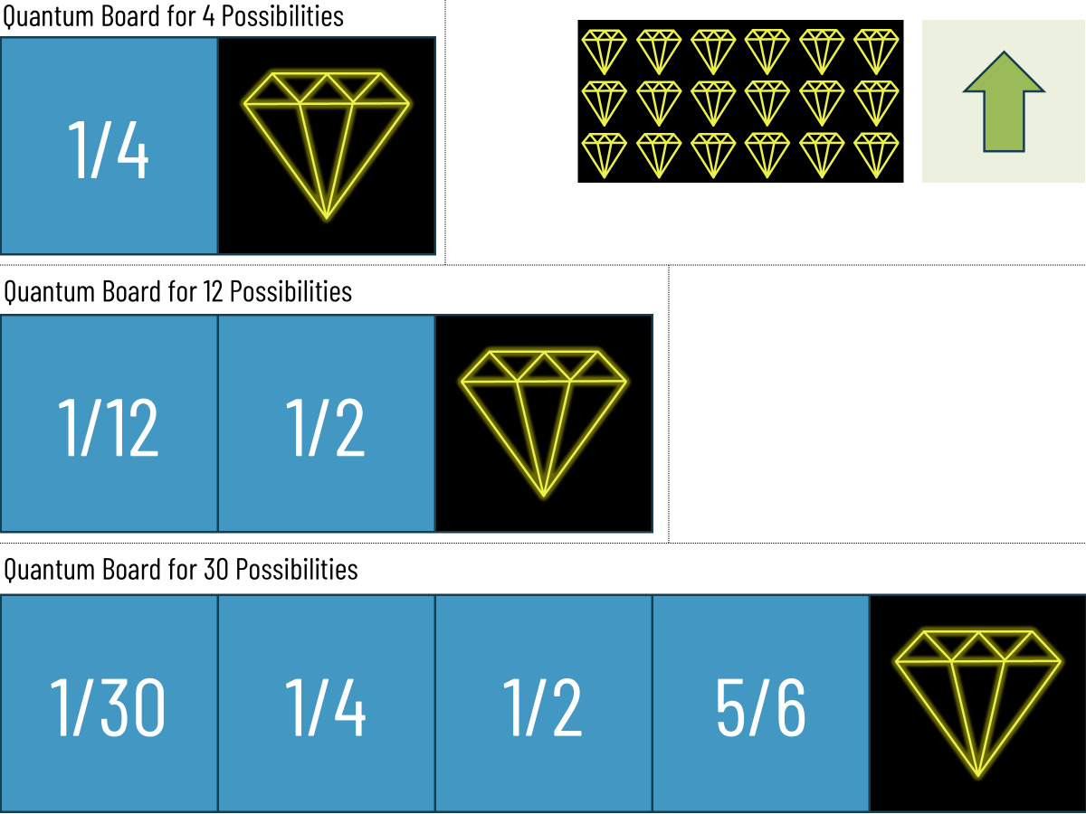
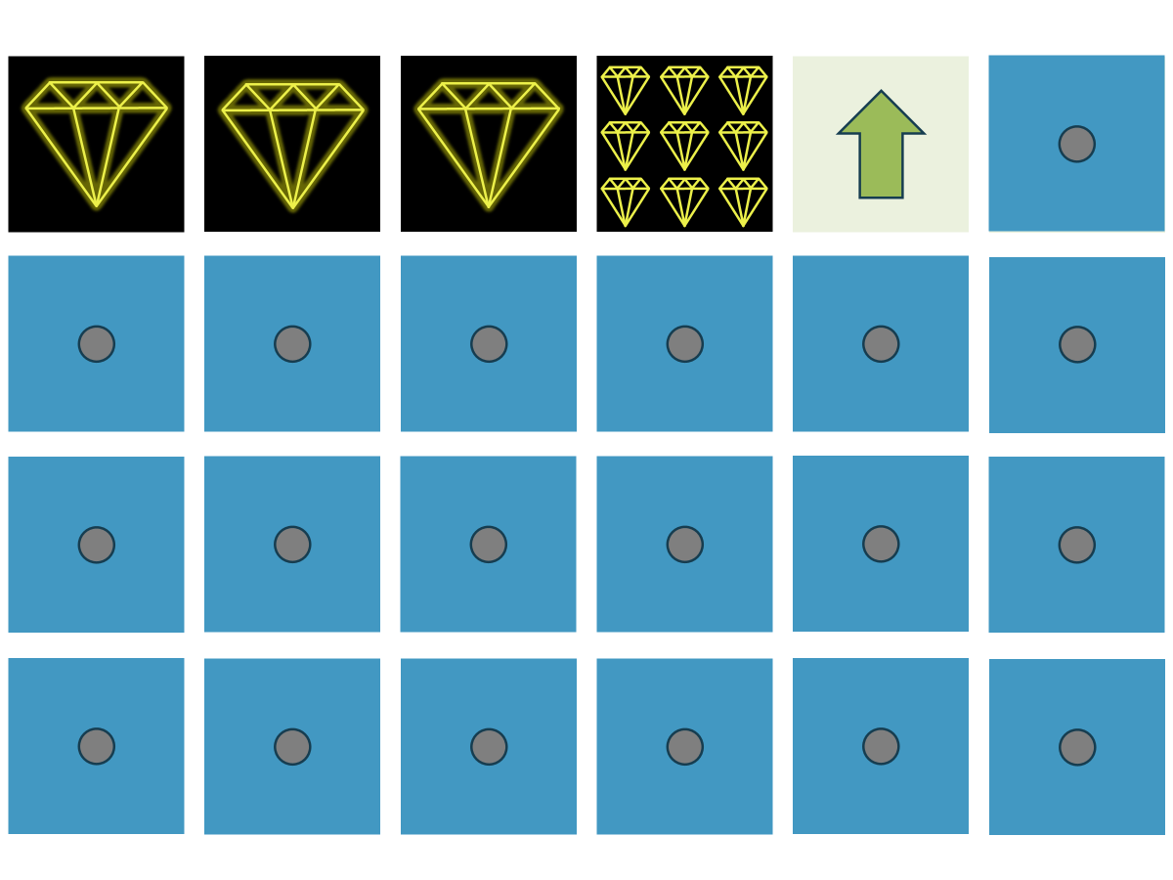
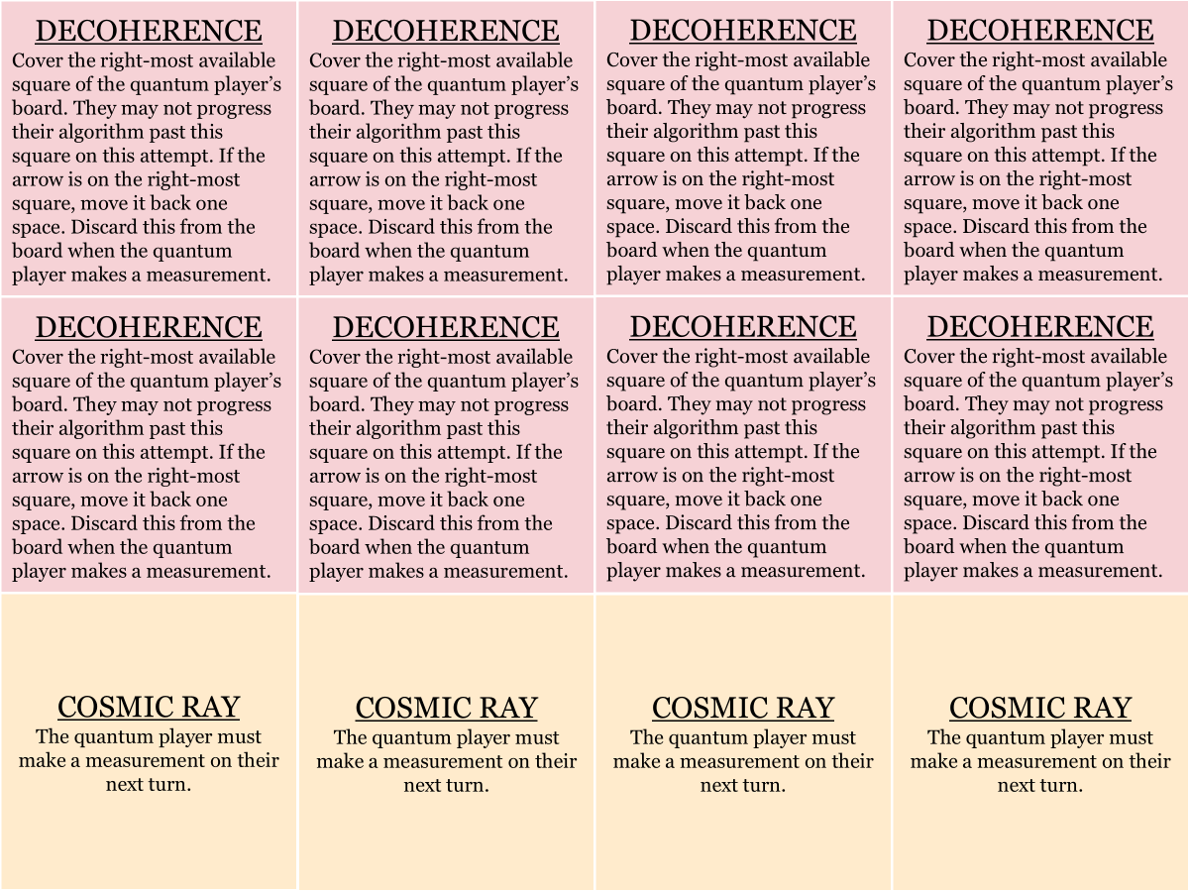
Hadamard’s Hoard Printing instructions
Game boards
Classical search cards
Event cards
Print the game boards and cut out the three boards
Extra point tokens and an arrow are included
Print double-sided to include a reference for which dice to use
Print and cut out the 48 classical search cards
Extra point tokens and an arrow are included
Print and cut out the 24 event cards
Print double-sided to label as event cards
Construct or print the dice
3D-print files (STL) available
Alternatively, construct out of coins and six-sided dice

Slide 10
Quantum Board for 4 Possibilities
1/4
Quantum Board for 12 Possibilities
1/12
1/2
Quantum Board for 30 Possibilities
1/30
1/4
1/2
5/6

Slide 11
Dice Guide for 4
1d4
Dice Guide for 12
1d12 or One half-coin and one half-d6
1 coin
Dice Guide for 30
1d30 or 2 half-d6 (approx.)
1d4 or 2 half-coins
1 coin
1 five-star d6

Slide 12
Notes:
Enough with the two pages exactly for a set of Database 4, Database 12, and Database 30.

Slide 16
DECOHERENCE
Cover the right-most available square of the quantum player’s board. They may not progress their algorithm past this square on this attempt. If the arrow is on the right-most square, move it back one space. Discard this from the board when the quantum player makes a measurement.
DECOHERENCE
Cover the right-most available square of the quantum player’s board. They may not progress their algorithm past this square on this attempt. If the arrow is on the right-most square, move it back one space. Discard this from the board when the quantum player makes a measurement.
DECOHERENCE
Cover the right-most available square of the quantum player’s board. They may not progress their algorithm past this square on this attempt. If the arrow is on the right-most square, move it back one space. Discard this from the board when the quantum player makes a measurement.
DECOHERENCE
Cover the right-most available square of the quantum player’s board. They may not progress their algorithm past this square on this attempt. If the arrow is on the right-most square, move it back one space. Discard this from the board when the quantum player makes a measurement.
DECOHERENCE
Cover the right-most available square of the quantum player’s board. They may not progress their algorithm past this square on this attempt. If the arrow is on the right-most square, move it back one space. Discard this from the board when the quantum player makes a measurement.
DECOHERENCE
Cover the right-most available square of the quantum player’s board. They may not progress their algorithm past this square on this attempt. If the arrow is on the right-most square, move it back one space. Discard this from the board when the quantum player makes a measurement.
DECOHERENCE
Cover the right-most available square of the quantum player’s board. They may not progress their algorithm past this square on this attempt. If the arrow is on the right-most square, move it back one space. Discard this from the board when the quantum player makes a measurement.
DECOHERENCE
Cover the right-most available square of the quantum player’s board. They may not progress their algorithm past this square on this attempt. If the arrow is on the right-most square, move it back one space. Discard this from the board when the quantum player makes a measurement.
COSMIC RAY
The quantum player must make a measurement on their next turn.
COSMIC RAY
The quantum player must make a measurement on their next turn.
COSMIC RAY
The quantum player must make a measurement on their next turn.
COSMIC RAY
The quantum player must make a measurement on their next turn.

Slide 17
EVENT
EVENT
EVENT
EVENT
EVENT
EVENT
EVENT
EVENT
EVENT
EVENT
EVENT
EVENT

Slide 18
EXTRA RAM
The classical player may hold this card and play it on any future turn. Once played, the classical player may flip one extra card on each turn. Discard any played RAM when the classical player gets a point. You may stack this card with more EXTRA RAM.
EXTRA RAM
The classical player may hold this card and play it on any future turn. Once played, the classical player may flip one extra card on each turn. Discard any played RAM when the classical player gets a point. You may stack this card with more EXTRA RAM.
EXTRA RAM
The classical player may hold this card and play it on any future turn. Once played, the classical player may flip one extra card on each turn. Discard any played RAM when the classical player gets a point. You may stack this card with more EXTRA RAM.
EXTRA RAM
The classical player may hold this card and play it on any future turn. Once played, the classical player may flip one extra card on each turn. Discard any played RAM when the classical player gets a point. You may stack this card with more EXTRA RAM.
EXTRA RAM
The classical player may hold this card and play it on any future turn. Once played, the classical player may flip one extra card on each turn. Discard any played RAM when the classical player gets a point. You may stack this card with more EXTRA RAM.
EXTRA RAM
The classical player may hold this card and play it on any future turn. Once played, the classical player may flip one extra card on each turn. Discard any played RAM when the classical player gets a point. You may stack this card with more EXTRA RAM.
BLUE SCREEN
Re-shuffle the database of the classical player, including all items that have already been investigated.
QUANTUM ERROR CORRECTION
The quantum player may hold this card and play it on their board on any future turn. Once played, if a Decoherence event is drawn, discard this card to nullify its effect. Any cards on the board must be discarded when a measurement is made.
QUANTUM ERROR CORRECTION
The quantum player may hold this card and play it on their board on any future turn. Once played, if a Decoherence event is drawn, discard this card to nullify its effect. Any cards on the board must be discarded when a measurement is made.
QUANTUM ERROR CORRECTION
The quantum player may hold this card and play it on their board on any future turn. Once played, if a Decoherence event is drawn, discard this card to nullify its effect. Any cards on the board must be discarded when a measurement is made.
QUANTUM ERROR CORRECTION
The quantum player may hold this card and play it on their board on any future turn. Once played, if a Decoherence event is drawn, discard this card to nullify its effect. Any cards on the board must be discarded when a measurement is made.
QUANTUM ERROR CORRECTION
The quantum player may hold this card and play it on their board on any future turn. Once played, if a Decoherence event is drawn, discard this card to nullify its effect. Any cards on the board must be discarded when a measurement is made.

Slide 19
EVENT
EVENT
EVENT
EVENT
EVENT
EVENT
EVENT
EVENT
EVENT
EVENT
EVENT
EVENT

Slide 20
Hadamard’s Hoard: Dice Options
The recommended playset is to progress through Database of 4, followed by 12 and 30
You may build the dice in a variety of ways to approximate the correct probability.
Mark a star/gem on a dice with the appropriate number of sides. This can either be on blank dice or with 3D-printed dice.
For the recommended progression, you will need 2 coins, 2 d4, 1 d12, 1 d30, and one d6 with five sides having gems.
Use a standard six-sided dice and coins with gems and half-gems marked on them. For half gems, the roller needs to roll both dice and get a half-gem on each to make a full gem.
For the recommended progression, you will need 2 full-gem coins, 5 half-gem coins, 3 half-gem d6, and 1 d6 with five gem on it.
Cut-outs for the six-sided die are on the next page.
Note that the probabilities for the last round will correspond to a database of 36, not 30, but these are quite close to each other in practice.
Note: In dice notation, “1d6” means one six-sided die.

Slide 21
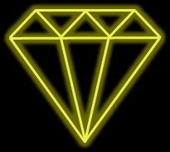
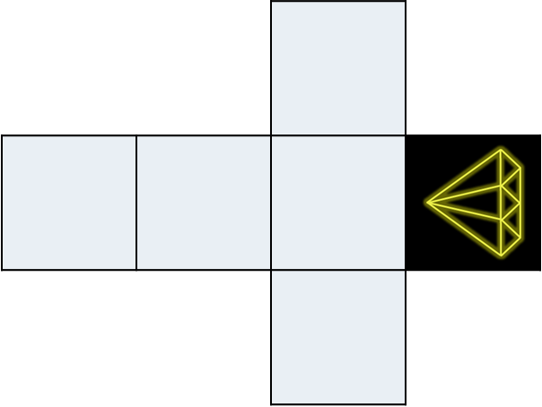
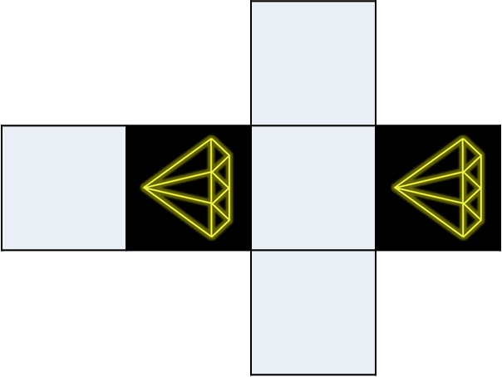
1d6
Two-gem d6
Five-gem d6
Half-star d6
Double-half star d6

Slide 22


Credits
Created by John Donohue
Special thanks: Dev Chauhan, Jack DeGooyer, Stephen Harrigan, Fiona Thompson, Khanjan Soni, and Benjamin Wong
Published by the IQC Scientific Outreach team
Contact: iqc-outreach@uwaterloo.ca
Institute for Quantum Computing
University of Waterloo
200 University Ave. W.
Waterloo, ON, Canada, N2L3G1
Copyright © 2026 University of Waterloo
About IQC
The Institute for Quantum Computing (IQC) is a world-leading research centre in quantum information science and technology at the University of Waterloo. IQC’s mission is to develop and advance quantum information science and technology through interdisciplinary collaboration at the highest international level. Enabled by IQC’s unique infrastructure, the world’s top experimentalists and theorists are making powerful new advances in fields spanning quantum computing, communications, sensors and materials. IQC’s award-winning outreach opportunities foster scientific curiosity and discovery among students, teachers and the community.
uwaterloo.ca/institute-for-quantum-computing

