Slide 1


Principal Component Analysis Applied to Polymeric Sensing Materials
Alison J. Scott and Alexander Penlidis
Department of Chemical Engineering
Institute for Polymer Research (IPR), University of Waterloo
40th Annual Symposium on Polymer Science/Engineering
Wednesday, May 9th, 2018

Slide 2
Introduction
Why Gas Analyte Detection?
Why Polymeric Sensing Materials?
  Good sensitivity and selectivity
  Room temperature operation
  Product customization potential
    Backbone/functional group selection & polymer doping
Analyte | Application
Ethanol | Reduce drinking & driving
Acetone | Diagnose diabetes
Benzene | Monitor indoor air quality

Slide 3
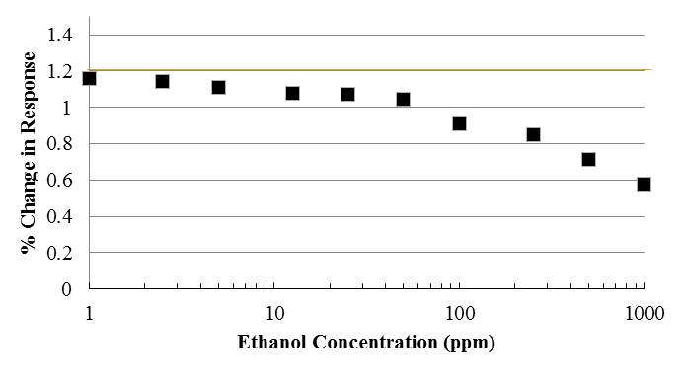
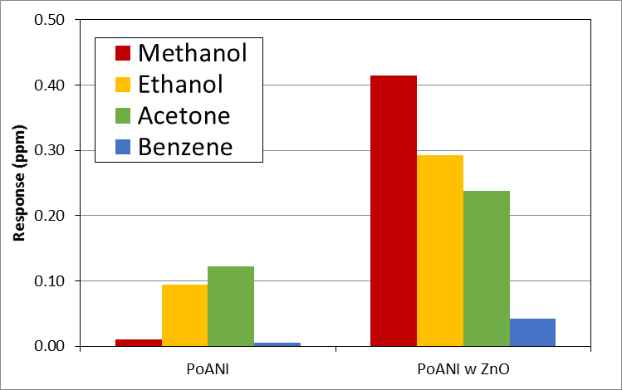
Sensing Materials
Sensitivity:
  Related to sensor’s detection limit
  Lower detection limit = more sensitive sensor
Selectivity:
  Ratio between responses (target analyte vs. interferent analyte)
Stewart, KME; Chen, WT; Mansour, RR; Penlidis, A. (2015) Journal of Applied Polymer Science 132 (28).

Slide 4
Experimental Test System
Analyte
MFC
PC
FM
Gas Chromatograph
Passive Mixer
Analyte
MFC
Analyte
MFC
Sample
MFC: Mass Flow Controller, PC: Pressure Controller, FM: Flow Meter, GC: Gas Chromatograph
Stewart, KME; Penlidis, A. (2013) Macromolecular Symposia 324 (1).

Slide 5
Principal Component Analysis (PCA)
Experimental work → large data sets
  PCA allows us to “see” useful trends (and clusters)
  PCA helps us to determine inter-relationships among variables
For sensing materials, PCA acts in essence as a filtering algorithm
  Collect responses from a variety of sensing materials
  Combine data to simulate a sensor array
Filtering Algorithm

Slide 6
Principal Component Analysis (PCA)
How does PCA work?
  Decomposes the data matrix (n observations & p variables) into:
    A score matrix (related to observations/cases)
    A loading matrix (related to variables)
  These show us the inter-relationships among the observations and among the variables
n
Data
≈
n
Scores
x
Loadings
m
p
p
m

Slide 7
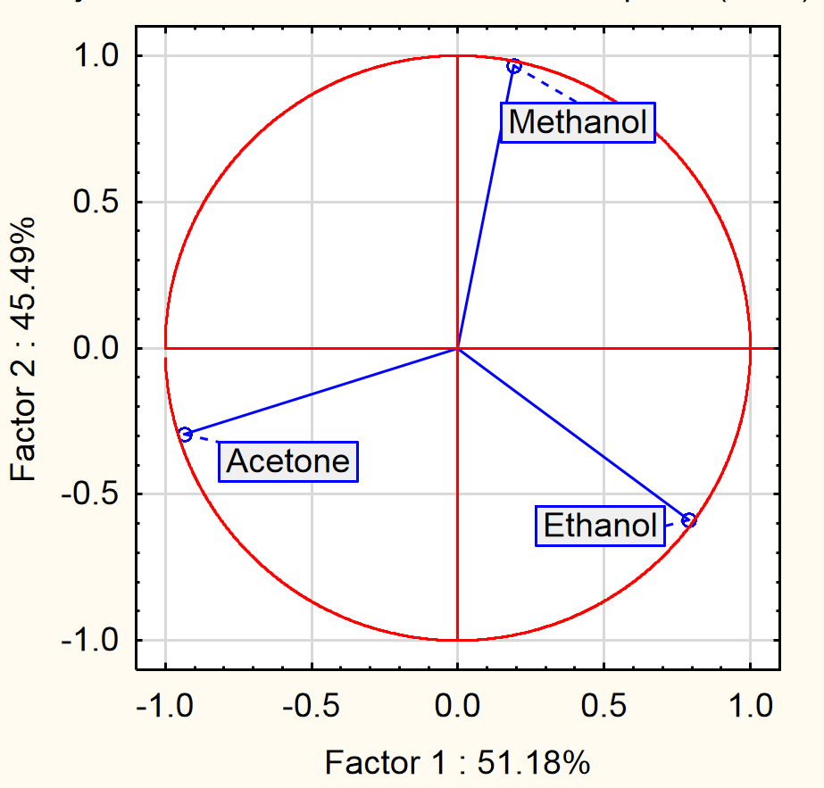
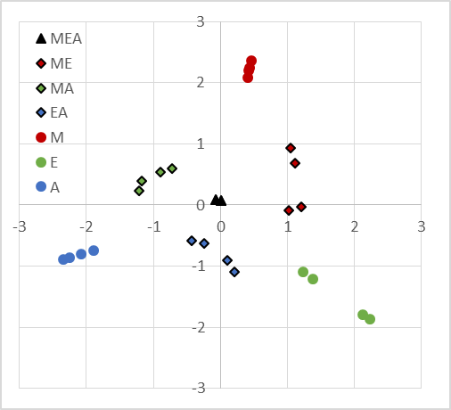
Case Study
Use PCA as a filtering algorithm for sensing materials
  Loadings: show separation between analytes (variables) to distinguish between different cases
Scores: provide information about how observations are linked

Slide 8
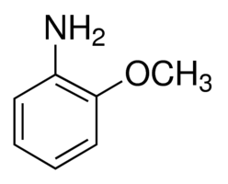
Case Study: PoANI
Derivative of polyaniline, poly-o-anisidine (PoANI)
  Undoped
  Doped with NiO or ZnO nanoparticles
Use individual materials (or combinations) to detect gas analytes
  Methanol, ethanol, acetone & benzene

Slide 9
4 Individual Gases; 1 Material
Loadings: which combination of factors gives best separation?
Notes:
This was the response of 4 gases for the ZnO-doped PoANI.
1 vs. 2 gives best separation between gases (may be hard to distinguish E and A in 1 vs. 3)
We will choose to plot the projection of cases for Factors 1 & 2 to create a “reference plot”

Slide 10
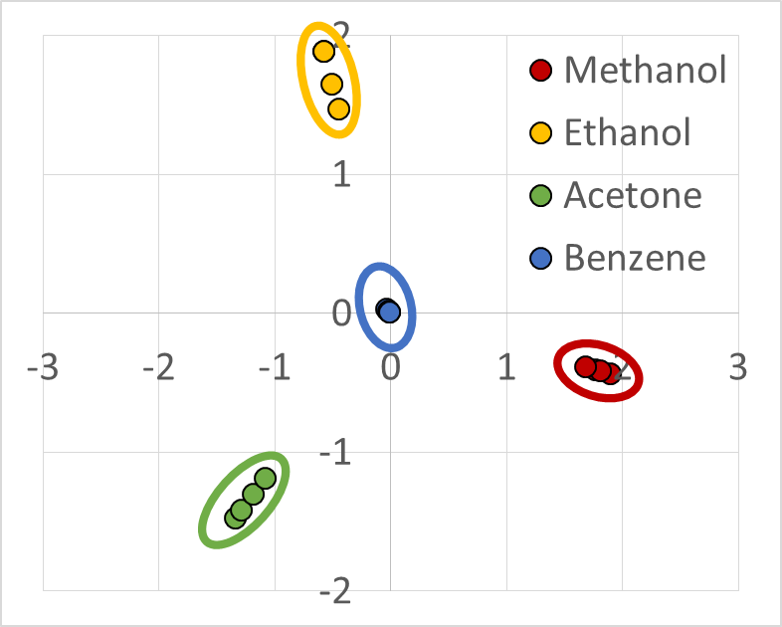
4 Individual Gases; 1 Material
Scores: easy distinction between all 4 gases (reference plot for unknown gases)
Benzene may be difficult to detect in gas mixtures…
Notes:
This can act as a reference plot; unknown gases fit into this “scheme”
Easy to distinguish between all 4 gases. However, since benzene is in the middle (likely due to low sorption on the sensing material), it may be harder to detect in gas mixtures.

Slide 11
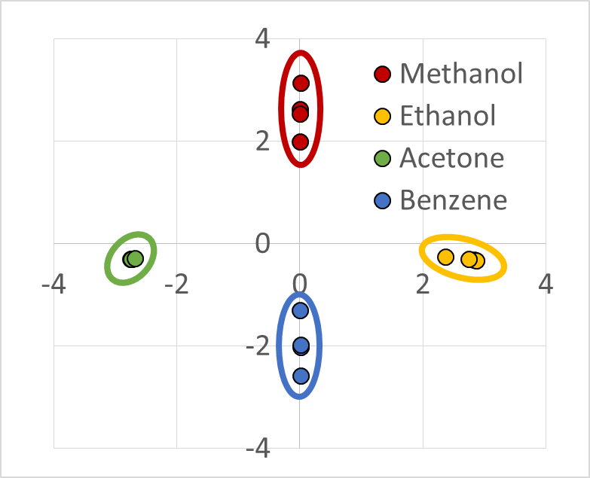
4 Individual Gases; Material Array
Material Array: combination of 3 PoANI-based sensing materials to improve separation
Notes:
This can act as a reference plot; unknown gases fit into this “scheme”
Easy to distinguish between all 4 gases. Benzene is not “central” anymore, which can theoretically improve distinction of gas mixtures.

Slide 12
4-Gas Mixture; Material Array
4-Gas Mixture: can individual gases still be identified when we include gas mixture data?
Experimental data include material responses to:
  Individual gases: Methanol (M), Ethanol (E), Acetone (A) & Benzene (B)
  2-Gas Mixtures: ME, MA, MB, EA, EB, AB
  3-Gas Mixtures: MEA, MEB, MAB, EAB
  4-Gas Mixture: MEAB
Notes:
Direct alignment no longer exists; interaction exists between gas analytes
Poor separation & outlying PoANI_M (doesn’t align with other M projections);
Motivated to remove PoANI data and try again (using 2 sensing materials)

Slide 13

4-Gas Mixture; Material Array
3-Material Array: does a material array help with gas identification?
OUTLYING PoANI_M
$∴$ REMOVE PoANI
Notes:
Direct alignment no longer exists; interaction exists between gas analytes
Poor separation & outlying PoANI_M (doesn’t align with other M projections);
Motivated to remove PoANI data and try again (using 2 sensing materials)

Slide 14
4-Gas Mixture; Material Array
2-Material Array: 2 sensing materials give better separation than 3 (better without PoANI)
Notes:
Separation is much improved when we eliminate PoANI as a sensing material.
“Sensor array” only requires NiO doped PoANI and ZnO doped PoANI.

Slide 15
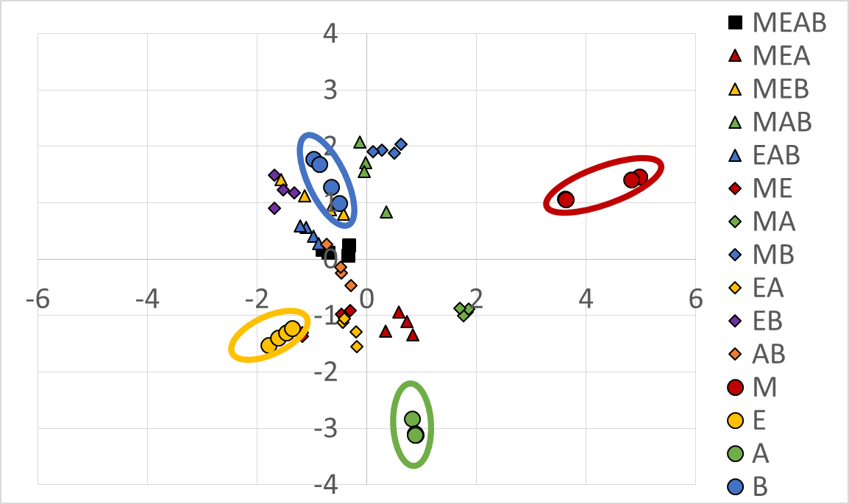
4-Gas Mixture; Material Array
2-Material Array: methanol, ethanol and acetone can be identified individually
Benzene &
Benzene-containing Mixtures
Notes:
B is still indistinguishable from gas mixtures, but M E and A are distinguishable.
B and mixtures containing B have similar projections (need to add a material to the array that is sensitive to B).

Slide 16
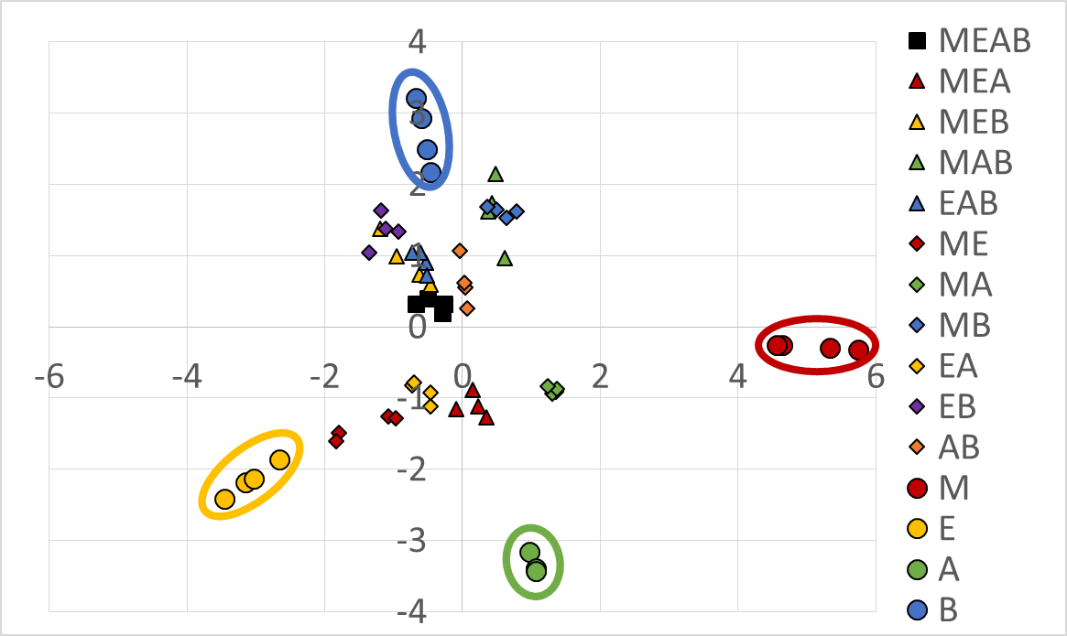
4-Gas Mixture; Material Array
3-Material Array: adding another (benzene-sensitive) material improves array performance
Notes:
Interior gas mixtures are still not distinguishable, but isolating individual gases is a step in the right direction; need to design materials that are highly sensitive and selective towards different gas analytes.
P25DMA w 20% NiO (data from KS)

Slide 17
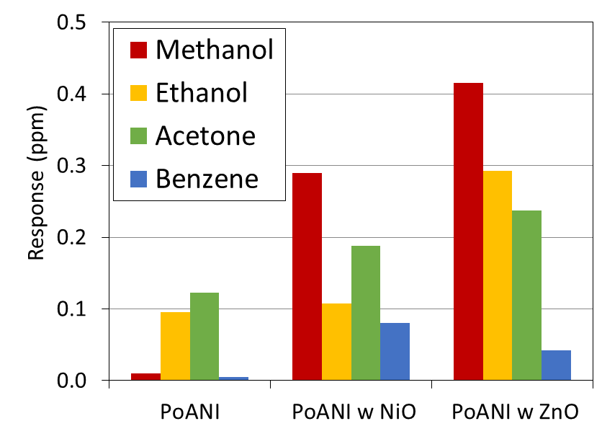

Do Results Make Sense?
Individual Gases: benzene had lowest sorption (hard to detect $∴$ hard to isolate)
  Material array provides more sensing info and better separation
  (vs. individual sensing material response)
  No interaction between gases (parallel loadings)

Slide 18
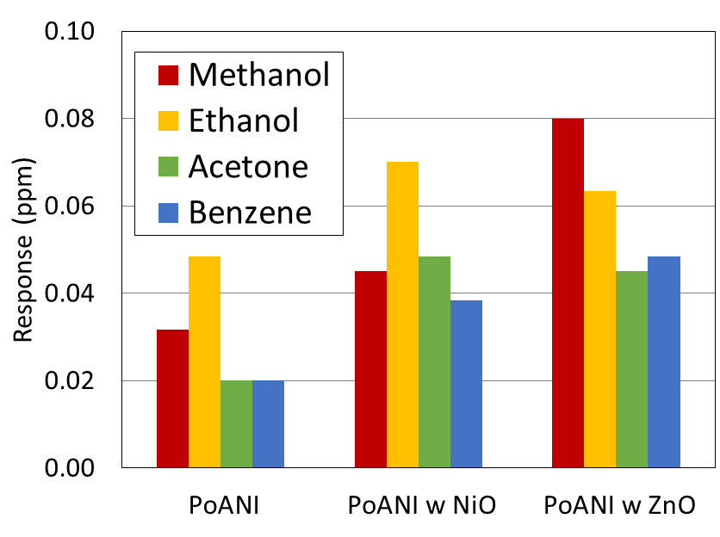
Do Results Make Sense?
4-Gas Mixture: benzene interactions prevalent when gas mixtures are analyzed
  Benzene sorption > acetone sorption for PoANI w ZnO
  Interactions?
    Benzene cannot be separated from other benzene-containing gas mixtures
Notes:
In the 4-gas mixture, benzene has better sorption than acetone. This indicates interactions between benzene and the other gases.
Interactions confound PCA results; makes sense that benzene (alone) cannot be “separated” from other benzene-containing gas mixtures

Slide 19
Concluding Remarks
Principal component analysis (PCA) is a valuable tool for analyzing sensing data
  Filtering algorithm provides “separation”
  Statistical results agree with physico-chemical expectations
Information from PCA allows for tailor-made, improved sensor arrays

Slide 20
Principal Component Analysis Applied to Polymeric Sensing Materials
Alison J. Scott and Alexander Penlidis
Department of Chemical Engineering
Institute for Polymer Research (IPR), University of Waterloo
40th Annual Symposium on Polymer Science/Engineering
Wednesday, May 9th, 2018

Slide 21
References
Stewart, KME; Penlidis, A. (2013) Macromolecular Symposia 324 (1).
Stewart, KME; Chen, WT; Mansour, RR; Penlidis, A. (2015) Journal of Applied Polymer Science 132 (28).
Stewart, KME; Penlidis, A. (2017) Polymers for Advanced Technologies 28 (3).

Slide 22
Sensing Materials
Sensing Materials vs. Sensors
Sensing Material
Conductive
Material Response
Δ Conductivity
Sensor Type
Resistive Sensor
Δ Mass
Capacitive Sensor
Mass-Based Sensor
Non-Conductive
Lightweight
Δ Capacitance
Notes:
Sensing materials are the materials that interact with the target analyte (adsorption or absorption occurs)
Sensors convert non-electrical inputs into an electrical output signal; certain sensor types require a specific material response, which in turn dictates material property requirements

Slide 23
Sensing Materials
Bulk Polymer Properties
Depend on sensor type
Glass transition temperature
Application-Specific Properties
Sensitivity
Selectivity
Physical structure
Affinity towards target analyte(s)
Other (e.g. stability)
Notes:
Linear parameter estimation techniques: incorrect parameter estimates and/or distorted error structure
Poorly designed experiments: too few data points (chosen at random and not necessarily replicated)
Experimental difficulties: error is inherent in experimental work, especially for low conversion experiments
Inappropriate kinetic models: several different copolymerization models exist, and this one (the ICC or Mayo-Lewis model) is not always valid.

Slide 24
Principal Component Analysis (PCA)
What is PCA?
  Multivariate data analysis technique
  Attempts to reduce total number of variables by creating components or factors
  These factors account for the majority of the variation using fewer data points
  Method gives us a 2-dimensional “window” through which we can look at a data set that contains many more variables
Filtering Algorithm

Slide 25
Principal Component Analysis (PCA)
How does PCA work?
  Creates factors, which are weighted linear combinations of the original variables
  First few factors contain most of the variation (for the entire data set), so only a few “principal components” need to be retained for analysis
~86% variation in 3 PCs
z₁ = a₁₁ x₁ + a₁₂ x₂ + … + a_{1p} x_{p}

Slide 26
4-Gas Mixture; 1 Material
4-Gas Mixture: separation of gases when mixture data is included in analysis
Notes:
2 by 3 gives best separation, therefore we can use it to evaluate MEAB mixture (use 4 gas, 3 gas, 2 gas mixture data & individual gas data)

Slide 27
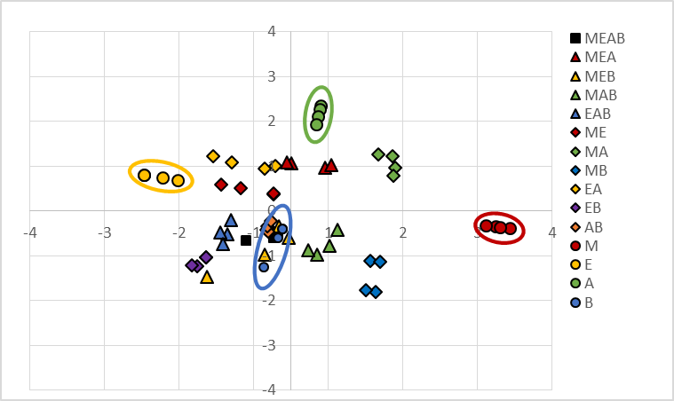
4-Gas Mixture; 1 Material
4-Gas Mixture: is one sensing material enough to distinguish between gases?
Acetone
Ethanol
Methanol
Benzene
Benzene &
Benzene-containing Mixtures
Notes:
As expected, B response is “confounded” with other gas mixtures.
However, M E and A (individual gases) can be identified.

Slide 28
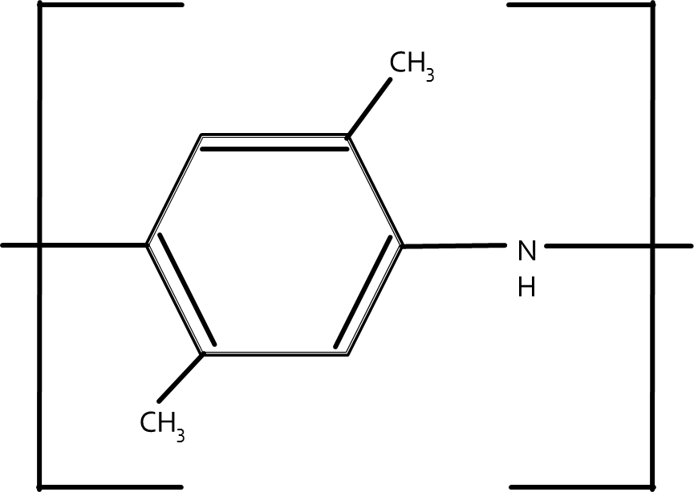
4-Gas Mixture; Material Array
3-Material Array: adding another (benzene-sensitive) material improves array performance
Poly (2,5-dimethyl aniline) doped with NiO
Notes:
Interior gas mixtures are still not distinguishable, but isolating individual gases is a step in the right direction; need to design materials that are highly sensitive and selective towards different gas analytes.
P25DMA w 20% NiO (data from KS)

Slide 29
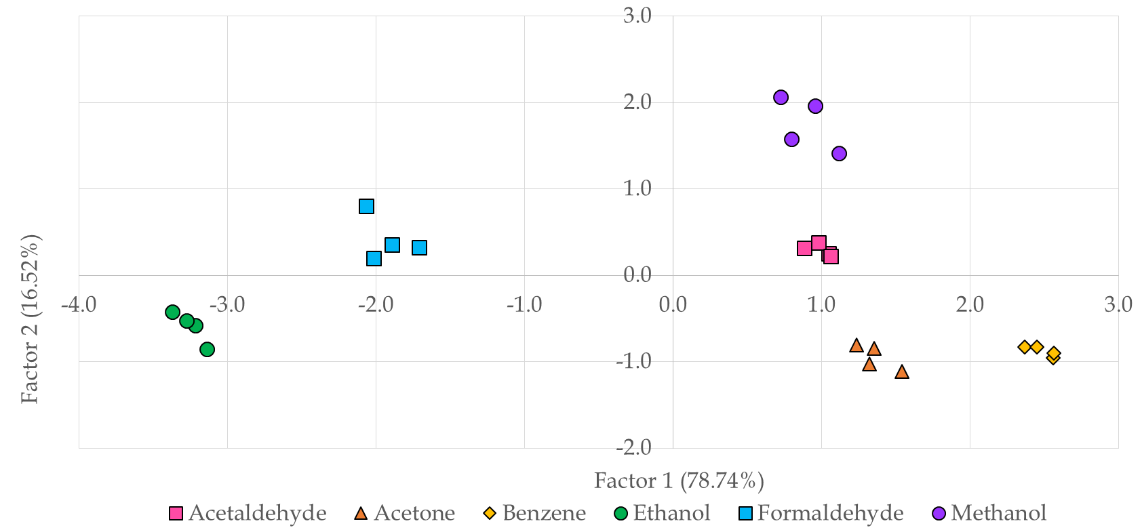
Unknown Gas ID

Slide 30
Do Results Make Sense?
PCA: successful filtering algorithm for sensing material data
  Loadings show separation between analytes & predict degree of separation
    Outliers suggest which sensing materials may not be appropriate for detecting target analytes
  Scores show how observations are linked
    Array performance is based on separation (and identification) of analytes
    Plots demonstrate how mixtures relate to pure (individual) gases & suggest interactions between gases

