Slide 1
2018 IPR Symposium
Low‐cost Synthetic Approach to Prepare Indigoid‐based Polymers for Solution Processable P‐type Organic Field‐effect Transistors
By Jenner Ngai
Supervisor: Prof. Yuning Li

Slide 2
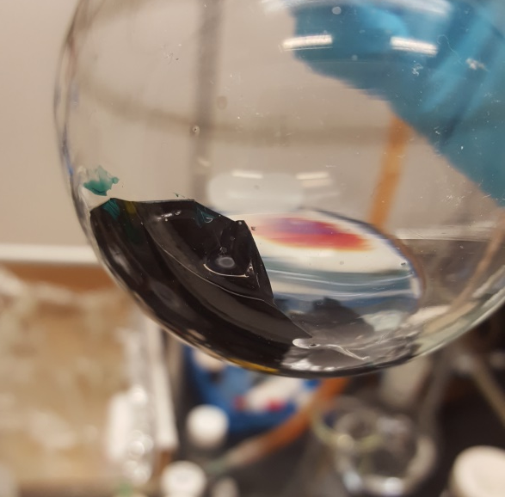
Synthesis of Polymer Semiconductors

Slide 3
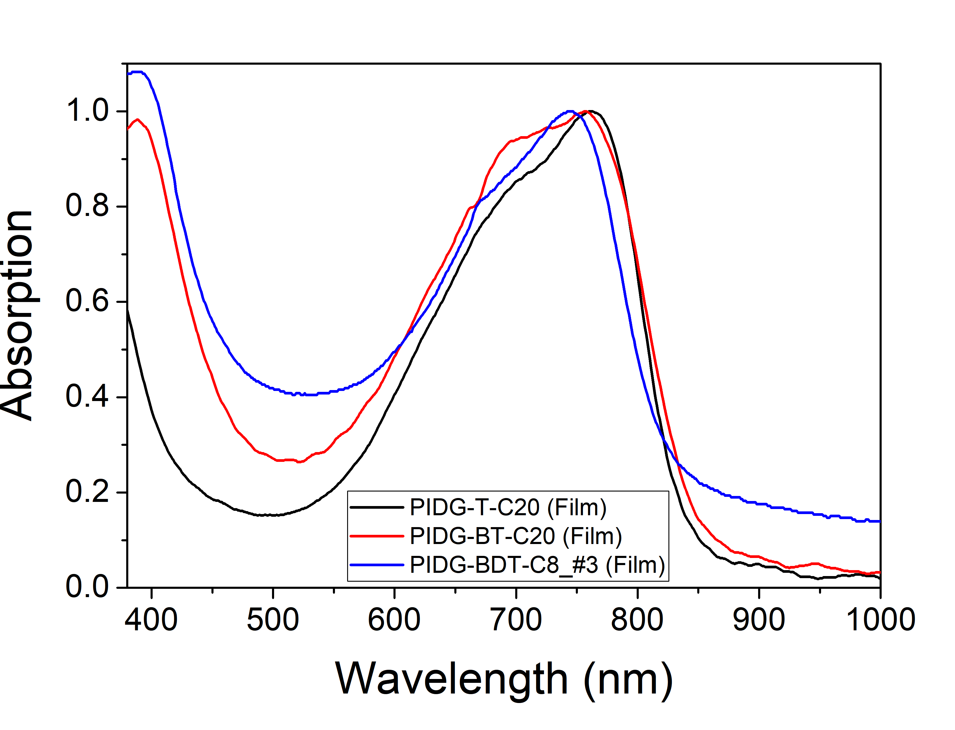
Physical Properties
Polymer | Mw | Mn | PDI
PIDG-T-C20 | 55,491 | 21,622 | 2.57
PIDG-BT-C20 | 38,574 | 18,586 | 2.08
PIDG-BDT-C8_#3 | 63,545 | 21,642 | 2.93
Polymer semiconductor ink
 | HOMO_{CV} (eV) | LUMO_{CV} (eV) | E_{g,CV} (eV) | E_{g,opt}* (eV) | λ_{max} (nm) | λ_{edge} (nm)
PIDG-T-C20 | -5.48 | -4.30 | 1.17 | 1.48 | 762 | 836
PIDG-BT-C20 | -5.27 | -3.89 | 1.38 | 1.44 | 758 | 860
PIDG-BDT-C8_#3 | -5.26 | -3.73 | 1.53 | 1.51 | 747 | 823

Slide 4
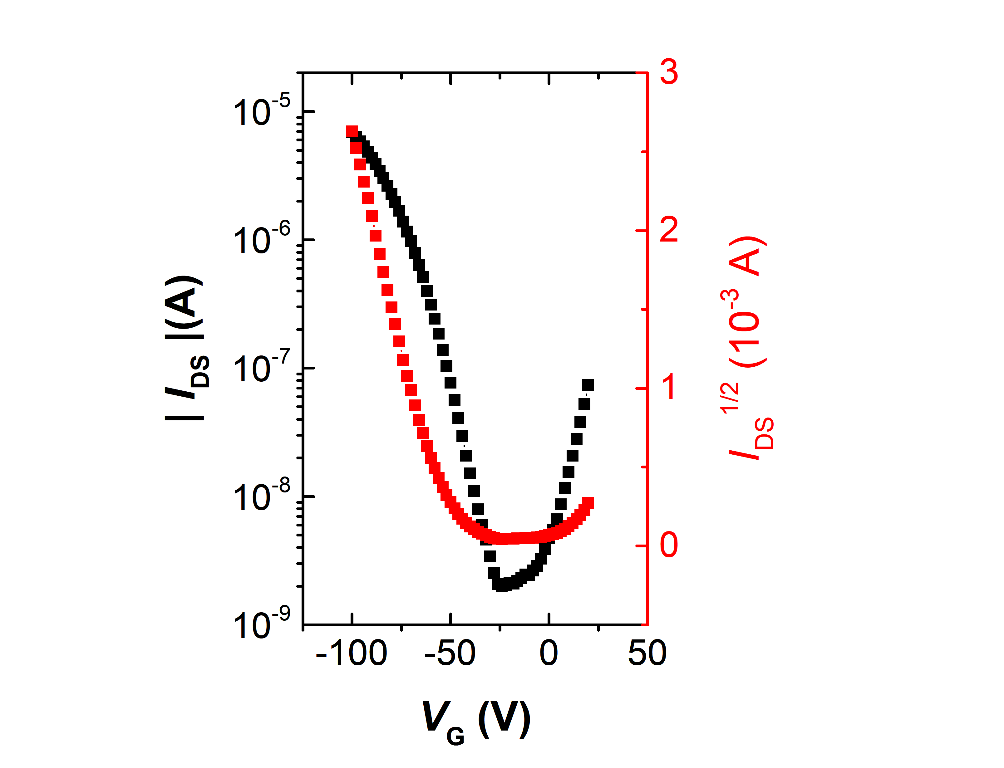
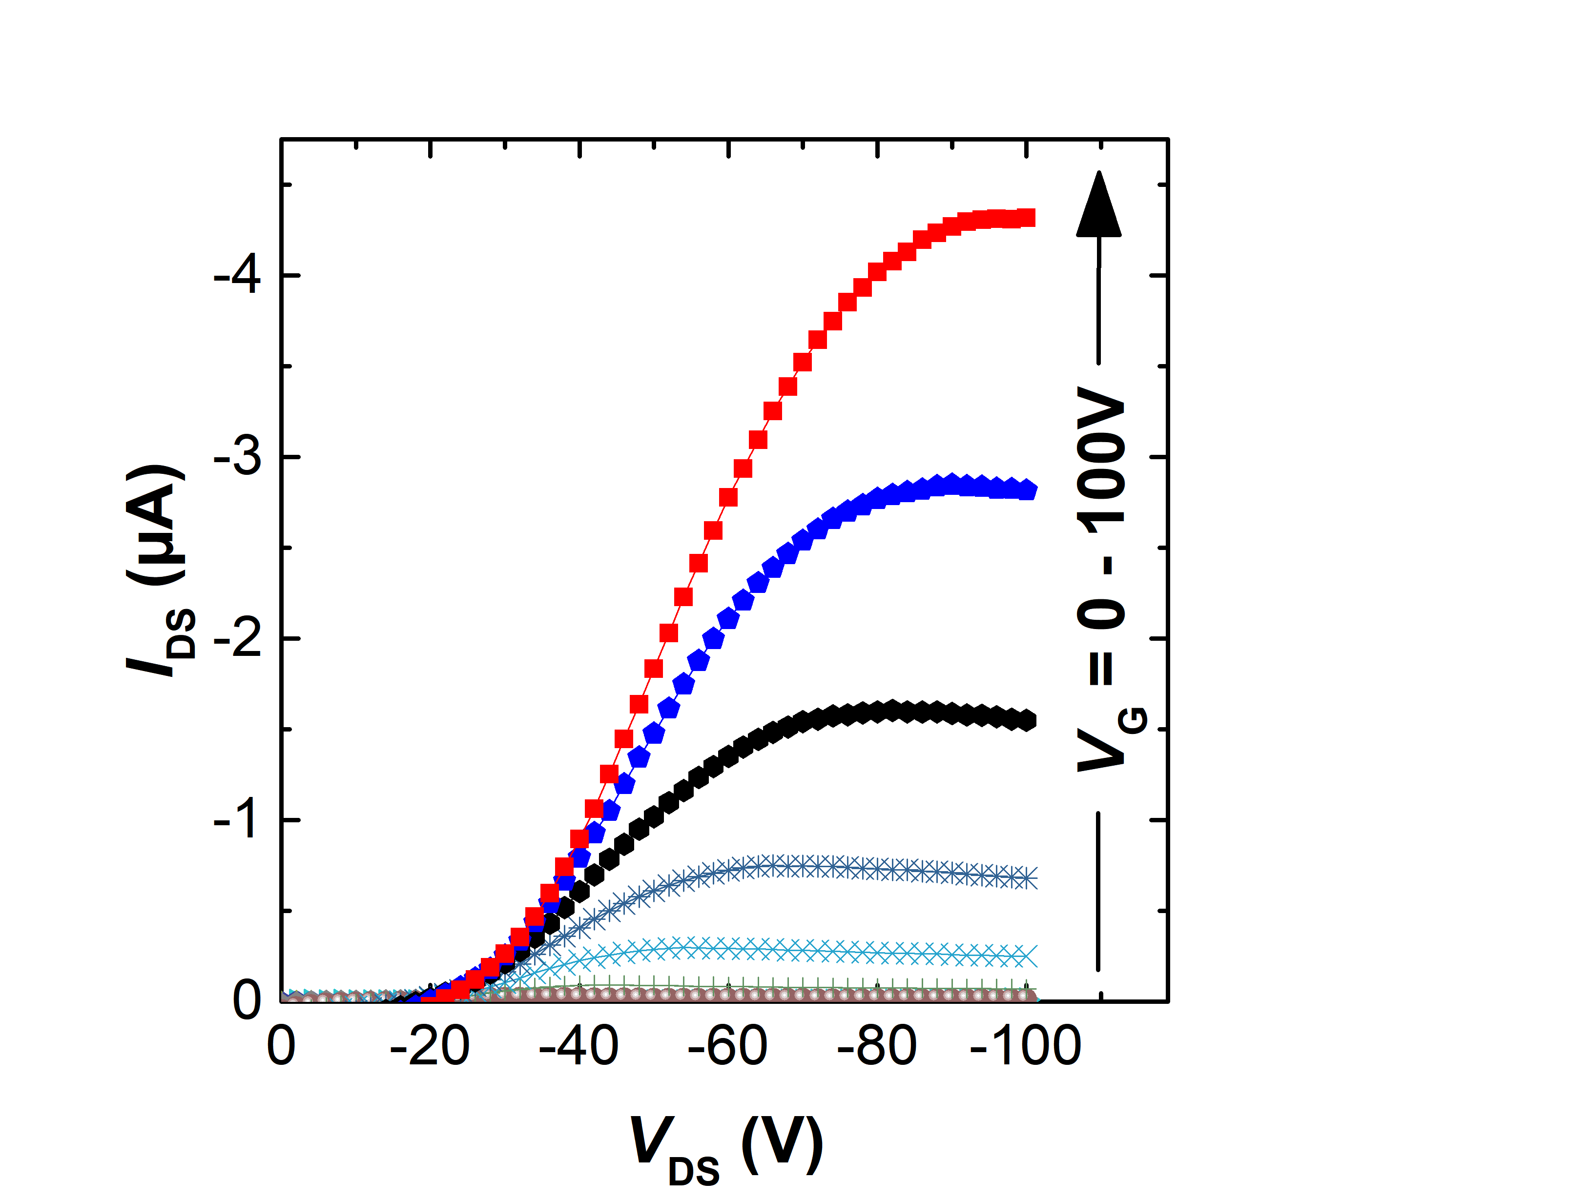
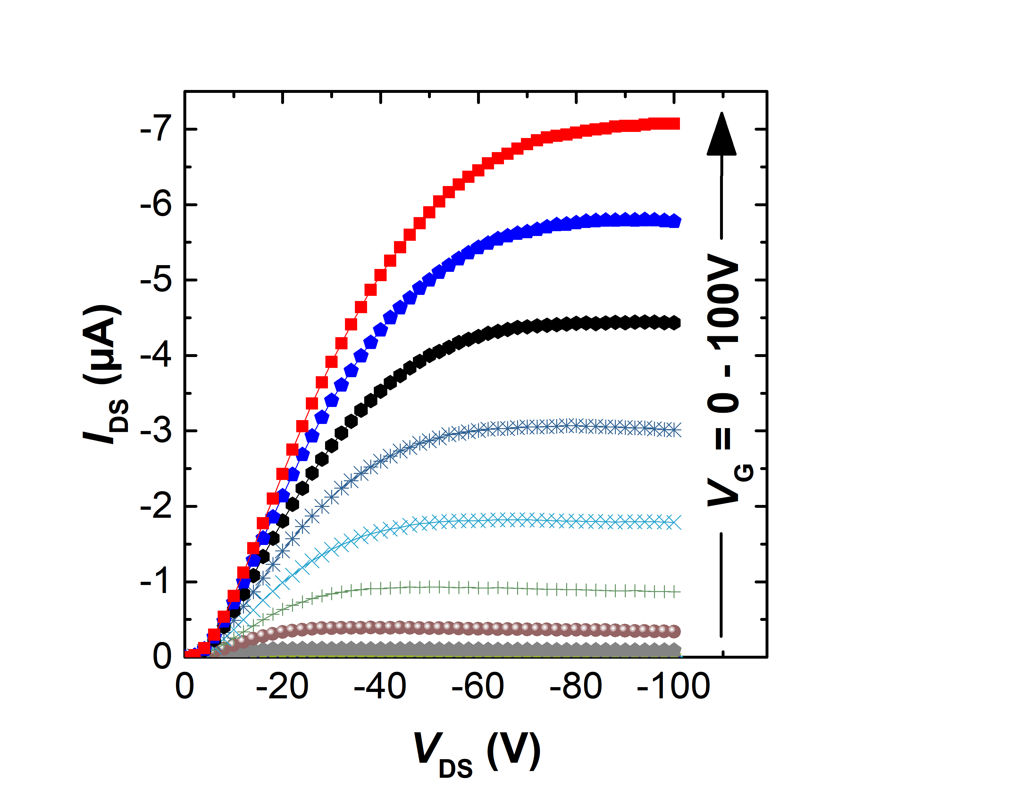
Organic Field-effect Transistor
Polymer | Annealing Temperature (ºC) | μ_{sat,h} (cm²V⁻¹s⁻¹) | V_{T,h} (V) | I_{ON/OFF,h}
PIDG-T-C20 | 50 | 2.4 × 10⁻³ | -34.2 | 1.3 × 10⁴
 | 100 | 5.0 × 10⁻³ | -58.8 | 3.1 × 10⁴
 | 150 | 0.015 | -52.0 | 3.0 × 10³
 | 200 | 2.2 × 10⁻³ | -63.7 | 3.0 × 10³
PIDG-BT-C20 | 50 | 2.0 × 10⁻³ | -43.3 | 1.7 × 10⁴
 | 100 | 2.7 × 10⁻³ | -39.9 | 1.3 × 10³
 | 150 | 0.027 | -43.8 | 1.4 × 10⁵
 | 200 | 3.0 × 10⁻³ | -43/6 | 3.3 × 10⁴

Slide 5
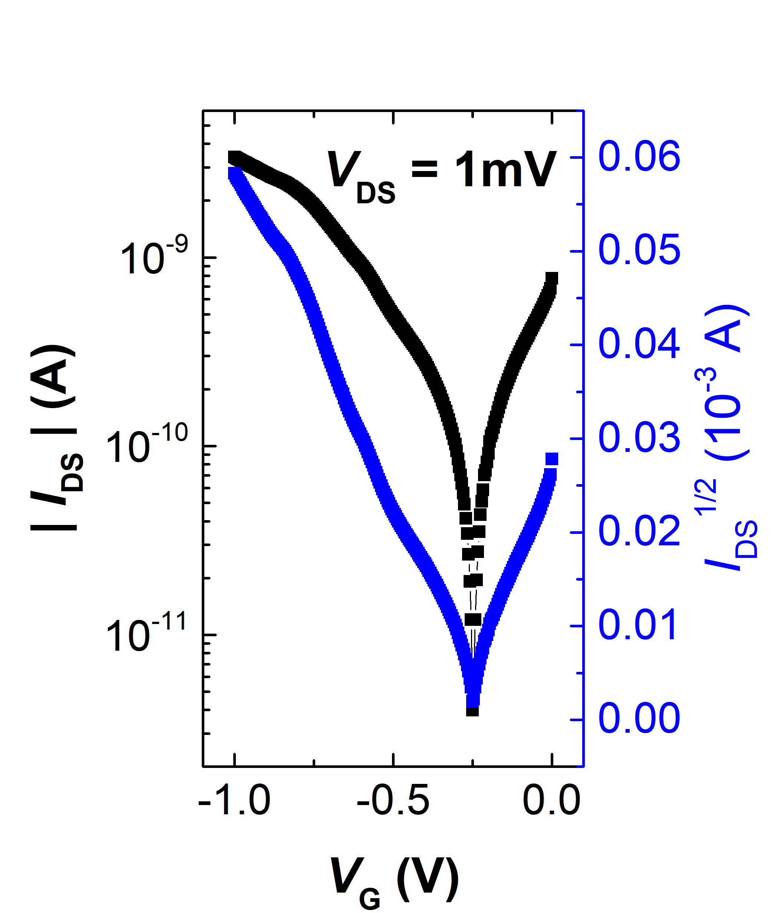
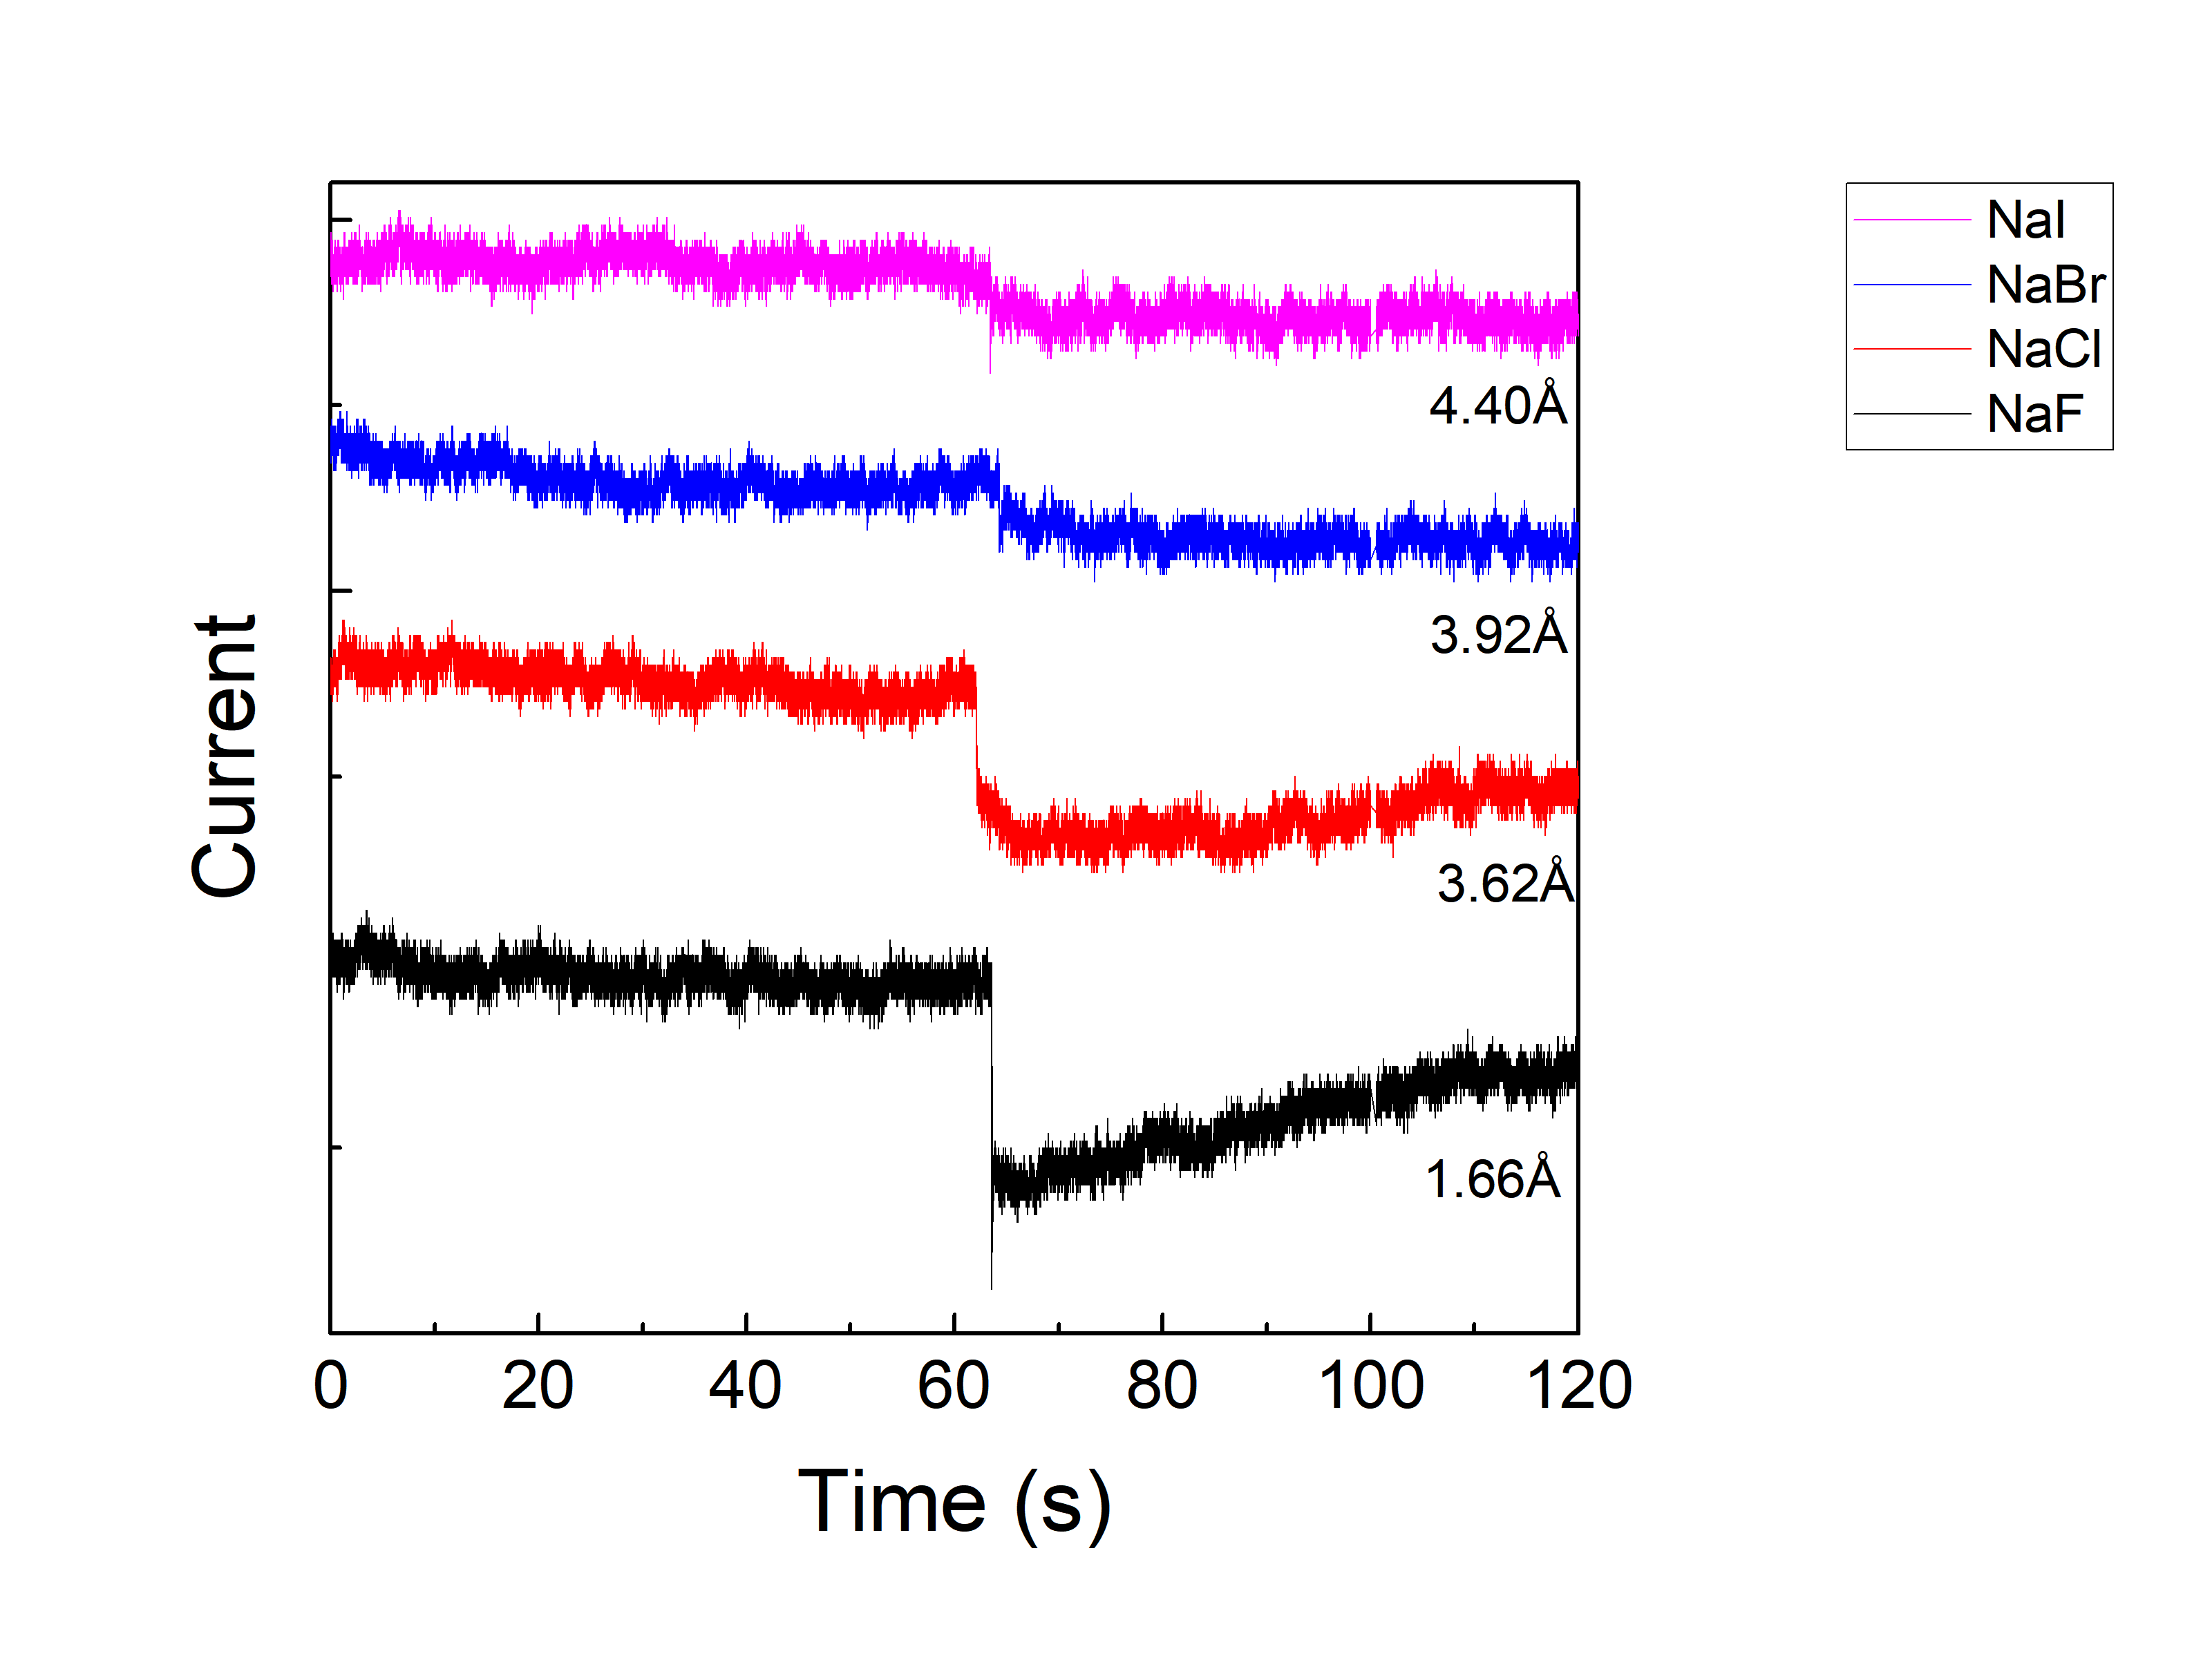
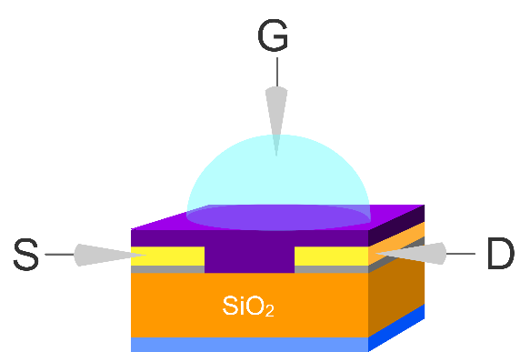
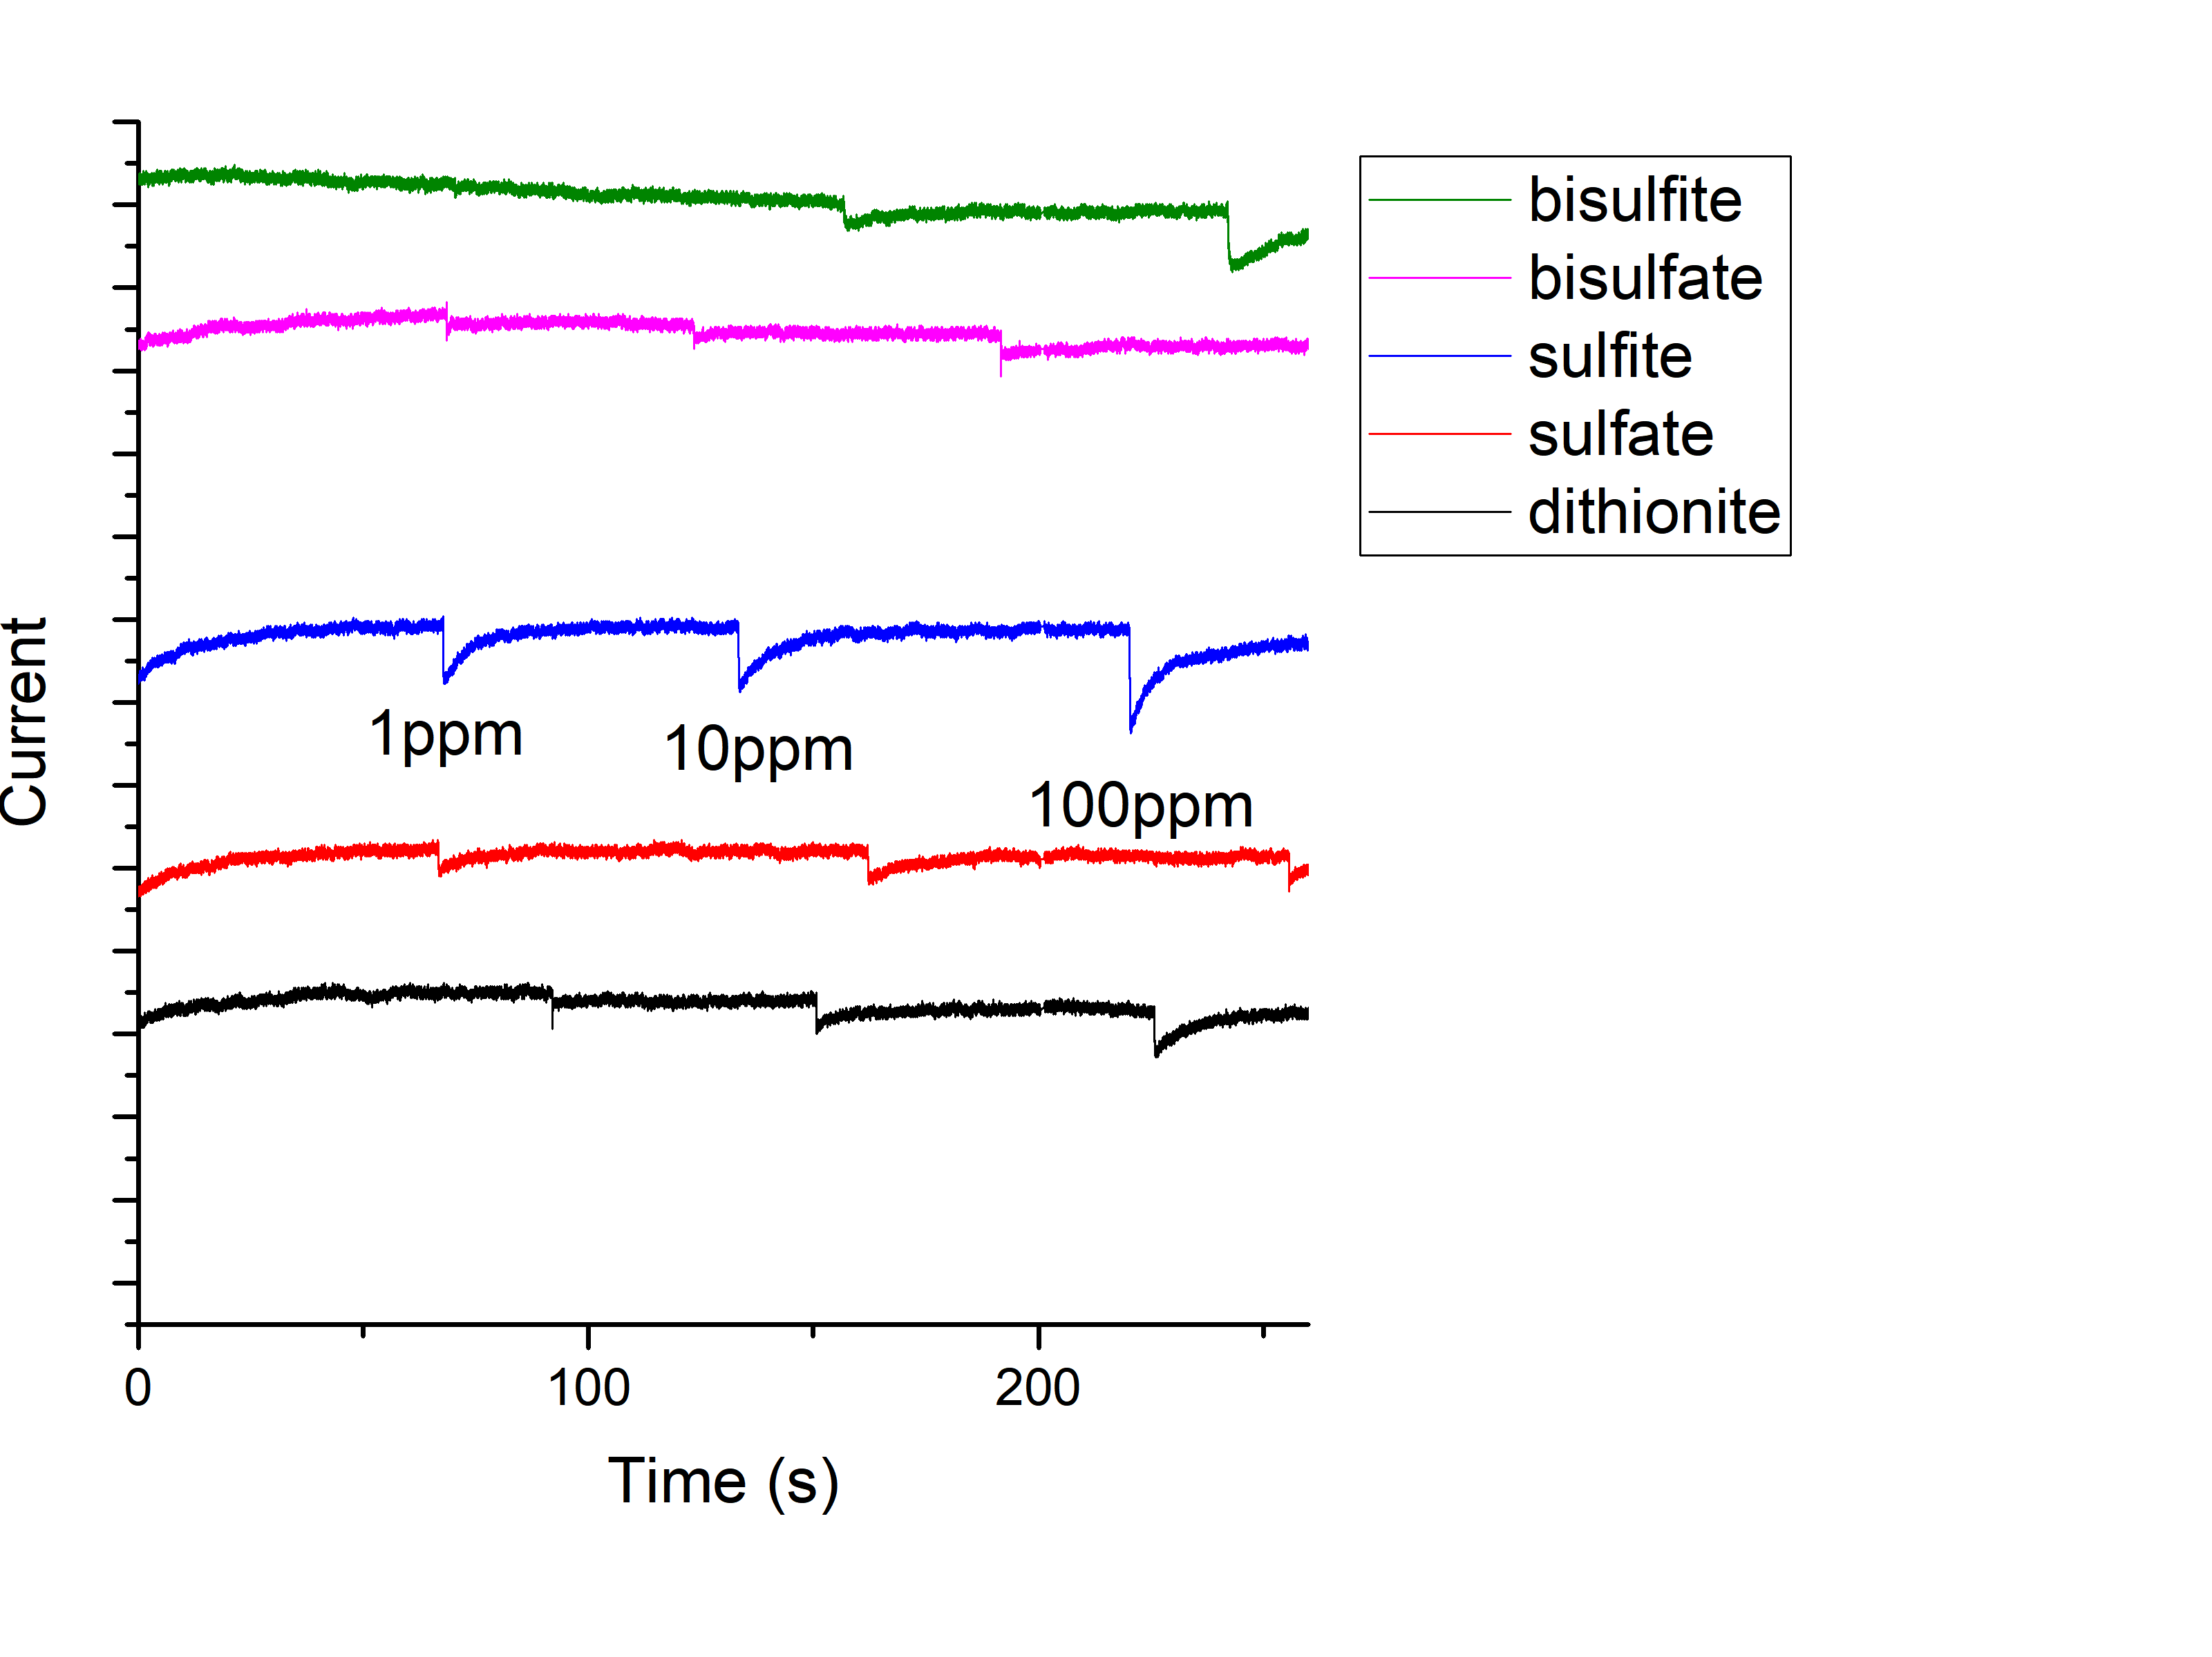
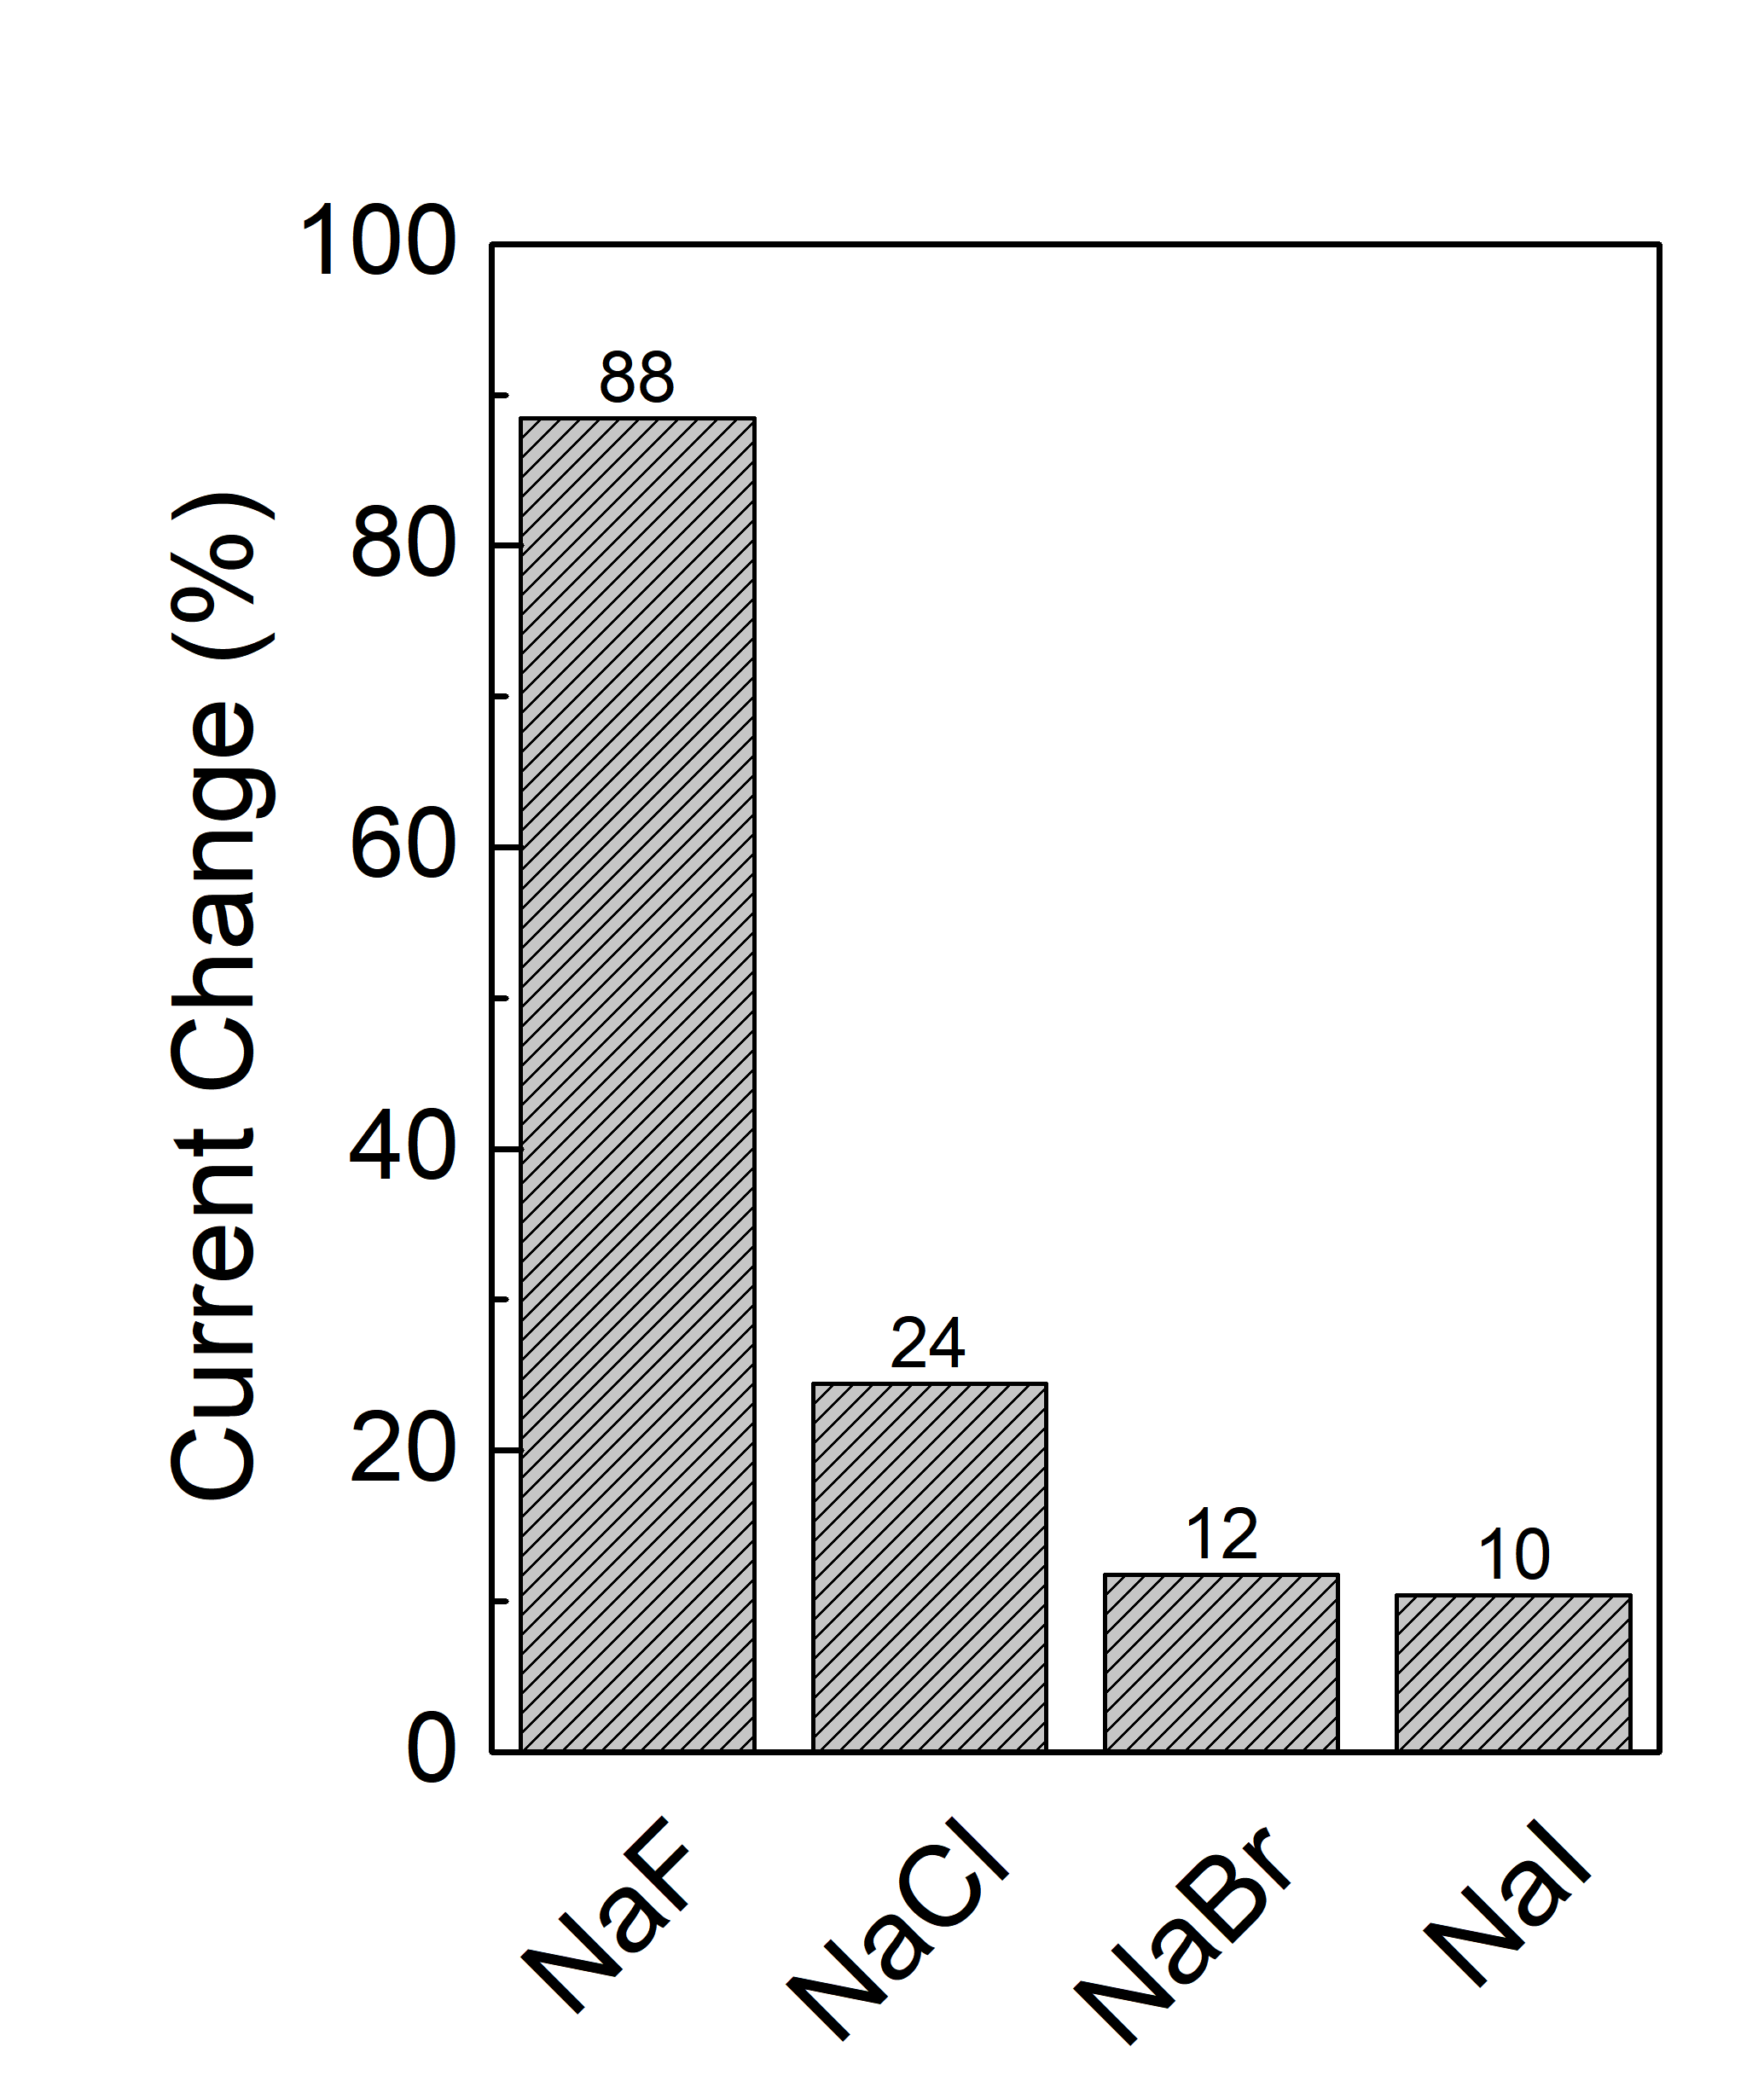
Applications
Halide ions sensing at 100 ppm values
Cl⁻
Br⁻
I⁻
F⁻
Water-gated organic field-effect transistor for sensing applications
Water-gated transistor transfer characteristic with low operating voltage (1-100mV)
Chemical Sensors
Gas Sensors
Biological Sensors
Solar Cells
Others…etc
Sensitivity of different anions

