Slide 1


Characterization of Self-Assembling Quinoline-Based Foldamers by Fluorescence Anisotropy
Jingqi Wang
Supervisor: Prof. Jean Duhamel
May 9, 2018

Slide 2
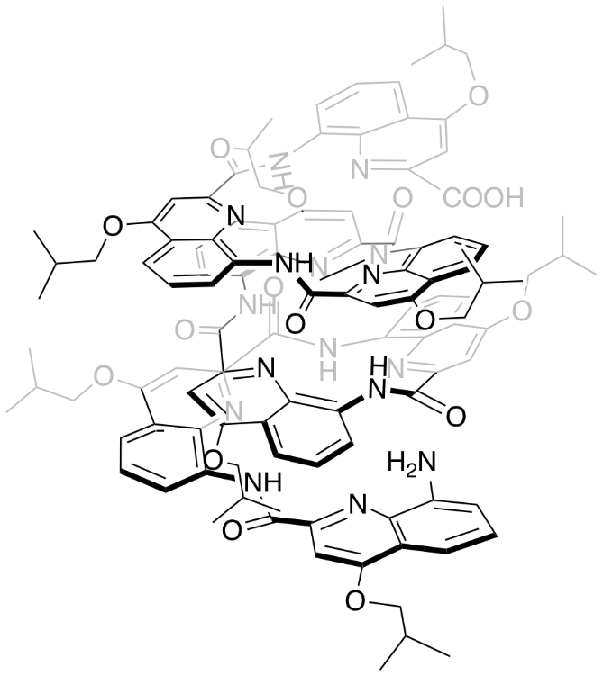
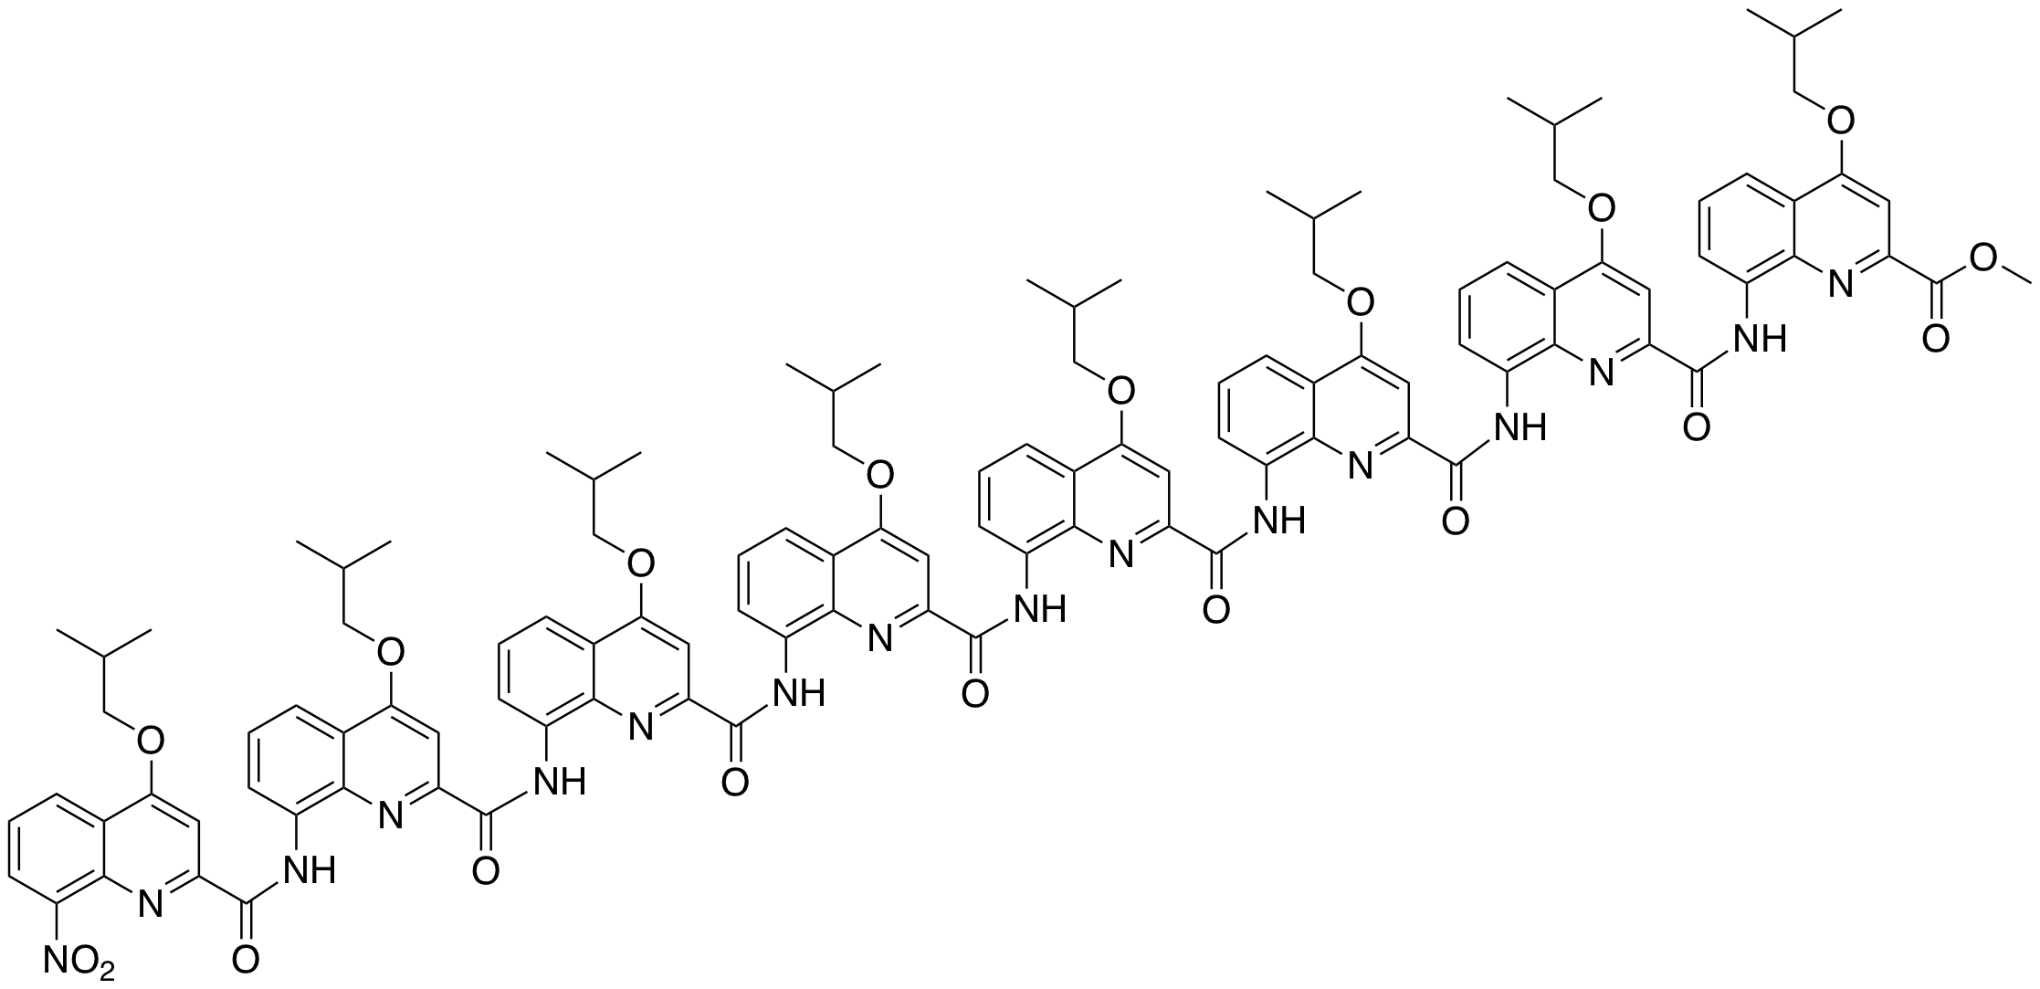
Foldamers: Artificial folded molecular architectures.
Problems encountered when dealing with Q_{n}
Method for elongating the foldamer into a polymer
Difficult to characterize the size in solution.
Potential methods to solve these problems
Induce polymerization of foldamers by metal complexation.
Characterize the average degree of polymerization of the foldamers by fluorescence anisotropy
Q₁
Q_{n}
Quinoline-based aromatic amide helical foldamer
Li, X. Synthesis and Physical Properties of Helical Nanosized Quinoline-Based Foldamers: Dynamic and Photoinduced Electron Transport. Ph.D thesis, University of Bordeaux, 2016.
Notes:
chromophores

Slide 3
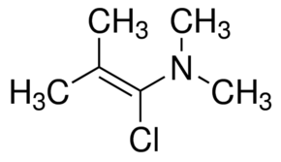
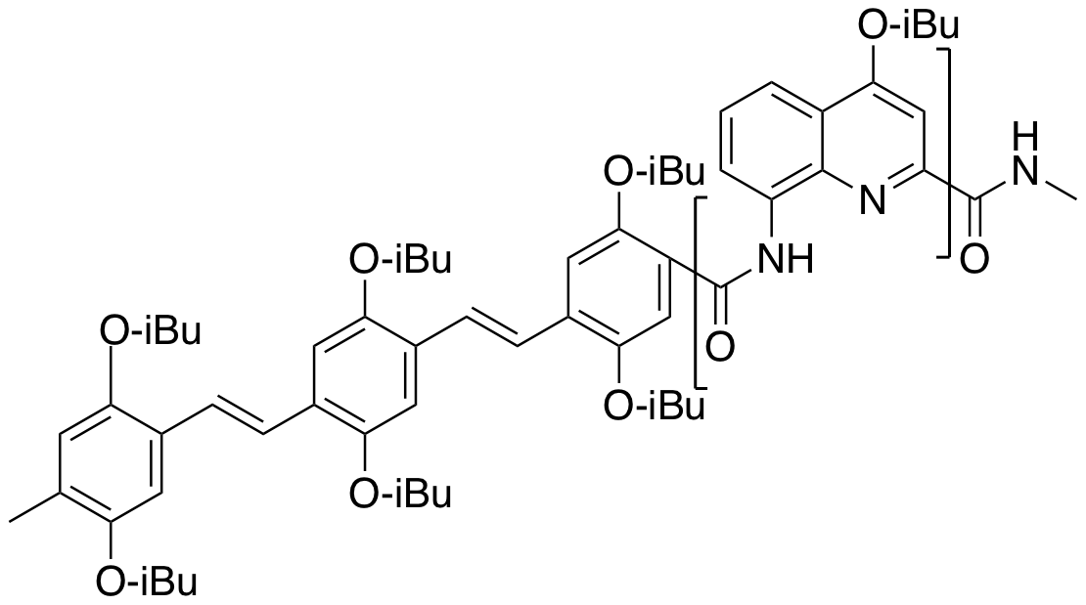
  Synthesis of foldamers
Segment doubling synthesis
n
Chromatography-free large scale synthesis
OPV
Q_{n}
Notes:
The monomer Q1 produced in Huc’s lab beforehand was reduced to amine by hydrogen with paldium on carbon as catalyst. Meanwhile, another part of Q1 turns into acid through the saponification of ester by NaOH, and subsequently the acid is activated by oxlyl acid. Then the coupling of amine and acid chloride is in the present of the reagent of DIEPA.
. As the oligamer prolong, the activity of nitro group is decreased, so we use ammonium format with pd/c and ammonium matavanadate as catalyst to reduce the nitro group.
problems arise from the low reactivity of the amine end-group and the formation of anhydrides between two acid end groups

Slide 4
  Synthesis of foldamers
OPVQ₄
OPVQ₇
OPVQ₉
OPVQ₁₇
OPVQ₂₄
OPVA
OPVQ₄A
OPVQ₈A
OPVQ₁₇A
Q₈A
Q₁₆A
Q₃₂A

Slide 5
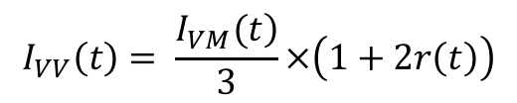
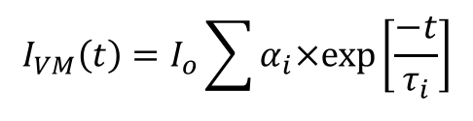
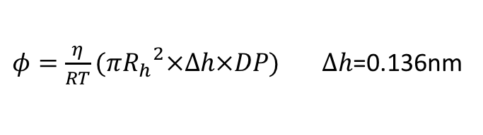
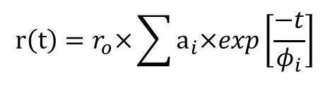
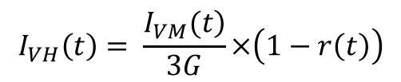
Complex foldamers with metal coordination
$$I_{VM}\left(t\right)=I_{ο}\sum{α_{i}×exp\left[\frac{−t}{τ_{i}}\right]}$$
$$I_{VV}\left(t\right)= \frac{\left.I_{VM}(t\right)}{3}×\left(1+2r\left(t\right)\right)$$
$$I_{VH}\left(t\right)= \frac{\left.I_{VM}(t\right)}{3G}×\left(1−r\left(t\right)\right)$$
$$r\left(t\right)=r_{o}×\sum{a_{i}×exp\left[\frac{−t}{φ_{i}}\right]}$$
$φ=\frac{η}{RT}(π{R_{h}}^{2}×∆h×DP)$ $∆h$=0.136nm
Maurizot, V. Ligation of Helical Foldamers by Metal Coordination. Unpublished. 2017
Meijer, E.W. Reversible Polumers Formed from Self-Complementary Monomers Using Quadruple Hydrogen Bonding. Science 1997, 278,1601-1604.
Notes:
聊两句 fluorescence
删掉polymer 加decay

Slide 6

Acknowledgements
Supervisor Prof. Duhamel
Huc’s Group of University of Bordeaux
Other lab members in Duhamel and Gauthier’s Groups
Funding
Bordeaux-Waterloo Research Grant
NSERC

