Slide 1
An Overview of Model Discrimination Techniques in Polymerization Processes
Noushin Majdabadifarahani, Alexander Penlidis
Department of Chemical Engineering, University of Waterloo
Thomas Duever
Department of Chemical Engineering, Ryerson University

Slide 2
Model Discrimination (MD) Basics
Model discrimination is a sequential procedure consisting of two steps:
Experimental design
Data analysis
Start with m (rival) mathematical models that can describe a process response y:
Notes:
Often at the beginning of a modelling study, there are several models which seem to provide a reasonable description of the process based on theory or existing experimental data. To model the process a decision needs to be made on which model is best.

Slide 3
MD Basics (Cont’d)
First step: Parameter estimation
Literature values and past work
(n-1) preliminary (or prior) experiments (trials, runs)
Carry out model discrimination experiments in a sequential fashion
Perform the next (n^{th}) experiment at those values of x for which:
Improve by considering the prediction variance:
Notes:
PE can often be obtained from the literature or from the researcher’s past work, but they may not be precise unless the experiments were designed specifically for the purpose of PE.
1st step: Design step: in which a discrimination criterion is used to choose the next experiment
2nd step: Data analysis is performed

Slide 4
Bayesian Approach
Weigh the criterion using model probabilities
Start by assigning prior model probabilities
Modify criterion:
Update model probabilities after each experiment
Continue until Pr(M_{i.n}) becomes sufficiently large, compared to others, such that model i is judged to be the “best”.
(Examine the “best” model for Lack-of-Fit (LOF))

Slide 5
Statistical Model Discrimination Methods
1. Expected Entropy (EE)
Designed to maximize the expected change in entropy (Bayesian approach); note: max entropy occurs when no info exists as to which model is best
2. Hsiang and Reilly (HR)
Improved the criterion by eliminating the need to linearize nonlinear models
3. Buzzi-Ferraris & Forzatti (BFF)
4. Other…
Notes:
2. In this method, uncertainty in the parameter estimation is expressed in the form of discrete parameter probability dist.
3. In BFF the next experiment is designed to maximize the difference in model predictions relative to prediction variance.

Slide 6
Remarks on Methods/Criteria
Data analysis: can handle nested and non-nested models
Models selected could all be inadequate! (Need to check residual plots, LOF tests, etc.)
Only models satisfying adequacy tests are considered for next step, i.e., the selection of a new experiment.
An estimate of the measurement variance is required
If discrimination is not achieved, then:
either more parameter estimation experiments are needed
or all models being considered are equally ‘good’ (or ‘bad’) descriptions of the process

Slide 7
Typical Design of Simulation Runs
Each run simulated with up to 20 experiments
Primary variables:
Three copolymer systems (STY/MMA, STY/AN, STY/BA)
Three model discrimination methods (EE, HR, BFF)
Secondary variables:
Measurement error level
Simulation model (terminal vs. penultimate)
Initial parameter estimates

Slide 8
Terminal vs Penultimate Mechanism (for the propagation steps)
Terminal mechanism/model
Only the last monomer unit on the growing polymer radical is assumed to influence radical reactivity (a total of 4 propagation steps and 2 reactivity ratios as parameters)
Penultimate mechanism/model
The environment of the terminal unit is taken into account (the last two monomer units on the growing polymer radical are affecting reactivity with a total of 8 propagation steps and 6 reactivity ratios as parameters)
Notes:
In the literature, several different mechanism have been proposed to describe the propagation step in free radical copolymerization
S1=S2=0

Slide 9
Steps in the Simulation Program
1. Design initial parameter estimation experiments (for instance, using the
D-optimal design criterion)
2. Simulate six parameter estimation experiments
3. Estimate reactivity ratios for both the terminal and penultimate models using the integrated copolymer equation
4. Select the model discrimination experiment and simulate it
5. Re-estimate reactivity ratios based on all available data (copolymer composition, triad fractions, other,…)
6. Update model probabilities or decision criterion
7. Repeat steps 4-6 until one model is chosen as ‘best’

Slide 10
Simulations Based on Triad Fraction Data
Triad fractions depend on same reactivity ratios (parameters) as copolymer composition
Triad fractions are simulated using the same models as copolymer composition data
Use four out of six triad fractions:
A₁₁₁+A₁₁₂₊₂₁₁+A₂₁₂=1
A₂₂₂+A₂₂₁₊₁₂₂+A₁₂₁=1
(Requires multivariate extensions of univariate discrimination criteria)

Slide 11
Application of BFF criterion to STY/AN based on Triad Fractions
Simulation Model | Model chosen as “best” at 95% confidence (Number of simulation runs) Terminal Penultimate Neither
Application to STY/MMA
Terminal Strong penultimate Small penultimate | 9 0 0 | 0 9 9 | 0 0 0
Application to STY/AN
Terminal Strong penultimate Small penultimate | 9 0 0 | 0 9 9 | 0 0 0
Application to STY/BA
Terminal Strong penultimate Small penultimate | 8 0 0 | 0 9 9 | 1 0 0

Slide 12
Simulation results - Triad Fraction Data
Use of triad fractions greatly improved ability to correctly discriminate compared to composition data (best method picked “correct” model in 98.8% of simulations)
Able to detect ‘smaller/weaker’ penultimate effects than those in literature
Improvement may be due to the use of 4 triad fractions instead of 1 copolymer composition
This finding may justify effort needed to obtain accurate triad fraction data

Slide 13
Application of BFF method to STY/AN based on Copolymer Composition and Chain-Length Data)

Slide 14
Effect of Impurities on MD – First Approach
Impurities are often ignored when describing polymerizations
Does the presence of impurities adversely affect the model discrimination procedure?
Could it lead to incorrect choices about aspects of the polymerization mechanism?
Generate data using (process) models with impurity effects
Candidate models for model discrimination have no impurity effects
Examples with impurity effects for the triad fraction and chain length (molecular weight) case studies for the STY/MMA system follow…

Slide 15
Weight Average Chain Length and Triad Fractions for the STY/MMA Case Study
Case Level of Impurity k_{imp}/k_{STY} (ppm)
1 0 0
2 50 0.1
3 50 1
4 500 0.1
5 500 1

Slide 16
Case 5 Results

Slide 17
Effect of Impurities - Second Approach: Discrimination with Three models
Generate data using models with impurity effects included
Add terminal model with impurities to the list of candidate models
Possible Outcomes?
The terminal/penultimate model is the only adequate model
The terminal model with impurities is the only adequate model
There is no adequate model
There are two or more adequate models

Slide 18
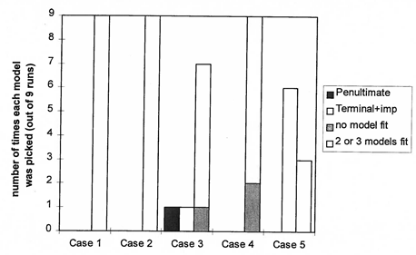
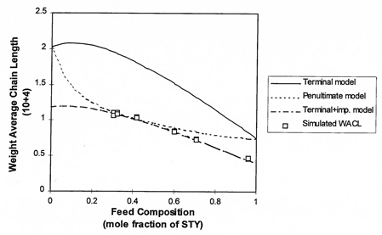
Impurity Effect Using Weight Average Chain Length (WACL) and Triad Fractions

Slide 19
Effect of Impurities – Overall Remarks
Polymerization data with impurity side reactions may be very misleading with regards to the real copolymerization mechanism.
Data from the terminal model with impurity side reactions (rxns) could be mistaken for the penultimate model when only the terminal and penultimate models are used for discrimination

Slide 20
Experimental Verification
Purpose: To verify the MD simulation results
Plan: Based on the simulation results pick:
-the most promising model discrimination method: BFF
-the most informative combination of the three measurements: Triad Fractions
-a well studied copolymerization system: STY/MMA

Slide 21
Experiments (several phases)
Multi-response D-optimal criterion to choose 4 optimal parameter estimation experiments:
8 parameter estimation experiments (2 independent replicates of the four optimal compositions)
C-NMR peak assignments (triad data) in good agreement with literature
Exp. No. | 1 | 2 | 3 | 4
Feed Composition | 0.8 | 0.5 | 0.4 | 0.2

Slide 22
95% joint confidence region for the terminal model parameters after 8 experiments
after 8 experiments Based on the data of Maxwell et al.(1993)

Slide 23
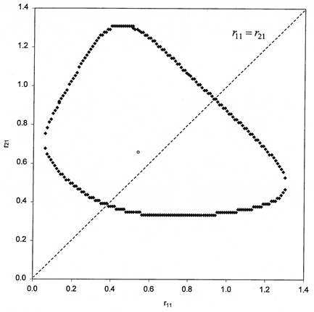
95% joint confidence region for model parameters after 9 experiments
For the Terminal Model For the Penultimate Model

Slide 24
Experiments: Overall Remarks
Reduction in joint confidence region area; better parameter precision
Terminal model lines (r₁₁ = r₂₁ and r₂₂ and r₁₂) pass through JCR slices; therefore, no improvement due to penultimate description
Estimation using the data of Maxwell et al. (1993) also yields large uncertainty in r₁₂. May indicate that it is difficult to precisely estimate all penultimate parameters
(Diagnostic tests indicated no significant improvement obtained by using penultimate model)

Slide 25
More Recent Methods in MD
Sequential Bayesian Monte Carlo model discrimination approach (SBMCMD)
SBMCMD can discriminate between rival models in copolymerization in fewer experiments compared to other methods
Confirmed that copolymer composition data do not provide enough insight for discrimination between terminal and penultimate models

Slide 26
Concluding Remarks
MD methods do improve our ability to choose between competing models and better quality models, in general, are obtained
Select measured variables carefully: Multiple responses may provide greater insight; using certain responses may pose a more difficult estimation problem
Applications everywhere in Science/Engineering, as long as rival mechanisms exist!
- Polymerization, Pharmacokinetics, Reservoir Eng., Chemical Rxn Eng., Catalysis, …

Slide 27
Thank you for your attention!

Slide 29
General Bibliography
Box, G. E. P., Hill W. J., Technometrics, 1967, 9, 57
Burke A. L., Duever T. A., and Penlidis A., Ind. Eng. Chem. Res. 1997, 36, 1016
Burke A. L., Duever T. A, and Penlidis A., J. of Polym. Sci., 1996, 34, 2665
Buzzi-Ferraris G., and Forzatti P., Chem. Eng. Sci., 1984, 39, 81
Buzzi-Ferraris G., and Forzatti P., Chem. Eng. Sci. 1983, 38, 225
Hill D. J. T., O’Donnell J. H., O’Sullivan, P. W., Macromolecules, 1982, 15, 960
Hsiang T., and Reilly P. M., Can. J. Chem. Eng., 1971, 49, 865
Landry R., Penlidis A., and Duever T. A., J. of Polym. Sci., 2000, 38, 2319
Maxwell, I. A., Aerdts A. M., and German A. L., Macromolecules, 1993, 26, 1956
Reilly, P. M., Can. J. Chem. Eng. 1970, 48, 168
Massoumi S., Duever T. A., Macromol. Theory Simul., 2016, 25, 435

Slide 30
Simulation results - Composition Data

Slide 31
Application of BFF method using Composition Data
Simulation Model | Model chosen as “best” at 95% confidence (Number of simulation runs) Terminal Penultimate Neither
Application to STY/MMA
Terminal Strong penultimate Small penultimate | 4 1 1 | 1 7 5 | 4 1 3
Application to STY/AN
Terminal Strong penultimate Small penultimate | 2 0 1 | 2 9 6 | 5 0 2
Application to STY/BA
Terminal Strong penultimate Small penultimate | 1 2 1 | 1 6 5 | 7 1 3

Slide 32
Simulation results - Copolymer Composition Data
Use of statistical model discrimination methods can reduce the number of experiments required
Using BFF method enabled the detection of much smaller penultimate effects than previously found
Composition data provide more information than thought possible

Slide 33
Application of BFF method to Copolymer Composition and Chain-Length data
Simulation Model | Model chosen as “best” at 95% confidence (Number of simulation runs) Terminal Penultimate Neither
Application to STY/MMA
Implicit penultimate Strong explicit penultimate Small explicit penultimate Terminal | 0 0 0 9 | 9 9 9 0 | 0 0 0 0
Application to STY/AN
Implicit penultimate Strong explicit penultimate Small explicit penultimate Terminal | 0 0 2 9 | 9 9 7 0 | 0 0 0 0
Application to STY/BA
Implicit penultimate Strong explicit penultimate Small explicit penultimate Terminal | 0 0 0 7 | 9 9 9 0 | 0 0 0 2

Slide 34
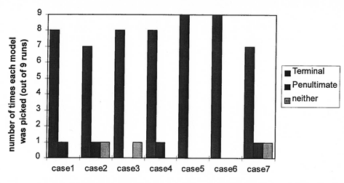
Impurity Effects on Model Discrimination with Triad Fractions

Slide 35
Application of Sequential Bayesian Monte Carlo Approach on Model Discrimination
Simulation Model | Model chosen as “best” at 95% confidence (Number of simulation runs) Terminal Penultimate Neither
Application to STY/MMA
Terminal Strong penultimate Small penultimate | 9 0 1 | 0 9 8 | 0 0 0
Application to STY/AN
Terminal Strong penultimate Small penultimate | 9 0 1 | 0 9 8 | 0 0 0
Application to STY/BA
Terminal Strong penultimate Small penultimate | 9 1 4 | 0 8 5 | 0 0 0

Slide 36
D-optimal Criterion
Draper and Hunter (1966):
φ = max |Θ|
Θ⁻¹ = ($\sum_{i=1}^{p}{ }\sum_{j=1}^{p}{ }$σ^{ij}J’_{i}J_{j})⁻¹
An estimate of is required to calculate Θ-1
It produces four optimal experiments, however at least 8 degrees of freedom are needed to estimate the four penultimate reactivity ratios and the 4*4 covariance matrix .
Four experiments are simulated twice to 2 mole % conversion.

Slide 37
Experiments: Phase II
BFF model discrimination criterion picks f_{1,0} = 0.84 (however, final decision criterion is not satisfied)
Need for additional parameter estimation experiment at f_{1,0} = 0.56 (G-optimality)

Slide 38
G-optimal Criterion
Seeks to minimize the maximum entry in the diagonal of the hat matrix: X(X'X)⁻¹X'
This has the effect of minimizing the maximum variance of the predicted values

