Slide 1
Long Range Polymer Chain Dynamics of Structured and Unstructured Polypeptides Probed by Pyrene Excimer Fluorescence
Remi Casier
Jean Duhamel
Department of Chemistry
May, 2018

Slide 2
Background Information
Polypeptide Structure
Biological Functions
Polypeptide Folding

Slide 3
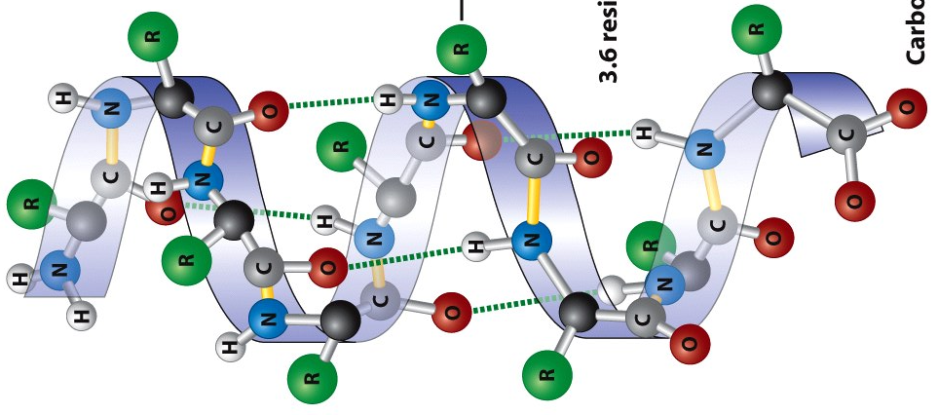
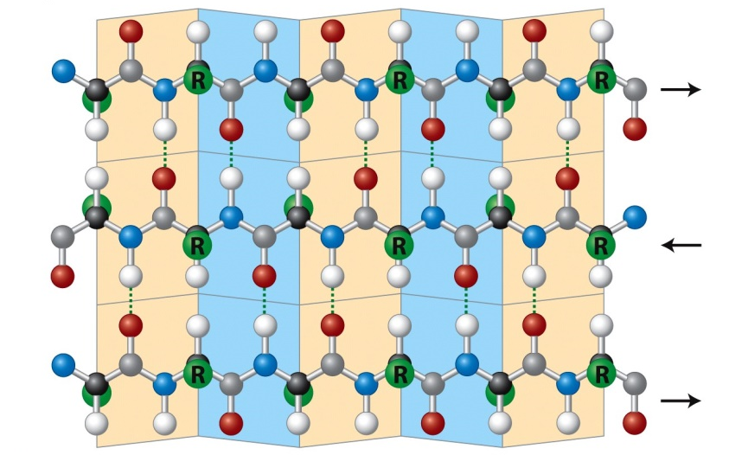
Polypeptide Structure
Primary: Sequence of amino acids.
Secondary: Regularly repeating local structures.
Tertiary: 3D arrangement of secondary structures.
Quaternary: Higher order structure containing several folded peptide chains.
Amino Acid
Residue
Peptide
Bond
α-helix
β-sheet
Secondary structures taken from: Molecular Cell Biology, 6th Ed., 2008, W. H. Freeman and company.

Slide 4
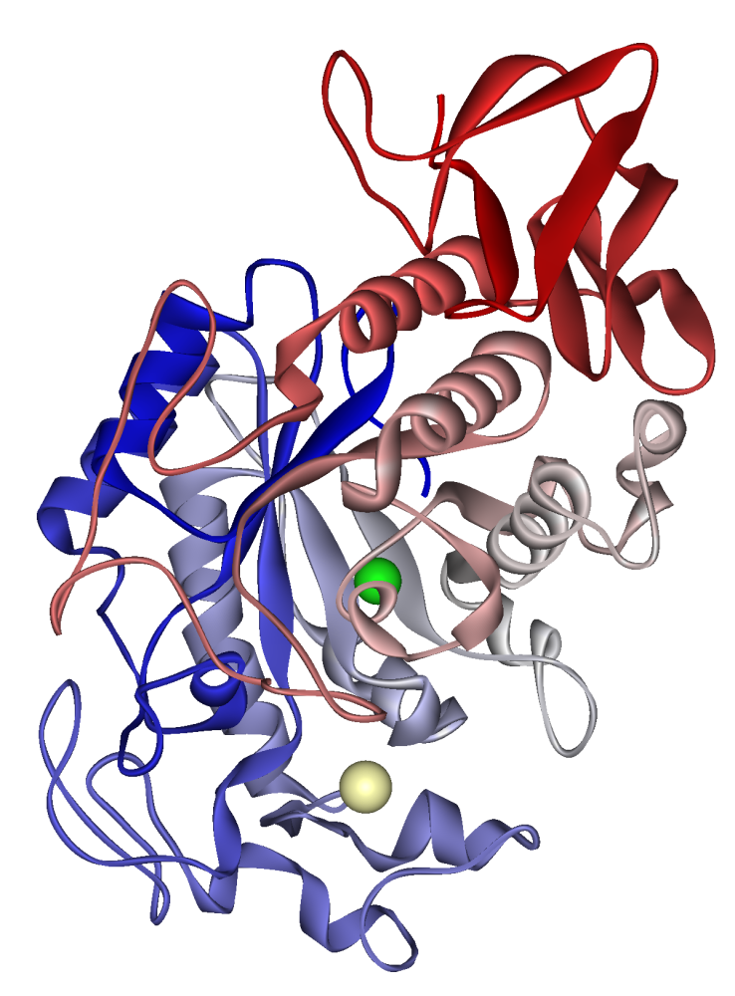
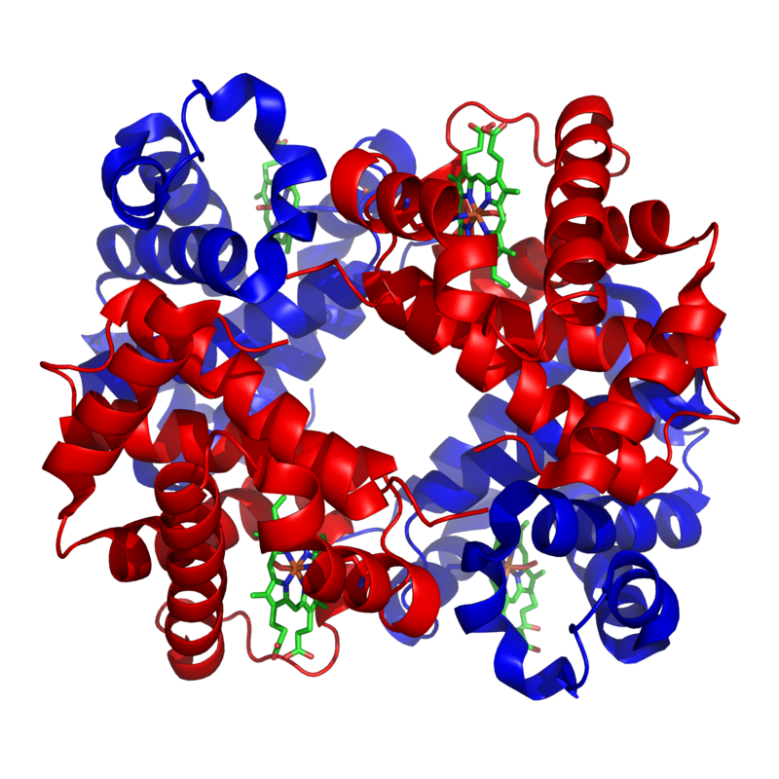
Polypeptide Functions
Carry out the information encoded in genes.
Enzymes
Catalyse chemical reactions within living organisms
Cell Signaling / Ligand Binding
Receptors which bind signaling molecules
Antibodies used to detect foreign bodies
Ligand transports used to shuttle small molecules (ex. hemoglobin)
Transmembrane proteins used to transport ligands through a cell membrane
Structural
Adds structural rigidity to biological components (eg. connective tissue)
Alpha-Amylase
Hemoglobin

Slide 5
Polypeptide Folding
Random Coil
“The protein folding problem has long been regarded as a fundamental mystery blocking our understanding of how the genetic information locked in DNA is transformed into a dynamic living organism”¹
Multiple Route
Energy Funnel
1972 Nobel Prize in Chemistry:
work on Ribonuclease A
Anfinsen, C. B.
Protein structure is determined by amino acid sequence
2013 Nobel Prize in Chemistry:
Development of Multiscale Models for Complex Chemical Systems
Karplus, M; Levitt, M.; Warshel, A.
Development of computational models used to simulate protein folding
Energy
Conformational Landscape
Native
Conformation
1. P. G. Wolynes; Schuler, B. Gordon Research Conferences 2016

Slide 6
The Time-Scale of Folding
Levinthal’s Paradox¹
Polypeptide with 100 residues (L = 100)
Each residue can adopt 3 conformations (N = 3)
Each conformation takes 1 ps to probe (τ = 10⁻¹² s)
How long would folding take?
Sequential Conformational Search:
t = N^{L}·τ = 3¹⁰⁰·1 ps ≈ 1.6 × 10²⁸ years
Foldon Conformational Search:
Polypeptide chain is thought of as a sequence of ‘groups’ of amino acids referred to as Foldons (N_{fold} ~ 20)²
t= (L/N_{fold})∙N^{Nfold}·τ = (100/20)×3²⁰×1 ps = 17 ms
Observed folding times:³ t = 10⁻¹ to 10³ s (ms to minutes)
1
2
3
…
4
5
Foldons
1. Levinthal, C. How to Fold Graciously. Mossbauer Spectroscopy in Biological Systems. Proceedings University of Illinois Bulletin, University of Illinois Press, Urbana, IL 1969, pp 22 – 24.
2. Englander, S. W.; Mayne, L. The Nature of Protein Folding Pathways, PNAS, 2014, 111, 15873 – 15880.
3. Branden, C; Tooze, J. Introduction to Protein Structure, Garland Publishing 1999.

Slide 7
Pyrene Excimer Fluorescence
Steady-State and Time-Resolved Fluorescence
Fluorescence Blob Model

Slide 8
Pyrene Excimer Fluorescence
I_{M}
I_{E}/I_{M} ratio is influenced by many factors.
k
Aggregated Pyrene
Unbound Pyrene
Monomer
Excimer
I_{E}
λ_{em} = 375 nm
λ_{em} = 510 nm

Slide 9
Fluorescence Blob Model (FBM)
blobs
Distinct Pyrene Species:
Forms excimer by diffusion
Undergoes rapid rearrangement to form excimer
Cannot form excimer during its lifetime (τ_{M})
Excimer formed by direct excitation of pyrene aggregates
Notes:
Blob Size:

Slide 10
Fluorescence Blob Model (FBM) of Polypeptides
Protein Foldons
Polypeptide blobs
Foldons
blobs
Folding
Blob Dynamics
How large are Foldons?
How quickly do Foldons fold?
Notes:
Blob Size:

Slide 11
Blob Dynamics by Time-Resolved Fluorescence
blob
N_{blob}
Py
k_{blob}
Py*
(PyPy)*
Number of residues encompassed within a blob
Rate constant of excimer formation within a blob
Monomer
Excimer

Slide 12
Model Polypeptides
Choice of Polypeptide
Polypeptide Structure

Slide 13
Model Polypeptides
Random Coil
Probe the first step of folding
Backbone dynamics
N_{blob} of a coil
Folded Structure
Probe the final folded state
Sidechain dynamics
N_{blob} of a folded polypeptide
Backbone Motion

Slide 14
Py-Poly(Glutamic Acid) (Py-PGA)
Py-Poly(L-Glutamic Acid) (Py-PLGA)
DMF
α-Helix
1-x
x
DMSO
Partial Helix
Py-Poly(D,L-Glutamic Acid) (Py-PDLGA)
DMF or DMSO
1-x
x
Random Coil

Slide 15
Conformation of PGA in Solution
Circular dichroism (CD) of the ¹B_{b} band of pyrene:
Molar Ellipticity:
$$[θ]∝A_{Left Circularly Polarized}−A_{Right Circularly Polarized}$$
PLGA DMF
Probes the final step of folding
Ideal for studying side chain dynamics
PLGA DMF
PLGA DMSO
PLGA DMSO
Probes an intermediate step of folding
PDLGA DMF/DMSO
PDLGA DMF/DMSO
Probes the first step of folding
Ideal for studying backbone dynamics

Slide 16
Results and Discussion
Steady-State Fluorescence
Blob Size
Blob Dynamics

Slide 17
α-Helical Poly(L-Glutamic Acid) Steady-State Fluorescence in DMF
Py[x]-PLGA (120 kDa)
x =
Monomer
14.3
Excimer
9.0
6.9
4.9
4.4
2.9

Slide 18
Steady-State Fluorescence: Helix vs. Coil
PLGA
DMSO
DMF
PDLGA
DMF
DMSO
The compact helical backbone promotes excimer formation

Slide 19
Time-Resolved Fluorescence: FBM
blob
N_{blob}
Py
k_{blob}
Py*
(PyPy)*
Number of residues encompassed within a blob
Rate constant of excimer formation within a blob
Monomer
Excimer

Slide 20
Size of a Folding Unit (N_{blob})
PLGA
PDLGA
DMF <N_{blob}> = 21 ± 1
DMSO
DMF
DMSO <N_{blob}> = 18 ± 1
<N_{blob}> = 10 ± 1
N_{blob} increases as the conformation of a PGA chain changes from a random coil to an α-helix, matching the previously reported Foldon size of ca. 20 for a partially denatured protein by hydrogen exchange experiments.¹
1) Englander, S. W.; Mayne, L. (2014) Proc. Natl. Acad. Sci. 111, 15873-15880.

Slide 21
Molecular Mechanics Optimizations
Number of residues PEF can occur between was found using HyperChem¹⁻³
Reference Residue
α-helix
…
N_{blob, MMO} = 23
N_{blob, exp} = 21 ± 1
Helix
11·2+1=23
Good Overlap
Poor Overlap
Coil
5·2+1=11
Coil
N_{blob, MMO} = 10 ± 1
N_{blob, exp} = 10 ± 1
Ingratta, M.; Duhamel, J. Effect of Side-Chain Length on the Side-Chain Dynamics of α-Helical Poly(L-Glutamic Acid) as Probed by a Fluorescence Blob Model. J. Phys. Chem. B 2008, 112, 9209−9218.
Duahmel, J.; Kanagalingam, S.; O’Brian, T. J.; Ingratta, M. W. Side-Chain Dynamics of an α-Helical Polypeptide Monitored by Fluorescence. J. Am. Chem. Soc. 2003, 125, 12810–12822.
Li, L.; Duhamel, J. Conformation of Pyrene-Labeled Amylose in DMSO Characterized with the Fluorescence Blob Model. Macromolecules 2016, 49, 7965−7974.

Slide 22
Dynamics of Folded and Unfolded PGA (k_{blob})
PLGA
PDLGA
DMF
DMF
DMSO
DMSO
Rigid helix ‘locked’ on the time-scale of PEF
Probes side chain dynamics
Coil free to move on the time-scale of PEF
Probes backbone dynamics
*
*
Py
k_{blob}
k_{blob}
(PyPy)*
Py*

Slide 23
Conformational Search Time (τ_{p})
How long does it take for each GA residue to probe a given conformation?
# of conformations within a blob = N^{Nblob} = 3^{Nblob}
Encounter time within a blob = k_{blob}⁻¹ = 3^{Nblob}·τ_{p}
For the coiled Py-PGA:
k_{blob} (PDLGA, coil) = 0.014 ± 0.002 ns⁻¹
N_{blob} = 10 ± 1
Encounter time within a blob = 70 ± 8 ns
τ_{p} = (k_{blob}·3^{Nblob})⁻¹ = 10^{−12.0 ± 0.7} s ≈ 1 ps
Matches the 1 ps prediction from Levinthal’s paradox!
blob
Py
70 ns
Py*
τ_{p}⁻¹

Slide 24
Summary
Py-PDLGA in DMF/DMSO
Py-PLGA in DMSO
Py-PLGA in DMF
N_{blob} = 10 ± 1
N_{blob} = 18 ± 1
N_{blob} = 21 ± 1
k_{blob} = 0.014 ± 0.002 ns⁻¹
Blob size was found to increase from 10 to 21 as folding occurred
Matched the Foldon size of ca. 20 found by HX in literature
Suggests the Foldon size may be limited by the backbone dynamics of a protein
k_{blob} of the coiled PGA was found to match predicted dynamics of folding
PEF provides a means in which to characterize the Foldon size and dynamics along the entire folding pathway
Casier, R.; Duhamel, J. Pyrene Excimer Fluorescence as a Direct and Easy Experimental Means to Characterize the Length Scale and Internal Dynamics of Polypeptide Foldons. Macromolecules 2018, 51, 3450–3457.

Slide 25
Thank You!
Questions?

Slide 28
Why is k_{blob} so Similar in DMF and DMSO?
DMF: η = 0.80 cP
DMSO: η = 1.99 cP
Based on viscosity, k_{blob} in DMF is expected to be about twice larger than in DMSO
DMSO
A previous study¹ has shown that PEF is about twice as efficient in DMSO than in DMF
DMF
Hall, T. MSc Thesis: Study of Arborescent Poly(l-Glutamic Acid) by Pyrene Excimer Formation, 2012, University of Waterloo, Waterloo, ON, pp 40–41.

Slide 29
Alpha-Amylase
Cl⁻
Ca²⁺
Catalyse hydrolysis of polysaccharides to glucose and maltose

Slide 30
Some Useful Equations
Volume of a polymer coil:
v = 0.5 θ-solvent
v = 0.6 good-solvent
k_{blob} is independent of viscosity
f_{q} - quenching efficiency , k₀ (diffusion limited) ~10¹⁰ M⁻¹s⁻¹
PMA (60 ± 3) ³
PEGMA (55 ± 5)²
CoBu-PS (43 ± 3)¹
PC4MA (41 ± 7)²
CoA-PS (39 ± 2)¹
PLGA (21 ± 2)
PDLGA (10 ± 1)

