Slide 1
Effect of Solution Temperature on the Properties of Mimics of Pour Point Depressants in Oil
Kiarash Gholami
Department of Chemistry
University of Waterloo
40th IPR Symposium 2018

Slide 2
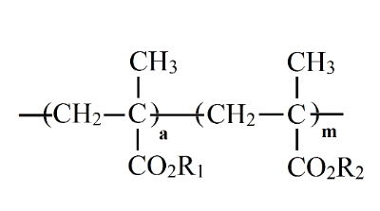
Problem: At low temperatures, the wax tends to separate and form a network of microcrystals in base oil, inhibiting oil flow and hindering lubrication.
Solution: PPDs can effectively reduce the temperature at which wax forms a network in oil while taking advantage of the presence of wax to obtain higher oil viscosity at higher temperatures.
PP
PP
Chemical structure of poly(alkyl methacrylate)s used as PPDs and constituted of two alkyl methacrylate monomers with side chains R₁ and R₂.
2

Slide 3
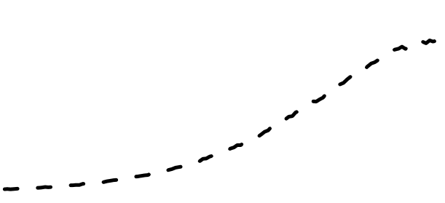

1.0
I_{M}
f_{inter} = $\frac{{CPy }_{\left(inter\& intra\right) − }{CPy }_{\left(intra\right) }}{{CPy }_{(inter\& intra)}}$
$$=\frac{{(\frac{I_{E}}{I_{M}})}_{(inter \& intra)}{−(\frac{I_{E}}{I_{M}})}_{(intra)}}{{(\frac{I_{E}}{I_{M}})}_{(inter \& intra)}}$$
0.8
0.6
Intensity (a.u.)
I_{E}
0.4
0.2
Excimer
Monomer
0.0
350
400
450
500
550
600
wavelength (nm)
Interpolymeric Interactions for the 2g/L and 0.01 g/L solutions of Py(6.7)-PC12/18MA in Oil
Py-PC18MA
Py(6.7)-PC18MA (2g/L)
Py(6.7)-PC18MA (0.01g/L)
+ PC18MA (2g/L)
Py(6.7)-PC18MA (2g/L)
I_{E}/I_{M}
Fluo. Int. (a.u.)
Fluo. Int. (a.u.)
f_{inter}
−30 to +10 ºC
−30 to +25 ºC
+15 to +25 ºC
Temperature (°C)
Temperature (°C)
Wavelength (nm)
Wavelength (nm)
3

Slide 4
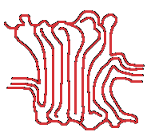
Comparison of the f_{inter} Plots of Py(6.7)-PC₁₈MA Before and After the Addition of EP Copolymers in Oil
Crystallization of EP(SM2)
EP(AM)
Py-PC₁₈MA
Crystallization of Py(6.7)-PC₁₈MA
EP(AM)
or
EP(SM2)
Py-PC₁₈MA
f_{inter}
EP(SM2)
Py-PC₁₈MA
Temperature (°C)
Plots of the molar fraction f_{inter} as a function of temperature for 2 g.L⁻¹ Py-PC₁₈MA solutions in oil:
(●) without EP copolymer (■) with 10 g.L⁻¹ EP(AM) (∆) with 10 g.L⁻¹ EP(SM2)
4

Slide 5
Conclusions
This study:
Probed the intermolecular interactions between wax and VII and PPD mimics in the presence of each other in engine oil.
Demonstrated that wax and PPD mimics interact with VIIs in engine oi. This effect was minimized at low temperatures where wax and the semicrystalline EP copolymer (VII) started to crystallize.
Further confirmed that the plots of f_{inter}-versus-T obtained from fluorescence measurements can be confidently used to measure the level of intermolecular interactions between different additives other than EP copolymers found in motor oil.
Acknowledgements
My Supervisor: Dr. Duhamel
Dr. Duhamel’s Research Group
Dr. Sheng Jiang and Dr. Solmaz Pirouz
5

