Slide 1
Probing the Effect of Low Molecular Weight Polymer Diluent on Latex Film Formation by Pyrene Excimer Fluorescence (PEF)
Zehou You
Supervisor: Prof. Jean Duhamel
May 9, 2018

Slide 2
Film Formation and Oligomer Incorporation
fraction of mixing f_{m}
Improving fraction of mixing
Traditional plasticizers are VOCs that will affect the human body and material quality after evaporation.
Incorporating Oligomer chains into polymer particles can facilitate film formation.^{1,2}
Two different techniques to probe film formation
Fluorescence resonance energy transfer (FRET)
Pyrene excimer fluorescence (PEF)
Soleimani, M.; Khan, S.; Mendenhall, D.; Lau, W.; Winnik, M.A. Polymer 2012, 53, 2652–2663.
Craun, G. P., Rosekelly, G. S., Floyd, F. L. Odor Free, Air Dry, Decorative Latex Paints. U.S. Patent 5,470,906, Nov 28, 1995.

Slide 3
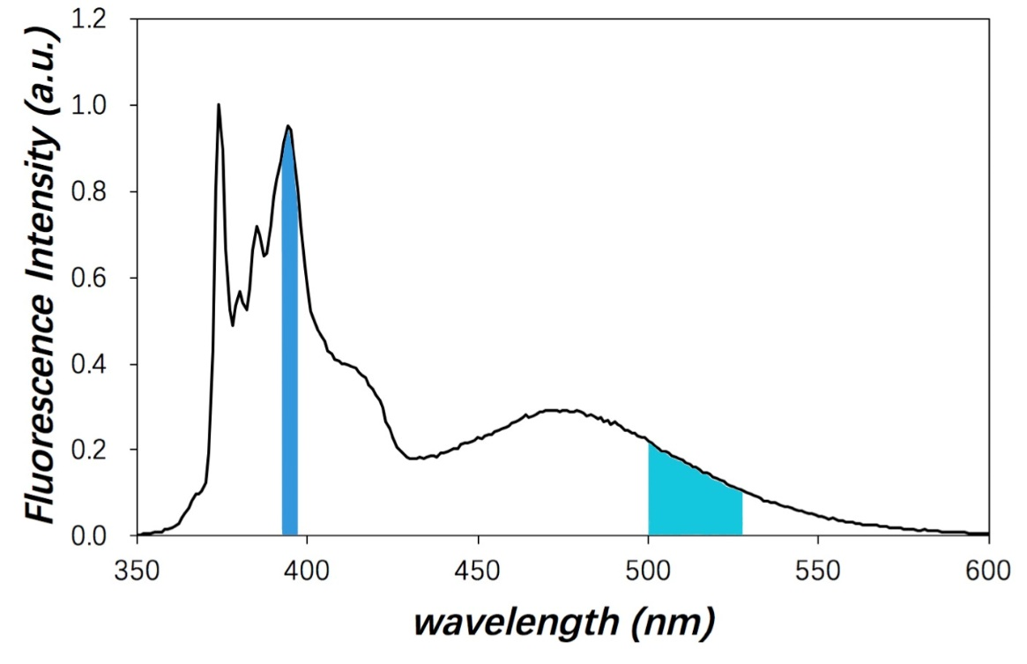
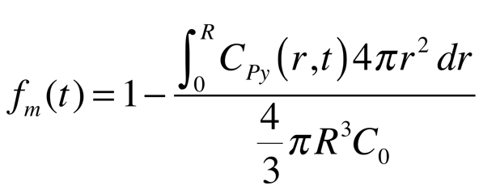
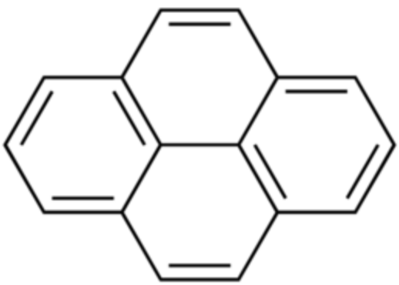
Pyrene Excimer Fluorescence (PEF¹)
hν
hν
Py Py Py* Py (PyPy)* (PyPy)
Py
Py
Py
Py
Py
I_{E}
Py
Py
I_{M}
Py
Py
Py
Py: pyrene
Casier, R.; Gauthier, M.; Duhamel, J. Macromolecules 2017, 50, 1635-1644.

Slide 4
Steady-state Fluorescence and Fraction of Mixing
seed
seed-oligomer
117 °C
89 °C
106 °C
99 °C
79 °C
94 °C
89 °C
69 °C
85 °C
83 °C

Slide 5
Diffusion Coefficients
seed
(0 wt%)
106 °C
99 °C
seed-oligomer
(29.6wt%, 1.9kD)
94 °C
89 °C
85 °C
117 °C
83 °C
seed
(0 wt%)
seed-oligomer
(29.6wt%, 1.9kD)
89 °C
79 °C
69 °C

Slide 6
Conclusions
Pyrene-labeled latex particles were synthesized and latex films were prepared by combining 95 wt% non-labeled latex with 5 wt% pyrene labeled latex.
The non-labeled latex contained oligomers to enhance polymer diffusion in the latex films during annealing.
Polymer diffusion was monitored as a function of temperature. The presence of oligomer enhanced substantially polymer diffusion.
Future Work
More non-fluorescent labeled latex particles must be prepared with varied contents of oligomers and the impact that the oligomer content has on polymer diffusion in the latex films will be quantified.
Acknowledgements
Jean Duhamel
Remi Casier
Members of the Duhamel and Gauthier groups
NSERC for funding

