Slide 1
New Conjugated Building Block IBDP For Organic Solar Cell
Xiaocheng ZHOU, Yinghui HE
Printed Electronic Materials Lab, Department of Chemical Engineering
2018 IPR Symposium
MAY. 09.2018

Slide 2
Background for IBDP:
Chem. Commun., 2015, 51, 8093--8096

Slide 3
IBDP Core Synthesis Scheme:
24.5%
75%
28%
54%
Xiaocheng’s data (Previous PHD Student’s Data)
Yinghui He, et al., Chem. Commun., 2015, 51, 8093--8096

Slide 4
Synthesis of monomer
Optimized amount of solvent and catalyst
Yield：increased from 28% to 44%!
57%

Slide 5
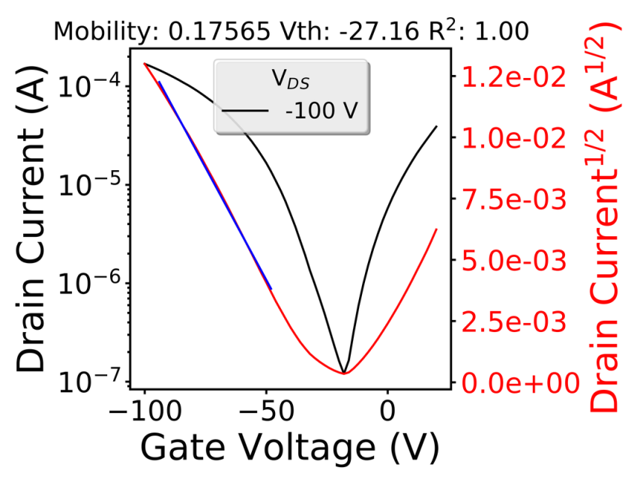
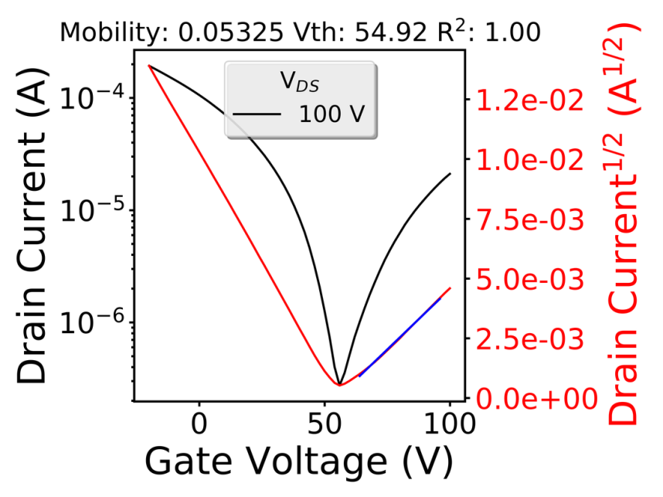
Charge transport properties
Au
Polymer
Au
DDTS Modified SiO₂
N++ doped Si
Polymer | Avg. µ_{e} (cm² V⁻¹ s⁻¹) | Max. µ_{e} (cm² V⁻¹ s⁻¹) | Avg. µ_{h} (cm² V⁻¹ s⁻¹) | Max. µ_{h} (cm² V⁻¹ s⁻¹)
PIBDPBT | 0.048 ± 0.006 | 0.053 | 0.14 ± 0.03 | 0.175
An ambipolar polymer
High electron and hole mobilities, which are sufficient as acceptor and donor for OPVs, respectively.

Slide 6
Properties of PIBDPBT
UV-vis-NIR: band gap
Cyclic voltammetry: HOMO and LUMO
Polymer | λ_{max}^{sol/film} (nm) | E_{g}^{opt} (eV) | HOMO/LUMO (eV)
PIBDPBT | 699/699 | 1.24 eV | -5.6/-3.7

Slide 7
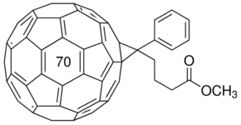
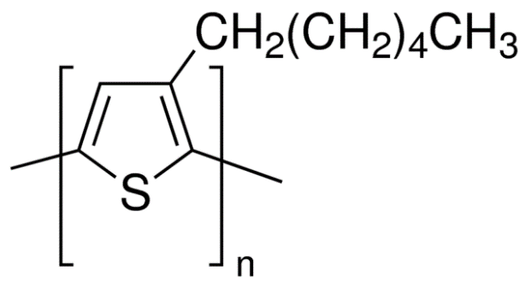
Preliminary OPV plans: Used as both donor and acceptor in OSCs
-3.2
-3.7
-3.7
-4.1
P3HT
PIBDPBT
E (eV)
E (eV)
PIBDPBT
PC₇₁BM
-5.1
-5.68
PC₇₁BM
-5.68
-5.9
Al
Al
LiF
Fully covered the range from 400 nm to 1000 nm!
LiF
P3HT:PIBDPBT
PC₇₁BM:PIBDPBT
PEDOT:PSS
PEDOT:PSS
ITO/glass
ITO/glass
HT-P3HT is a commercially available donor.

Slide 8
Future work
Synthesis optimization (New route)
Polymer optimization such as side chains and donor building blocks
Device fabrication

Slide 9



Acknowledgments
The project is supported by:
Members:
Yuning Li, Jenner H.L. Ngai, Arthur D Hendsbee, Han Meng,
Jiaxin Zhu, George Chang, Mozhgan Sadeghianlemraski

