Slide 1

Synthesis of pH-responsive Arborescent Amphiphilic Copolymers for Drug Delivery Applications
Basma Mahi
Supervised by Prof. Mario Gauthier

Slide 2
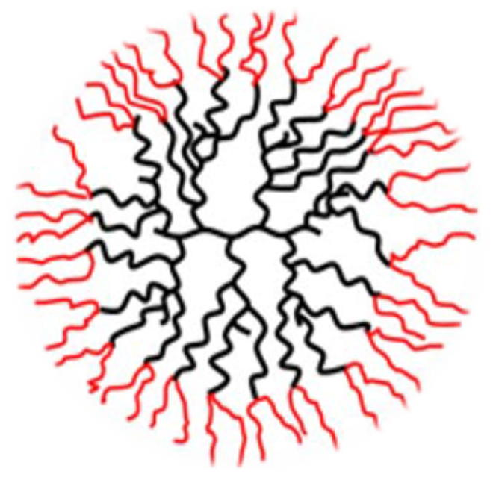
Unimolecular Micelles
Hydrophobic
Core
Hydrophilic
Corona

Slide 3
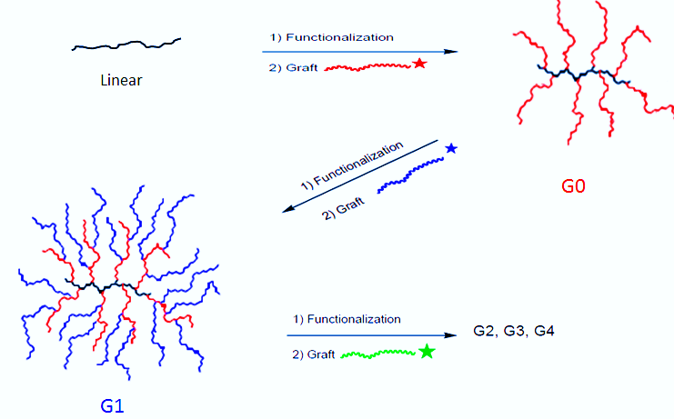
General Scheme for Arborescent Polymer
Synthesis – Poly(γ-benzyl L-glutamate) Core
Teertstra and Gauthier, Prog. Polym. Sci. 2004, 29, 277–327

Slide 4
Research Goal
PBG side chain optimization is necessary to improve the grafting yield
Solution…?
Lactam ring

Slide 5
Characteristics of Arborescent G0 Obtained with Side Chains Stored Under Different Conditions
Results
Time | Sample | Side Chains | Molar Ratio SC : CO₂H | Gy% | PDI
Freshly prepared | G0 G0#1 | Uncapped PDI=1.02 | 1:1.25 1:1.5 | 59 62 | 1.03 1.16
 | G0 G0#3 | Capped PDI=1.07 | 1:1.25 1:1.5 | 69 80 | 1.05 1.60
Stored @RT for 10 days | G0#2 | Uncapped PDI=1.02 | 1:1.5 | 41 | 1.09
 | G0#4 | Capped PDI=1.07 | 1:1.5 | 80 | 1.99
G0PBG obtained using uncapped side chains, without (blue) and with (red) storage
G0PBG obtained using capped side chains,
without (blue) and with (red) storage
Lower grafting yield expected for side chains stored @RT due to cyclization

Slide 6
Conclusions
Capping of the PBG chains with a different amino acid to increase the grafting yield appears to work
L-Lysine may not be the best choice for that purpose
Other amino acids are being investigated
Synthesis of arborescent micelles and targeted delivery will then be investigated

