Slide 1

Compression of Nano‐sized Amylopectin Fragments Probed by Pyrene Excimer Fluorescence (PEF) in DMSO
Damin Kim and Lu Li
Prof. Jean Duhamel
May 9th, 2018

Slide 2
Outline
Background
- Amylopectin
- Cluster Model
- Pyrene Fluorescence
- Solution Cluster Model (SCM)
Results and Discussion
Conclusions
Future work
Acknowledgements

Slide 3
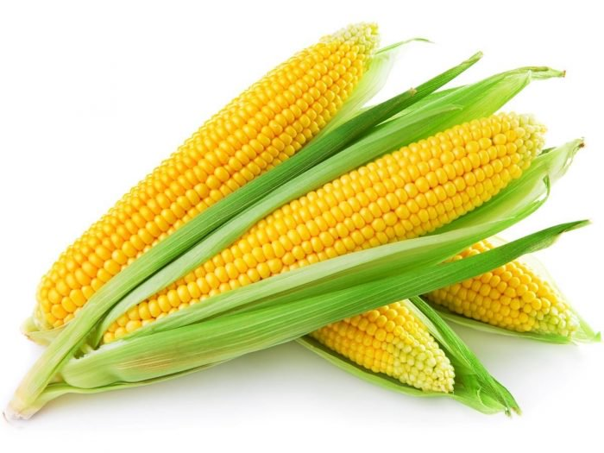
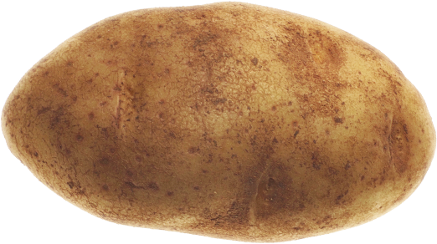
Background: Amylopectin
α−1,6 glycosidic bond
Properties
Biodegradable
Biocompatible
Non toxic
Economically and environmentally friendly
α−1,4 glycosidic bond

Slide 4
Background: Cluster Model
Structural cluster-type models
French
1972
Robin et al.
1974
Manners and Matheson
1981
10 Å
Density of Dry Amylopectin
= 1.5 g/mL
Notes:
- Cluster model was introduced around 1970
Amylopectin consist of crystalline and amorphous region
Cluster is the a group of branched chain separated by a linear segments.
- Density of dry amylopectin 1.5 g/mL

Slide 5
Background: Pyrene Excimer Fluorescence (PEF)
*
*
+
τ_{M}
Large molar extinction coefficient and quantum yield.
Formation of Excimer.
Excimer formation is dependent on
the local concentration and
diffusion coefficient of pyrene.
τ_{E}
I_{E}
I_{M}
I_{E}/I_{M} α k_{diff} [Py]_{local}

Slide 6
Background: Pyrene Fluorescence
Quenching of Pyrene
Lifetime of pyrene
The efficiency of quenching can be described with the bimolecular quenching rate constant, k_{q}
- Sensitive to the local environment
  lifetime
where R_{F} and R_{Q} are the radii of the fluorophore and quencher and D_{Q} is the diffusion coefficient of a quencher. p is the probability of quenching.

Slide 7
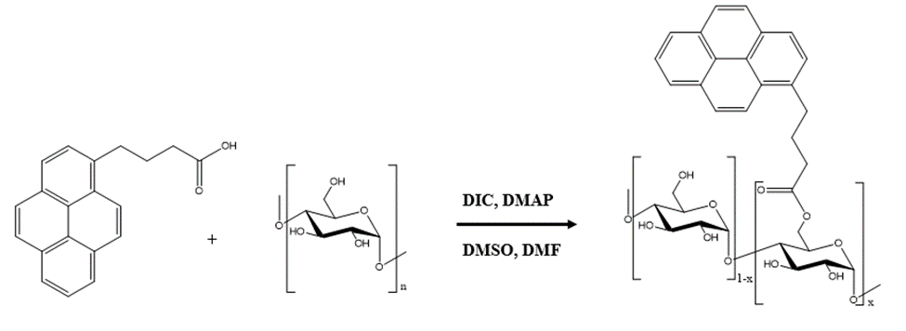
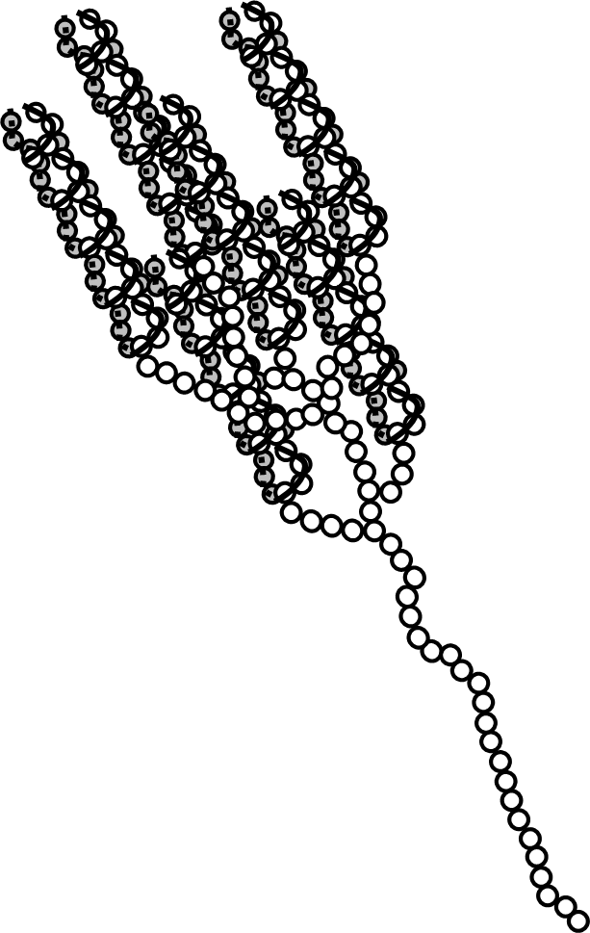
Background: Pyrene Excimer Fluorescence (PEF)
*
*
+
τ_{M}
τ_{E}
I_{E}
I_{M}
Pyrene

Slide 8

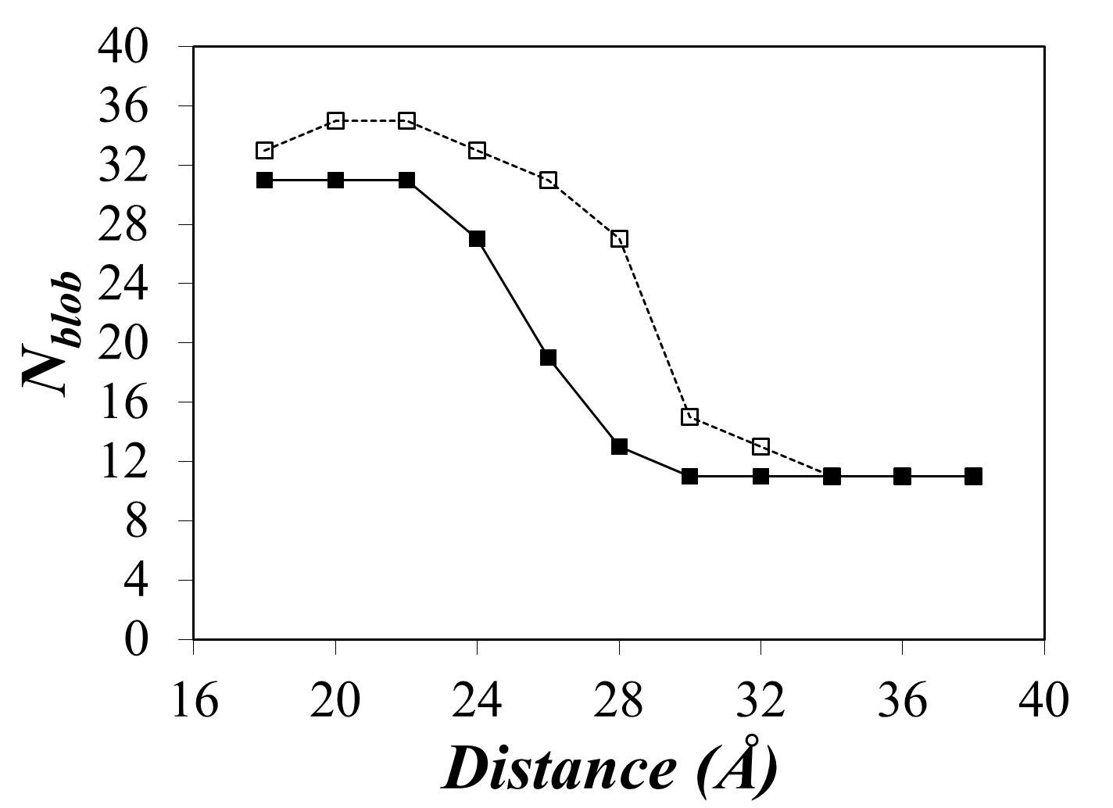
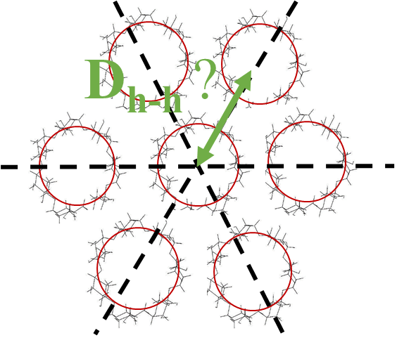
Solution Cluster Model
What is the distance between helices in solution?
10 Å
Single Helix
Single Helix
D_{h-h} > 34 Å
# Anhydroglucose Units Pyrene can see
Cluster Model
# Anhydroglucose Units Pyrene can see
Double Helix
Double Helix
Effective Distance
16 < D_{h-h} < 34 Å
Solution Cluster Model
D_{h-h} ~ 27.5 Å
In dilute system
Notes:
Based on hyperchem simulation and fluorescence measurement, the distance between two helices are about 27 .5 angstrom

Slide 9
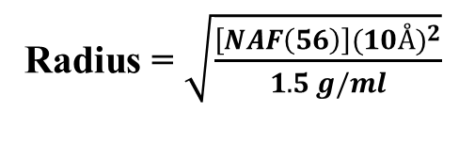
Solution Cluster Model
What is the distance between helices in solution?
10 Å
Density= 1.5 g/ml
Radius = 10Å
Single Helix
# Anhydroglucose Units Pyrene can see
Cluster Model
Density= [NAF (56)], g/mL
Double Helix
Radius = $\sqrt{\frac{\left[NAF\left(56\right)\right](10{Å)}^{2}}{1.5 g/ml}}$
Solution Cluster Model
Notes:
Based on hyperchem simulation and fluorescence measurement, the distance between two helices are about 27 .5 angstrom

Slide 10
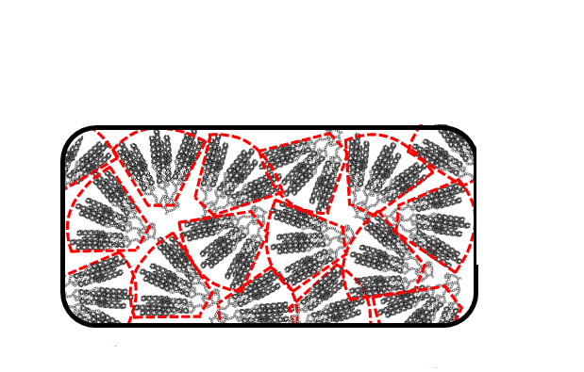
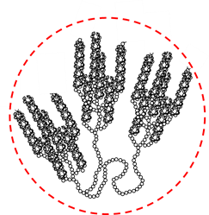
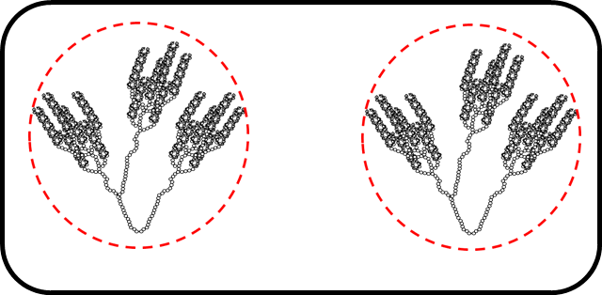
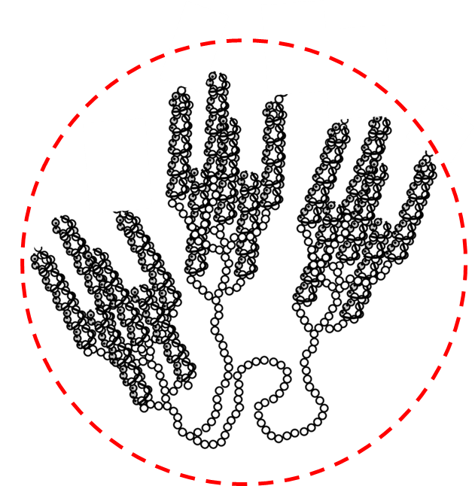
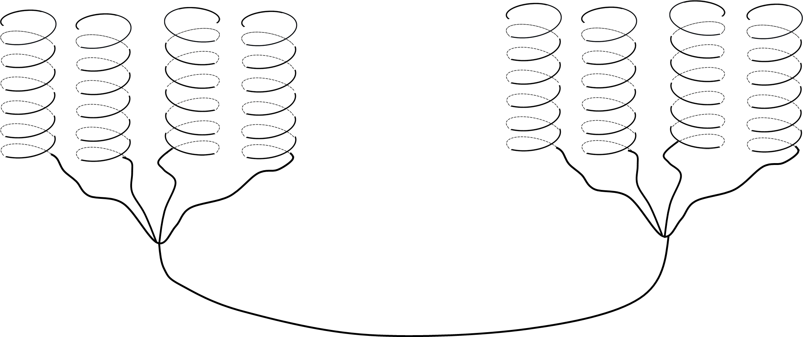
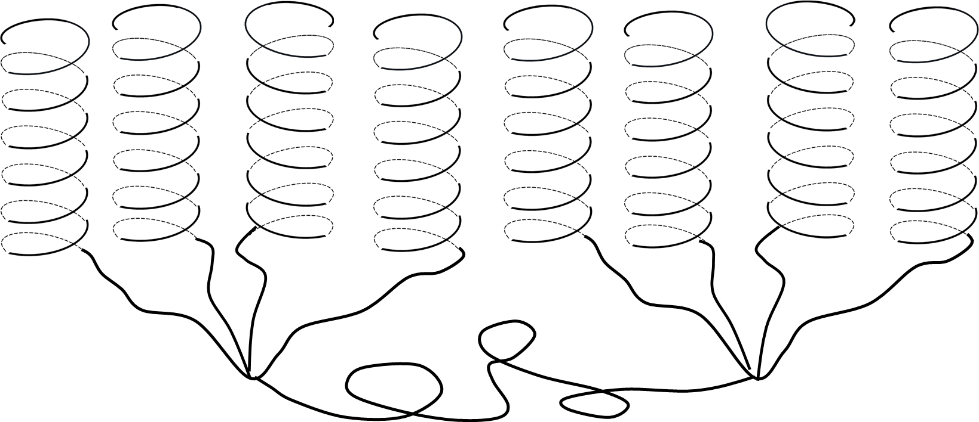
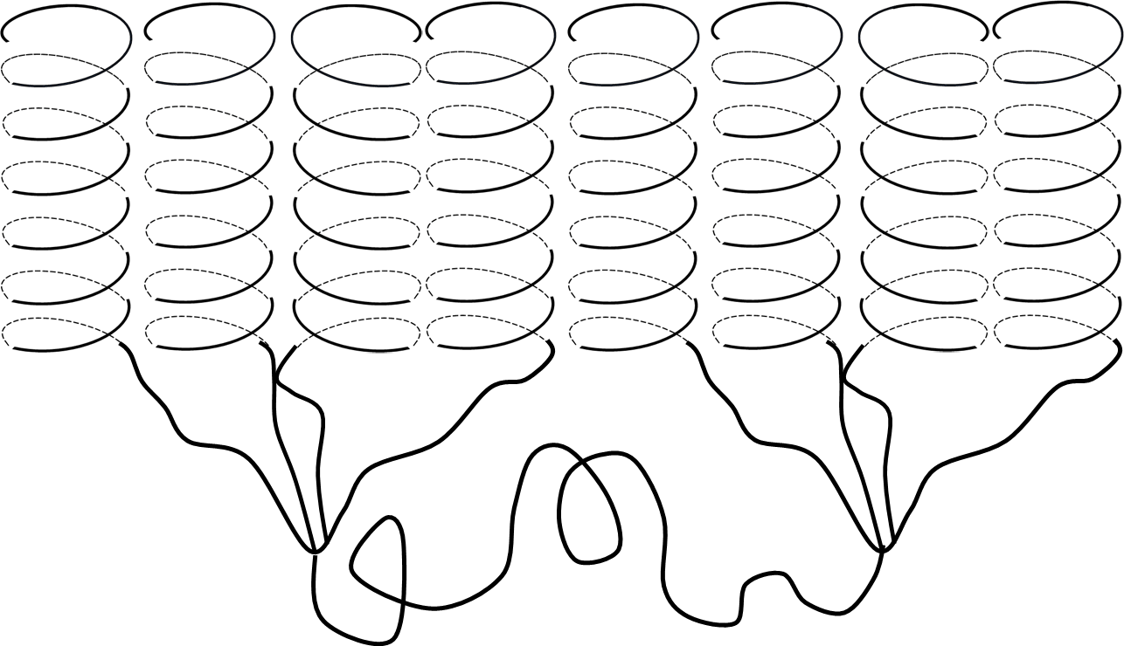
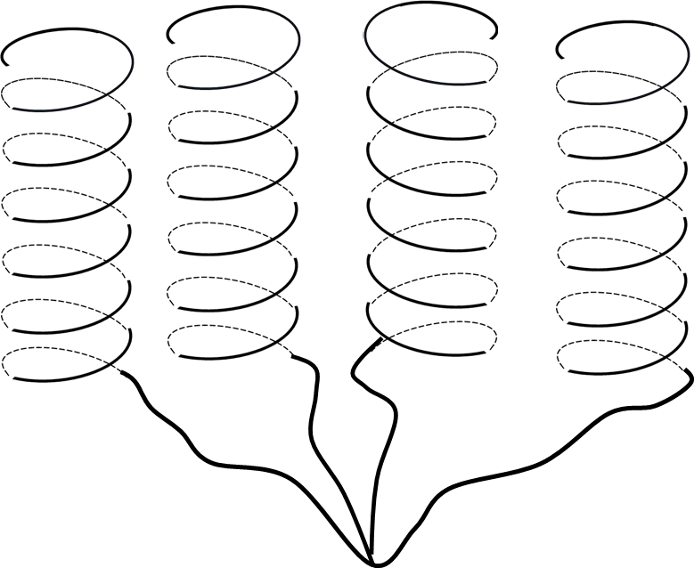
Semi Dilute regime (C*< C)
Background: Osmotic Pressure
C**< C
Dilute regime ( C < C*)
Semi-Dilute regime ( C < C*)
Concentrated Regime(C**< C)
Dense Regime
(C***< C)
27.5Å
>> 34Å
27.5Å
~34Å
>> 27.5Å
C*** < C
C < C*
27.5Å
< 34Å
C**:Concentration where d_{c-c} is closer than 34 Å and excimer can be formed b/w two clusters
C***: Concentration where d_{c-c} and d_{h-h} much shorter than 27.5 Å. The short distance restricts the mobility of pyrene
C = C *

Slide 11
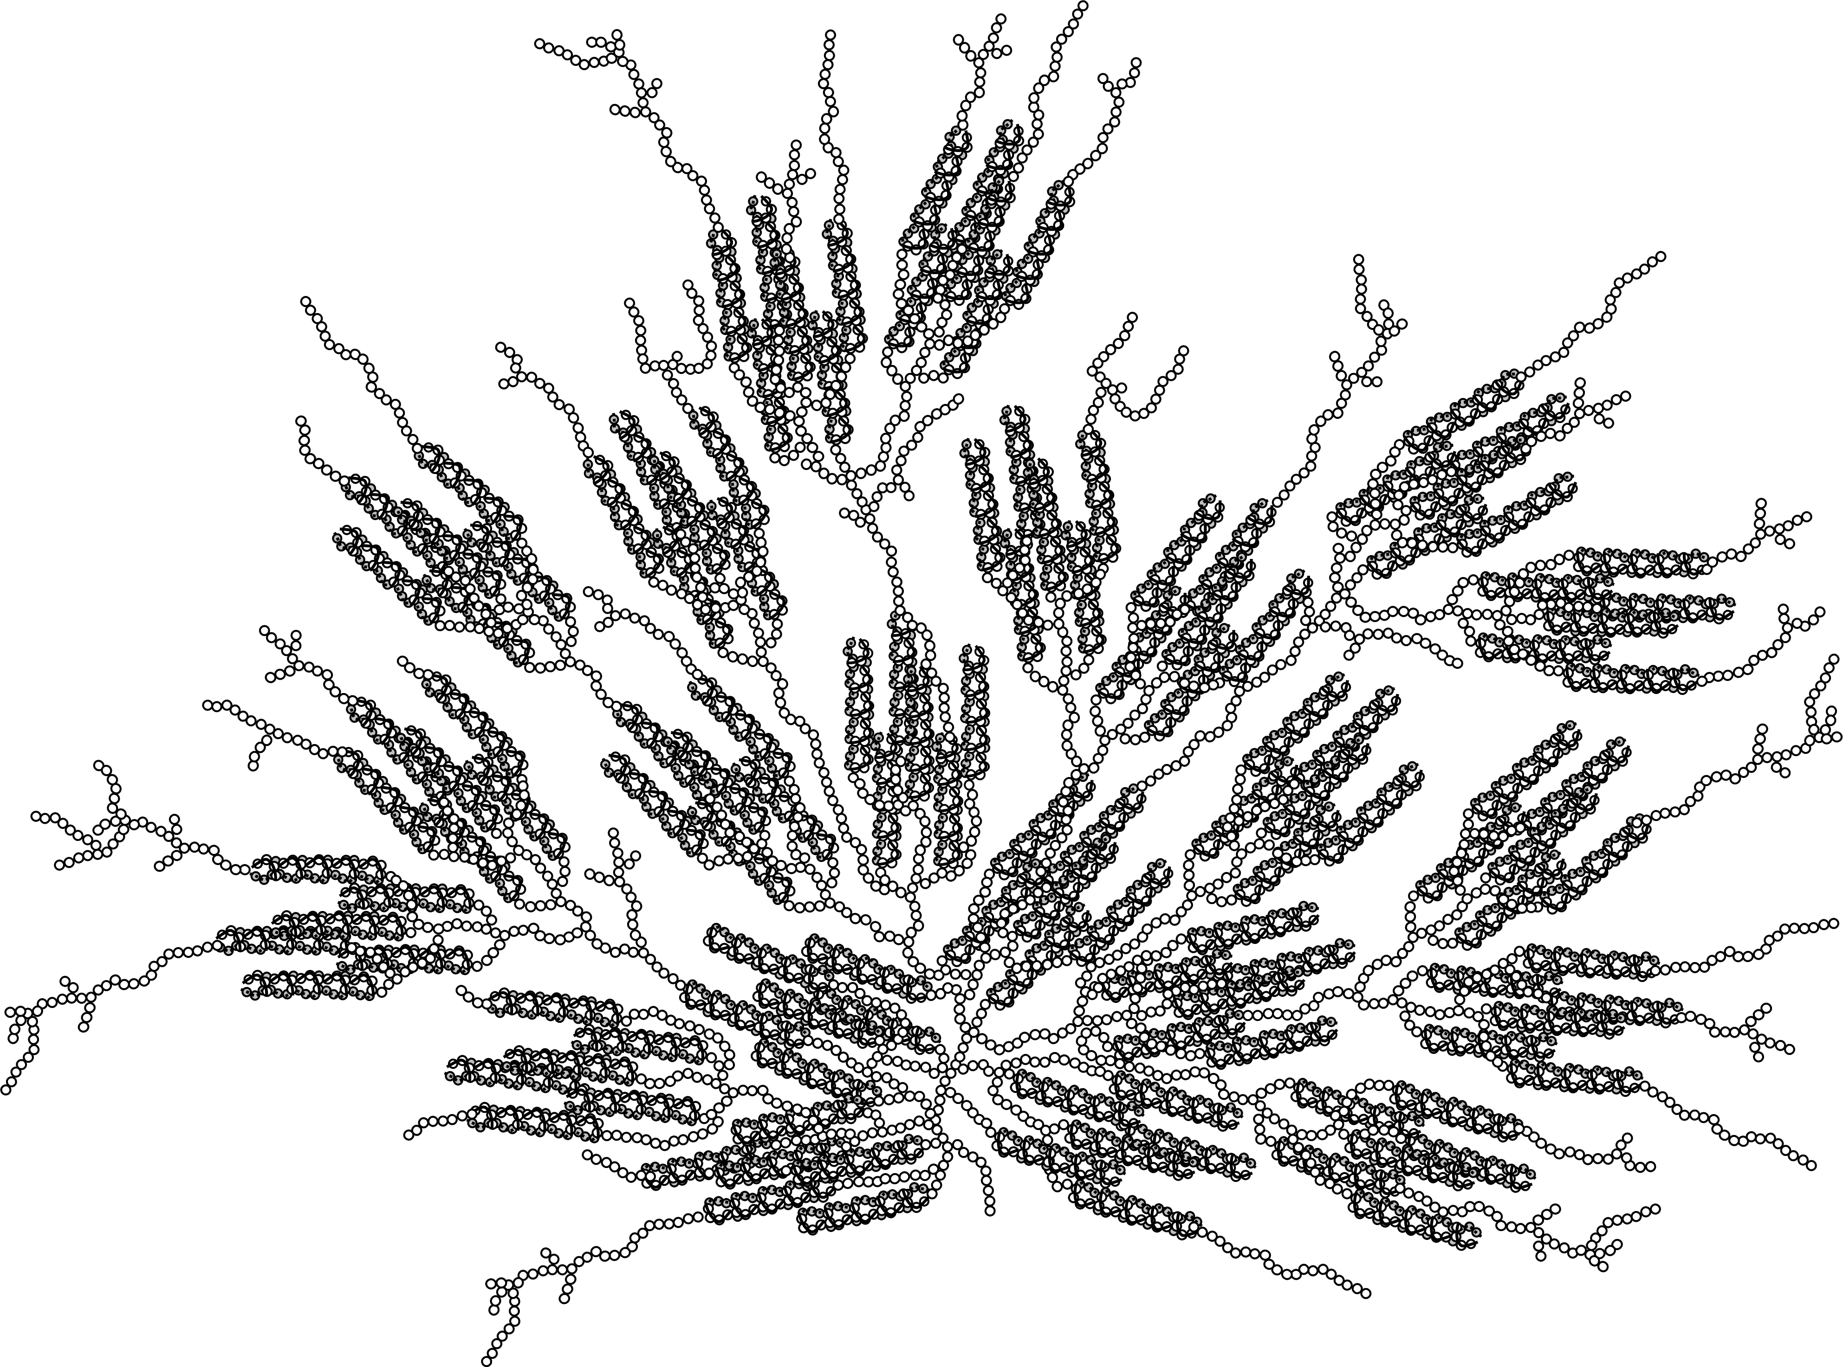
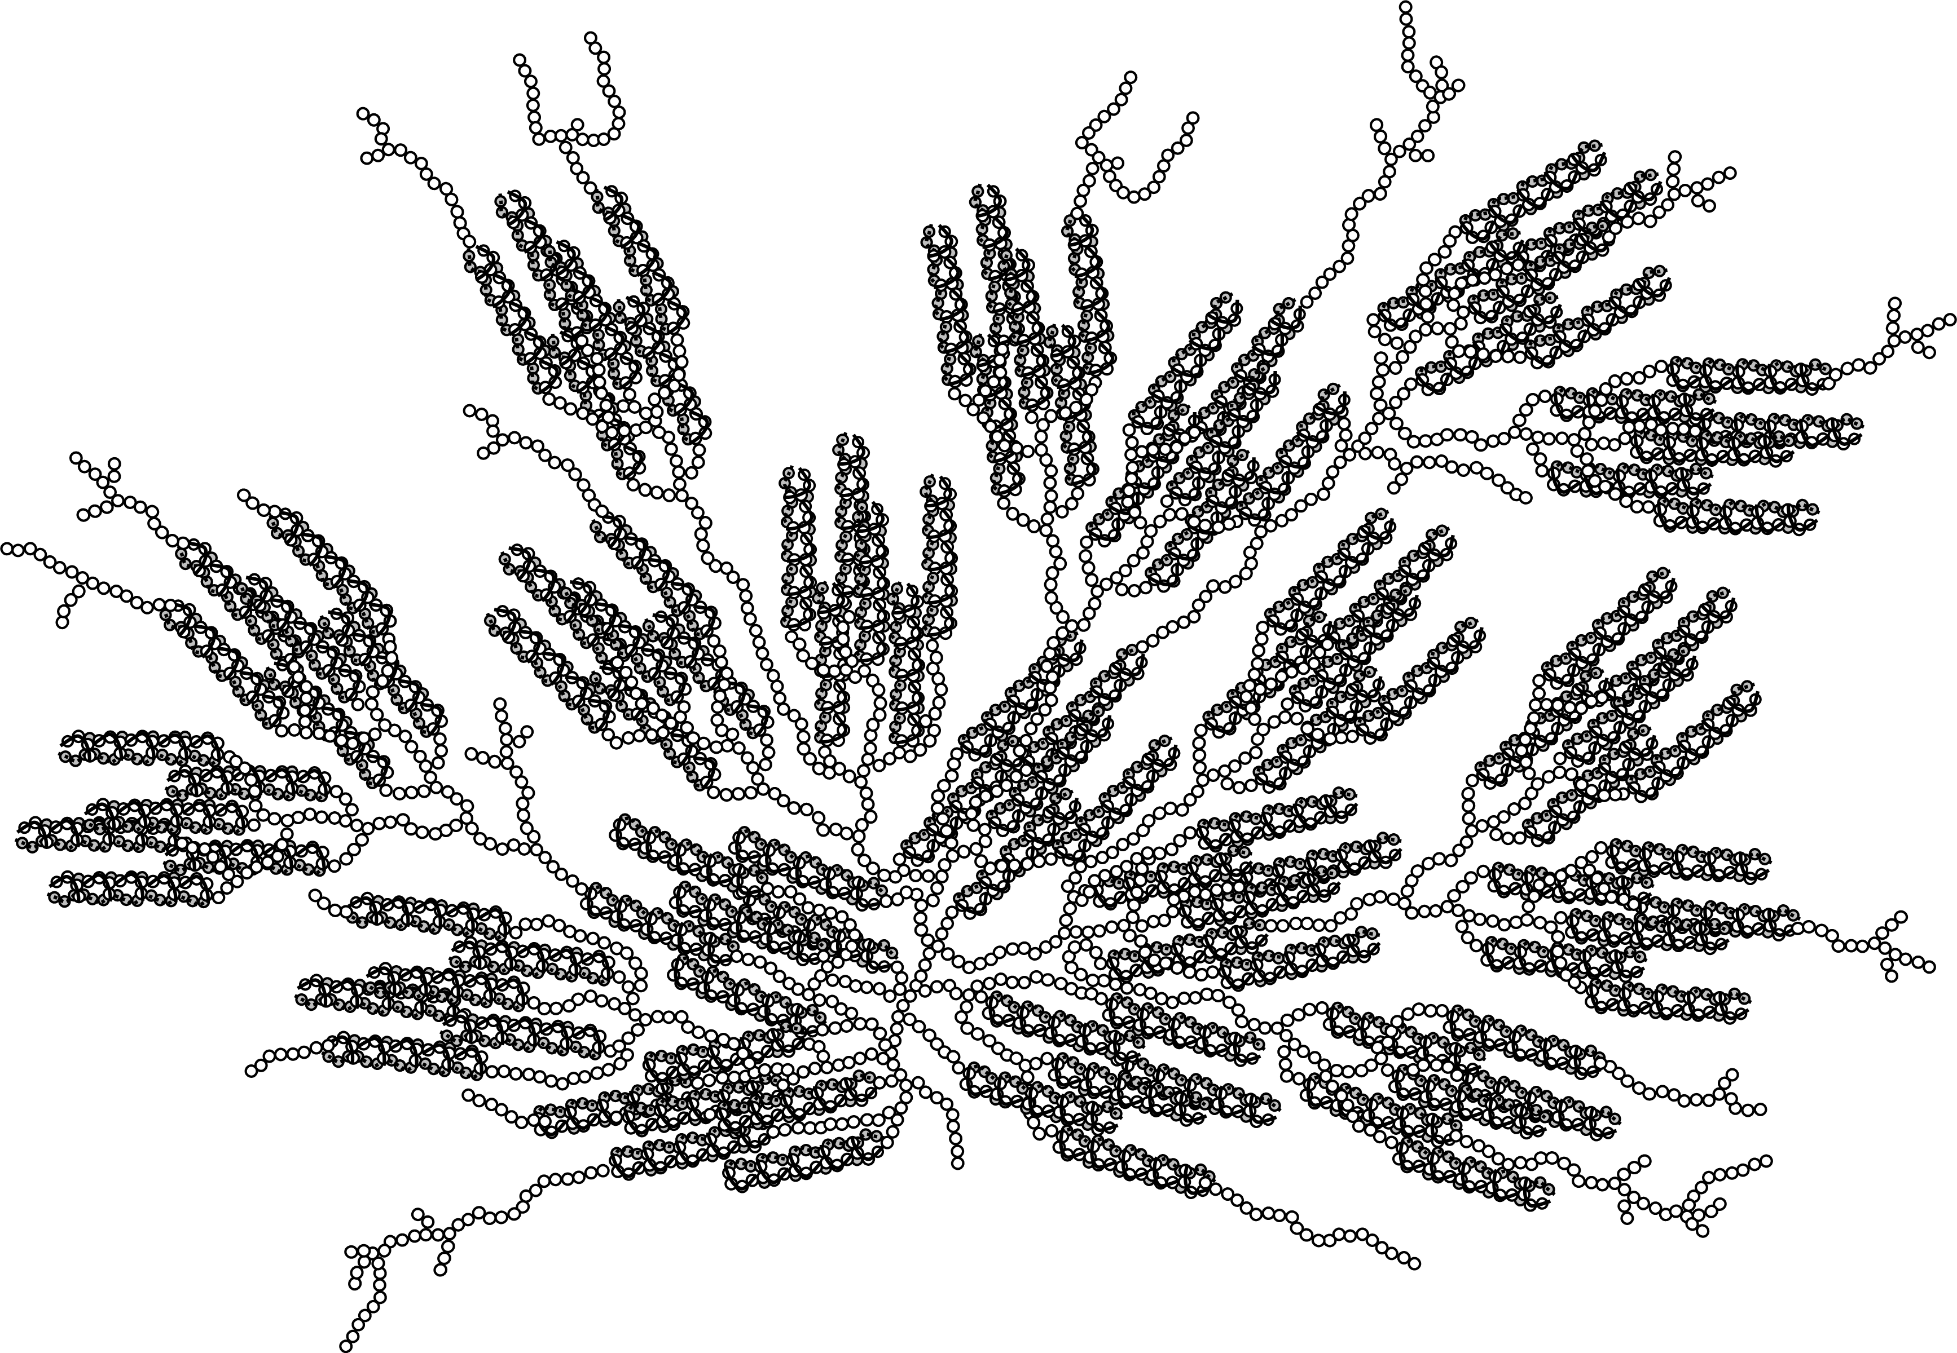
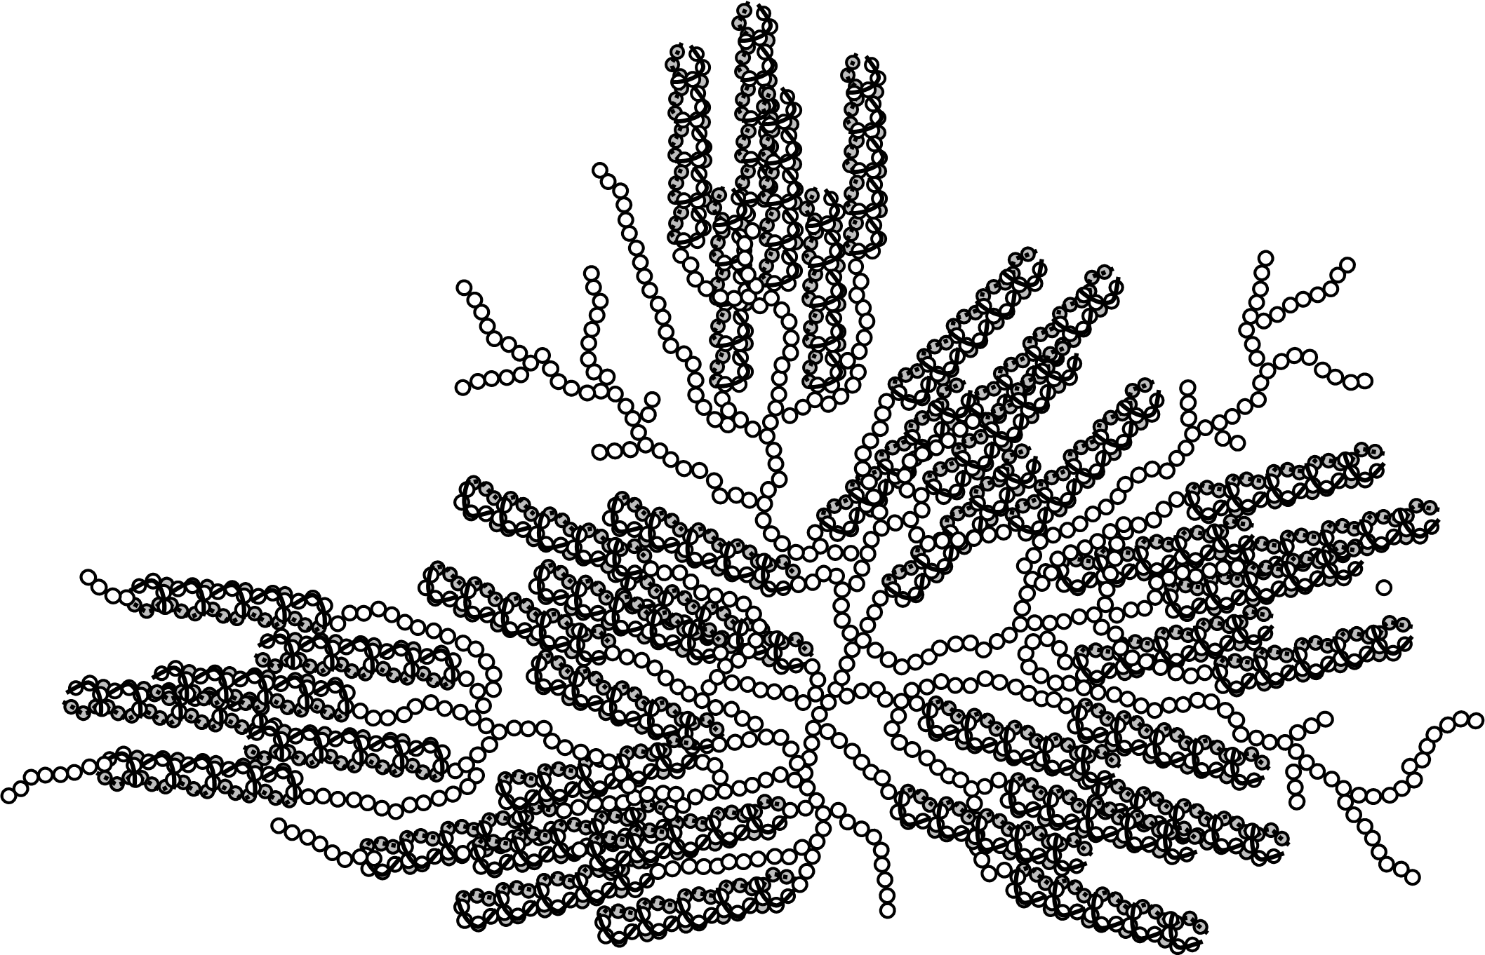
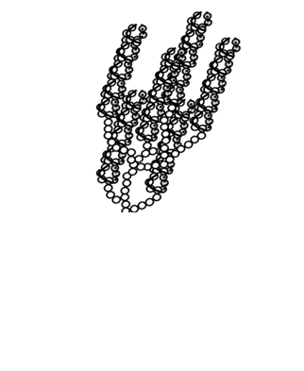
NanoSized Amylopectin Fragments
Research grade nanosized amylopectin fragments (NAFs) were prepared by Ecosythetix.
~ 200 nm
~ 56 nm
~ 16 nm
~ 8 nm
NAF(56)
NAF(16)
NAF(8)
Amylopectin
Notes:
In this presentation, compression of the naf will be studied with pef.

Slide 12
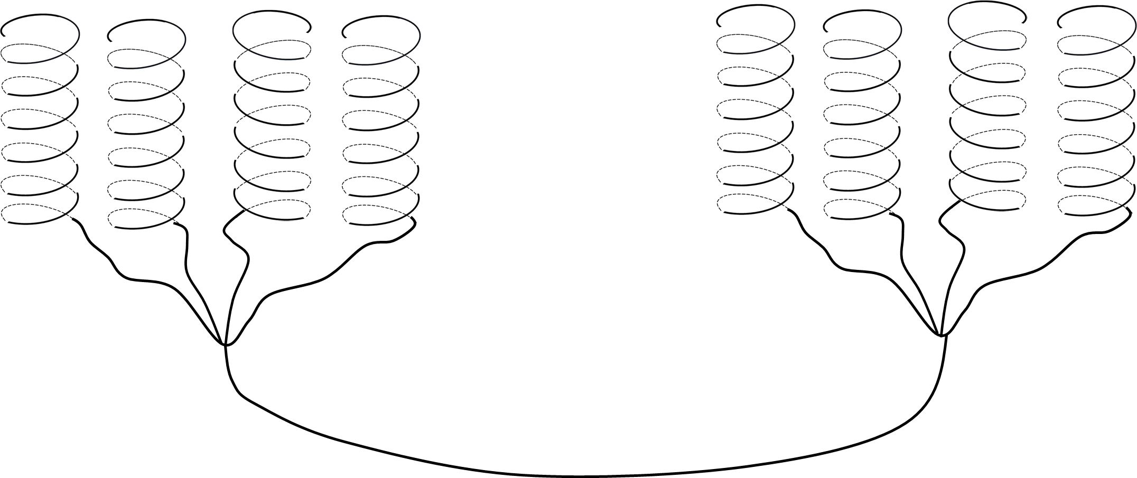
Experimental Conditions
Intramolecular interaction
What changes does the Cluster experience?
+
I_{E}/I_{M} α k_{diff} [Py]_{local}
Py Labeled NAFs
Unlabeled NAFs
1. Examine the effect of k_{diff}
2. Examine the effect of I_{E}/I_{M}
Py(0.006%)-NAF(56)
Py(6%)-NAF(56)

Slide 13
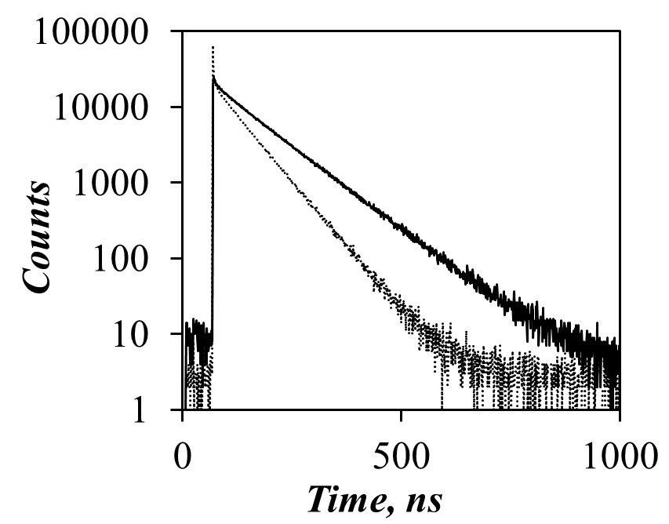
Results and Discussion
Experimental Conditions: Py(60ppm)-NAF(56) was mixed with 0-53.6 wt% NAF(56). The amount of Py(60ppm)-NAF(56) was adjusted to get enough fluorescence signal without forming excimer.
[NAF (56)]= 53.6 wt%
τ= 133 ns
[NAF (56)]
= 0.1 wt%
τ= 100 ns

Slide 14
Results and Discussion
Experimental Conditions: Py(60ppm)-NAF(56) was mixed with 0-53.6 wt% NAF(56). The amount of Py(60ppm)-NAF(56) was adjusted to get enough fluorescence signal without forming excimer.
where
27.5Å
>> 34Å
C*
27.5Å
< 34Å
Local environment of pyrene becomes more viscous
Dilute Regime
Regime 1
11.4 (±0.4) wt%

Slide 15

Results and Discussion
Experimental Conditions: 7.8×10⁻³ wt% of Py(6%)-NAF(56) was mixed with 0-56 wt% NAF(56)
I_{E}/I_{M} α k_{diff} [Py]_{local}
C***
=46wt%
10 Å
Cluster Model
Solution Cluster Model
Density= 1.5 g/ml
Density= [NAF (56)], g/mL
Radius = 10Å
Radius = $\sqrt{\frac{1.5\frac{g}{mL}(10{Å)}^{2}}{\left[NAF\left(56\right)\right]}}$
Effective distance: 16 ~36 Å
Concentration | Distance
C* | 96.8 Å
C** | 26.1 Å
C*** | 12.9 Å
1.5wt%
C**=16 wt%

Slide 16
Results and Discussion
Experimental Conditions: 7.8×10⁻³ wt% of Py(6%)-NAF(56) was mixed with 0-56 wt% NAF(56)
I_{E}/I_{M} α k_{diff} [Py]_{local}
~12.9Å
No change in [Py]_{local}
Increase in [Py]_{local}
C***
C*
C**
27.5Å
>> 34Å
27.5Å
< 97Å
27.5Å
<~26 Å
Semi dilute Regime
Conc. Regime
Dense Regime
1.5wt%
16 wt%
46 wt%

Slide 17
Experimental Conditions: 7.8×10⁻³ wt% of Py(6%)-NAF(56) was mixed with 0-56 wt% NAF(56)
Results and Discussion
Further increase in η
Diffusion
< 26.1 Å
12.9Å
Direct excitation
27.5 Å
*
*
+
High quantum Yield
Low quantum Yield
At C**
At C***
38 wt%
Excimer formed via diffusion
[NAF(56)]=0.01wt%
[NAF(56)]= 56 wt%
C*
Formed via Direct Excitation
Max λ
C**
38 wt%
C**
Notes:
At C*** the distance between helices is too short which results in confining pyrene molecules in a small given area. As pyrene molecules are so close to each other, they will form excimer without having time to reorient themselves. The excimer will be formed with poor orientation. Poor overlapped excimer has low quantum yield.

Slide 18
Results and Discussion
C***
C*
C**
C***
Amylopectin
NAF (8)
NAF (56)
NAF(16)
C**

Slide 19
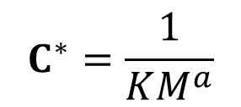
Results and Discussion
27.5Å
~ 27Å
$$C^{∗}=\frac{1}{KM^{a}}$$
C**
27.5Å
>> 34Å
27.5Å
< 34Å
~14Å
C***
Dilute Regime
Semi Dilute Regime
Conc.
Regime
Dense
Regime
Notes:
C* depends on the molecular weight of the particle
C** and C*** relate the cluster and is independent to the size of particle. Compression of helice will start at around 16 wt% for any sized fragments. 40% (4)

Slide 20
Conclusions
Compressibility of amylopectin and NAFs was studied by Pyrene Excimer Fluorescence (PEF).
  Increase in the concentration of NAFs built up the osmotic pressure which triggers their compression.
  The compression of helice of cluster is independent to the size of fragment and starts around 15.7 (±1.6) wt %

Slide 21
Future Work
Dispersions with higher concentrations of NAFs in DMSO will be prepared to study the conformation changes experienced by NAFs during film formation.

Slide 22
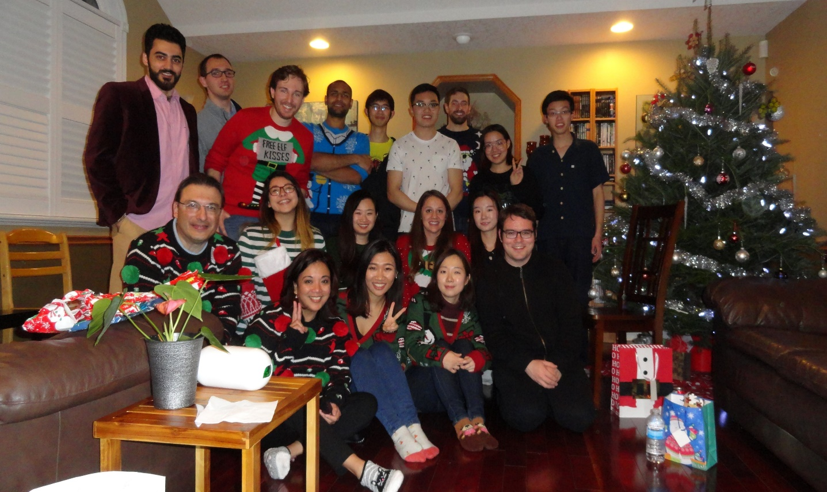

Acknowledgements
Prof. Jean Duhamel
Lu Li
All members from Duhamel and Gauthier’s labs
All Ecosynthetix’s project members
22

Slide 23
Thank You
23

Slide 24
Results and Discussion
C*
C**
C***
27.5Å
>> 34Å
27.5Å
< 34Å
27.5Å
< 34Å
>> 27.5Å
Regime 1
Regime 2

Slide 25
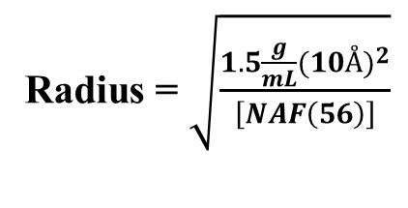
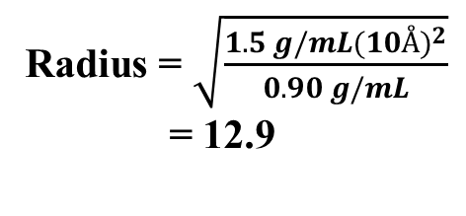
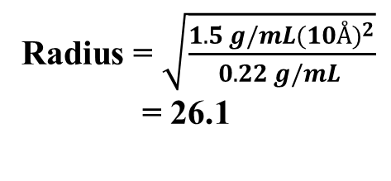
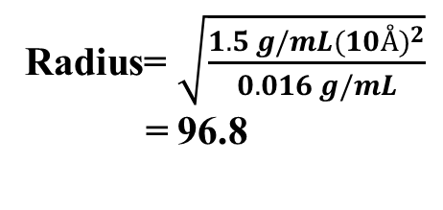
Density= [NAF (56)], g/mL
10 Å
Density= 1.5 g/ml
Radius = $\sqrt{\frac{1.5\frac{g}{mL}(10{Å)}^{2}}{\left[NAF\left(56\right)\right]}}$
Radius = 5Å
Cluster Model
Solution Cluster Model
C*=0.016 g/mL
C**= 0.22 g/mL
C***=0.90 g/mL
Radius= $\sqrt{\frac{1.5 g/mL(10{Å)}^{2}}{0.016 g/mL}}$
= 96.8
Radius = $\sqrt{\frac{1.5 g/mL(10{Å)}^{2}}{0.22 g/mL }}$
= 26.1
Radius = $\sqrt{\frac{1.5 g/mL(10{Å)}^{2}}{0.90 g/mL}}$
= 12.9

Slide 26
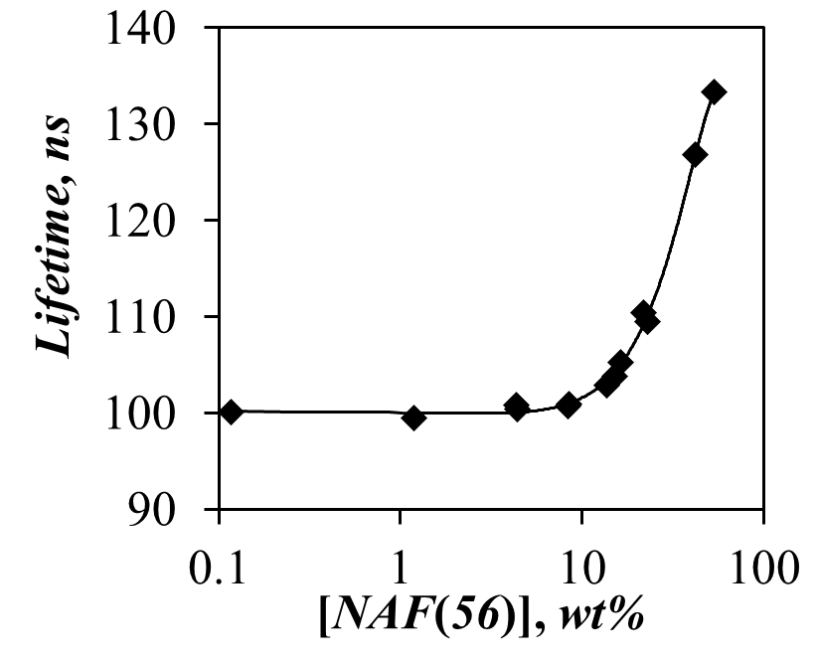
Results and Discussion
Experimental Conditions: Py(60ppm)-NAF(56) was mixed with 0-53.6 wt% NAF(56). The amount of Py(60ppm)-NAF(56) was adjusted to get enough fluorescence signal without forming excimer.
where
27.5 Å
> 36 Å
At C< C*
No Change
27.5 Å
> 36 Å
At C*
11.4 (±0.4) wt%
Increase in η
27.5 Å
< 36 Å
C*
At C**,
11.4 wt%
Notes:
Longer lifetime of pyrene indicates that the local environment of pyrene gets more viscous with increasing [NAF(56)]. This implies that diffusion is hindered at NAF(56) concentration greater than 11.4 (±0.4) wt%.

Slide 27
Results and Discussion
C**
Concentration where I_{E/}I_{M} begins to increase (= [Py]_{local} begins to increase)

Slide 28
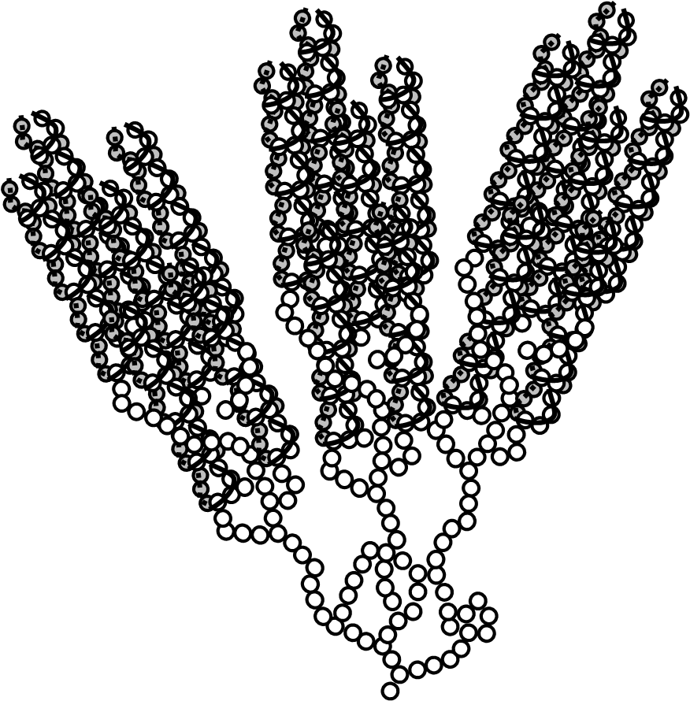
Background: Osmotic Pressure
Stage 1: Dilute region ( C < C*)
C < C*
C*< C < C**
Stage 2: Semi Dilute region (C = C*)
C**< C < C***
Stage 3: Concentrated region(C*< C)
C < C***

Slide 29
Results and Discussion
Experimental Conditions: 7.8×10⁻³ wt% of Py(6%)-NAF(56) was mixed with 0-56 wt% NAF(56)
I_{E}/I_{M} α k_{diff} [Py]_{local}
27.5 Å
> 36 Å
At C< C*
No Change
27.5 Å
> 36 Å
At C*
Increase in [Py]_{local}
C*
16 wt%
C**
27.5 Å
< 36 Å
At C**, 16 wt%

Slide 30
Background: Osmotic Pressure
C < C*
C = C*
C > C*
What happens to the Cluster?
I_{E}/I_{M} α k_{diff}[Py]_{local}
C = C*
C < < C*
27.5 Å
> 36 Å
27.5 Å
< 36 Å
Compression
< 27.5 Å
< 27.5 Å
Increase in [Py]_{local}
Change in local environment of pyrene

Slide 31
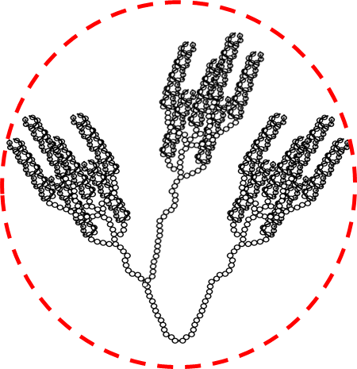
Background: Osmotic Pressure
Stage 1: Dilute region ( C < C*)
In a dilute system, a polymer is highly swollen.
Stage 2: Semi Dilute region (C = C*)
Increase in concentration
Partial interpenetration is possible with chains outside a macromolecule
C < C*
C = C*
C < < C*
Stage 3: Concentrated region(C*< C)
Further interpenetration is prevented by branched segments which results in compression instead.

