Slide 1
Hierarchical Self-Assembly Induced by Dilution-Enhanced Hydrophobic Hydration
Presented by: Dapeng Liu
Supervisor: Xiaosong Wang

Slide 2
Outline
1. Introduction
2. Dilution-induced self-assembly of Fp(CH₂)₆Azobenzene^{trans} MCsomes
3. The conditional effect of hydrophobic hydration
4. Hierarchical self-assembly of MCsomes
5. Summary

Slide 3
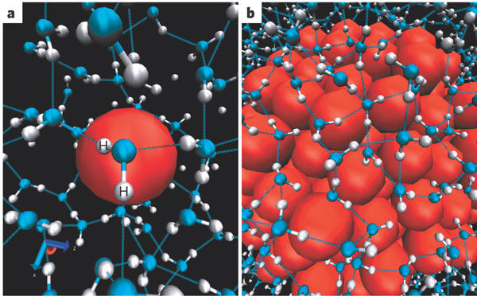
Hydration of hydrophobic solutes
Hydrophobic solutes
H atom
O atom
Small solutes
Large solutes
Nature 437, 640–647
Hydrophobic hydration is the hydration of hydrophobic molecules or surface.
Notes:
Hydrophobic hydration involves the minimization of the free energies of water molecules near nonpolar surfaces.

Slide 4
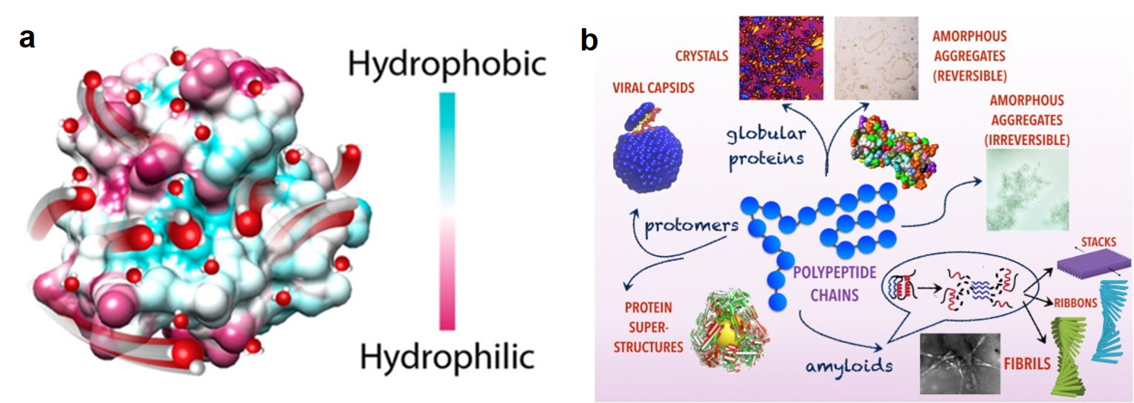
Hydrophobic hydration in protein chemistry
water
J. Am. Chem. Soc. 2017, 139 (49), 17890-17901.
Current Opinion in Colloid & Interface Science 2016, 22, 73-79.
Hydrophobic hydration plays an important role in protein folding and self-assembly.

Slide 5
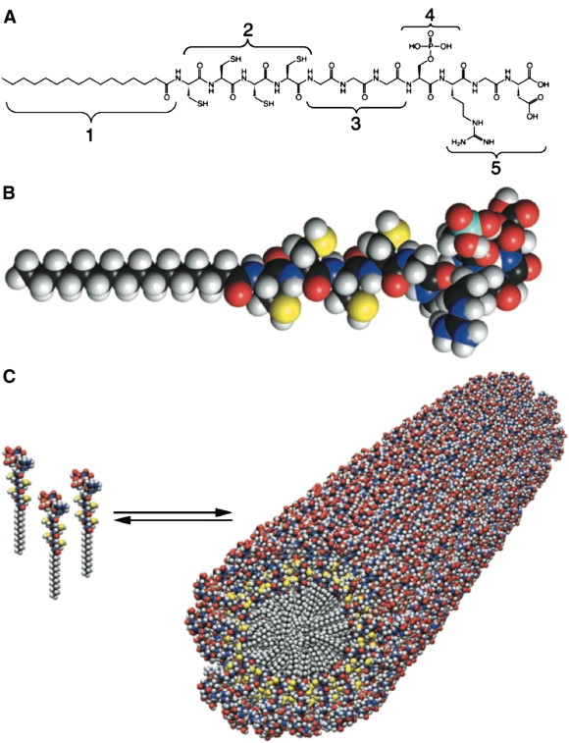
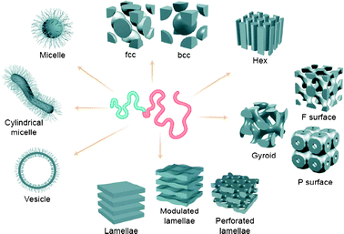
Chemical self-assembly
Science 294.5547 (2001): 1684-1688.
Chem. Soc. Rev. 2012, 41 (18), 5969-5985.
Most model systems in chemical self-assembly are focused on amphiphilic nature instead of the hydrophobic hydration

Slide 6
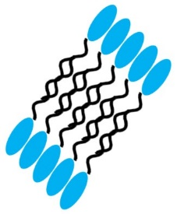
Aqueous self-assembly of hydrophobic molecules FpC₆X
Self-assembly in water
Hydration of Fp head
FpC₆X
MCsome
FpC₆X
C₆X tail ( )
Hydrophobic
Fp head
FpC₆
[δ⁻]
[δ⁺]
FpC₆Azobenzene
Hydrated
Fp head
[δ⁻]
Recently our groups synthesized a series of hydrophobic metal carbonyl complexes which could self-assemble into nanovesicles by hydrated Fp head.

Slide 7
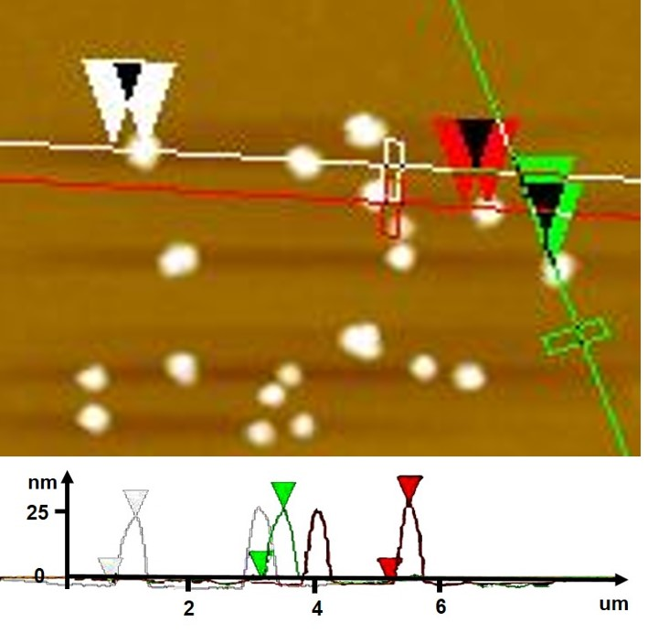
Charaterization of Fp(CH₂)₆Azobenzene^{trans} Mcsomes
a
DLS
b
TEM
D_{h} = 168 nm
PDI: 0.174
500 nm
c
AFM
d
SEM
200 nm
1 um
Fp(CH₂)₆Azobenzene^{trans} MCsomes with ca. 170 nm were formed.

Slide 8
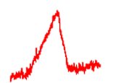
Dilution-induced self-assembly of Fp(CH₂)₆Azobenzene^{trans} MCsomes
a
b
c
14 μM
140 μM
500 nm
500 nm
Time aging
Dilution of MCsomes
Helical structures
Dilution of Fp(CH₂)₆Azobenzene^{trans} MCsomes could induce the self-assembly of MCsomes.

Slide 9
1. How does dilution induce self-assembly of FpC₆Azobenzene^{trans} MCsomes?
2. How do FpC₆Azobenzene^{trans} MCsomes transform to helical structures?

Slide 10
Dilution-induced zeta potential change of Fp(CH₂)₆Azobenzene^{trans} MCsomes
Self-assembly in water
Hydration of Fp head
FpC₆Azobenzene^{trans}
MCsome
[δ⁻]
[δ⁺]
Hydrated
Fp head
[δ⁻]
Dilution of Fp(CH₂)₆Azobenzene^{trans} MCsomes could cause the surface charge decrease

Slide 11
The IR spectra of Fp(CH₂)₆Azobenzene^{trans} MCsomes during the dilution process
MCsome
[δ⁻]
[δ⁺]
[δ⁻]
No shifts in the wavenumbers for the absorption peaks suggest that the dilution results in no detectable variation in polarized CO groups in the Fp head.

Slide 12
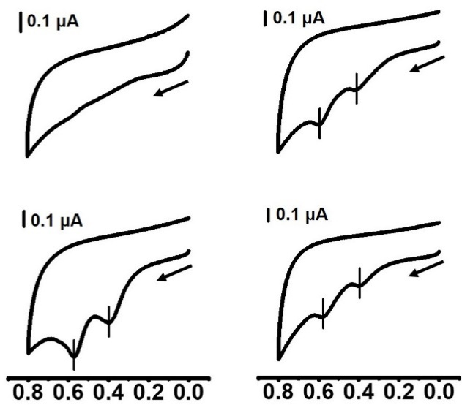
CV experiments of Fp(CH₂)₆Azobenzene^{trans} MCsomes during the dilution process
Hydration cavity
140 µM
70 µM
d_{Fp-Fp}
ΔE_{1/2} = 0.20 V
MCsome
$∆E_{1/2}$ $∝$ $\frac{1}{d_{Fp−Fp}}$
35 µM
14 µM
[δ⁻]
[δ⁺]
ΔE_{1/2} = 0.18 V
ΔE_{1/2} = 0.16 V
[δ⁻]
Potential (V)
Potential (V)
CV indicates that the dilution could enhance the hydrophobic hydration of Fe in the MCsomes.
Notes:
the close proximity of the adjacent Fp head groups on the surface of colloids results in two oxidation potentials separated by a redox coupling (ΔE_{1/2}) because the oxidation of the iron element next to the oxidized one requires a higher potential

Slide 13
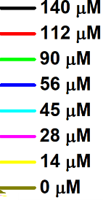
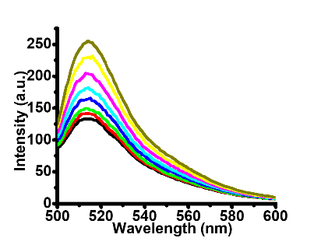
Calcein quenching experiments of Fp(CH₂)₆Azobenzene^{trans} MCsomes during the dilution process
the Stern-Volmer plot
MCsome
[δ⁻]
[δ⁺]
Hydrated
Fp head
[δ⁻]
Calcein
More hydration of Fe, more quenching of calcein
Calcein quenching experiments verified that the dilution could enhance the hydrophobic hydration of Fe in the MCsomes
Notes:
The Stern-Volmer plot for the fluorescence quenching of calcein

Slide 14
Dilution-enhanced hydrophobic hydration (HH) of Fe in the MCsomes
[δ⁻]
[δ+]
[δ⁻]
Dilution
Fe [δ⁺]
O [δ⁻]
Fe [δ⁺]
O [δ⁻]
Zeta potential ζ = -51 mV
ζ = -31 mV
Less HH
Water-Carbonyl Interactions
Increased HH
(HH: hydrophobic hydration)

Slide 15
How do MCsomes transform to helical structures?

Slide 16
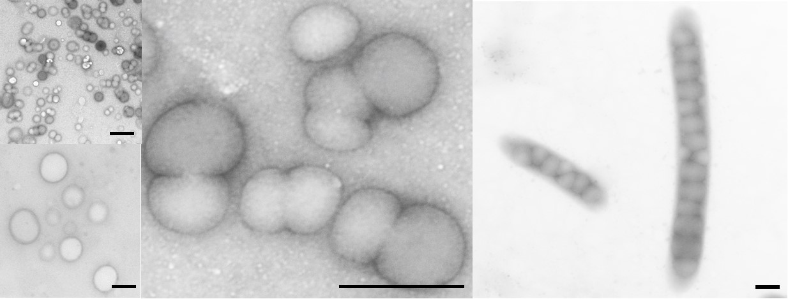
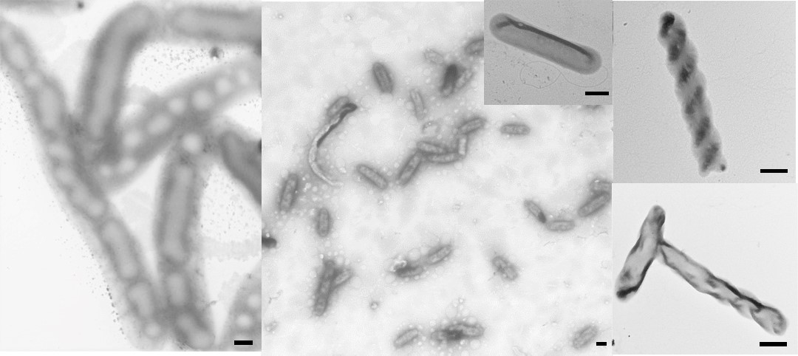
TEM was used to track the hierarchical self-assembly of MCsomes
a
c
d
b
e
f
g
h
Scale bar: 500 nm
Different intermediates were obtained by TEM during the structural evolution

Slide 17
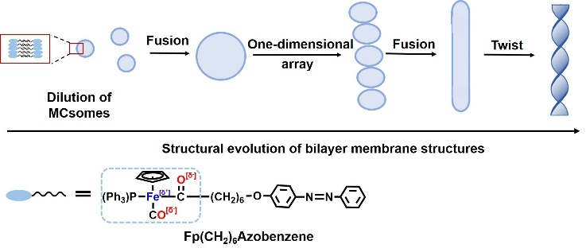
The hierarchical self-assembly of MCsomes
Scheme of the hierarchical self-assembly of MCsomes

Slide 18
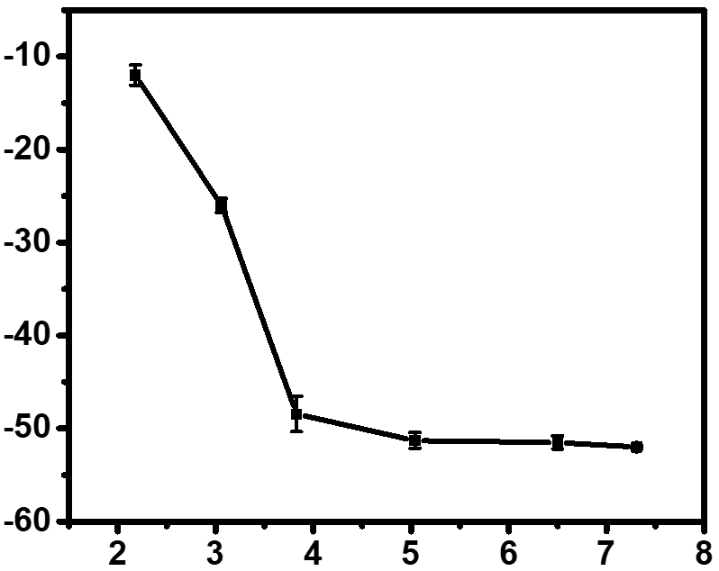
The hierarchical self-assembly of FpC₆Azobenzene^{trans} MCsomes at pH = 3
FpC₆Azobenzene^{trans} colloid (140 uM)
FpC₆Azobenzene^{trans} colloid (140 uM, pH=3)
Zeta potential (mv)
pH
TEM
20 µm
500 nm
The hierarchical self-assembly of MCsomes was also observed in the colloid (140 uM) at pH = 3.

Slide 19
Summary
Hydrophobic FpC₆Azobenzene molecules could self-assemble into MCsomes in water by hydration of Fp head.
Dilution could enhance the hydrophobic hydration of Fe in the Fp head which decrease the surface charge of the MCsomes.
The enhanced hydrophobic hydration of Fe could be verified by CV and dye quenching experiments.
The decreasing surface charge could induce hierarchical self-assembly of nanovesicles to helical structures.
The structural evolution from nanovesicles to helical structures could be observed by TEM which proceed through large vesicles, one-dimensional array of vesicles, tubes and helical structures.

Slide 20
Thank you

