Slide 1
Viscoelastic Properties of Crosslinked Chitosan Edible Films
Joseph Khouri
Supervisors: Profs. C. Moresoli and A. Penlidis
Dept. of Chemical Engineering

Slide 2
PRODUCTION
Chitin Sources
Main: Crustaceans (exoskeletal shells), Secondary: Fungi (stem walls), Squid pen, cuttlefish
Chitin → Chitosan conversion
Mineral removal
Protein removal
De-colorization
Deacetylation
Acid treatment,
HCl < 5 %, T ~ RT
Base treatment,
NaOH < 5 %, T < 80 ºC
Oxidation,
KMnO₄ or UV
Base treatment, boiled
NaOH > 40 %, T > 100 ºC
CaCO₂
CaCO₂
CaCO₂

Slide 3
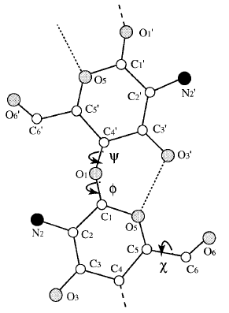
STRUCTURE
(1,4)-2-amino-2-deoxy-β-D-glucan
Units alternate by 180º
n – glucosamine residue
m – N-acetyl glucosamine residue
DD = degree of deacetylation = 100 % × n
Chitosan = DD > 60 %, or > 7 % nitrogen
Chitin = DD < 60 % or < 7 % nitrogen
Okuyama et al. Macromolecules, 1997, 30, 5849-5855
Molecular weight commercial chitosan, M_{v} = 50 to 500 kDa

Slide 4
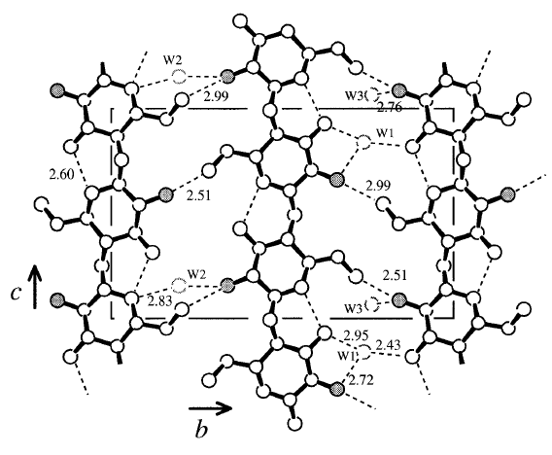
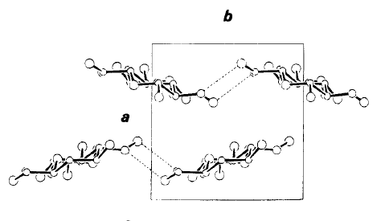
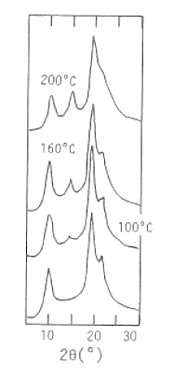
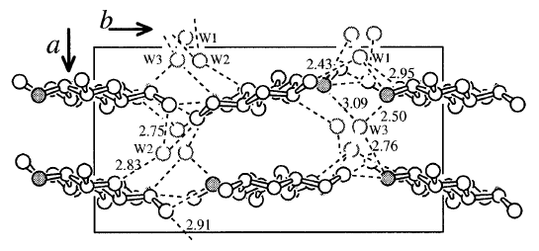
STRUCTURE
Semi-crystalline, 35 – 60 %; two-fold helical conformation (“zig-zag”); strong H-bond network
Allomorphs
Tendon
- hydrated
- Orthorhombic
- Anti parallel
chain packing
Annealed
Anhydrous
Orthorhombic
anti parallel
packing
annealed ~ 15º
tendon ~ 10º
Okuyama et al. Macromolecules, 1997, 30, 5849-5855
Yui et al. Macromolecules 1994, 27, 7601 - 7605

Slide 5
APPLICATIONS
Medical/Health
Membranes/Industrial Technology
Food
Hydrogels for drug delivery
Scaffolds for bone regeneration
Hemostatic/
anticoagulant material
Cosmetics
(skin, oral care)
Heavy ion removal from waste water
Flocculating agent
Fuel cell membrane
Thickener, stabilizer
Preservative
Appetite suppressant
Coatings/packaging

Slide 6
PROPERTIES
Property | Chitosan | Common plastics (LDPE, PP, etc..)
Water Vapor Permeability (WVP) [g/(m-s-Pa)] | 1 – 10 ×10⁻¹¹ | 0.01 – 1 ×10⁻¹¹
Oxygen Gas Permeability (OP) [cm³/(m-s-Pa)] | 1 × 10⁻¹⁵ – 1 × 10⁻¹³ | 1 × 10⁻¹³ – 1 × 10⁻¹²
Tensile Strength (TS) [MPa] | 1 – 100 | 1 - 100
Elongation Before Break [%] | 1 – 50, 100 (with plasticizer) | 1 – 1,000
Young’s Modulus [GPa] | 0.1 – 3 | 1 - 10
Processability | Solvent casting, Limited molding | Moldable (thermo-, injection, blow, etc…)

Slide 7
MODIFICATION
Objectives for modification: (i) Reduce hydrophilicity, (ii) improve mechanical properties, while (iii) not causing significant changes to gas barrier or antibacterial properties
Composites
Grafting
Crosslinking
With hydrophobic compounds, lipids (e.g., palmitic, stearic, octanoic, acids):
– Some improvement in gas barrier
– Little to no improvement, in WVP, TS
With polysaccharides:
– No significant change in properties
With hydrophobic compounds, lipids (e.g., stearic acid):
– Some improvement in hydrophobicity, some compromise in TS and antibacterial properties
– Improvement in antioxidation (with gallic acid)
With multifunctional compounds
(e.g., tannic acid);
- Some improvement in TS, WVP, and oxygen permeability
- Some reduction of antibacterial properties

Slide 8
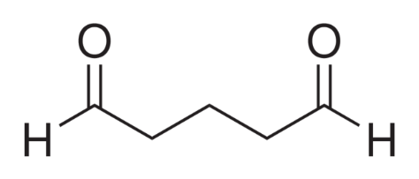
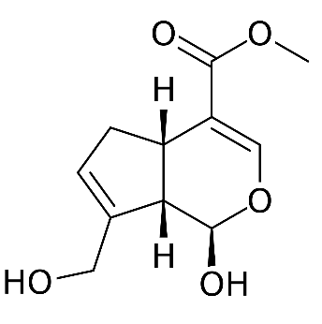
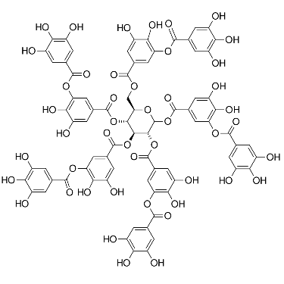
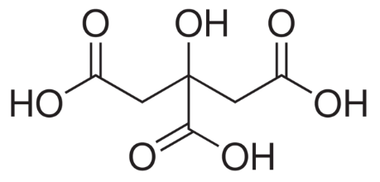
CROSSLINKERS
Epichlorohydrin
Glutaraldehyde
- Waste water treatment applications
- Toxic
- Biomedical applications
- Total health impact / suitability for food applications still unknown
Genipin
Tannic Acid
- Improvements in TS, WVP
- Non-toxic
Improvements in TS, WVP
Non-toxic
Not fully studied with chitosan for edible film applications
Citric Acid

Slide 9
CROSSLINKING
Crosslinking with citric acid investigated with:
 | Target application
Starch | Food packaging
Proteins (peanut, …) | Food packaging
Carboxymethyl cellulose – Hydroxyethylcellulose | Superabsorbent hydrogel
Hydroxy propyl methyl cellulose (HPMC) | Food packaging
Chitosan-HPMC composite | Food packaging
Chitosan-Alginate composite | Drug delivery
Chitosan graft on wool, cotton | Textiles
Chitosan, chitosan graft on polyurethane | Food packaging, drug delivery, biomedical applications

Slide 10
CROSSLINKING
NaH₂PO₂
105 – 190 ºC, 5 min – 6 hours, 5 – 30 % citric acid (w/w), 0 – 15 % catalyst

Slide 11
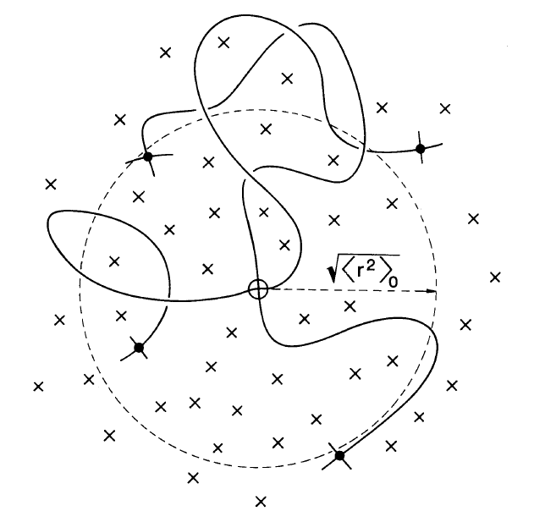
CROSSLINKING
FTIR
Reddy and Yang,
Food Chemistry 2010, 118, 702-711
Rubber Elasticity Theory
E – elastic storage modulus
G – elastic shear modulus
M_{c} – average molecular weight
between crosslinks
R – gas constant
T – temperature
V – Poisson Ratio
ν – crosslink density
ρ – material density

Slide 12
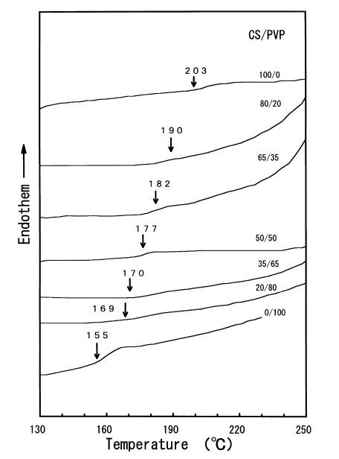
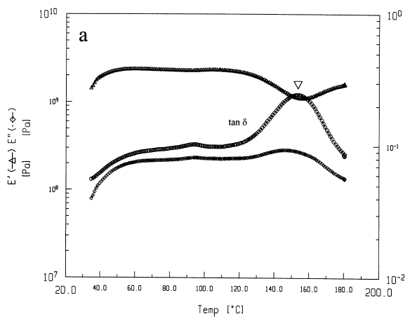
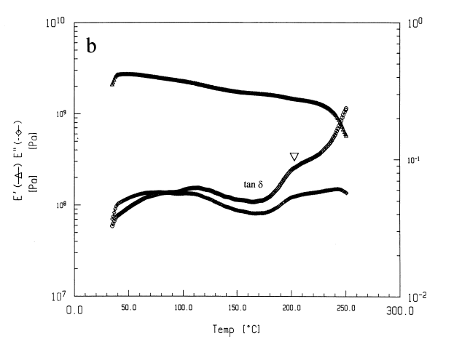
VISCOELASTICITY
Glass transition temperature, T_{g}, of chitosan in dispute. Estimates ~ 140 – 200 ºC.
Undetectable, weakly observable with DSC
Chitosan/poly (N-vinyl
pyrrolidone)
E′ – storage modulus
E′′– loss modulus
tan(δ) = E′′ /E′
chitosan film
Debate on the nature of the DMA tan(δ) peak near 160 ºC,
glass transition vs. molecular motion of pseudo-stable state type
Preheated chitosan film
Sakurai Polymer 2000, 21,
7051 - 7056

Slide 13
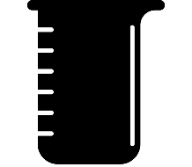
EXPERIMENTAL
Films prepared from solvent casting with acetic acid (Ac)
Neat
Neutralized
Glutaraldehyde (3, 6, 12 % w/w-chitosan), homogeneous and heterogeneous
Citric Acid (15 % w/w-chitosan), with and without heat treatment (HT) (150 ºC, 0.5 h)
Neutralization
Homogeneous Crosslinking
Single step,
Chitosan + Ac
+ crosslinker in solution
Ac⁻
Ac⁻
NH₃⁺
NH₃⁺
NH₂
NH₂
neutralize
NaOH
Heterogeneous Crosslinking
Ac⁻
NH₃⁺
NH₃⁺
NH₂
NH₂
Multistep, prepare film, immerse in aqueous solution with crosslinker
Ac⁻

Slide 14
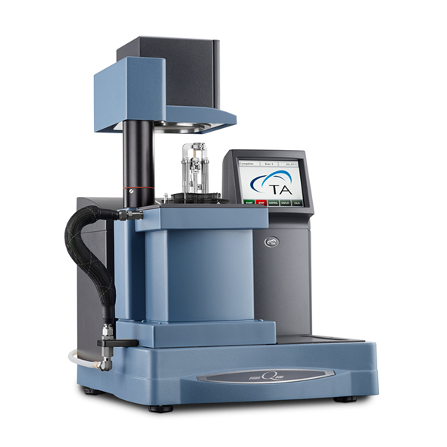
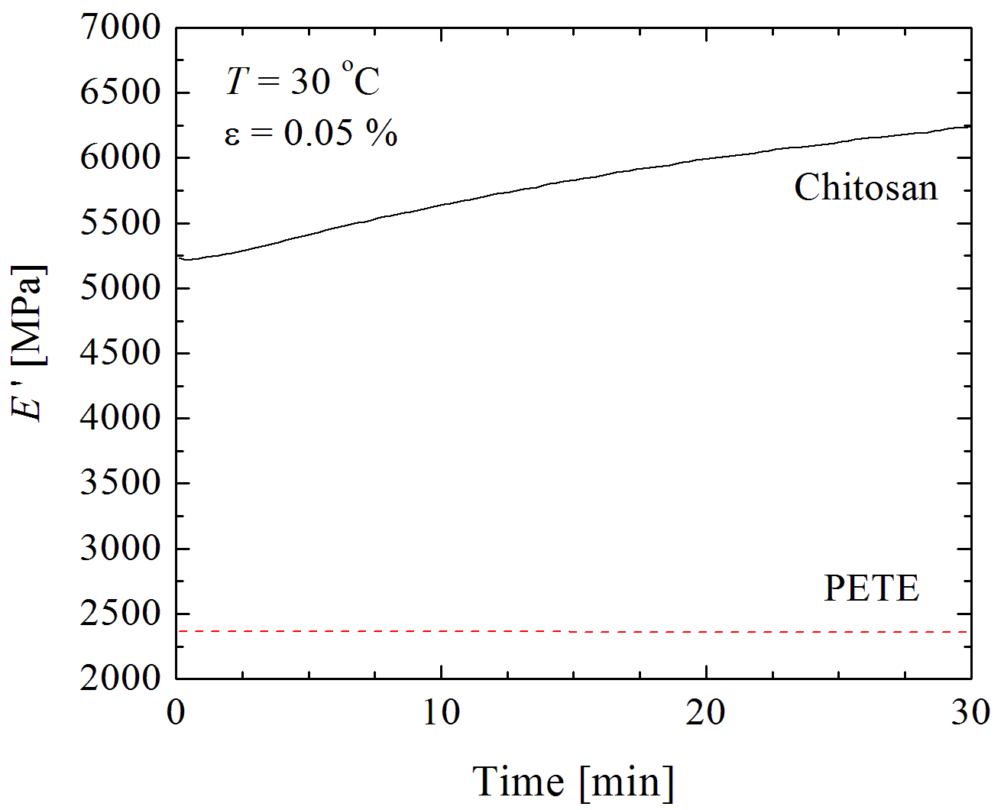
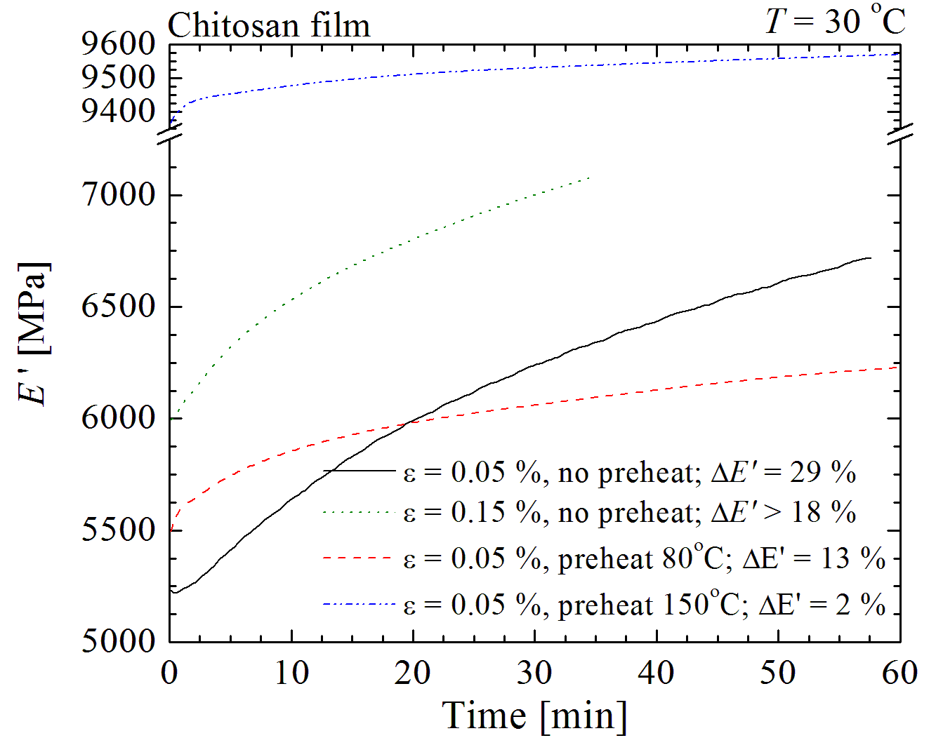
EXPERIMENTAL
Dynamic Mechanical Analysis
DMA Q800 (TA Instruments), tensile clamp
Single Scan
T-range = 30 – 200 ºC
q = 3 ºC/min
ε = 0.15 %
f = 1 Hz
Preheated Scans
Equilibrated at 140 ºC / 10 min
Followed by regular scan
(http://norleq.com/en/dt_portfolio/q800-dma-2-2/)

Slide 15
RESULTS
Effects of preheating
No Preheat
Preheated

Slide 16
RESULTS
Non-Preheated Films

Slide 17
RESULTS
Preheated Films
Peak 1
Peak 2

Slide 18
RESULTS
Viscoelastic properties
Film | Preheated | E' (195 ºC) [MPa] | T (tanδ peak 2) [ºC] | tanδ peak 2
Neat | N | 2382 ±127 | 165 ± 3 | 0.216 ± 0.045
 | Y | 2289 ± 152 | 169 ± 4 | 0.213 ± 0.034
Neutralized | N | 4143 ± 334 | 188 ± 10 | 0.078 ± 0.001
 | Y | 4092 ± 397 | 187 ± 5 | 0.078 ± 0.003
Glutaraldehyde | N | 3264 ± 146 | 168 ± 1 | 0.100 ± 0.013
 | Y | 3061 ± 410 | 181 ± 8 | 0.129 ± 0.045
CA+HT | N | 4479 ± 635 | 131 | 0.096
 | Y | 4612 ± 244 | 165 ± 3 | 0.051 ± 0.004
CA | N | 4727 ± 349 | 130 ± 8 | 0.097 ± 0.026
 | Y | 4348 ± 93 | 167 ± 1 | 0.061 ± 0.005
CV(E′) = 5 – 15 %
CV(T_{p2}) = 1 – 6 %
CV(tanδ_{p2}) = 4 – 25 %
CV = 100 % × std. dev. / mean

Slide 19
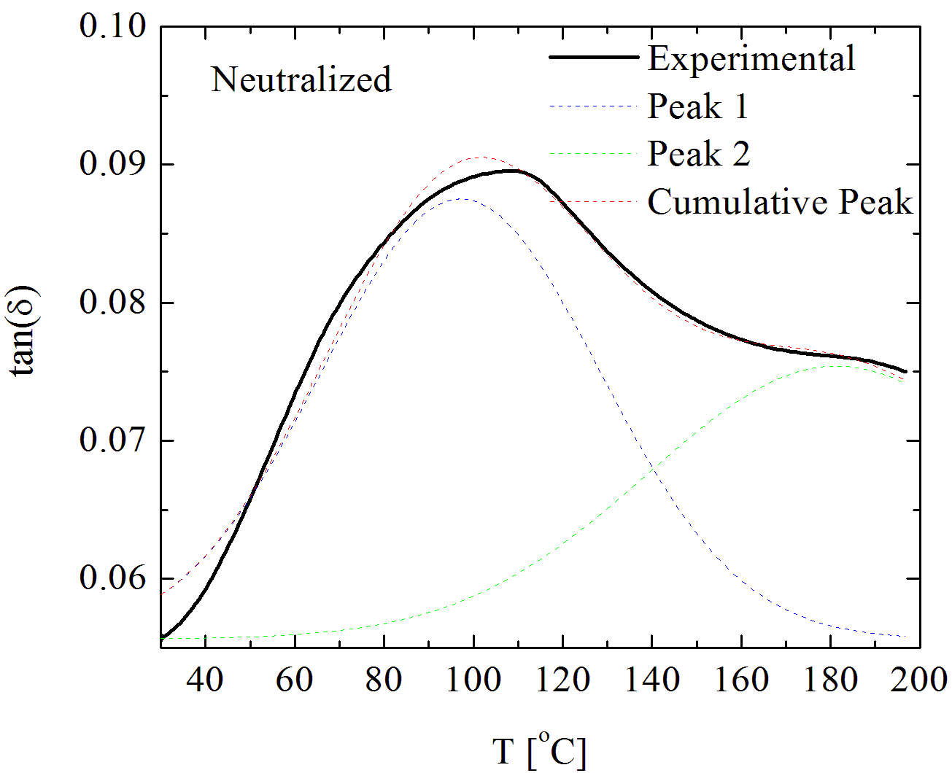
RESULTS
Peak Deconvolution
Peak center
Gaussian distribution
Baseline chosen as lowest tanδ value
Neat – Glutaraldehyde – no significant difference
Heat treated and non heat treated citric acid films – no significant difference
Full Width at Half Maximum
Neutralized – Citric acid films – no significant difference
(FWHM-GLU > FWHM-CA)
Heat treated and non heat treated CA films – no significant difference

Slide 20
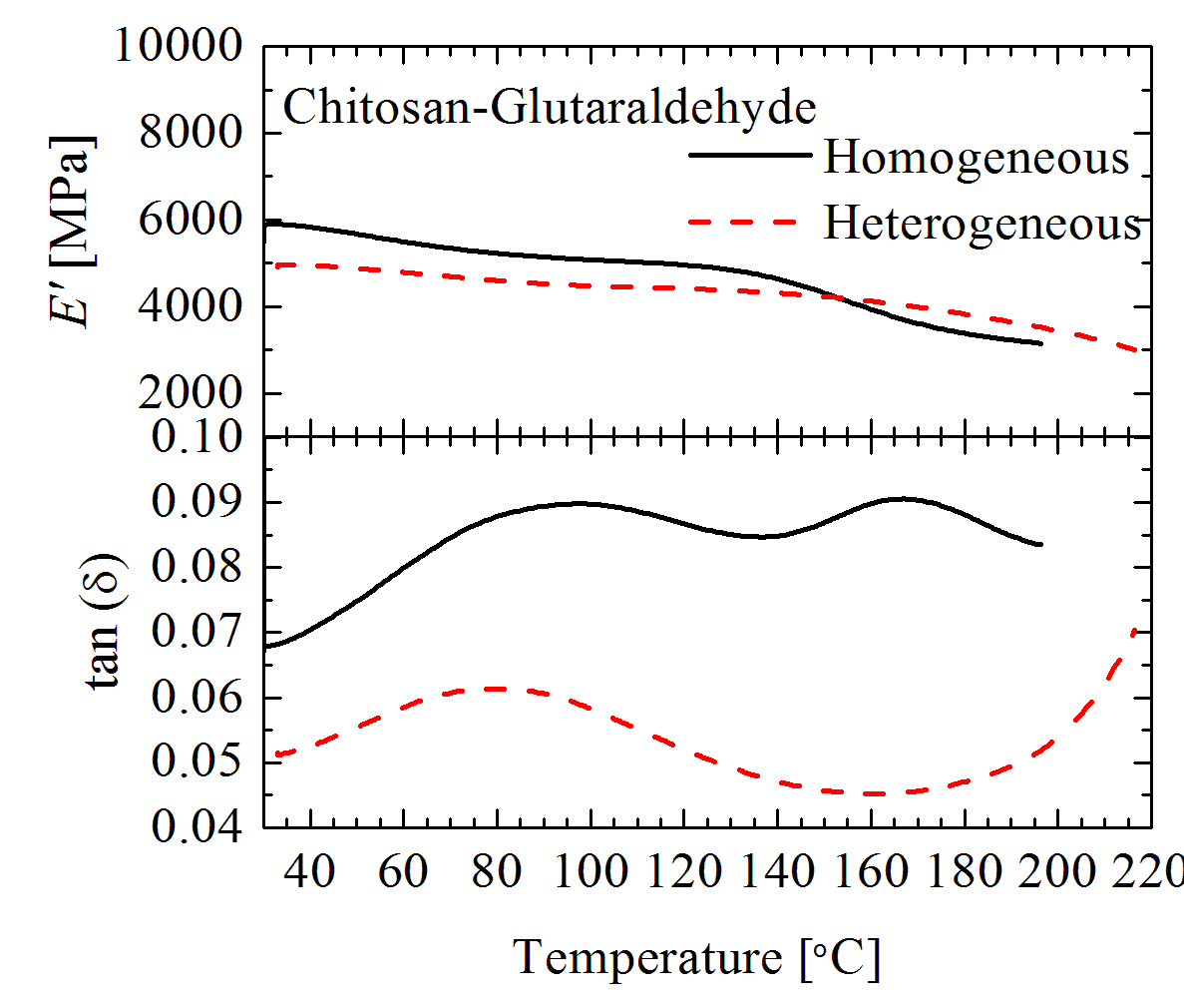
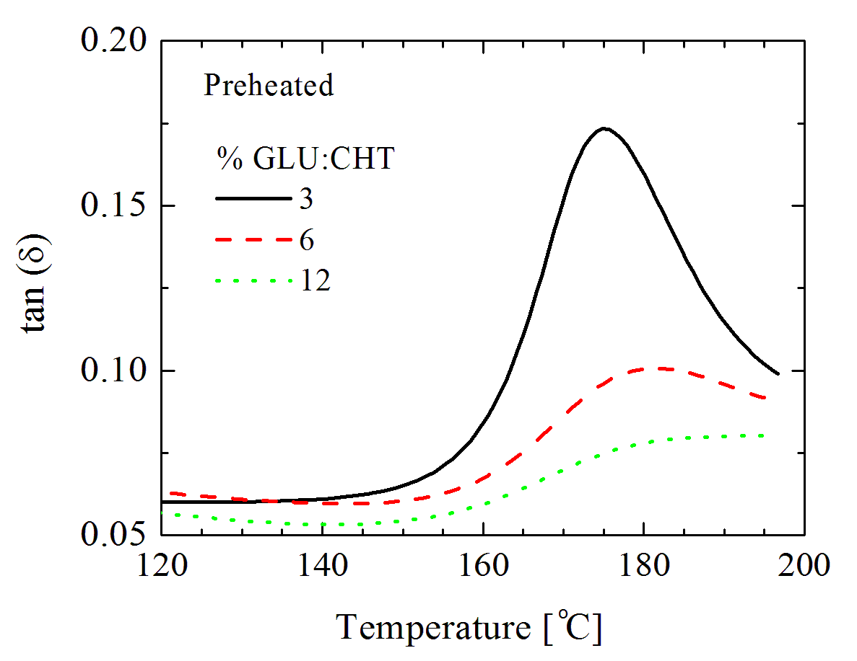
RESULTS
Crosslinking with Glutaraldehyde

Slide 21
Concluding Remarks & Upcoming Work
Contribution to knowledge on the viscoelastic properties of chitosan by incorporation of different crosslinkers and preheating conditions
No strong evidence of covalent crosslinking - considerations for using catalyst (sodium hypophosphite) to promote this
Investigate further heterogeneous and homogeneous crosslinking with glutaraldehyde; different concentrations, immersion times
Test physicochemical properties (TS, WVP) of chitosan-citric acid crosslinked films

Slide 22
Thank you for listening

Slide 23
Clip art references
lobster by Rutmer Zijlstra from the Noun Project
Crab by Icons Producer from the Noun Project
Shrimp by Iconic from the Noun Project
Mushrooms by Bakunetsu Kaito from the Noun Project
Squid by Cristiano Zoucas from the Noun Project
doodle by Kyle Tezak from the Noun Project
protein by Ricardo Moreira from the Noun Project
Pill by Hopkins from the Noun Project
Health by MRFA from the Noun Project
membrane fabric by Olena Panasovska from the Noun Project
Outfall by Luis Prado from the Noun Project
packaged food by Made from the Noun Project
protein powder by ProSymbols from the Noun Project
Beaker by Márcio Duarte from the Noun Project
drop by kareemovic2000 from the Noun Project
tray by Smalllike from the Noun Project

Slide 24
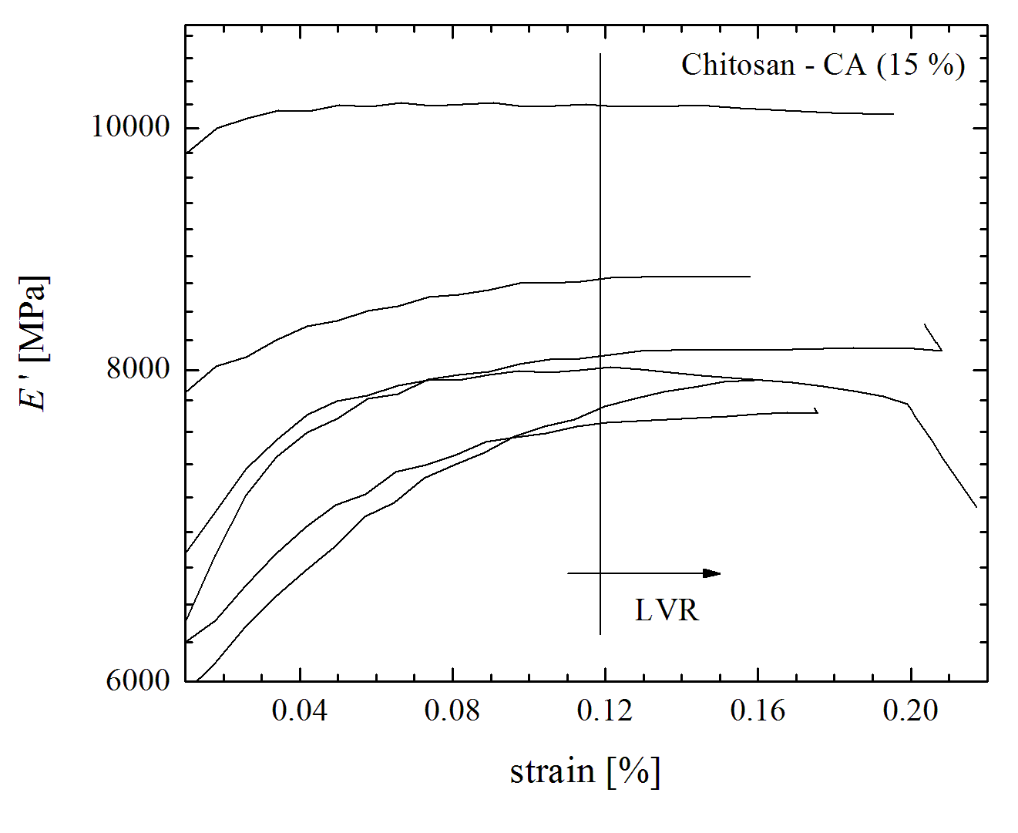
EXPERIMENTAL

