Slide 1
Dehydration Polymerization for Poly(hetero)arene Conjugated Polymers
Institute For Polymer Research
May 9, 2018
Presented By: Sara Abuadas
Supervisor: Derek Schipper
Notes:
Thank you for the kind introduction, My name is Sara Abuadas and I've been working under the supervision of Dr. Derek Schipper on a project about Dehydration Polymerization for Poly(hetero)arene Conjugated Polymers.

Slide 2


Semiconductors
Inorganic Semiconductors
Organic Semiconductors
Difficult to Process
Lightweight
Not Flexible
Flexible
Potentially Cheap
Expensive
Processable
Tunable
Notes:
Semiconductors are integrated into all of the electronics out there today.
A semiconductor is a substance, usually a solid chemical, element or compound, that can conduct electricity under some conditions but not others.
Inorganic semiconductors are widely used however they do have a few disadvantages to them such as they are difficult to process, they are not flexible, and can be expensive relative to organic semi conductors.
Interest in organic semiconductors has grown as they possess a few advantages such as they tend to be lightweight, can be flexible, potentially cheap, they are easier to process as well as they can be tuned depending on the properties required.

Slide 3
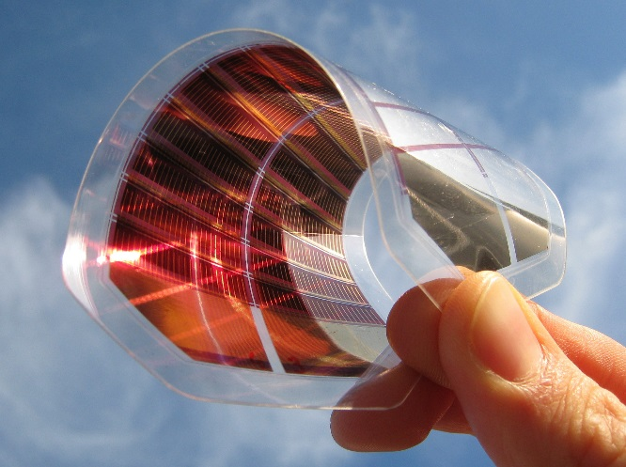
Organic Semiconductors
Conjugated Small Molecules
Conjugated Polymers
Poly(3-hexylthiophene)
Using PC₇₁BM as acceptor, PCE: 9.3%
Notes:
Organic semiconductors have made there way into various applications such as organic Light emmitting diodes, organic photovoltaics as well as field effect transistors. And we owe all this to two types of molecules; Conjugated small molecules and conjugated polymers.
Here we have a conjugated small molecule DRCN7T. Consists of 7 thiophene units as well as 2-(1,1-dicyanomethylene)rhodanine as the terminal unit. With PC71BM as the acceptor, a power conversion efficiency of 9.3% is obtained which is the highest so far for small molecules OPV’s.
As for conjugated polymers, this is poly 3 hexyl thiophene, which is used in OLEDS as well as field effect transistors due to its excellent properties as well as good thermal and chemical stability.

Slide 4
Synthesis of Conjugated Polymers
Transition Metals Required
Produces Metal Toxic Waste
Requires More Synthetic Steps
Notes:
These molecules are typically synthesized through transition metal cross-coupling reactions such as Suzuki and Stille reactions.
However these reactions typically require expensive transition metals such as Palladium/Tin, as well as they tend to produce stoichiometric amount of metal toxic waste.
Moreover, to access the precursors required for cross-coupling reactions, prefunctionalization of the substrate is necessary adding further synthetic steps to the total synthesis.

Slide 5
Dehydration
Industrial Polymers Via Dehydration
?
Notes:
Because we're limited to traditional cross-coupling reactions for conjugated polymer synthesis, we have difficulty making these things on large scale. Further more, residual transition metal impurities result in lower efficiencies.
If we take a look at how we prepare industrial polymers on a large scale, one reaction often used is a dehydration or polycondensation reaction which only produces water as a byproduct.
The first example here shows synthesis of polyethylene terephthalate from the condensation reaction of terephthalic acid and ethylene glycol which actually happens to be the fourth most produced polymer.
The second example is the synthesis of nylon 6,6 from hexamethylenediamine and adipic acid which is also produced on a multi ton scale.
The question was can we streamline the production of conjugated polymers in a similar manner through the dehydration of heteroarenes and arenes. That way we can eliminate the use of metals, while still creating sp2 carbon-carbon bonds.

Slide 6
Dehydration Reaction
Dehydration Reaction
Minimal Workup
New Heterocyclic Biaryl C-C Bond
No Transition Metal
Water Byproduct
Notes:
We envisioned being able to synthesize conjugated polymers using a dehydration type reaction.
In fact we were able to develop a reaction of that type using thiazole N-oxides as the substrate. In this example, an equivalent of 4,5 dimethyl thiazole n-oxide is reacted with another equivalent of the same n-oxide forming this sp2 carbon carbon bond between the two thiazole molecules, eliminating an equivalent water as the byproduct.
These thiazole n-oxides can be accessed through a simple oxidation reaction using mild oxidants such as mcpba.
In this dehydaration example of this thiazole, the dimer was obtained in an 88% yield. Again notice that the oxide is lost on one of the thiazole molecules in the dimer.
This reaction typically occurs in 5 minutes requiring minimal workup while still maintaining relatively high yields.
Again carbon carbon bond formation occurs without the use of transition metals and with water as a by product.

Slide 7
Reaction Development
Entry | Solvent | Base | Temp (˚C) | Time (Min) | Yield (%)
1 | PhMe | NaOtBu | 90 | 30 | 25
2 | PhMe | NaOtBu | 50 | 30 | 63
3 | PhMe | NaOtBu | rt | 30 | 25
4 | PhMe | LiOtBu | rt | 30 | 83
5 | Et₂O | NaOtBu | rt | 30 | 70
6 | THF | LiOtBu | 0 | 30 | 77
7 | THF | LiOtBu | 0-rt | 5 | 88
Notes:
The reaction conditions were optimized by screening various solvents, bases, temperatures and reaction time.
First, Sodium tert butoxide was used for the dehydration reaction at 90 degrees for 30 minutes obtaining a 25% yield of the dimer.
Lowering the temperature to 50 degrees caused an increase in yield to 63 %.
Decreasing the temperature to rt caused a significant decrease in yield.
Changing the base to Lithium tertbutoxide resulted in a significant increase in yield.
Changing the solvent to diethylether and swapping the base back to sodium tertbutoxide decreased the yield to 70%.
Using THF as the solvent, lowering the temperature to 0 degrees, as well as using lithium tertbutoxide caused an increase in yield.
Finally running the reaction from 0-rt for 5 minutes gave us the highest yields and those conditions were chosen.

Slide 8
Proposed Mechanism
Notes:
The mechanism hasn’t been studied in great detail yet but here is a proposed mechanism. A base first deprotonates the most acidic proton generating a carbanion. This carbanion then attacks a second equivalent of thiazole n-oxide, causing it to lose aromaticity. Then through a proton transfer as well as an elemination, aromaticy is regained, generating the thiazole dimer as well as water.

Slide 9
Small Molecules Scope
Notes:
We then tested the scope of the dehydration reaction. The reaction tolerated different thiazole derivatives such as ones containing alkyl chains. Moreover thiazole derrivatives containg aryl groups with electron withdrawing substituents as well as aryl groups with electron donating and electron nuetral substituents. Lastly thiazole derrivatives containing other heteroarenes such as thiazole and thiophene were used. The yields for the most part are over 80% with the exception of a few compounds.

Slide 10
Cross Dehydration and Reduction
Cross Dehydration
21% 2:1
Reduction
Notes:
We were also able to access cross dehydration products of various thiazoles. In this example 4,5 dimethyl thiazole n-oxide was reacted with 5 phenyl thiazole n-oxide forming all four isomers,
Moreover we are able to remove the n-oxide functional group using zinc dust in THF and aqueous ammonium chloride to give the deoxygenated product in 97% yield.
This reduction reaction seems to work well with other dehydration products reducing this n-oxide group in an 89% yield.

Slide 11
Dehydration Polymerization
Monomer Synthesis
Dehydration Polymerization
Notes:
Next, we thought of using the dehydration reaction to synthesize polymers. This can be done by incorporating two thiazole molecules on each end of a conjugated pi spacer. which can be done using a direct arylation reaction, then both thiazoles were oxidized to form the di-noxide. When the dinoxides were reacted with base a polymer with respectable molecular weights was formed.

Slide 12
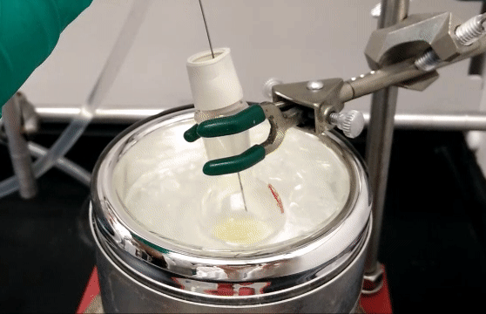
Dehydration Polymerization
Notes:
This reaction tends to occur quite rapidly, as you can see as soon as one drop of base is added, polymer can be seen crashing out in the round bottom flask.
GPC relative

Slide 13
Dehydration Polymerization Scope
Notes:
We managed to synthesize a few polymers using the dehydration reaction with respectable molecular weights. One incorporating a fluorene pi conjugated spacer, one with an aryl pi conjugated spacer and one with a thiophene pi conjugated spacer.
We thought of using this reaction to also synthesize molecularly defined oligomers but before diving into that lets talk about a few of the advantages and disadvantages of polymers vs. small molecules

Slide 14
Advantages and Disadvantages
Conjugated Polymers
Advantages:
Higher performance
Disadvantages:
No defined structure
Batch to batch variation
Conjugated Small Molecules
Advantages:
Less batch to batch variation
Defined structure
Disadvantages:
Lower performance
Power Conversion Efficiency: 5.7% to 2.5%
Notes:
One of the advantages of using conjugated polymers over conjugated small molecules is that they tend to have higher performances. As for disadvantages: Polymers don’t have defined structures. So, After a polymerization reaction, a distribution of molecular weights is obtained relative to having one molecule with a precisely defined structure. And that can be problematic because it introduced batch to batch variation. One study done on 5 batches of PCDTBT which is a conjugated polymer used in photovoltaics, showed that Power conversion efficiency was reduced with increasing amounts of small molecular weight component in that batch. This is disadvantageous in photovoltaics, because you would want to obtain high efficiencies consistently
As for conjugated small molecules advantages include, less batch to batch variation because they have a defined structure. So you’re always isolating the same small molecules consistently. However, they tend to have lower performances relative to conjugated polymers
Moreover in conjugated polymer synthesis, polymerization reactions such as stille tend to give big distributions.

Slide 15
Advantages and Disadvantages
Conjugated Polymers
Disadvantages:
No defined structure
Batch to batch variation
Conjugated Small Molecules
Disadvantages:
Lower efficiencies
Notes:
we wanted to combine the advantages of both polymers and small molecules by having a very large small molecule with same molecular weight as polymer but without the distribution.
Hopefully this will contain the advantages of both while getting rid of the disadvantages.
in sense that they would have molecularly defined structures which would essentially eliminate the batch to batch variation and hopefully have higher performances.
We would like to synthesize these long conjugated molecules through an iterative divergent convergent type approach

Slide 16
Iterative Divergent/Convergent (IDC) Approaches
Orthogonal protected monomer
Deprotecting
Coupling
Deprotecting
Coupling
Notes:
An iterative divergent/convergent approach starts off with an orthogonally protected monomer. In this case we have protecting groups A and B. This protected monomer is partitioned half, where opposite sides are deprotected. In this half, were deprotecting B and in the other A is deprotected. The two are then coupled, typically through a cross-coupling reaction affording an orthogonally protected dimer. The orthogonally protected dimer is then partitioned again and opposite sides are once again deprotected. And through another coupling reaction, a tetramer is formed. Essentially after every deprotecting/coupling cycle, the molecular weight is doubled. This type of approach allows you to access long molecules in minimal synthetic steps. As well the ability to control the chain length and sequence of order. Once the desired length of molecule is obtained the end groups are deprotected and functionalized accordingly

Slide 17
General IDC Approach
Br(CH₂)(CH₂)₁₀CHO
Wittig Reaction
BrCH₂(CH₂)₁₀CH=CH(CH₂)₁₀CHO
Wittig Reaction
Repetition until C₁₉₂
Notes:
This approach was first utilized by Whiting in 1982 where they synthesized an orthogonally protected bromo-acetal, which was partitioned in half. In one half the bromo acetal was deprotected affording the aldehyde while the second half was reacted with triphenylphosphine, forming the phosphinium salt. Upon addition of a base, the Ylide was formed which was reacted with the aldehyde through a wittig reaction, forming the C24 orthogonally protected bromo acetal. Once again, the dimer was slpit in half where the acetal was deprotected generating the aldehyde in the first half. While the second half was reacted with triphenylphosphine generating the phosphnium salt and through another round of Wittig reaction the molecular weight was doubled once again forming the C48 protected tetramer. The same reactions were repeated twice more synthesizing the C96 and C192.

Slide 18
IDC Approach for Conjugated Systems
Oligo(thiophene ethynylene)s (OTE)s
Oligo(p-phenylene)s
n= 1,2,4,8,16
Oligo(phenylene ethynylene)s (OPE)s
n= 1,2,4,8
n= 1,2,4,8
a) (i) LDA, (ii) I₂; b) K₂CO₃ ; c) Pd(PPh₃)₂Cl₂, CuI, i-Pr₂NH
Notes:
This approach has also been used to synthesize conjugated oligomers. The tour group, synthesized oligo(thiophene ethynylenes) using an IDC approach. First they synthesized the thiophene monomer with protected alkyne unit. It was then split in half where the 5 position was iodinated in one half, and the alkyne was protodesilylated in the other half. The two were then coupled through a SONOGASHIRA cross coupling reaction generating the dimer. Repetition of the same 3 reactions afforded the tetramer, octamer and 16-mer. This type of approach has also been used to synthesize other classes of conjugated oligomers such as Oligo(para-phenylenes) as well as Oligo(phenylene, ethynylenes). So far this approach has been limited to phenyl and alkyne systems.

Slide 19
Approach Inspired by IDC
Deprotecting
Oxidation
Coupling
Dehydration
Oxidation
Deprotecting
Coupling
Dehydration
Notes:
Our proposal is to use a similar type approach to an IDC using oxidation/dehydration reactions to synthesize long conjugated polymers containing thiophene and thiazole building blocks.
We’re gonna do this by starting off with a thiazole derivative, oxidizing it to form the n-oxide, then use a dehydration reaction to get to the dimer,
If we oxidize the dimer and do another dehydration reaction, a tetramer is formed. And that way we’ve doubled the molecular weight of our molecule after every oxidation/dehydration cycle.
Our approach compared to the typical IDC approach requires less synthetic steps. 6 reactions are required to reach a tetramer using a typical IDC approach while only 4 reactions are required for ours.
Moreover, our approach doesn’t deal with protecting and deprotecting groups, just activation of certain bonds. That way we don't have to spend time screening for protecting groups that are suitable with our reaction conditions.

Slide 20
IDC Approach
40%
25%
90%
70%
Notes:
In this case we synthesized the monomer through a direct arylation reaction of 2-5 dibromothiophene with 4 methyl thiazole producing this compound in a 40% yield. We then oxidized it using mcpba and isolated the mono n-oxide in a 25% yield. Dehydration of the mono n-oxide resulted in dimer formation in a 90% yield. the product of the second oxidation was slightly unstable. However pushing the reaction forward through a dehydration reaction resulted in formation of the tetramer.
Over the two reactions 70% yield.
I’d like to make note of the Regioselectivity, If this n-oxide was here instead of here a different isomer would be formed. And after the dehydration reaction we’re isolating a mixture of isomers which we can then completely reduce to get the one molecule without the N-Oxide group.

Slide 21
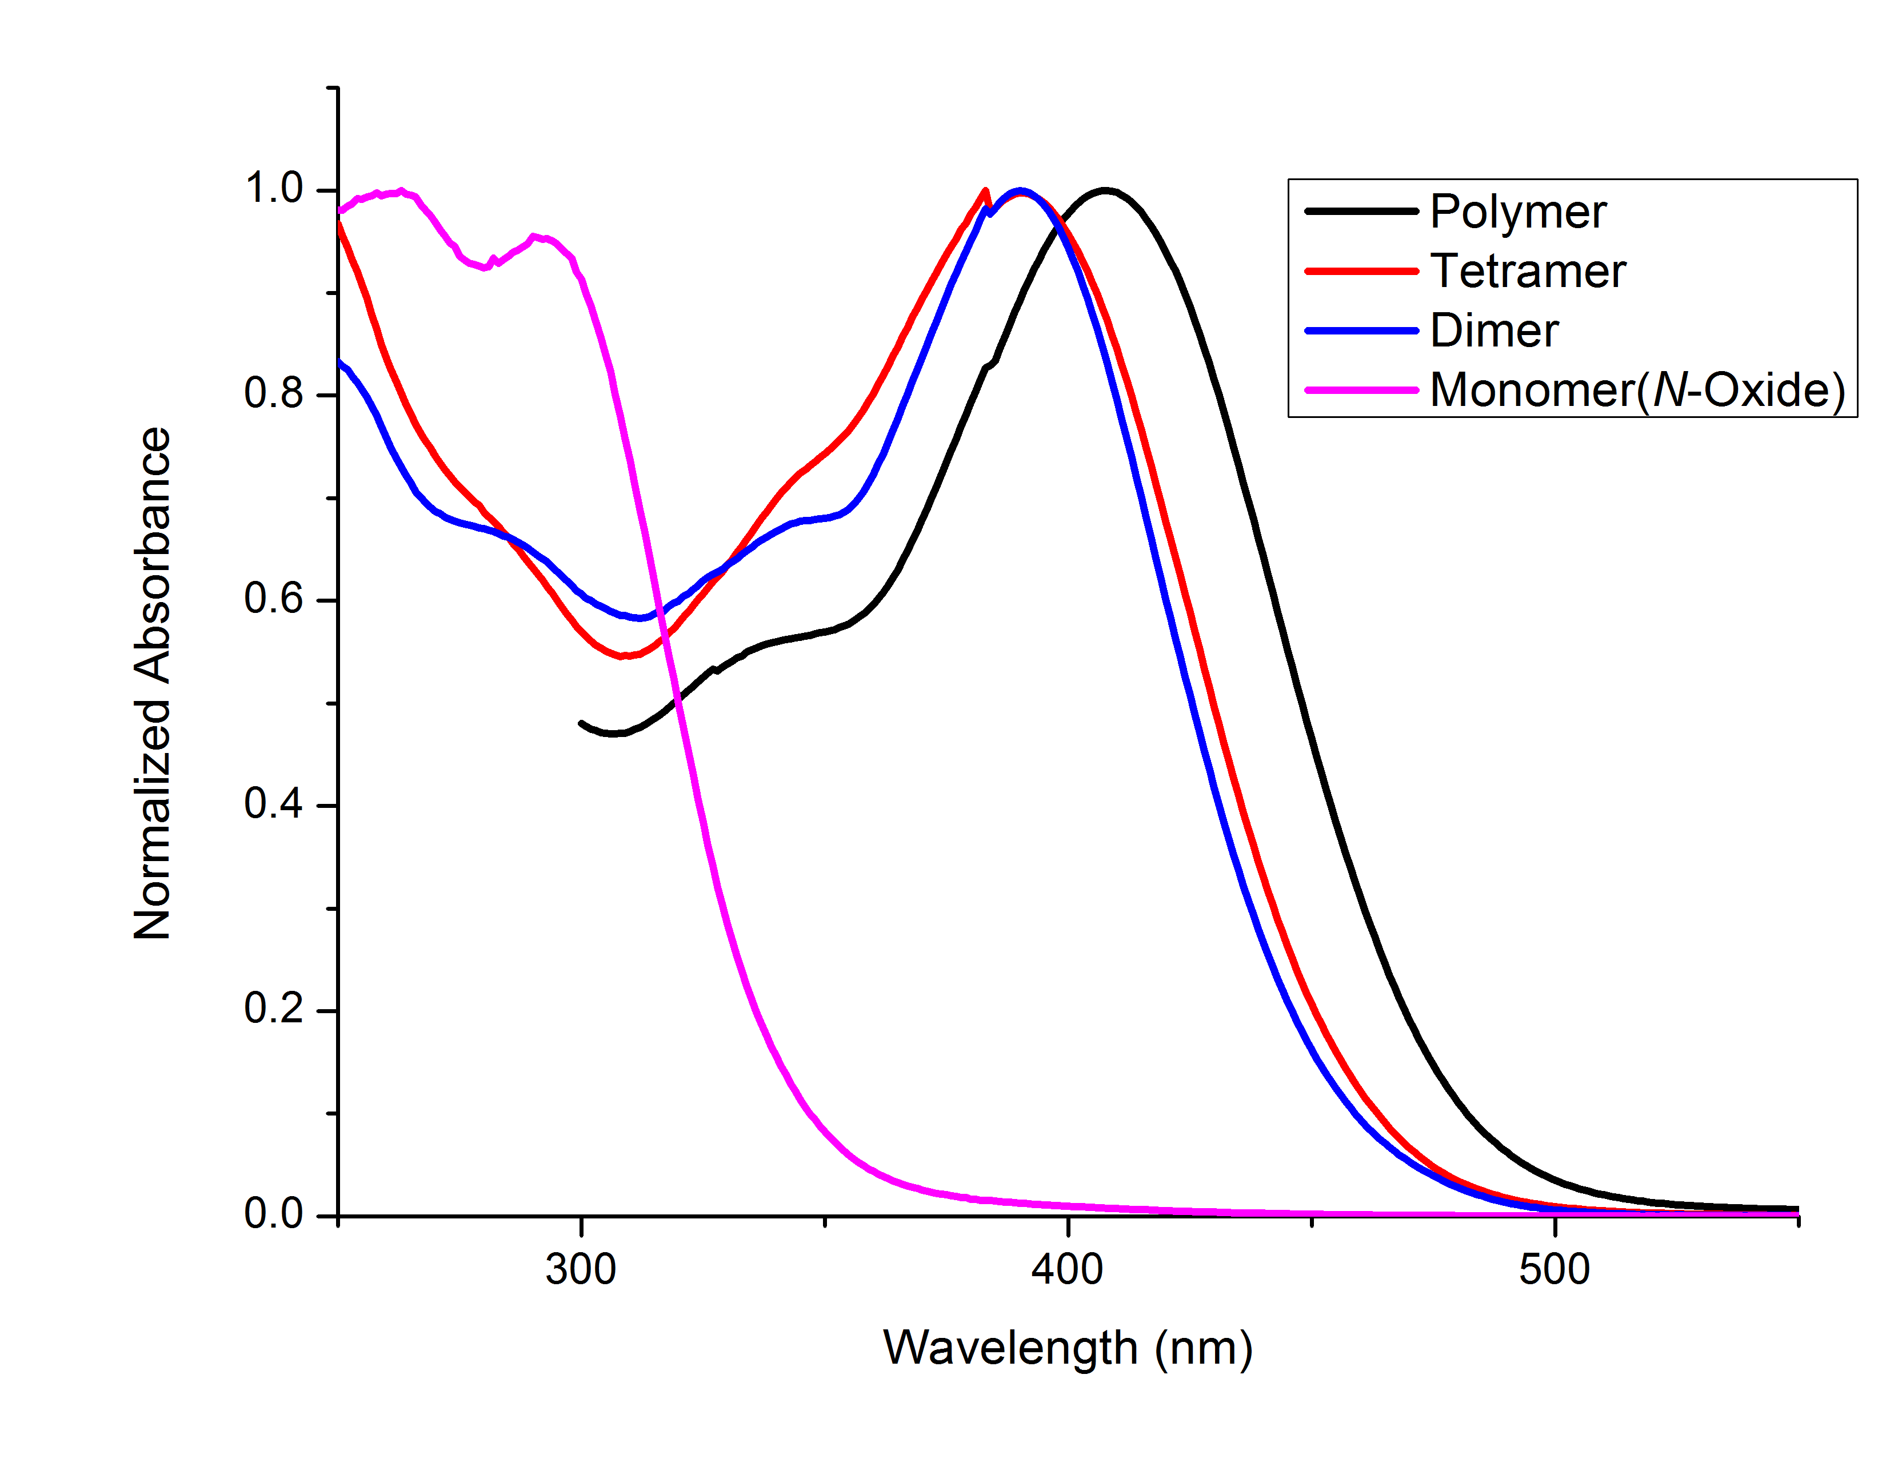
IDC Approach
Peak RV - (ml) | 19.633 | 20.850
Mn - (Daltons) | 2,636 | 815
Mw - (Daltons) | 2,926 | 864
Mz - (Daltons) | 3,313 | 915
Mp - (Daltons) | 2,448 | 776
Mw/Mn | 1.110 | 1.061
Peak RV - (ml) | 19.633 | 20.850
Mn - (Daltons) | 2,636 | 815
Mw - (Daltons) | 2,926 | 864
Mz - (Daltons) | 3,313 | 915
Mp - (Daltons) | 2,448 | 776
Mw/Mn | 1.110 | 1.061
Peak RV - (ml) | 19.633 | 20.850
Mn - (Daltons) | 2,636 | 815
Mw - (Daltons) | 2,926 | 864
Mz - (Daltons) | 3,313 | 915
Mp - (Daltons) | 2,448 | 776
Mw/Mn | 1.110 | 1.061
Peak RV - (ml) | 19.633 | 20.850
Mn - (Daltons) | 2,636 | 815
Mw - (Daltons) | 2,926 | 864
Mz - (Daltons) | 3,313 | 915
Mp - (Daltons) | 2,448 | 776
Mw/Mn | 1.110 | 1.061
Peak RV - (ml) | 19.633 | 20.850
Mn - (Daltons) | 2,636 | 815
Mw - (Daltons) | 2,926 | 864
Mz - (Daltons) | 3,313 | 915
Mp - (Daltons) | 2,448 | 776
Mw/Mn | 1.110 | 1.061
Peak RV - (ml) | 19.633 | 20.850
Mn - (Daltons) | 2,636 | 815
Mw - (Daltons) | 2,926 | 864
Mz - (Daltons) | 3,313 | 915
Mp - (Daltons) | 2,448 | 776
Mw/Mn | 1.110 | 1.061
Peak RV - (ml) | 19.633 | 20.850
Mn - (Daltons) | 2,636 | 815
Mw - (Daltons) | 2,926 | 864
Mz - (Daltons) | 3,313 | 915
Mp - (Daltons) | 2,448 | 776
Mw/Mn | 1.110 | 1.061
Notes:
Taking the tetramer and putting it through our GPC resulted in this plot over here with a narrow distribution

Slide 22
UV-VIS
Peak RV - (ml) | 19.633 | 20.850
Mn - (Daltons) | 2,636 | 815
Mw - (Daltons) | 2,926 | 864
Mz - (Daltons) | 3,313 | 915
Mp - (Daltons) | 2,448 | 776
Mw/Mn | 1.110 | 1.061
Peak RV - (ml) | 19.633 | 20.850
Mn - (Daltons) | 2,636 | 815
Mw - (Daltons) | 2,926 | 864
Mz - (Daltons) | 3,313 | 915
Mp - (Daltons) | 2,448 | 776
Mw/Mn | 1.110 | 1.061
Notes:
We did some UV-VIS spectroscopy on the monomer, dimer, tetramer and polymer as you can see in the plot of absorbance VS wavelength.
The mono n-oxide is the most blue shifted with two peaks at around 250 and 300 nm. Once the molecular weight was doubled you can see a significant red shift to around 390 nm. There isn’t a significant difference between the peak for the dimer and tetramer. However there is a slight red shift to 410 nm going from tetramer to polymer.

Slide 23
Conclusion
Dehydration Reaction
Small Molecules
Development of the reaction
Various small molecules were synthesized
EWD/EDG, incorporation of other groups
Dehydration Polymerization
Reaction extended to polymerization
3 different polymers were synthesized
Molecularly Defined Oligomer
Problematic oxidation lead to synthesis of only one example
Notes:
To conclude we were able to develop a dehydration reaction. Use it to synthesize various small molecules with various aryl and heteroaryl groups.
We extended its use to synthesize polymers through the synthesis of the Di-N oxides and reacting that with base.
And lastly used the dehydration reaction to synthesis an oligomer in a stepwise approach.

Slide 24

Acknowledgments
Dr. Derek Schipper
IPR Organizers
Rafael Mirabal
Geoffery Sinclair
Serxho Selmani
Jianan Wang
Luke Vanderzwet
Monika Kaulak
Wayne Wang
Dr. Emmett
#SchipperLabChristmasParty
Notes:
I would like the thank my supervisor Derek Schipper for his support on this project, as well all members of the schipper group for their consistent help and support! A Special shoutout to Luke Vanderzwet for synthesizing all of the polymers in this project. And to Raff for the cross-dehydration as well as reduction of the small molecules. And Dr. Emmett for kickstarting the project.
and of course all of you for your kind attention!

