Slide 1

Characterization of Gemini Surfactants and their Interactions with DNA by Pyrene Excimer Formation (PEF)
By
Abdullah Basalem
Supervisor: Prof. Jean Duhamel
May 9, 2018

Slide 2
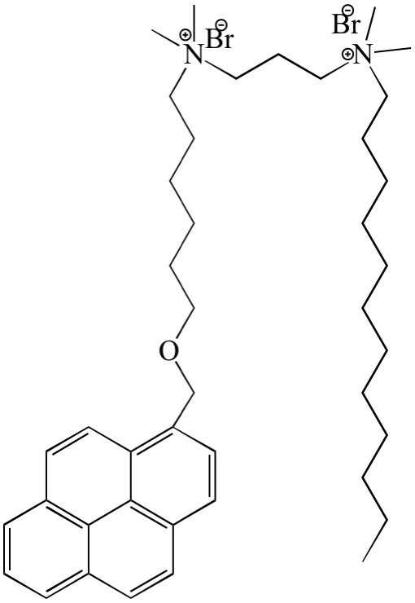
Gemini Surfactants
±
±
±
±
Spacer
Lower CMC than its regular counterparts.
More efficient in lowering water surface tension.
Ability to complex with DNA for gene delivery.
Spacer
Py
Py
Angew. Chem. Int., Ed. 2003, 42, 1448– 1457.

Slide 3


Pyrene Excimer Formation
Monomer Emission “I_{M}”
Excimer Emission “I_{E}”
Monomer Decay
Py_{diff}
$${1/τ}_{m}$$
Py_{free}
$${1/τ}_{E}$$
Py_{agg}
Excimer Decay

Slide 4
Characterization of PyO-3-12
By time-resolved fluorescence:
CMC = 0.37 ± 0.02 mM
By tensiometry:
CMC = 0.42 ± 0.04 mM
CMC
CMC

Slide 5
Interactions of PyO-3-12 with DNA
The interactions with DNA was done by using calf thymus DNA (CT-DNT).
(-/+) ratio is used to express the concentrations of both CT-DNA and PyO-3-12.
[PyO-3-12] was kept constant at 0.1 mM.
[CT-DNA] was varied to cover 0 – 1.7 -/+ ratio.
Three distinct regions can be clearly identified in both I_{E}/I_{M} vs -/+ ratio and I₁/I₃ vs -/+ ratio.
- - - - - - - -
- - - - - - - -
- - - - - - - -
- - - - - - - -
- - - - - - - -
- - - - - - - -

Slide 6
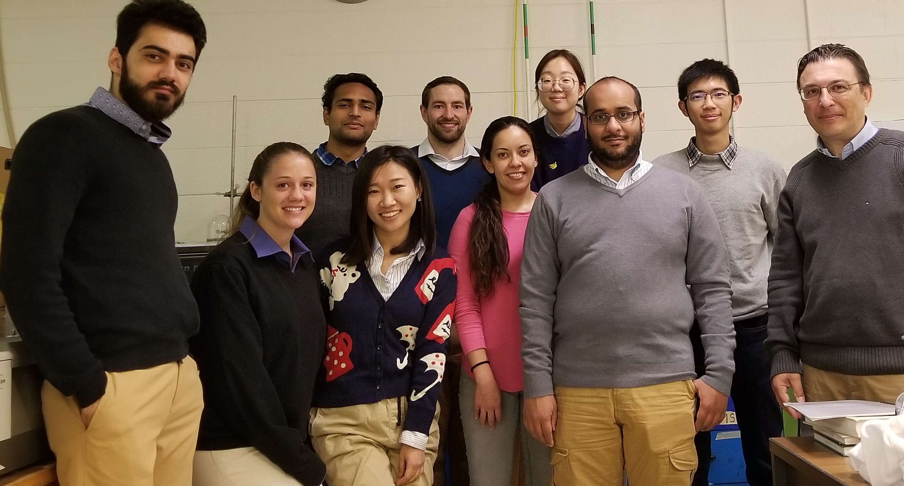
Future Work & Acknowledgments
To sum up:
  PyO-3-12 was synthesized and characterized and its CMC was found to be 0.42 mM and 0.37 mM by tensiometry and TRF respectively.
  The interactions between DNA/PyO-3-12 was probed using fluorescence and further investigation needs to be done to have full picture.
For future work:
  Further characterization of PyO-3-12 such as Nagg determination and DLS.
  More DNA/PyO-3-12 studies need to be done.
  The interactions of DNA/PyO-3-12 complexes with the helper lipid (DOPE) should be performed next.
Prof. Jean Duhamel.
Committee Members.
Duhamel and Gauthier’s lab members.
HEHD & NSERC.

