Slide 1
UV-absorbing Cellulose Nanocrystals as Functional Reinforcing Fillers in Poly (vinyl chloride) Film Zhen Zhang, Gilles Sèbe, Xiaosong Wang, Kam C. Tam
wzhangzhen@gmail.com

Slide 2
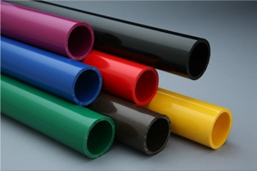
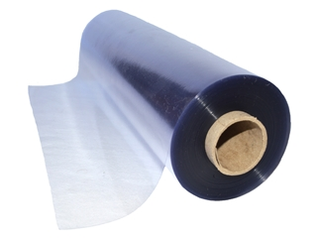
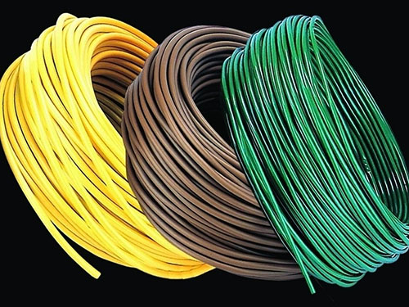
Poly (vinyl chloride) (PVC)
Pipes
Films
Construction
Electronics
Issues of PVC:
Low thermal stability: manufacturing
Weathering degradation due to heat and UV light
Consequences:
Color change: discoloration or bleaching
Mechanical performances: hard & brittle
Objective: Utilisation of Cellulose Nanocrystals (CNCs) as reinforcing agents and stabilisers in PVC
Waste management 2016, 48, 300-14. Polymer Composites 2016, 37 (7), 2171-2183. Polymers 2015, 7 (9), 1767-1788.

Slide 3
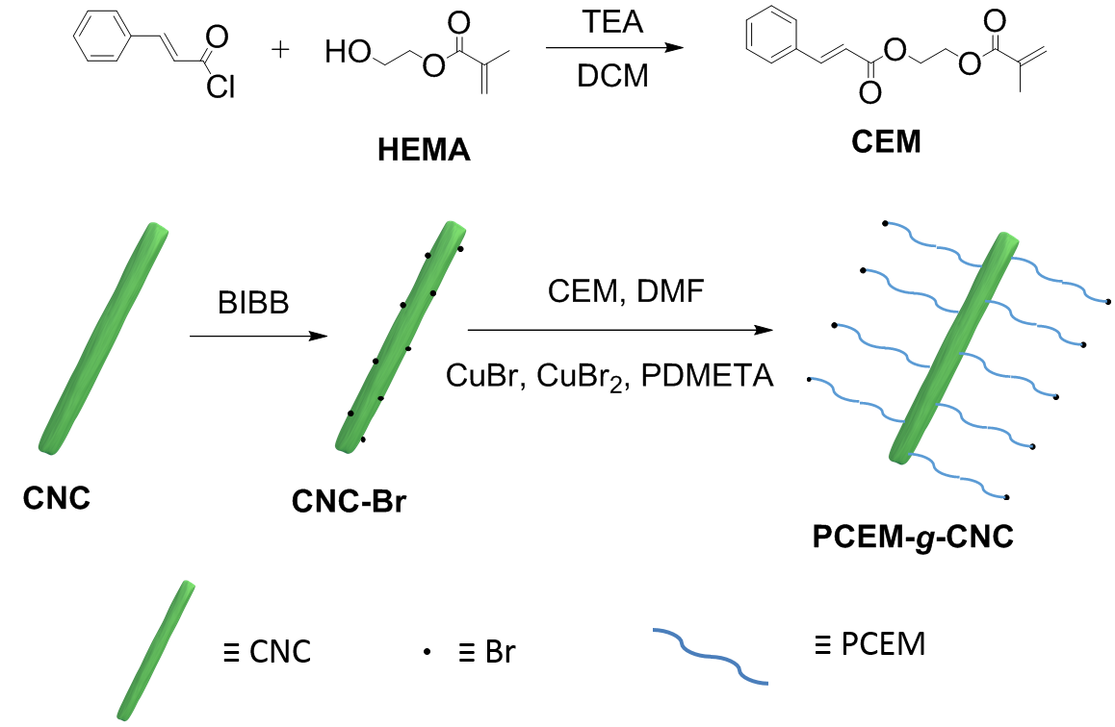
Preparation and UV crosslinking of PCEM-g-CNC
Poly(cinnamoyloxy ethyl methacrylate) (PCEM) grafted at the CNC surface by surface initiated Atom Transfer Radical Polymerization
PCEM-g-CNC film undergoes photodimerization when irradiated by UV irradiation
The CNCs should impart reinforcing properties
PCEM is photoactive and is expected to impart UV-absorbing and photo-crosslinking properties
The UV absorption of the conjugated C=C bond at 276 nm decreased with time during irradiation----->> cross-linking
Macromolecules 2014, 47 (23), 8247-8254. Nature 2005, 434 (7035), 879-882.

Slide 4
Optical properties of PVC/PCEM-g-CNC films
Transmittance before and after annealing at 80 ºC
Transmittance before and after UV irradiation at 365 nm
Highly transparency in the visible region with the PCEM-g-CNC filler
UV-blocking properties (below 320 nm)
UV-stabilizer for PVC: the lowest transmittance increase in the visible region after UV irradiation
Thermal stabilizer for PVC: the lowest transmittance reduction in the visible region after heat annealing

Slide 5
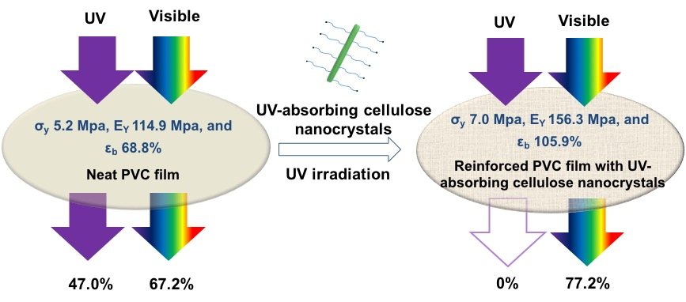
Mechanical properties of PVC/PCEM-g-CNC films
Tensile testing before and after 24 h UV irradiation at 365 nm
PCEM-g-CNC/PVC film: one stone four birds
(1) UV-blocking (2) UV-resistance
(3) Thermal stability (4) Mechanical performance
The PCEM-g-CNC filler act as reinforcing agent The mechanical performances of the PVC/PCEM-g-CNC film increase after UV irradiation
UV-Absorbing Cellulose Nanocrystals as Functional Reinforcing Fillers in Poly(vinyl chloride) Films. Zhen Zhang, Gilles Sèbe, Xiaosong Wang, and Kam C. Tam. ACS Applied Nano Materials 2018 1 (2), 632-641. DOI: 10.1021/acsanm.7b00126

Slide 6
Acknowledge
Thanks for your attention
Thanks to supervisors and lab mates.
wzhangzhen@gmail.com

