Slide 1
Access to Poly(heteroarylene-vinylene)s via Rhodium(III)-Catalyzed Hydroarylation of Alkynes
IPR 2018
Serxho Selmani

Slide 2
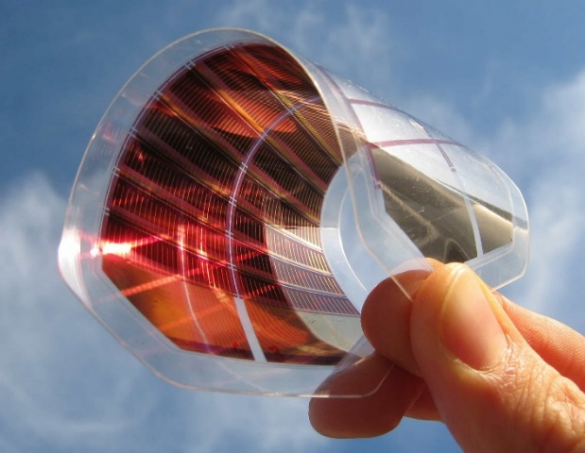
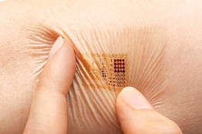
Conjugated Polymers
Photovoltaics
Smart Skin
Flexible Displays
Quinoidal Form

Slide 3
Poly(p-phenylene-vinylene)s
First electroluminescent polymers
Gilch: (1966)
Poor functional group and heteroaromatic tolerance
Many synthetic steps
Swager: (1995)
Small scope of reactivity
H. G., Gilch and W. L. Wheelwright, J. Polym. Sci. A-1 Polym. Chem. 1966, 4, 1337.
M. J. Marsella, D.-K. Fu, T. M. Swager, Adv. Mater. 1995, 7, 145.

Slide 4
Direct Arylation Polymerization
Less synthetic complexity and cost
P., Berrouard, et al., Angew. Chem. Int. Ed. 2012, 51, 2068.
D. J. Schipper, M. Hutchinson, K. Fagnou, J. Am. Chem. Soc. 2010, 132, 6910.

Slide 5
Scope of Polymerization

Slide 6
Absorption Emission Spectra

Slide 7
Absorption Emission Spectra

Slide 8
Absorption Emission Spectra

Slide 9
Conclusion
Developed new method for access to heteroaromatic conjugated polymers
Electron rich and poor aromatics are tolerated
Reduced synthetic complexity

Slide 10
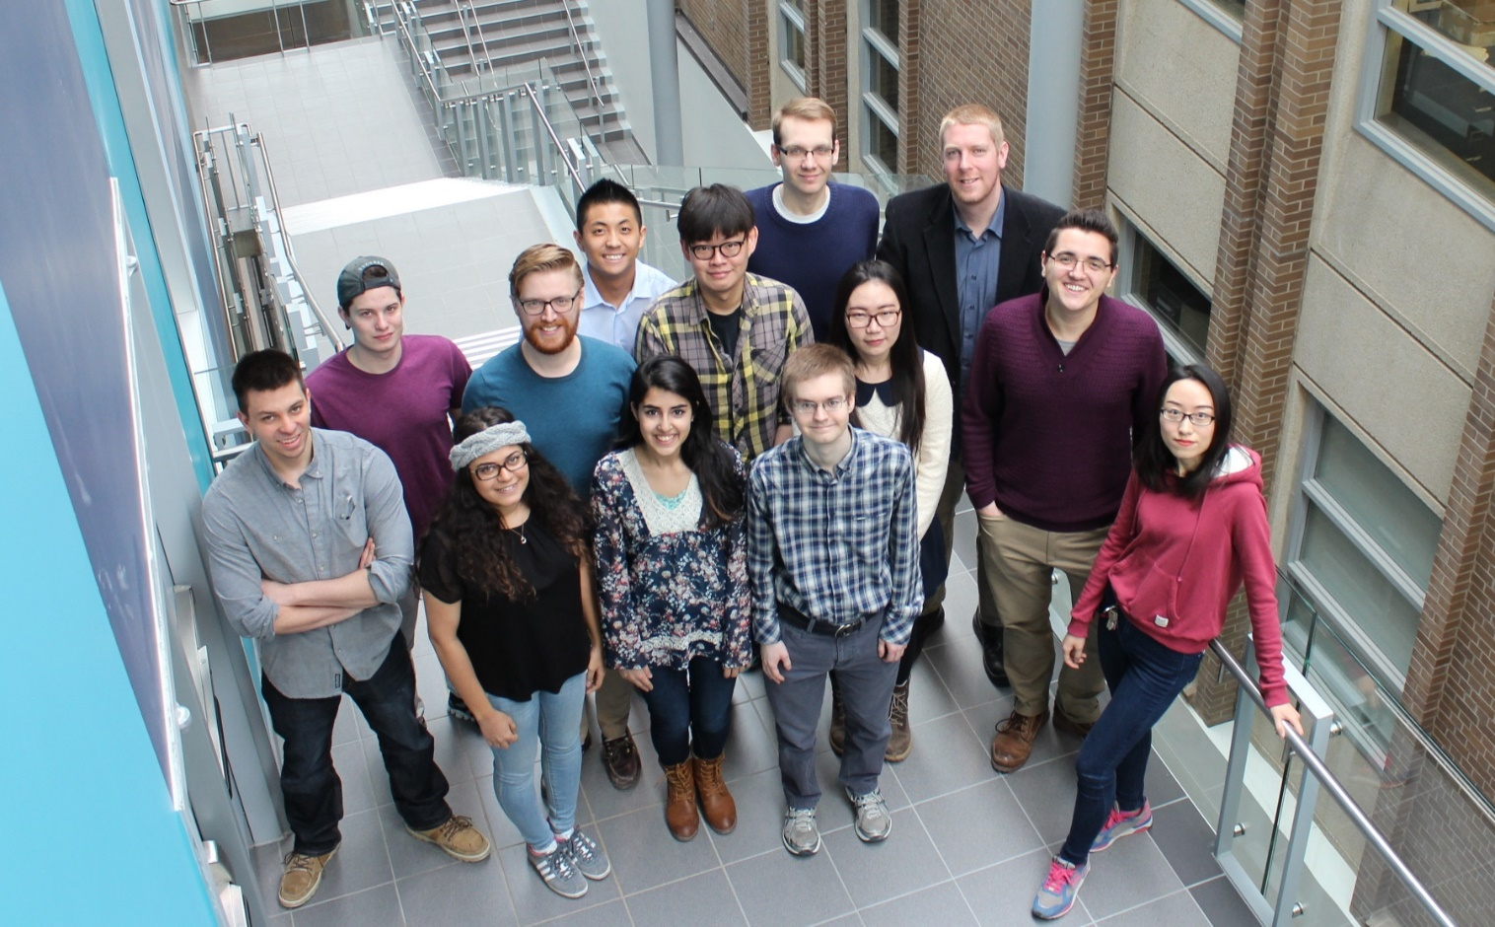
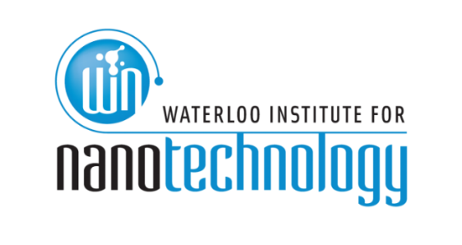
Acknowledgements
Dr. Derek Schipper
Luke Vanderzwet
Andrew Kukor

