Slide 1





Detecting Minute Quantities of Nitrated Organic Compounds by Fluorescence Quenching of Pyrene-Labeled Starch Nanoparticles
By: Sanjay Patel
Supervisor: Jean Duhamel
University of

Slide 2
Outline
Introduction
- General Overview for Nitrated Compound Detection
- Starch Nanoparticles
- Pyrene
Experimental
- Synthesis of Pyrene Labeled Starch Nanoparticles
- Quenching Experiments in DMSO and Water
- Quenching studies on Py-SNP-coated filter paper
Conclusions
Future work
Acknowledgements

Slide 3
Outline
Introduction
- General Overview for Nitrated Compound Detection
- Starch Nanoparticles
- Pyrene
Experimental
- Synthesis of Pyrene Labeled Starch Nanoparticles
- Quenching Experiments in DMSO and Water
- Quenching studies on Py-SNP-coated filter paper
Conclusions
Future work
Acknowledgements

Slide 4
General overview: Nitrated Organic Compounds
Security Risks¹
→ Typically nitrated organic compounds are explosive
Health and Environmental concerns¹
→ Have toxic and mutagenic effects
→ Ground water contaminations
Kou-San, J. and Parales, R. Nitroaromatic Compounds , from Synthesis to Biodegradation Microbiol. Mol. Biol. Rev. 2010, 74. 2, 250-272.

Slide 5
General Overview: Current detection methods
Ion mobility spectroscopy
→ Pros: High sensitivity, high throughput, reliable, robust
→ Cons: Cost prohibitive, not portable
Canines
→ Pros: Low detection limits (ppt)
→ Cons: Expensive to train and maintain, tire, will get distracted
Caygill, J. S.; Davis, F.; Higson, S. P. J. Current Trends in Explosive Detection Techniques. Talanta. 2012, pp 14–29.

Slide 6
General Overview: Current Research
Analytic instrumentation approach¹
→ Ion mobility spectroscopy, mass spectroscopy, Raman spectroscopy, etc.
→ Pros: Typically are sensitive, selective, and robust
→ Cons: Prohibitively expensive, and non-portable
Sensor techniques^{1,2}
→ Electrochemical sensors, mass sensors, optical sensors, biosensors and etc
→ Pros: Typically are portable, easily operated, cost effective
→ Cons: “Expensive” to produce, lack in sensitivity, selectivity, and reliability
Caygill, J. S.; Davis, F.; Higson, S. P. J. Current Trends in Explosive Detection Techniques. Talanta. 2012, pp 14–29.
Singh, S. Sensors-An effective approach for the detection of explosives. J. Hazard. Mater. 2007, 144, 15-28.

Slide 7
Criteria for a optical sensor
Cost effective
Portable
  → Typically they are incorporated into hand held devices
Sensitive and selective
Easily operated and visualized
Typical optical sensors
Use different substrates as backbones such as linear polymers, nanoparticles, dendrimers, and etc
→ Labeled with conjugated polymers, fluorophores, quantum dots or aggregation induced emission pendants (AIEgens)
Singh, S. Sensors-An effective approach for the detection of explosives. J. Hazard. Mater. 2007, 144, 15-28.

Slide 8
Starch Nanoparticles
Starch is a biodegradable polymer composed mainly of amylopectin (highly branched)
Amylopectin
Advantages:
- Safe and cost effective nanomaterial based on food-grade starch
- Biodegradable
- Readily adsorbs onto polar surfaces, such as filter paper, glass and etc

Slide 9
Why use Pyrene?
High quantum yield and large molar extinction coefficient
Long fluorescence lifetime
Excimer
Hydrophobic

Slide 10
Outline
Introduction
- General Overview for Nitrated Compound Detection
- Starch Nanoparticles
- Pyrene
Experimental
- Synthesis of Pyrene Labeled Starch Nanoparticles
- Quenching Experiments in DMSO and Water
- Quenching studies on Py-SNP-coated filter paper
Conclusions
Future work
Acknowledgements

Slide 11
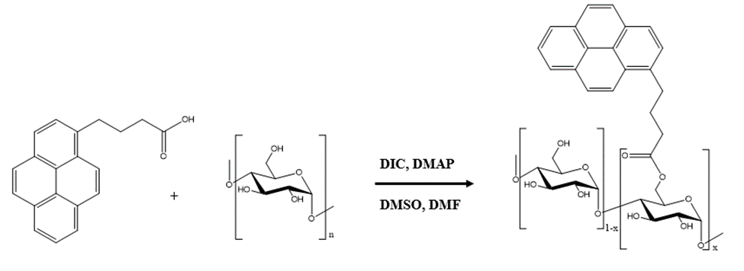
Pyrene labeled Starch Nanoparticles Synthesis
SNPs were dispersed in a 3:1 mixture of DMSO:dimethyl formamide (DMF).
1-Pyrenebutyric acid and dimethylaminopyridine (DMAP) were added to mixture (stirred for 30 minutes).
The mixture was put in an ice bath while diisopropylcarbodiimide (DIC) was added dropwise.
Reaction was stirred for 48 hrs under N₂. Next Py-SNPs were purified by precipitation.

Slide 12
Outline
Introduction
- General Overview for Nitrated Compound Detection
- Starch Nanoparticles
- Pyrene
Experimental
- Synthesis of Pyrene Labeled Starch Nanoparticles
- Quenching Experiments in DMSO and Water
- Quenching studies on Py-SNP-coated filter paper
Conclusions
Future work
Acknowledgements

Slide 13
Types of Quenching
K_{s}
Py
+
Q
(Py-Q)
f = fraction of excitation light absorbed by non-complexed pyrene labels
f·i(t)
(1-f)·i(t)
k_{q}
Py*
+
Q
Decrease in fluorescence intensity
1/τ_{M}
Reabsorption:
  Whereby the emission or excitation light is absorbed by another molecule.
  Quencher absorption will only affect steady-state fluorescence measurements and not time-resolved fluorescence measurements.

Slide 14
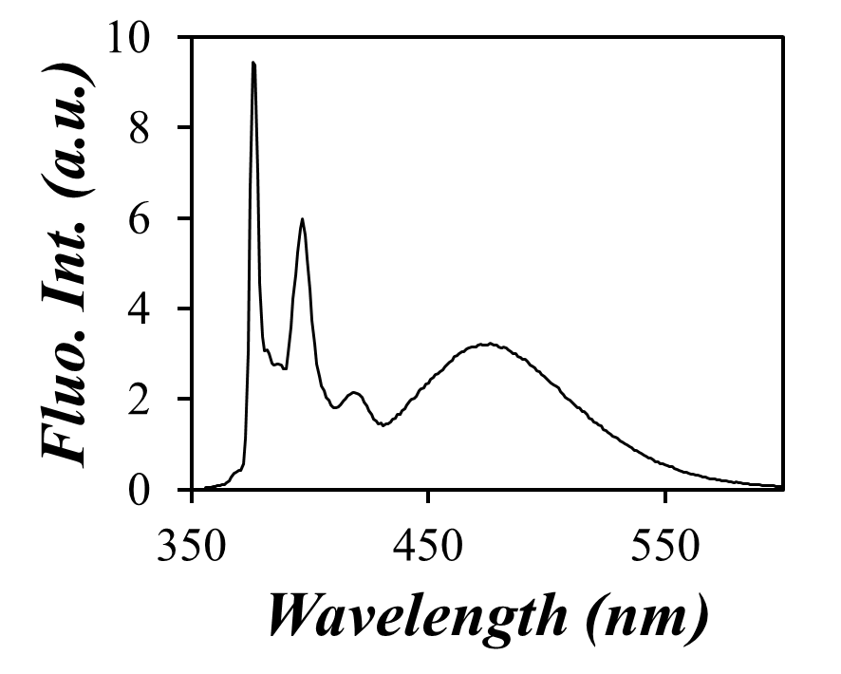
Steady-State Fluorescence
hv
k
hv
SNP
SNP
SNP
SNP
Py + Py
Py + Py*
(PyPy)*
(PyPy)
τ_{M}⁻¹ s⁻¹
τ _{E}⁻¹ s⁻¹

Slide 15
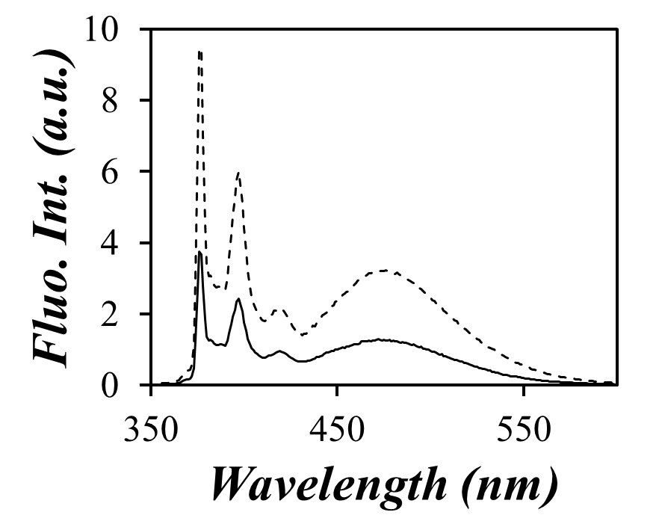
Steady-State Fluorescence
hv
k
hv
SNP
SNP
Q +
SNP
SNP
+ Q
Py + Py
Py + Py*
(PyPy)*
(PyPy)
τ_{M}⁻¹ + k_{qM}[Q] s⁻¹
τ _{E}⁻¹ + k_{qE}[Q] s⁻¹

Slide 16
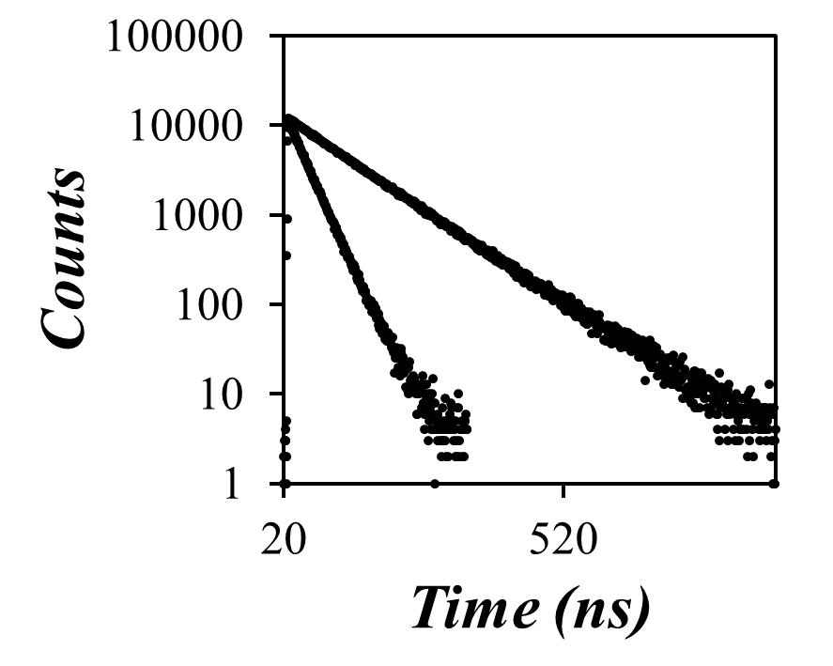
Time Resolved Fluorescence
K_{s}
Py
+
Q
(Py-Q)
f·i(t)
(1-f)·i(t)
Yields the average time a fluorophore spends in its excited state after excitation.
k_{q}
Py*
+
Q
Decrease in fluorescence intensity
1/τ_{M}

Slide 17
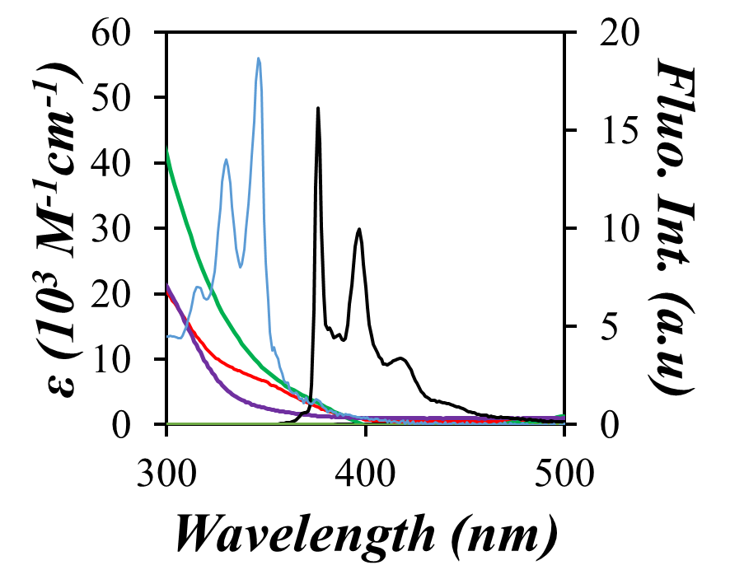
Quencher Absorption in DMSO
Normalized absorption and emission spectra of pyrene
Trinitrotoluene
Dinitrotoluene
Nitrotoluene
Quencher | Concentration range used | Max Abs. at 346 nm | Max Abs. at 375 nm
Nitrotoluene | 0 mM to 4 mM | 1.71 | 0.46
Dinitrotoluene | 0 mM to 3 mM | 1.88 | 0.60
Trinitrotoluene | 0 mM to ___ mM

Slide 18
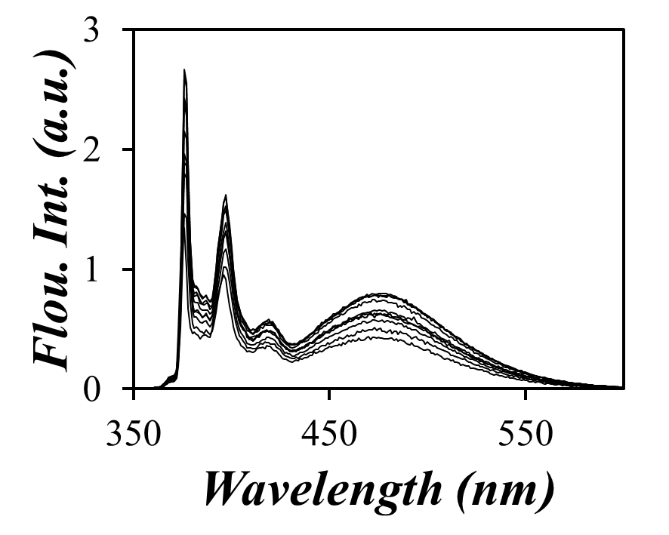
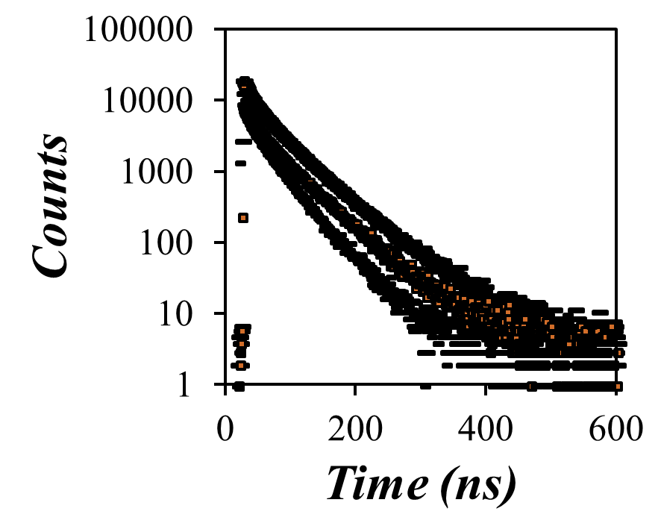


Quenching by Nitrotoluene in DMSO
$$\frac{F_{0}}{F}=1+k_{q}∙τ_{0}∙[Q]$$
$$\frac{τ_{0}}{τ}=1+k_{q}∙τ_{0}∙[Q]$$
[Nitrotoluene] ↑
[Nitrotoluene] ↑
0 mM
0 mM
4 mM
4 mM

Slide 19
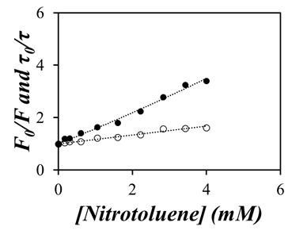
Quenching by Nitrotoluene in DMSO
K_{s}
Py
+
Q
(Py-Q)
f·i(t)
(1-f)·i(t)
k_{q}
Py*
+
Q
Decrease in fluorescence intensity
1/τ_{M}
F_{o}= Fluorescence intensity of the dye without quencher
τ_{o}= Lifetime of the dye without quencher
[Q]= Concentration of quencher
k_{q}= Bimolecular quenching rate constant
F_{o}/F
τ_{o}/τ

Slide 20
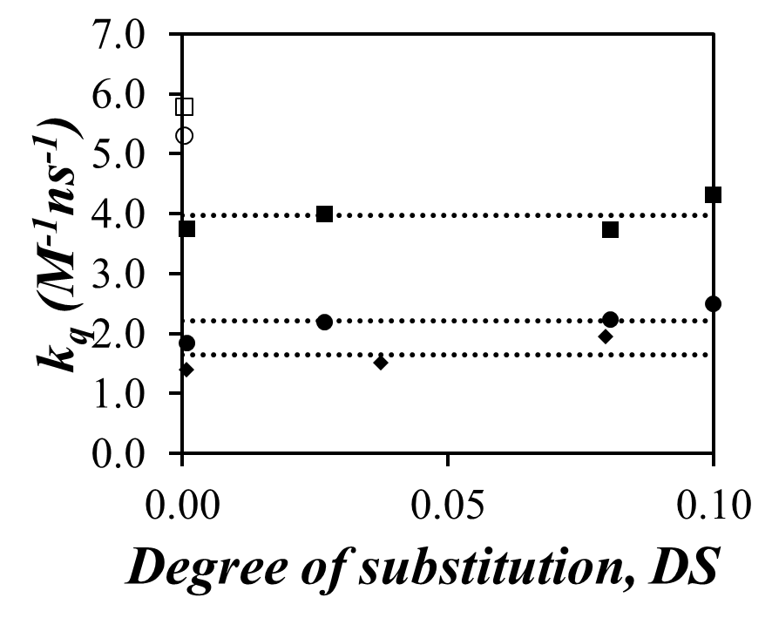
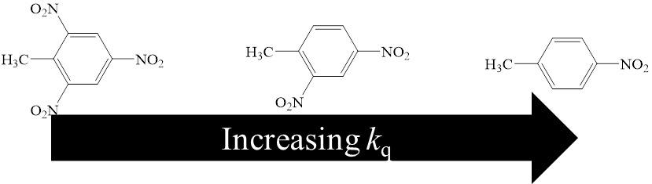
Quenching in DMSO
MNT =
DNT =
TNT =

Slide 21
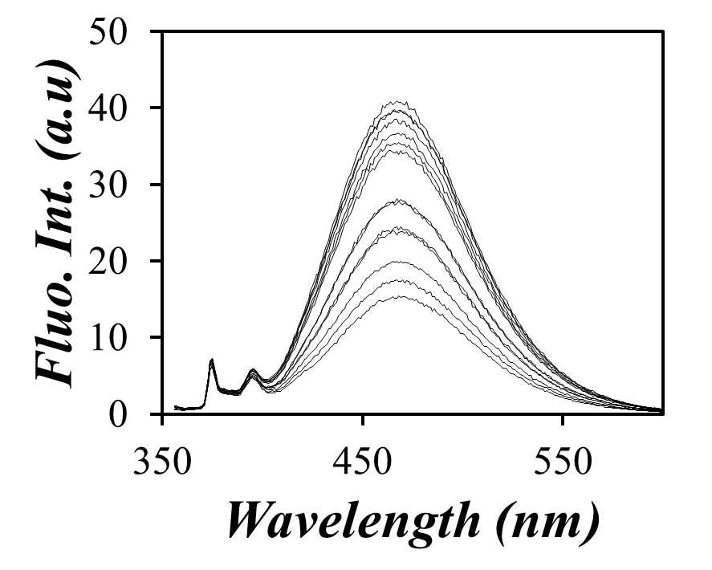
Quenching by Nitrotoluene in Water
DMSO
Water
[Nitrotoluene] ↑
[Nitrotoluene] ↑
0 mM
0 mM
4 mM
0.3 mM

Slide 22
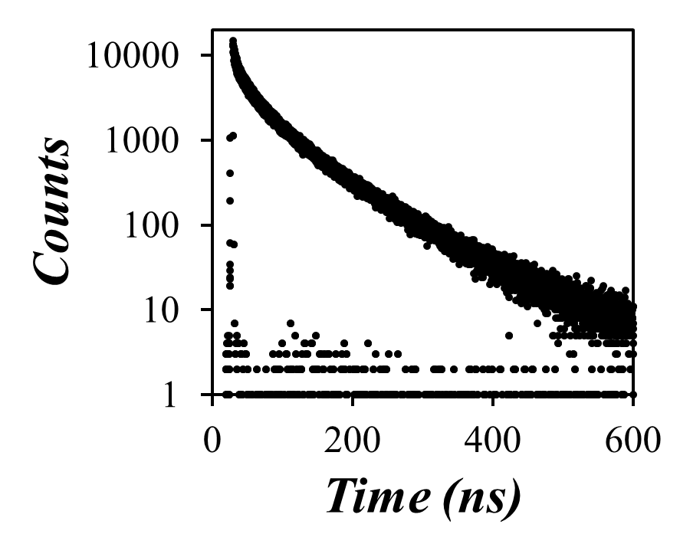
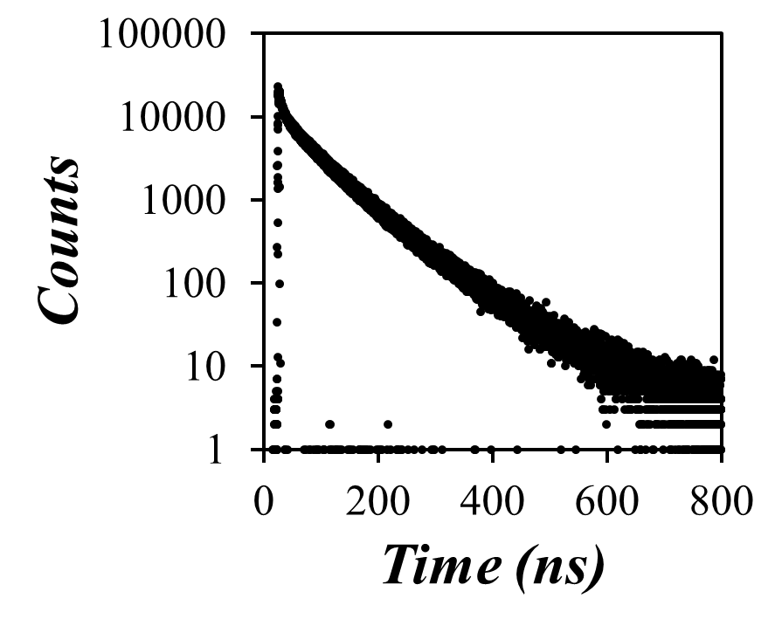
Quenching by Nitrotoluene in Water
At 375 nm
At 510 nm

Slide 23
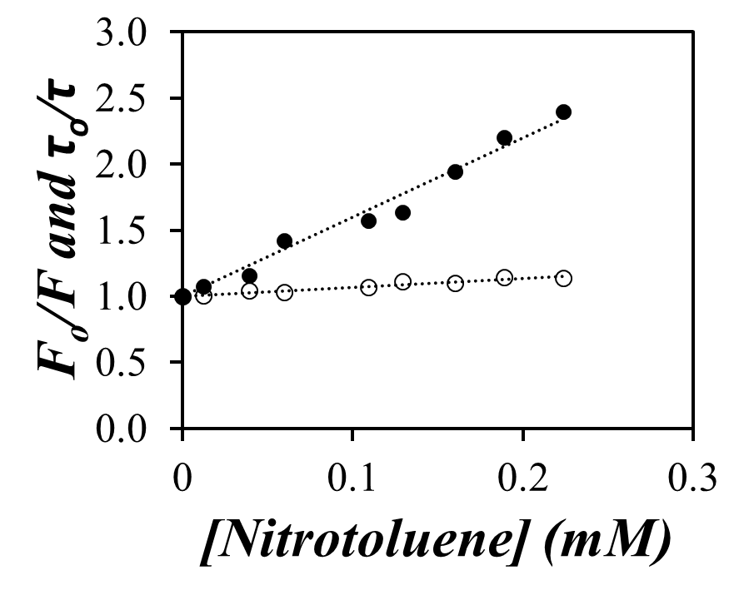
Quenching by Nitrotoluene in Water
K_{s}
Py
+
Q
(Py-Q)
f·i(t)
(1-f)·i(t)
k_{q}
Py*
+
Q
Decrease in fluorescence intensity
1/τ_{M}
At 510 nm
F_{o}/F
~0
τ_{o}/τ
F₀= Fluorescence intensity of the dye without quencher
τ_{o}= Lifetime of the dye without quencher
[Q]= Concentration of quencher
k_{q}= Bimolecular quenching rate constant
K_{S}= The equilibrium constant for the formation of the ground-state complex

Slide 24
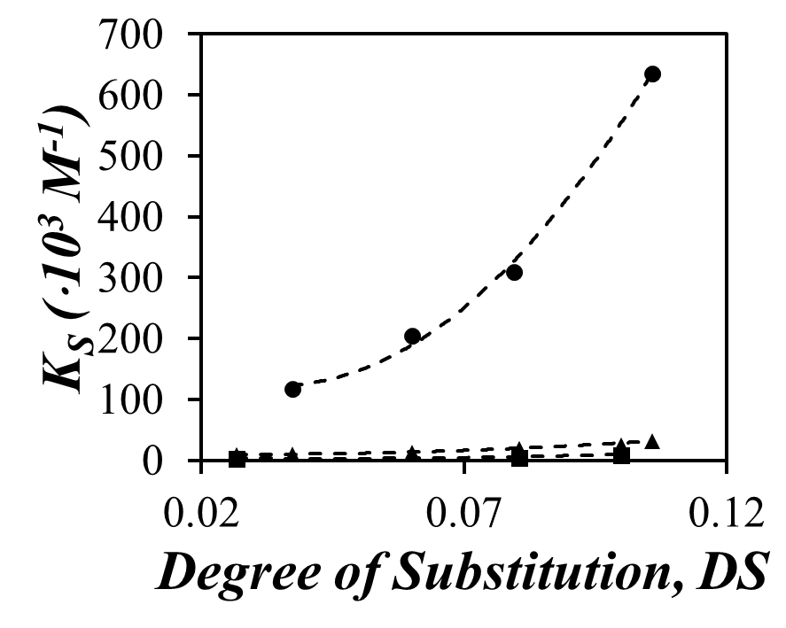
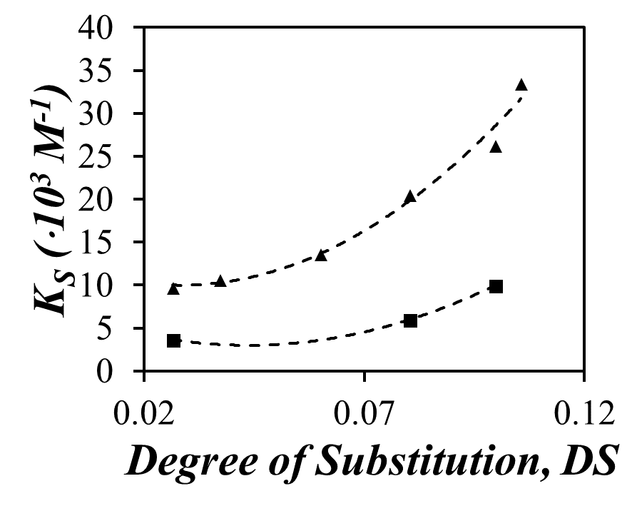
Comparison of K_{S}
Trinitrotoluene
Dinitrotoluene
Increasing K_{s}
Mononitrotoluene

Slide 25
Outline
Introduction
- General Overview for Nitrated Compound Detection
- Starch Nanoparticles
- Pyrene
Experimental
- Synthesis of Pyrene Labeled Starch Nanoparticles
- Quenching Experiments in DMSO and Water
- Quenching studies on Py-SNP-coated filter paper
Conclusions
Future work
Acknowledgements

Slide 26

Drop Method: Py-SNP-coated filter papers
Quencher in ethanol/acetonitrile
Py-SNP in water
Q
N₂ in
Q
N₂ in
N₂ out
Q
N₂ out
Q
Q
Q
Q
Q
Q
Filter paper
Py-SNP coated paper
Filter paper
Quenched Py-SNP coated paper
1 hour after drying
1 hour after drying
20 µL of water was added and the steady-state fluorescence spectra were acquired.
20 µL of water was added and the steady-state fluorescence spectra were acquired.

Slide 27




In the absence of quencher
Ethanol + Quencher
< ^{w}F₀/^{e}F₀>
^{w}F₀
^{e}F₀
Py-SNP
In the presence of quencher
(^{w}F₀/^{e}F)
^{w}F₀
^{e}F

Slide 28
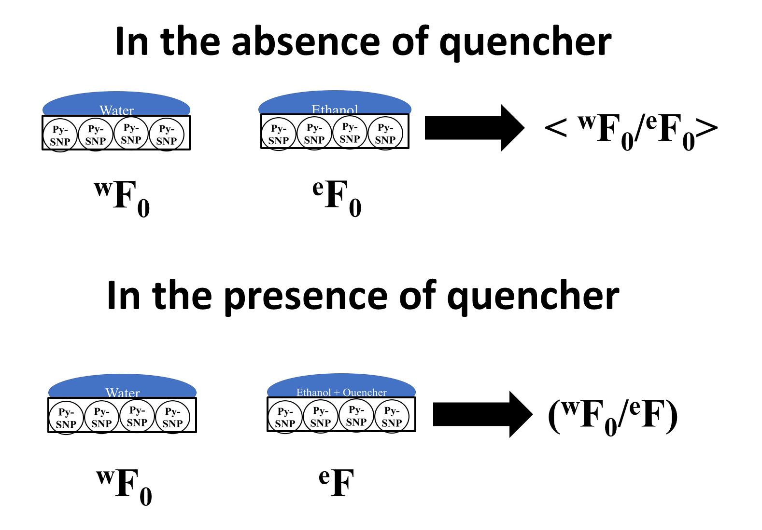
It should be noted a change in the fluorescence intensity was observed when going between water and ethanol or acetonitrile. To account for this, all ^{w}F₀/^{e}F ratios were normalized to the average change in the fluorescence intensity in the absence of quencher.

Slide 29
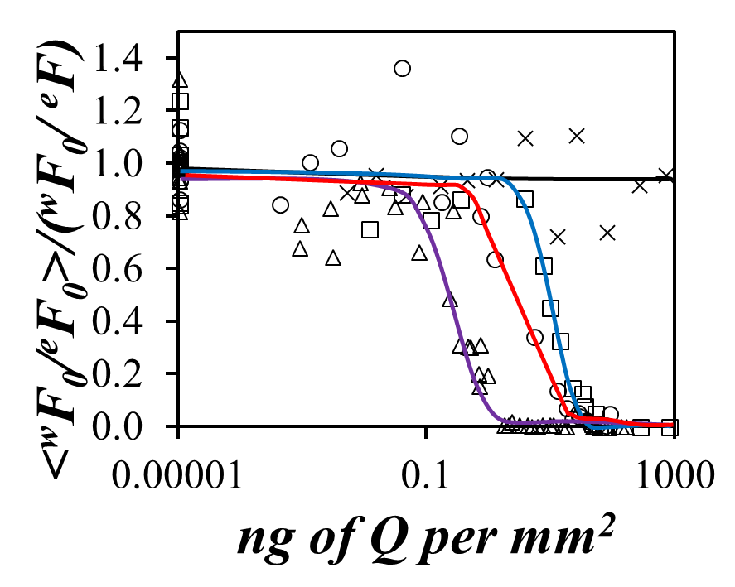
Quenching studies on filter paper
Naphthalene
(no quenching)
Mononitrotoluene
40 (± 14) ng per mm²
Dinitrotoluene
21 (± 8) ng per mm²
Trinitrotoluene
2 (± 0.6) ng per mm²

Slide 30
Outline
Introduction
- General Overview for Nitrated Compound Detection
- Starch Nanoparticles
- Pyrene
Experimental
- Synthesis of Pyrene Labeled Starch Nanoparticles
- Quenching Experiments in DMSO and Water
- Quenching studies on Py-SNP-coated filter paper
Conclusions
Future work
Acknowledgements

Slide 31


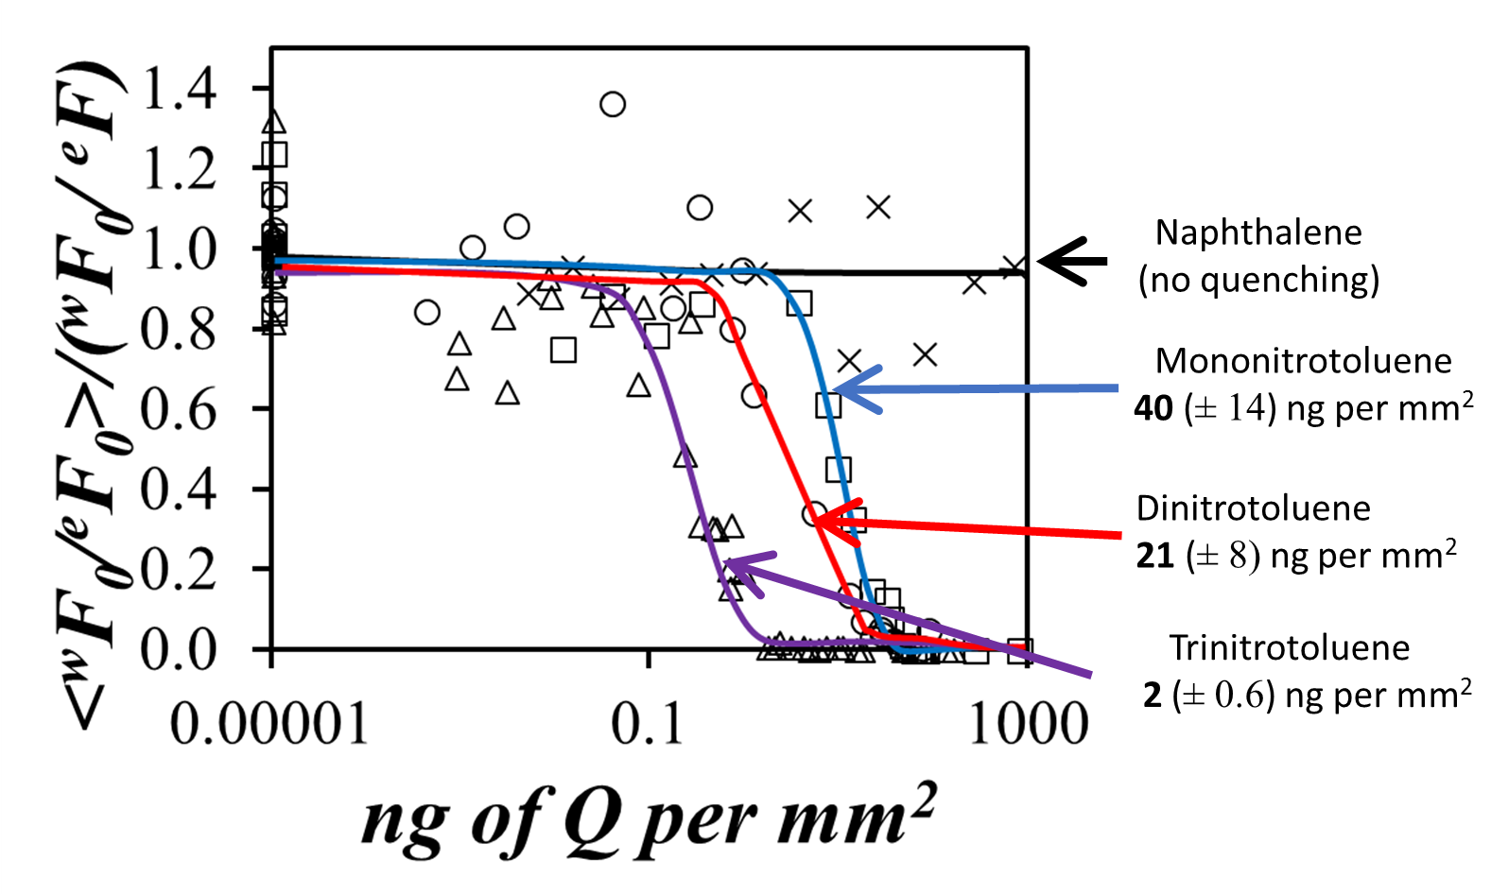
Conclusions
Actual change in color of the Py-SNP coated filter paper with increasing quencher concentration

Slide 32
Future Work
Characterize the quenching of Py-SNPs in DMSO with TNT
Conduct quenching studies on the Py-SNP –coated filter papers with picric acid, other common contaminants and explosive compounds to demonstrate its selectivity.
Optimize the Py-SNP-coated filter paper

Slide 33


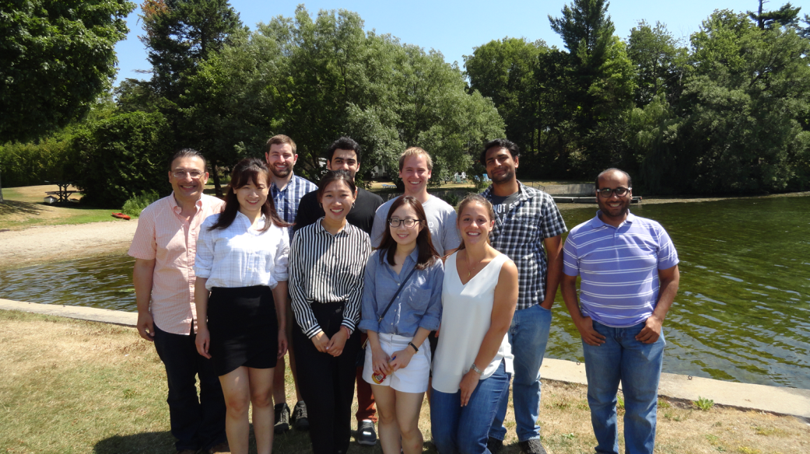
Acknowledgements
Supervisor: Jean Duhamel
Lu Li and Damin Kim
The Duhamel Group
University of

