Slide 1
Synthesis of Water Dispersible Polypyrrole (PPy) Nanowires
Pengxiang Si

Slide 2
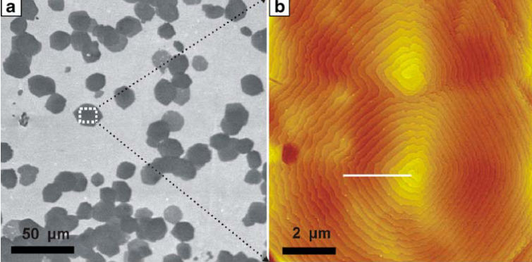
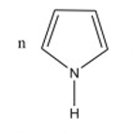
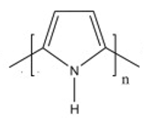
Synthesis of water dispersible polypyrrole (PPy) nanowires
APS
1M HCl
dopamine
Cetrimonium bromide (CTAB)
Polypyrrole (PPy)
2CTA⁺+S₂O₈²⁻
(CTA)₂S₂O₈ ↓
n(CTA)₂S₂O₈ ↓+
+
SO4²⁻
Colloid and Polymer Science, 287(11), 1325–1330.

Slide 3
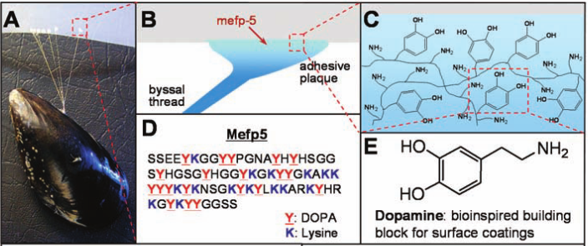
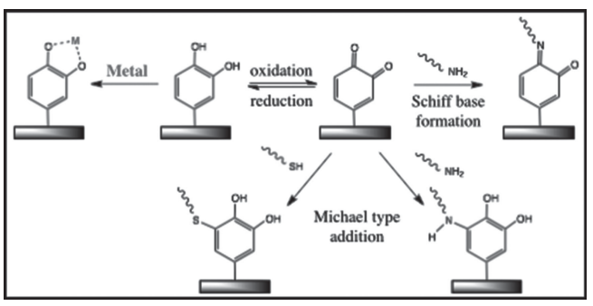
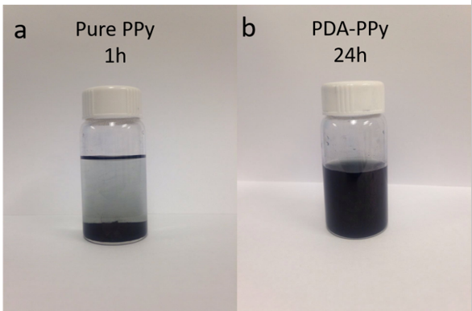
Synthesis of water dispersible polypyrrole (PPy) nanowires
Stankiewicz, P. (2007). 318(OCTOBER), 426–431.
Z-Potential=
-40.8±1.7mV
water
0.075 DA/Py mole ratio

Slide 4
Synthesis of water dispersible polypyrrole (PPy) nanowires
0 DA/Py mole ratio
0.075 DA/Py mole ratio
0.15 DA/Py mole ratio
1μm
1μm
1μm
Nano-wire Morphology
Good dispersity and stability in water
Good conductivity (3.7 S/cm)
Compress to pellet
0.075 DA/Py mole ratio

