Slide 1



Characterization of Hydrophobically Modified Starch NanoParticles by
Pyrene Fluorescence
Damin Kim, Ryan Amos, Jean Duhamel*, Mario Gauthier*
University of Waterloo
Notes:
19 sec

Slide 2
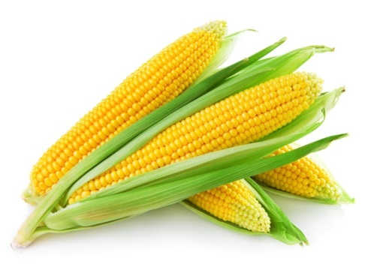
Outline
1. Background
1.1 Starch
1.2 Starch NanoParticle
1.3 Pyrene Fluorescence
2. Loading Capacity of HM-SNP
3. The Level of Protection of HM-SNPs
4. Effect of Alkyl Chain Length
5. Conclusions
6. Future Work
7. Acknowledgements
Notes:
8sec

Slide 3
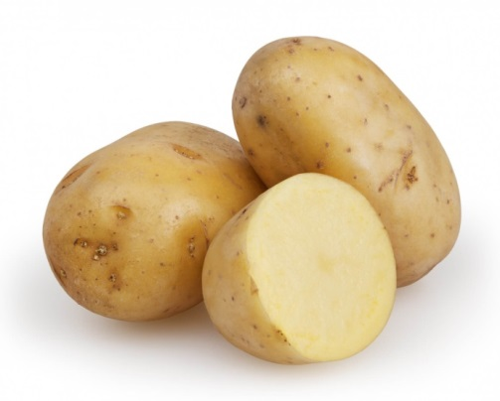
Background:Starch
1,6 glycosidic bond
1,4 glycosidic bond
1,4 glycosidic bond
Amylose
Amylopectine
Properties
Biodegradable
Biocompatible
Non toxic
Adundant
Economical and Environmental friendly
Notes:
present limitations: high viscosity, susceptibility to retrogradation, limited digestibility for some, and limited solubility for others.
Most native starch has limitation for the industrial use and need to be modified.
52sec

Slide 4
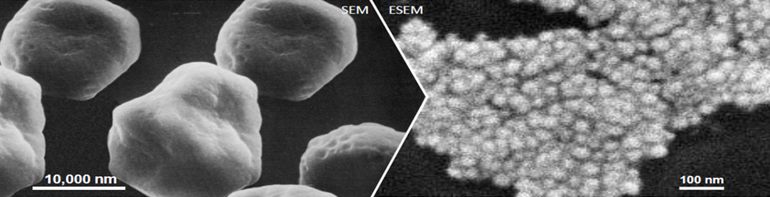
Background:Starch NanoParticles
Starch Granule
  Starch NanoParticle (SNP)
Starch Nanoparticles (SNPs): Prepared by EcoSynthetix by extruding starch
Smaller than 100 nm
Dispersed in water
Able to swell
Having hydroxyl groups that can undergo chemical modification
Notes:
One of modification of starch was done by company called ecosynthetix via extrusion process.
Current application of snp is for paper coating. Hydrophobic modification with oh on snp will generate amphiphilicity and expects to use as hydrophobic carrier
34 sec

Slide 5
Absence of hydrophobic microdomain
Hydrophobically Modification of SNPs
Increase in DS
Scheme 1. The hydrophobic modification of SNP with hexanoic and propionic acid.
Functional Group | DS
Hexanoic Acid (C6) | 0.03
 | 0.05
 | 0.08
 | 0.09
 | 0.10
 | 0.12
 | 0.15
Functional Group | DS
Propionic Acid (C3) | 0.03
 | 0.05
 | 0.15
 | 0.20
 | 0.25
Generation of hydrophobic microdomains
Notes:
the formation of hydrophobic microdomain opens a gate to the potential use of HM-SNPs as a hydrophobic carrier. And the potential increases as hydrophobicity of hm-snp is good enough to attract hydrophobic molecules. The hydrophobicity of hm-SNP was evaluated with pyrene fluorescence.
43 sec

Slide 6
Pyrene Fluorescence
s₁
(0,0)
(0,2)
Vibronic state
2
1
0
s₀
Electronic state
Large molar extinction coefficient and quantum yield
Low solubility in water (~ 0.7 μM)
Sensitive to the local environment
  lifetime
  (~ 350 ns in unaerated organic solvent)
  Polarity (I₁/I₃)
I₁/I₃ ~ 1.8 in water (---)
I₁/I₃ ~ 0.6 in Cyclohexane (ㅡ)

Slide 7
SNP Fluorescence
Fluorescence emission of SNP:
The natural fluorescence of the HM-SNPs distorts the fluorescence of pyrene and a background correction must be applied.
2. Fluorescence Decay of SNP: The decay analysis program needs an extra parameter to account the fluorescence decay of SNP.
SNP dispersion
Py in SNP dispersion
Non-BG corrected spectrum
BG-corrected
spectrum
Fluorescence of SNP (~ 30 ns)
Fluorescence of Pyrene
(> 300 ns)
7

Slide 8
Outline
1. Background
2. Loading Capacity of HM-SNP
3. The Level of Protection of HM-SNPs
4. Effect of Alkyl Chain Length
5. Conclusions
6. Future Work
7. Acknowledgements
Py
Py
Py
Py
Py
Py
Py
Py
Py
Py
Notes:
Experiments were designed to demonstrate the concept of using HM-SNP as a hydrophobic carrier by pyrene fluorescence. One of essencial concept as a hydrophobic carrier is the interaction between the carrier and probe. This concept was proved by equilibirium and loading capacity.

Slide 9
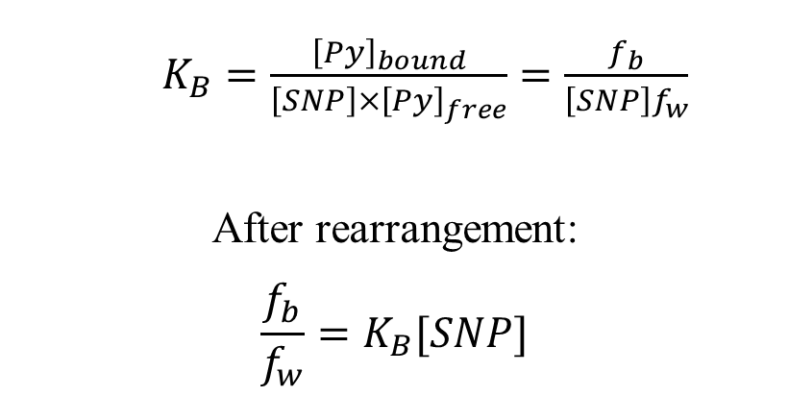

Loading Capacity of HM-SNPs
Analysis of the fluorescence decays
The fluorescence decays of pyrene in solutions of HM-SNPs have three components
$$SNP+Py_{w} \underset{⇔}{K} Py_{b}$$
Py bound to HM-SNPs
(τ ~ 300 ns)
Py in water
(τ = 130 ns)
$K_{B}=\frac{{\left[Py\right]}_{bound}}{\left[SNP\right]{×\left[Py\right]}_{free}}=\frac{f_{b}}{\left[SNP\right]f_{w}}$
After rearrangement:
$$\frac{f_{b}}{f_{w}}=K_{B}[SNP]$$
HM-SNPs (τ ~ 30 ns)

Slide 10

Loading Capacity of HM-SNPs
Py
Fluorescence decays of pyrene were acquired at different [HM-SNPs] and constant [pyrene].
Py
Py
Py
$$\frac{f_{b}}{f_{w}}=K[SNP]$$
Py
Py
Py
Py
Increase in DS
Py
Py
Py
Py
Py
Py
Py
Py
Py
The f_{bound}/f_{free} ratio increased linearly with increasing C6(x)-SNP(0) concentration, as expected.The slope of these plots yielded K_{B}
The y-intercept of the plot of the I₁/I₃ was extrapolated to yield ( I₁/I₃)₀ ratio corresponding to pyrene bound to SNP(0).
Py
Py
Py
Py
Py
Py
Py

Slide 11
Py
Loading Capacity of HM-SNPs
Py
Py
Py
Py
Py
Py
Py
Increase in DS
Py
Py
Py
Py
Py
Py
Py
Py
Py
Binding of pyrene to C6(x)-SNP(0) was enhanced with increasing DS of hexanoic acid, resulting in a less polar environment for pyrene.
Py
Py
Py
Py
Py
Py
Py

Slide 12
Loading Capacity of HM-SNPs
Loading capacity of pyrene in HM-SNPs was determined with UV-Vis spectrospectroscopy and applying Beer lamber Law.
A_{Py}= lε_{Py}[Pyrene]
Where A_{Py} is the absorbance of pyrene at 336 nm, l is the path length of the absorption cuvette, and ε_{Py} is the molar extinction coefficient of pyrene.
ε_{pySNP} was determined with absorbance of a known concentration of pyrene
and equalled to 29,600 (± 380) M⁻¹cm^{−1.}
The loading capacity of pyrene in the C6(x)-SNP(0) particles was determined by measuring the absorbance of a C6(x)-SNP(0) dispersion saturated with pyrene crystals. The constant absorbance over time indicated full loading of
pyrene in HM-SNP.
hν
Py
Py
Py
Py
Py
Py
Notes:
he interaction between py and snp was quantitatively determined with uv

Slide 13
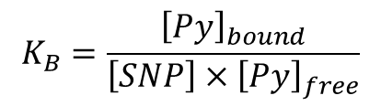
Loading Capacity of HM-SNPs
The absorbance of pyrene free in water was subtracted from the total absorbance of pyrene in the aqueous dispersion of HM-SNPs.
The [Py]_{bound} and [Py]_{W} concentrations determined from the absorption spectrum were also used to determined K_{B} which was compared to K_{B} obtained from the fluorescence decay analysis.
$$K_{B}=\frac{{\left[Py\right]}_{bound}}{\left[SNP\right]{×\left[Py\right]}_{free}}$$
Where ε_{PySNP} = 29,600 (± 380) M⁻¹cm⁻¹
○ Absorbance
● Fluorescence
Notes:
ε_{pySNP} was determined with absorbance
of a known concentration of pyrene
and equalled to 29,600 (± 380) M⁻¹cm^{−1.}

Slide 14
Outline
1. Background
2. Loading Capacity of HM-SNP
3. The Level of Protection of HM-SNPs
3.1 Quenching of Pyrene by Oxygen
3.2 Quenching of Pyrene by Nitromethane
4. Effect of Alkyl Chain Length
5. Conclusions
6. Future Work
7. Acknowledgements
Q
Py
Q
Q
Py
Py
Q
Py
Py
Py
Q
Q
Notes:
Another improtant factor as hydrophobic carrier is whether it can protect its probe from external obstacle. The level of protection of pyrene of modified snp was simulated by quenching study.

Slide 15
Quenching
Quenching: an excited fluorophore loses energy to a quencher and comes back to its ground state without emitting a photon of light
[Nitromethane]
0 mM
10 mM
[Nitromethane]
=0 mM
5 mM
15
15
15
Notes:
In quenching study where a fluorophore and a quencher remain same, the kq is dependent on the probability of quenching. Longer lifetime of pyrene indicates more inefficient quenching by oxygen. When pyrene bound to SNP, orientation of pyrene is more restricted and the probability of quenching decreases. The poor probability of quenching reflected in longer lifetime of pyrene in SNP dispersion compared to water.

Slide 16
Quenching of Pyrene by Oxygen
Lifetime of pyrene
τ and τ₀ are lifetime of fluorophore in presence/absence of a quencher, respectively
The efficiency of quenching can be described with bimolecular quenching rate constant, k_{q}
Where R_{F} and R_{Q} are the radii of the fluorophore and quencher and D_{Q} is diffusion coefficient of a quencher. p is the probability of quenching.
Increase in τ_{o} is a result of the increase of the microviscosity experienced by the pyrene molecule bound to HM-SNPs
16
16
16
Notes:
In quenching study where a fluorophore and a quencher remain same, the kq is dependent on the probability of quenching. Longer lifetime of pyrene indicates more inefficient quenching by oxygen. When pyrene bound to SNP, orientation of pyrene is more restricted and the probability of quenching decreases. The poor probability of quenching reflected in longer lifetime of pyrene in SNP dispersion compared to water.

Slide 17
Quenching of Pyrene by Nitromethane
Quenching of pyrene by a water soluble quencher, nitromethane
k_{q} of pyrene by nitromethane was determined with fluorescence decays at the different [nitromethane].
Q
Py
Q
Q
Py
Py
Q
Py
Py
Aqueous Dispersion
of HM-SNP
Q
Water
Q
Py
Linear Stern Volmer plot obtained from quenching pyrene in water while the downward plot was obtained from quenching pyrene in the aqueous dispersion of HM-SNP. The downward Stern Volmer Plot indicates the protection of pyrene from quenching.

Slide 18
The Level of Protection of HM-SNPs
k_{q} of pyrene by nitromethane was determined with lifetime of pyrene corresponding to the pyrene accessible to nitromethane.
k_{q} decreases with increasing DS of hexanoic acid. This agrees with experiment result obtained with τ_{o}. Pyrene experiences more viscous environment with increasing DS. The level of protection is independent from the DS.

Slide 19
Outline
1. Background
2. Loading Capacity of HM-SNP
3. The Level of Protection of HM-SNPs
4. Effect of Alkyl Chain Length
5. Conclusions
6. Future Work
7.Acknowledgements
VS

Slide 20
Effect of Alkyl Chain Length
C6-SNP
Smaller K_{B}, shorter τ_{o}, higher k_{qSNP} indicated that pyrene experiences polar and less viscous environment in C3-SNPs than in C6SNPs
C3-SNP
Increase in DS
C6-SNP
C6-SNP
C3-SNP
C3-SNP
C3-SNP
C6-SNP
Notes:
increase

Slide 21
Outline
1. Background
2. Loading Capacity of HM-SNP
3. The Level of Protection of HM-SNPs
4. Effect of Alkyl Chain Length
5. Conclusions
6. Future Work
7. Acknowledgements

Slide 22
Conclusions
SNPs were hydrophobically modified with propionic (C3) and hexanoic (C6) anhydride and
characterized with pyrene fluorescence.
The hydrophobicity of the HM-SNPs increased with increasing DS of hydrophophobic pendant and the length of the alkyl chain. As DS of pendants and alkyl chain length increases, more vis-cous and hydrophobic microdomains were generated by the HM-SNPs as demonstrated by
    an increase in K_{B}
    a decrease in τ_{o}, k_{q} and (I₁/I₃)_{o}
More hydrophobic microdomains can be generated by maintaining a same DS and increasing
the length of the hydrophobic alkyl chain length than by increasing the DS of a shorter alkyl
chain.
The level of protection and loading capacity of pyrene were not improved much by the
hydrophobic modification of the SNP with C3 and C6 pendants.

Slide 23
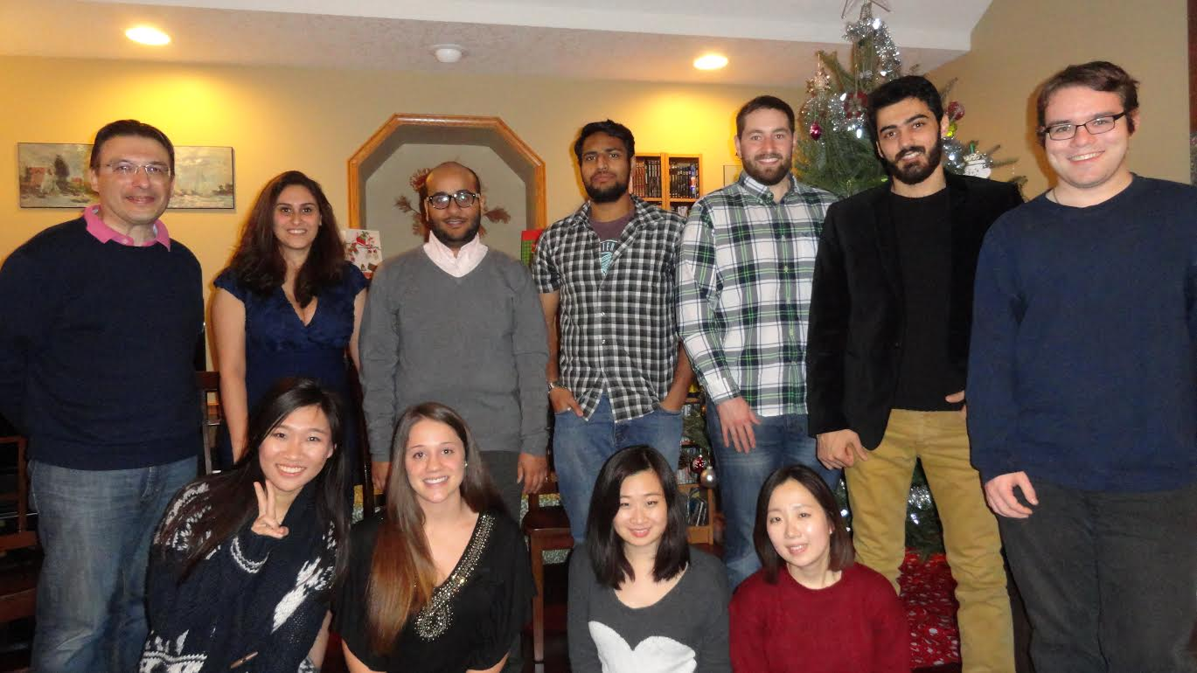

Acknowledgments
Prof. Jean Duhamel
Prof. Mario Gauthier
Prof. Michael Tam
Lu Li and Ryan Amos
Duhamel and Gauthier’s group members
All coworkers from EcoSynthetix Projects

