Slide 1

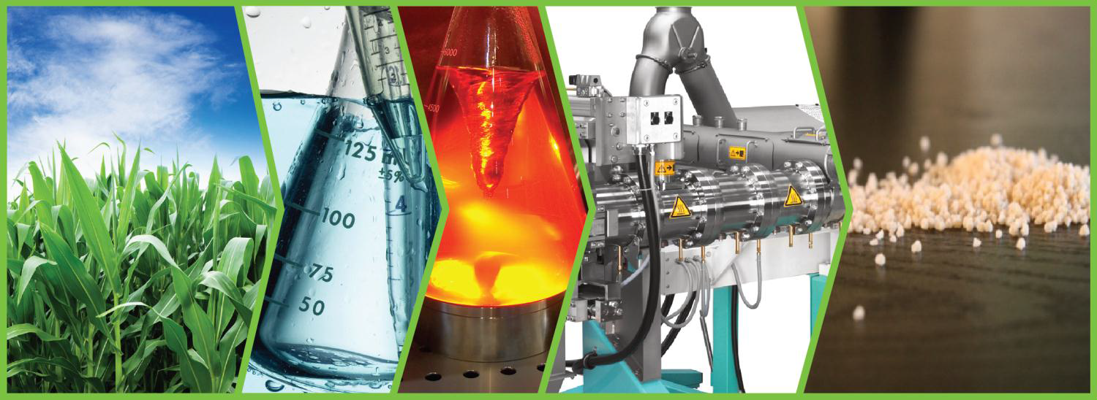
Conformation of the Side Chains of Amylopectin in DMSO Determined by Pyrene Excimer Fluorescence and Molecular Mechanics Optimizations
Name: Lu Li
Supervisor: Prof. Jean Duhamel

Slide 2
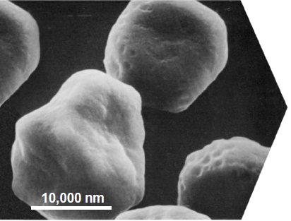
Introduction: Organization of the starch granule
1
6
4
5
2
1
3
6
4
5
Branched polymer –Amylopectin
α-1,4-glucan with 1,6-glycosidic branches
(2×10⁶ anhydroglucose units)
2
1
3
Linear α-1,4-glucan – Amylose
(200 to 2000 anhydroglucose units)

Slide 3
Amylopectin Cluster Model
Amylopectin
Structural cluster-type models
French
1972
Robin et al.
1974
Manners and Matheson
1981
Crystallography and starch degradation studies led to the conclusion that long B-chains bear several short A-type (6 < DP < 30) side chains. The short A-chains arrays of crystalline of single and mostly double helices.
3

Slide 4
Conformation of Amylose and Amylopectin in DMSO
Amylose
Amylopectin
1
6
4
5
2
1
3
Since many chemical modifications are conducted in DMSO where polysaccharides are soluble, it would be worthwhile to determine the conformation of starch in DMSO.
But, this is challenging!
Beeren, S. R. and Hindsgaul, O. Angew. Chem., Int. Ed. Engl. 2013, 52, 11265-11268.
Detailed structural information on polysaccharides is very difficult to obtain, and they are therefore often described either schematically or as “averaged” structures, obscuring the molecular detail.
4

Slide 5
Amylose conformation
In water, amylose forms a random coil based on the consistent results obtained by optical rotation, intrinsic viscosity [η], light scattering, and sedimetation measurements
However, despite much experimental work done on dilute solutions of amylose, its conformation in DMSO is still a matter of controversy
Random coil:
Intrinsic viscosity versus weight-average molecular weight (Everett et al.¹, Banks et al.², Nakanishi et al.³)
Helix:
Intrinsic viscosity versus weight-average molecular weight (Cowie⁴, Fujii et al.⁵)
NMR (St-Jacques et al⁶, Norman et al.⁷, Jane et al.⁸)
Amylose precipitated from DMSO into a nonsolvent adopts a helical conformation based on crystallographic studies⁹
1. Everett, W.W.; Foster, J. F. J. Am. Chem. Soc. 1959, 81, 3464.
2. Banks, W.; Greenwood, C. T. Carbohydr. Res. 1968, 7, 414.
3. Nakanishi, Y.; Norisuye, T.; Teramoto, A. Macromolecules 1993, 26, 4220.
4. Cowie, J. M. G. Macromol. Chem. Phys. 1961, 42, 230.
5. Fujii, M.; Honda, K.; Fujita, H. Biopolymers 1973, 12, 1177
6. St-Jacques, M.; Sundararajan, P. R.; Taylor, K.J.; Marchessault, R. H. J. Am. Chem. Soc. 1976, 98, 4386
8. Jane, J. L.; Robyt, J. F. Carbohydr. Res. 1985, 140, 21
7. Cheetham, N. W. H.; Tao, L. Carbohydr. Polym. 1998, 35, 287

Slide 6
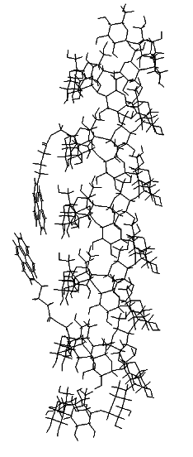
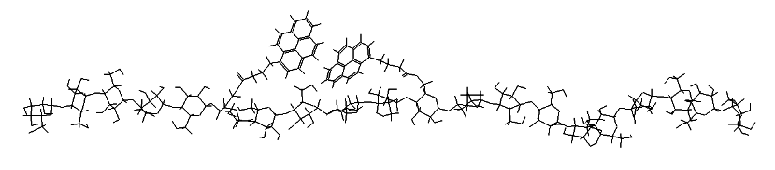
Amylose conformation
However, despite much experimental work done on dilute solutions of amylose, its conformation in DMSO is still a matter of controversy
The two conformations are expected to exhibit very different internal dynamics
Amylose (Helix)
Characterize the internal dynamics of amylose in DMSO
Amylose (Random coil)
Pyrene excimer formation

Slide 7
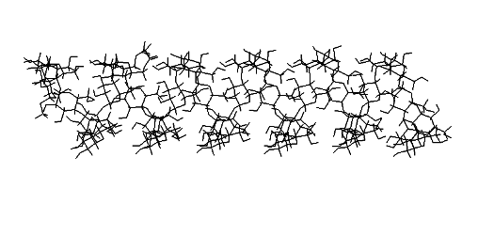
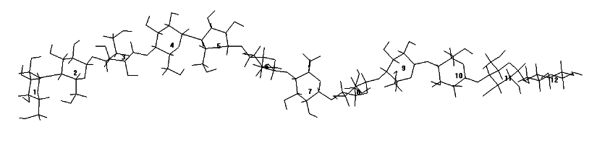
Amylose conformation
Amylose (Helix)
The two conformations are expected to exhibit very different internal dynamics
Characterize the internal dynamics of amylose in DMSO
Amylose (Random coil)
Pyrene excimer formation
As a comparison, poly(methyl acrylate) (PMA) was studied in DMSO.
Flexible polymer with T_{g} equal to 12 ˚C.
Synthesized by Shiva Farhangi

Slide 8
Pyrene-labeled polymers and chain stiffness
k
diff
h
ν
+
Py
+
Py
Py* +
Py
(PyPy)*
τ
M
τ
E

Slide 9
  Synthetic Route for Labeling polysaccharides with Pyrenebutyric Acid
+
DIC, DMAP
DMSO + DMF
DIC: Diisopropylcarbodiimide
DMAP: Dimethylaminopyridine
Procedure
  Amylose was dissolved into a mixture of DMSO and DMF (3:1); pyrenebutyric acid and DMAP were added
  The mixture was put in an ice bath,and DIC was added dropwise
  The reaction was left at room temperature for 48 hours under N₂ in the dark
  The reaction mixture was precipitated into methanol three times to get rid of free pyrene
The method was developed by Wei Yi

Slide 10
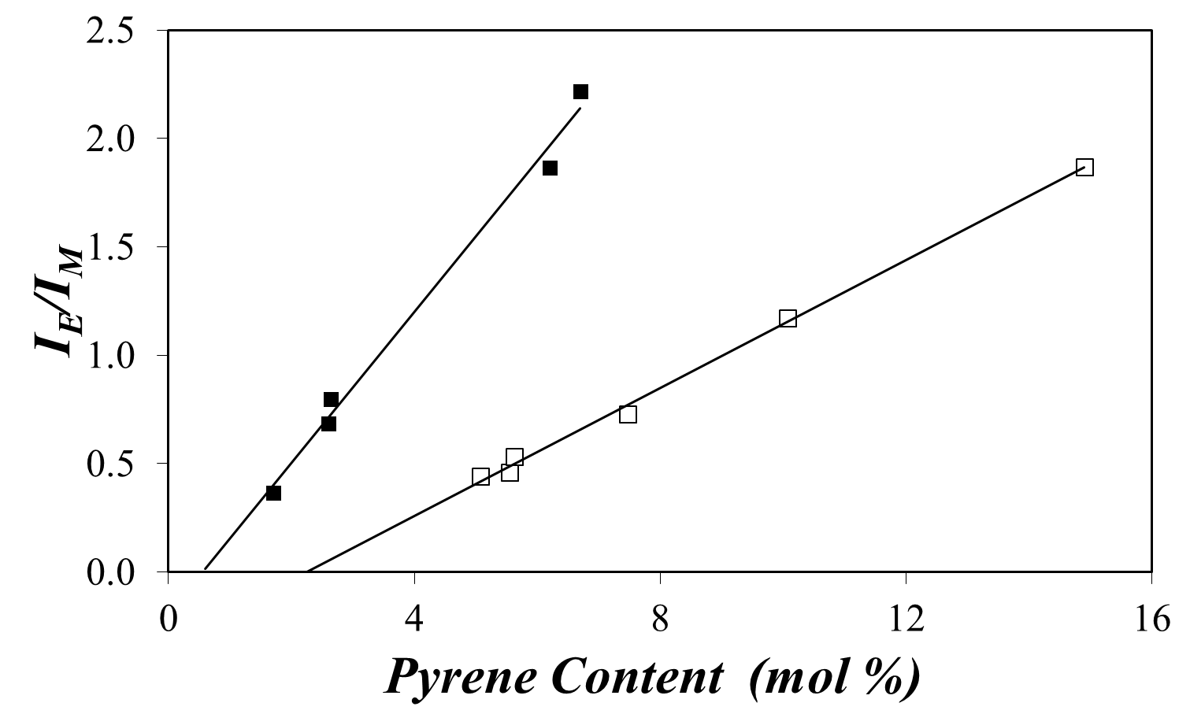
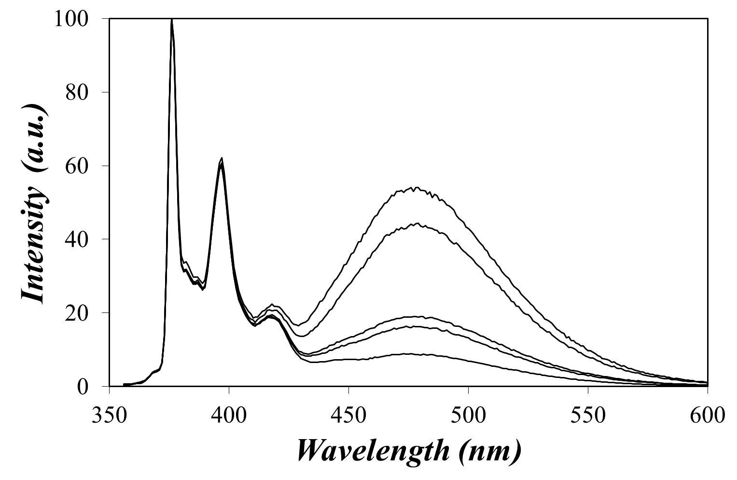
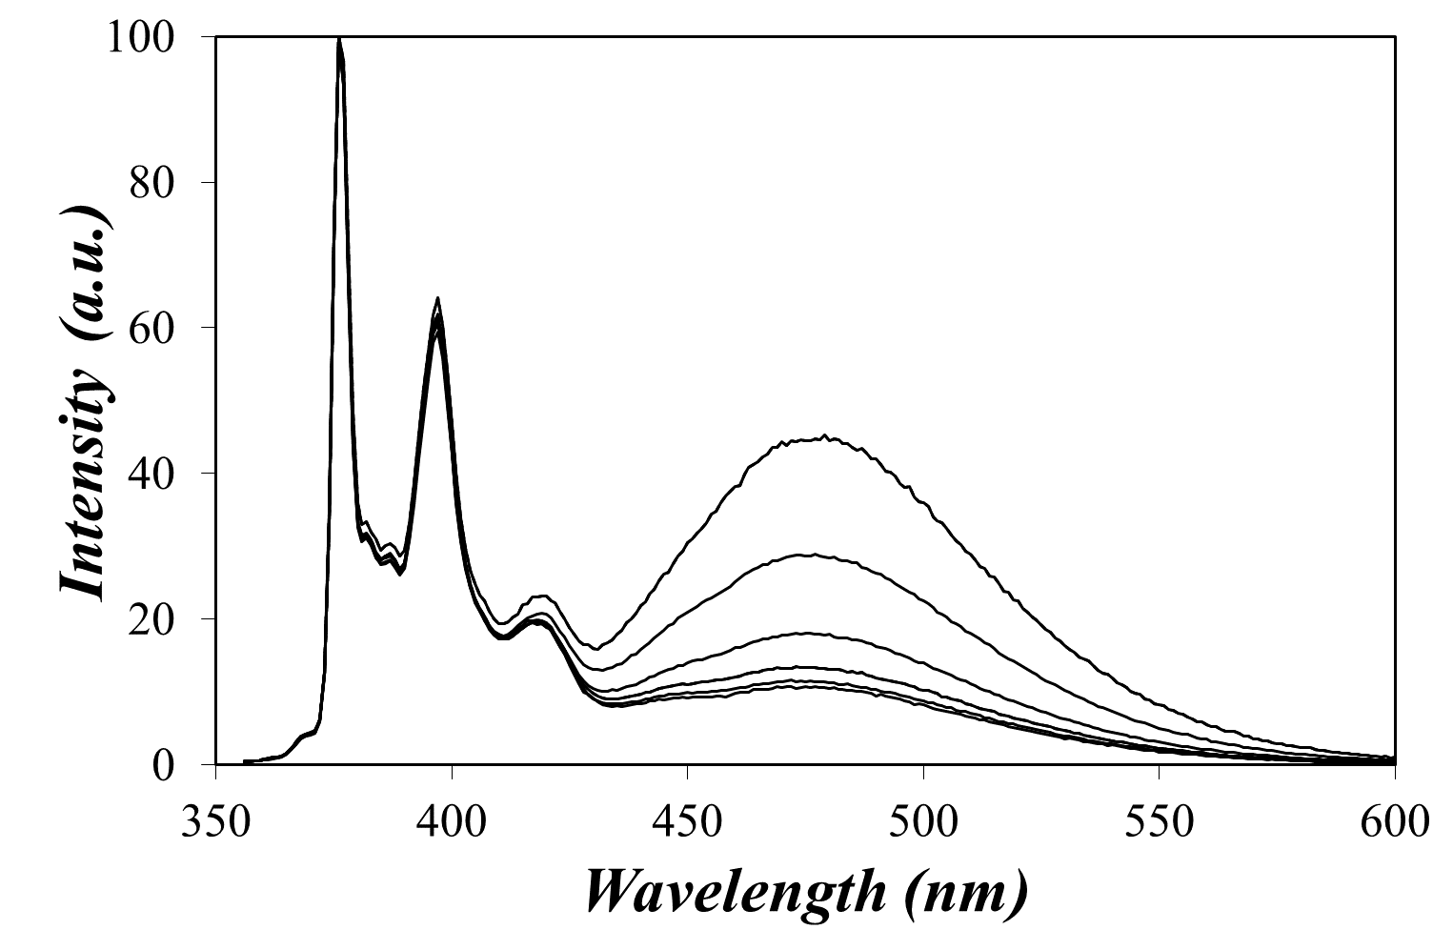
  Steady-State fluorescence results
PMA in DMSO
Amylose in DMSO
m(I_{E}/I_{M}) | per monomer unit | per backbone atom
PMA | 0.35 | 0.70
Amylose | 0.15 | 0.75

Slide 11
Time-Resolved Fluorescence Spectroscopy
Excimer formation by diffusion
λ_{ex} = 346 nm
Monomer quenching
Coupled
λ_{em} = 375 nm
λ_{em} = 510 nm
Coupling of the kinetics of monomer quenching and excimer formation allows for global analysis of the monomer and excimer decays; improves accuracy.

Slide 12
The Fluorescence Blob Model (FBM)
FBM Parameters:
  k_{blob}: Excimer formation rate constant
  in a blob containing one excited and
  one ground-state pyrene
  <n>: Average number of ground-state
  pyrenes per blob
  k_{exch}: Exchange rate constant of
  ground-state pyrenes between two
  blobs
  N_{blob}: The blob size in number of
  monomer units
  <k_{blob}N_{blob}>: Excimer formation rate constant
Py
Py
*
Py
Py
Py
Py
Py
Py

Slide 13
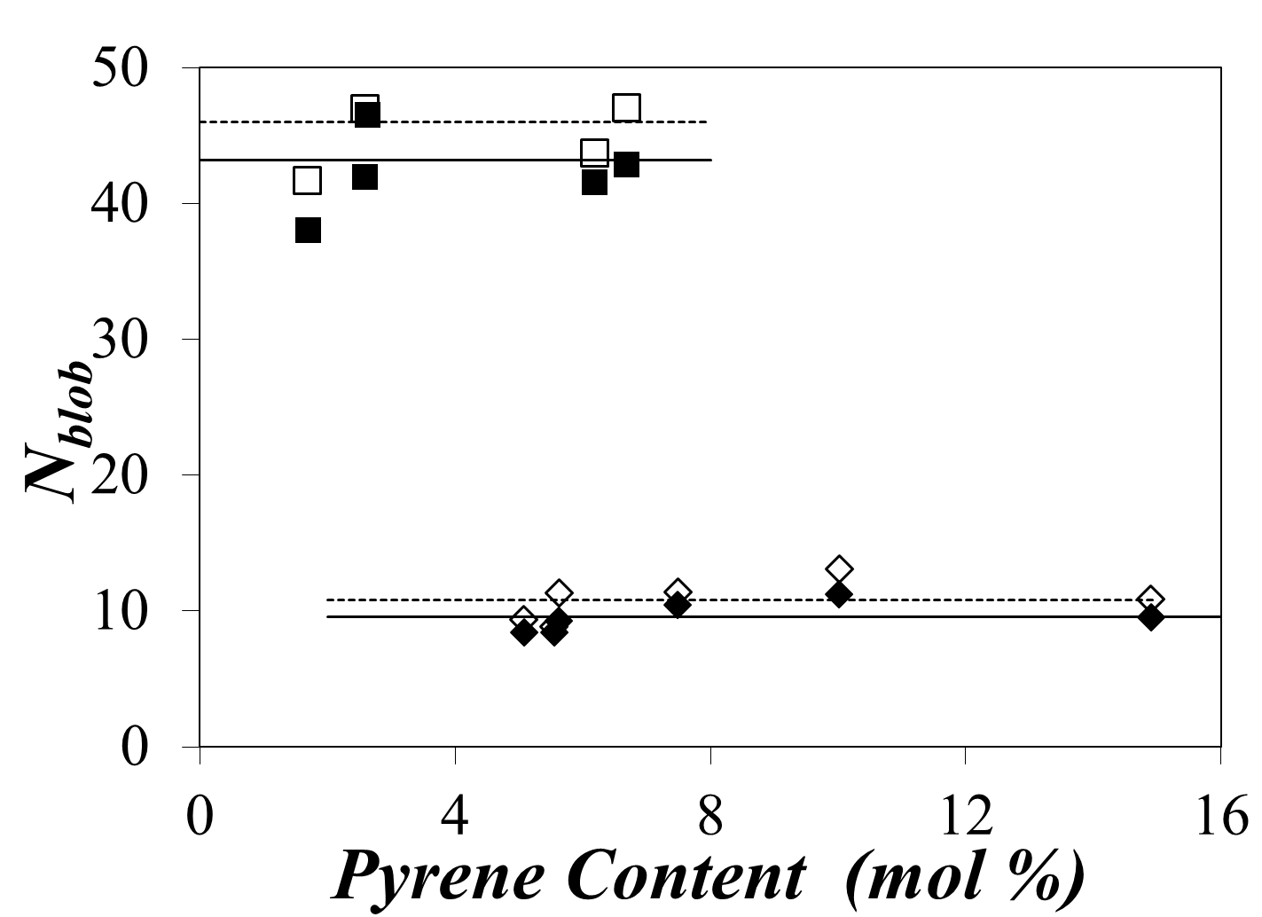
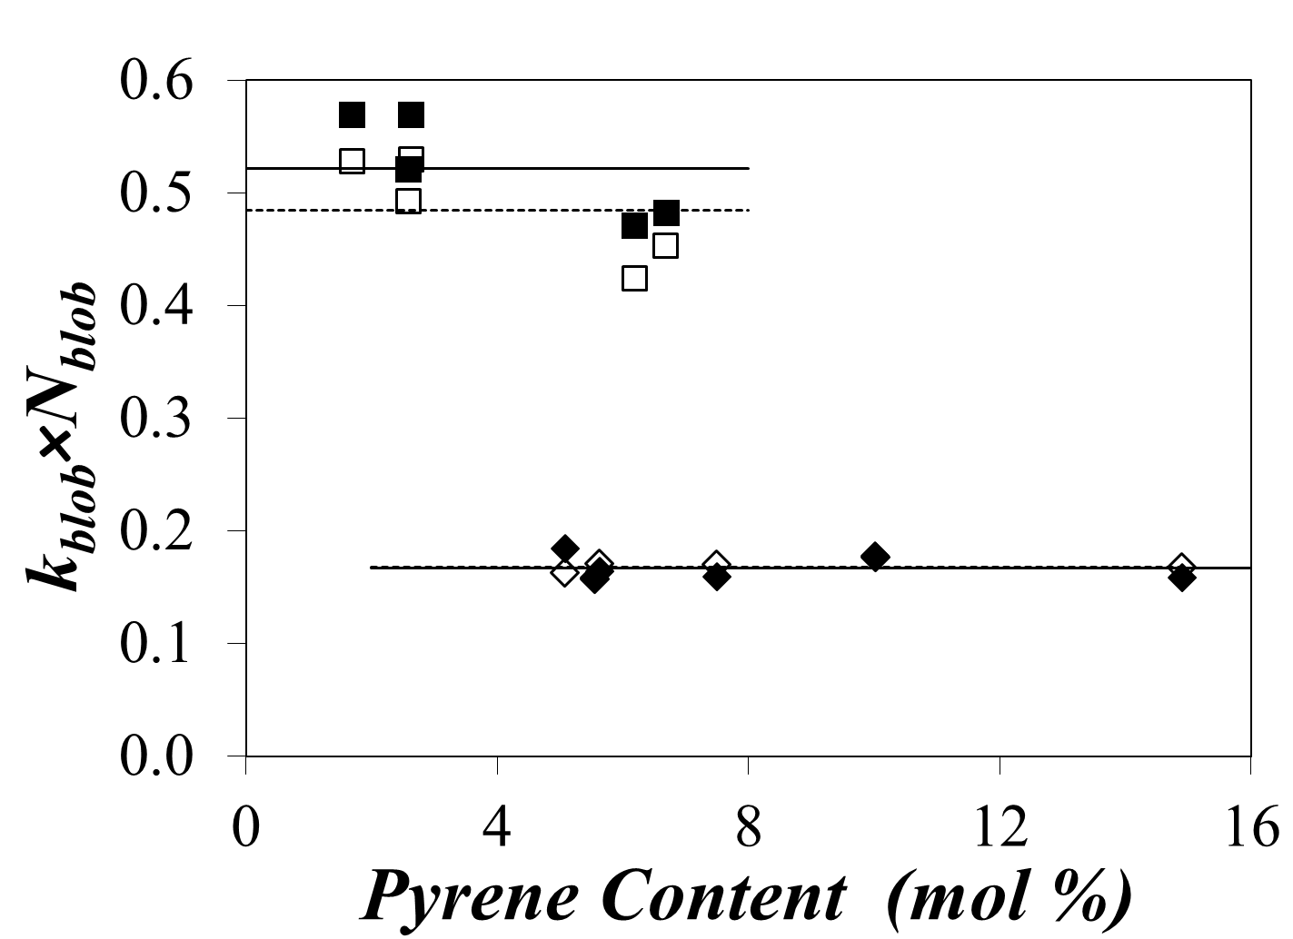
Time-Resolved Fluorescence Spectroscopy
PMA (degassed)
PMA (aerated)
PMA (aerated)
PMA (degassed)
Amylose (degassed)
Amylose (aerated)
Amylose (aerated)
Amylose (degassed)
The overall average <N_{blob}> value for amylose is 11±2 (55 ± 10 chain atoms)
The overall average <N_{blob}> value for PMA is 45±2 (90±4 chain atoms)
<k_{blob}×N_{blob}> for amylose is found to be 0.17 ± 0.01ns⁻¹ (0.85 ± 0.05ns⁻¹ chain atoms)
<k_{blob}×N_{blob}> for PMA is found to be 0.50 ± 0.05 ns⁻¹ (1.0 ± 0.01 ns ns⁻¹ chain atoms)
Py-PMA and Py-Amylose form excimer with a similar efficiency.
The unexpectedly large value of <k_{blob}×N_{blob}> for amylose cannot be explained by a higher mobility of the amylose backbone which can be only explained amylose adopting a helical conformation in DMSO.

Slide 14
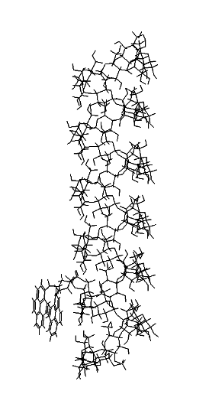
An illustration of the ability of two pyrene groups to overlap using Hyperchem
The conformation of amylose is optimized from the crystal structure of 7-fold amylose provided by Nishiyama et. al.
Two pyrene groups separated by 1 Glucose
Good overlap
Two pyrene groups separated by 22 Glucose
No overlap
Nishiyama, Y.; Mazeau, K.; Morin, M.; Cardoso, M. B.; Chanzy, H.; Putaux, J. Macromolecules 2010, 43, 8628

Slide 15
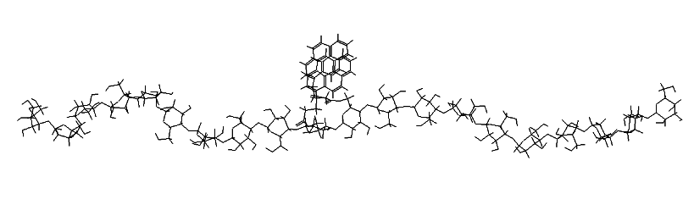
An illustration of the ability of two pyrene groups to overlap using Hyperchem
Two pyrene groups separated by 1 Glucose
Good overlap
Two pyrene groups separated by 6 Glucose
No overlap
The orientation of an individual glucose unit changes along linear chain. The two pyrene groups have to be attached on different glucose units to minimize the effect of configuration.

Slide 16
Comparison of the results obtained by blob model analysis and Hyperchem simulation
The blob model analysis suggests that pyrene can probe its surrounding area which consists of 11±2 glucose units.
A good overlap between two pyrenes is identified by one pyrene having at least 7C-atoms covered by a second pyrene. ¹
Hyperchem simulation indicates that the number of glucose units that an excited pyrene can reach equals 11 regardless of the type of helix generated by amylose.
1. Duhamel, J.; Kanagalingam, S.; O'Brien, T. J.; Ingratta, M.W. J. Am. Chem. Soc. 2003, 125, 12810-12822.

Slide 17
Comparison of the results obtained by blob model analysis and Hyperchem simulation
The blob model analysis suggests that pyrene can probe its surrounding area which consists of 11±2 glucose units.
If amylose is a random coil in DMSO, <N_{blob}> must be 7 or less. That is contrary to the results of fluorescence analysis. => Amylose must adopt a helical conformation in DMSO.

Slide 18
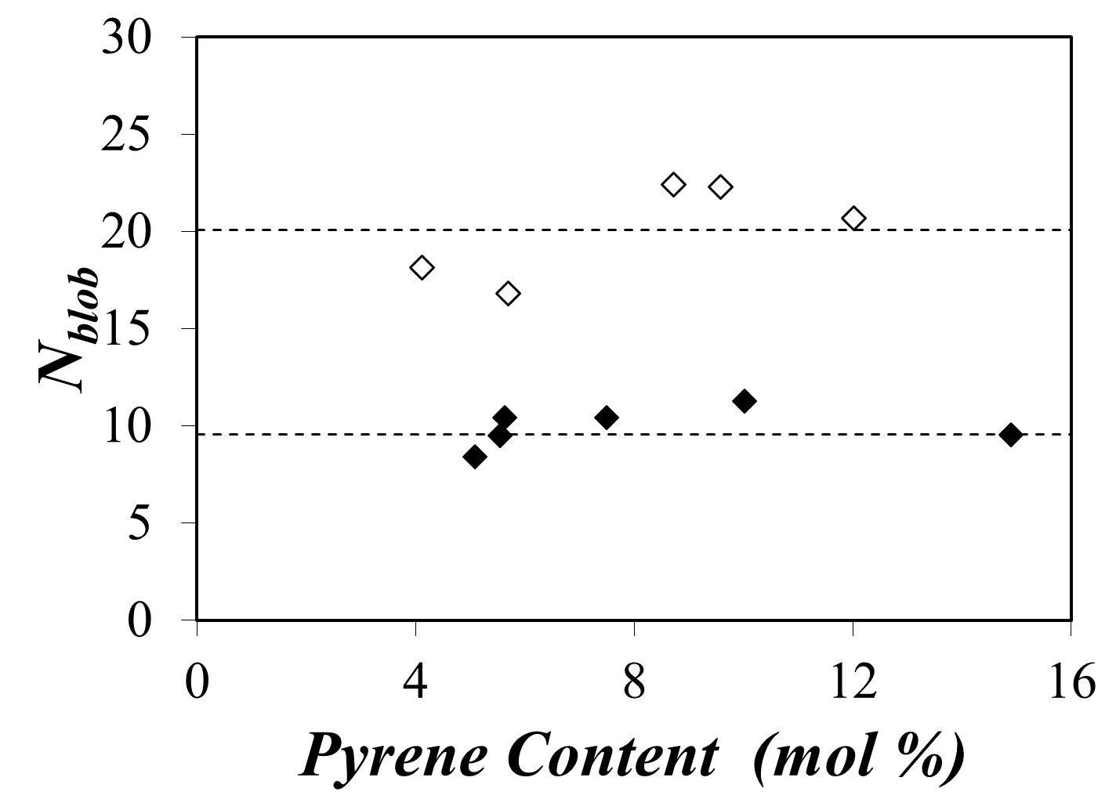
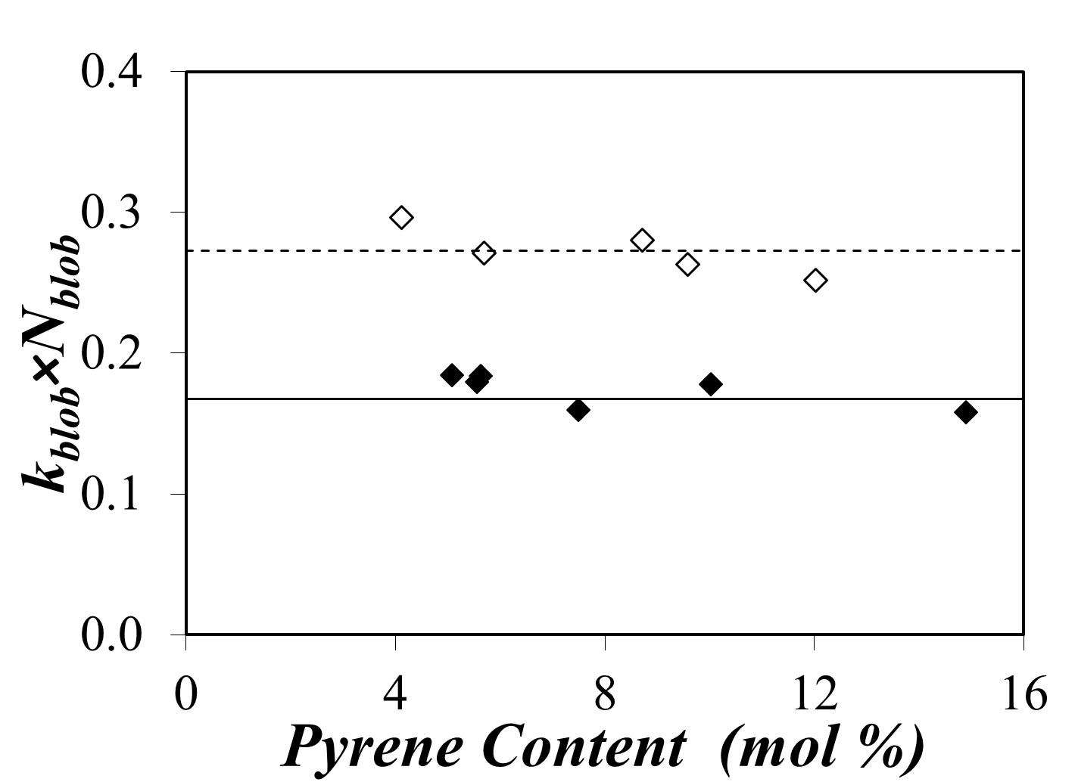
FBM results
Amylopectin
Amylopectin
Amylose
Amylose
 | <N_{blob}> | <k_{blob}×N_{blob}> (ns⁻¹)
Amylopectin | 20±3 | 0.27 ± 0.02
Amylose | 11±2 | 0.17 ± 0.01
Amylopectin even denser than the compact amylose helixes

Slide 19
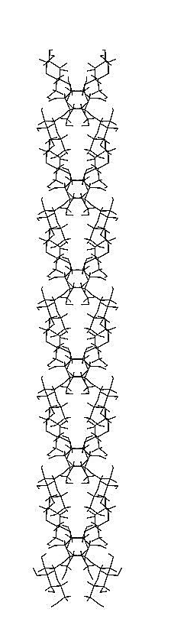
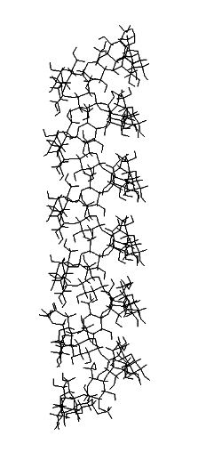
Origin of the difference in N_{blob} (10 – vs – 20)
7-fold helix
N_{blob} = 11
double helix
N_{blob} = 11

Slide 20
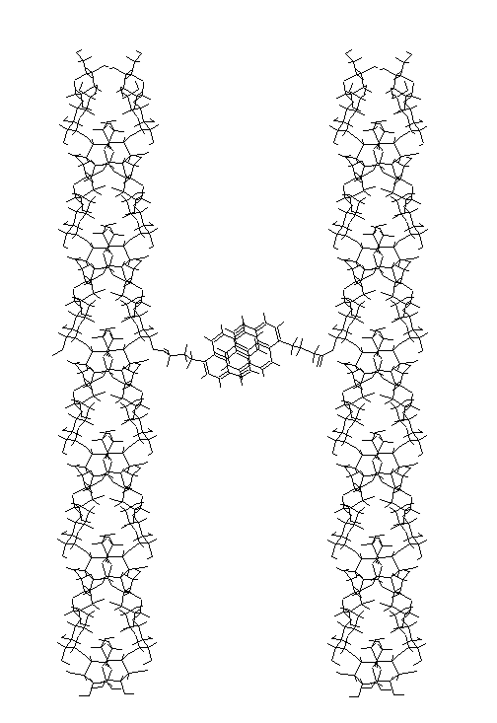
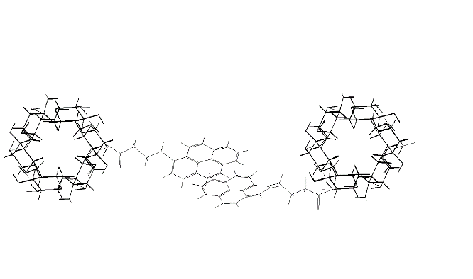
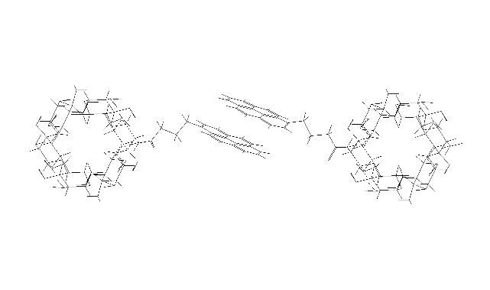
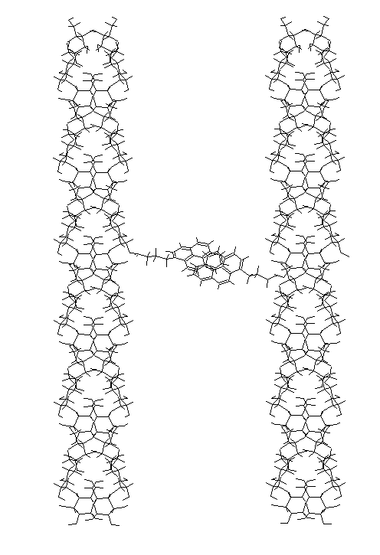
Origin of the difference in N_{blob} (10 – vs – 20)
26 Å between the helices
32 Å between the helices
Good overlap
Poor overlap
20

Slide 21
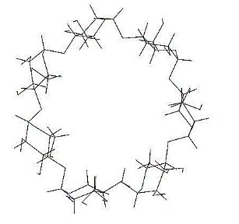
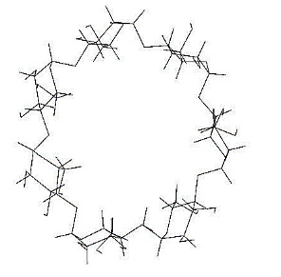
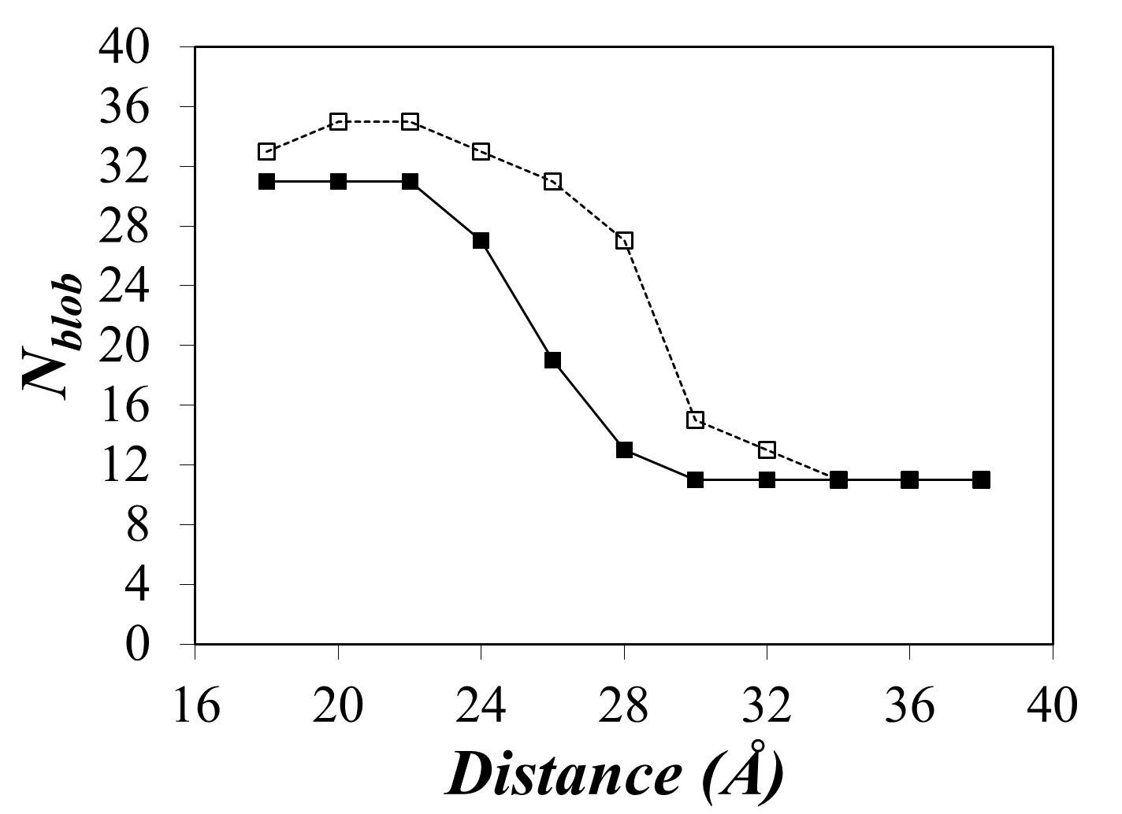
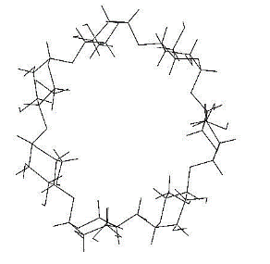




Origin of the difference in N_{blob} (10 – vs – 20）
single helix
double helix
 | <N_{blob}> | Distance (Å)
Amylopectin | 20±3 | 26-29
Amylose | 10±1 | N/A

Slide 22
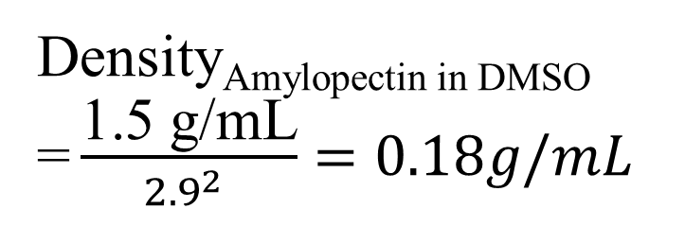
Origin of the difference in N_{blob} (10 – vs – 20）
10 Å
29 Å
Density_{Dry Amylopectin}
= 1.5 g/mL
Density_{Amylopectin in DMSO}
= $\frac{\text{1.5 }\text{g}\text{/}\text{mL}}{{2.9}^{2} }=0.18g/mL$

Slide 23
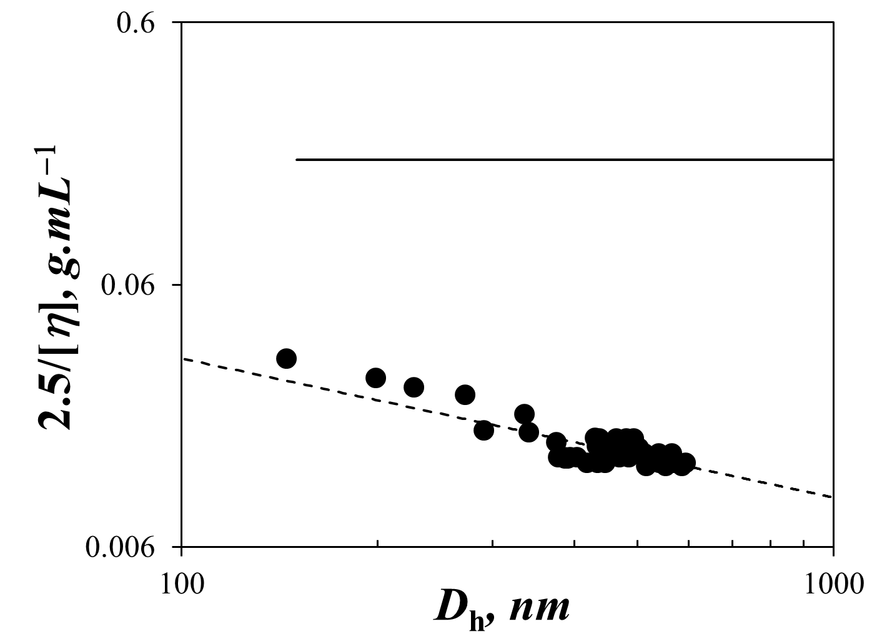
Comparison of the results obtained by blob model analysis and intrinsic viscosity
FBM analysis indicates that the sides chains in amylopectin must be densely packed.
Intrinsic viscosity indicates the whole macromolecule has a much lower density.
Density calculated from N_{blob}
Density calculated from intrinsic viscosity
Millard M.; Dintzis, F.; Wilett, J. L.; Klavons, J. A. Cereal Chem. 1997, 74, 687-691

Slide 24
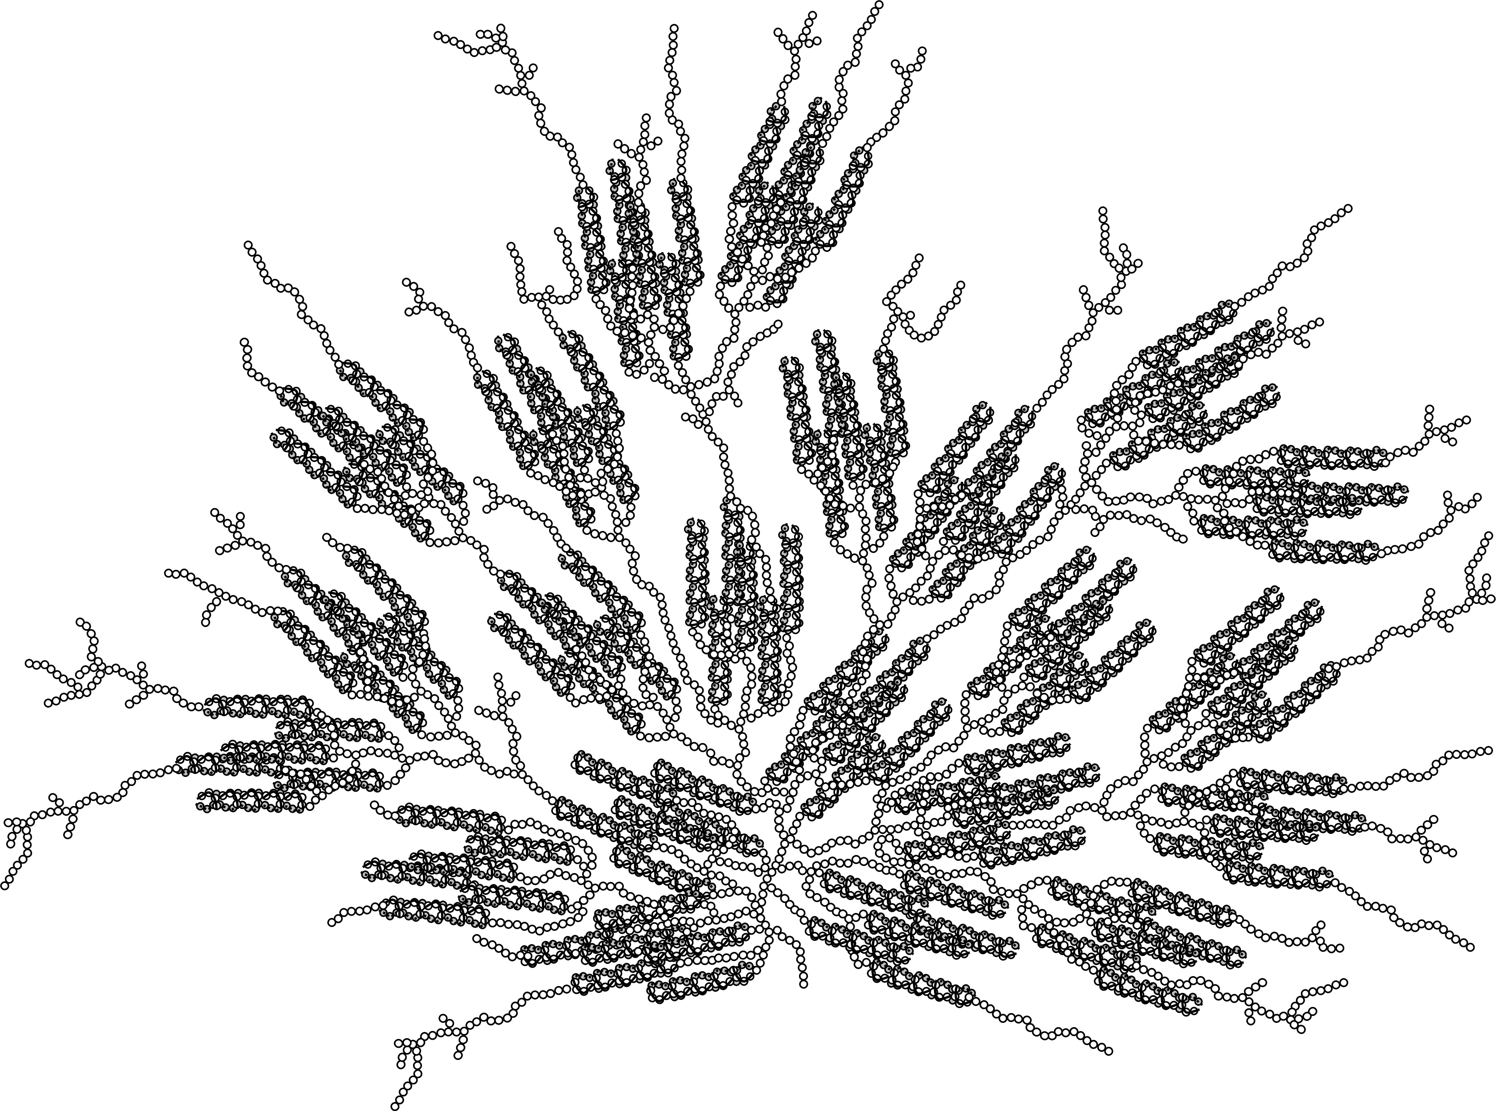
Conclusions: Solution-Cluster (Sol-CL) model
Detailed structural information on polysaccharides is very difficult to obtain, and they are therefore often described either schematically or as “averaged” structures, obscuring the molecular detail.
Solution-Cluster (Sol-CL) model: dense clusters of double helices are connected to each other by linear polysaccharide. This model give us a better understanding of the following properties of amylopectin.
Small Mark-Houwink-Sakurada (MHS) exponents ( [η] = 0.3×M_{w}^{0.4} )
Less pronounced excluded volume effect comparing to linear polymers
Shear-thinning
Shear-thickening

Slide 25


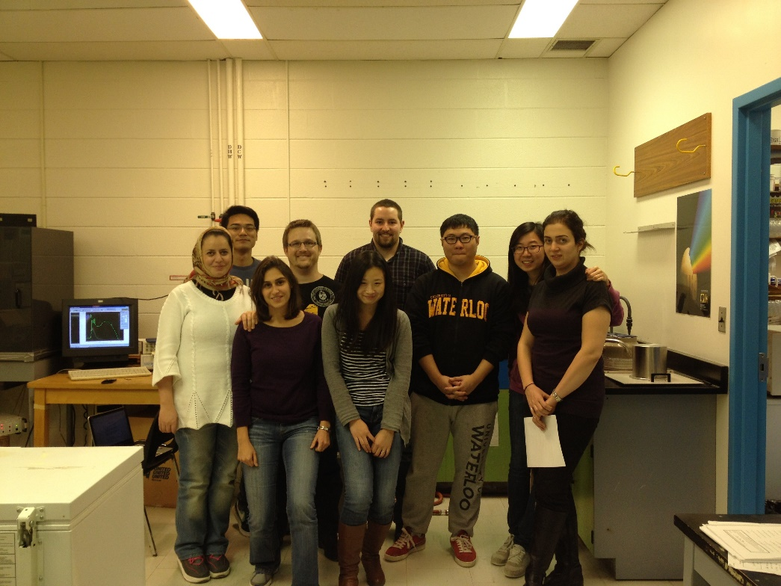
Acknowledgements
Lab members:
Duhamel Group Gauthier Group
Project colleagues:
Wei Yi Qian Zhang
Joanne Fernandez Ryan Amos
Magda Karski Duncan Li
Imran Khimji Alexander Ip
Ziyi Sun Howard Tsai
Damin Kim Bowen Zheng

