Slide 1
Teams Roster Sync
Paul Dietrich, IST

Slide 2
Agenda
UW Teams history
Classroom Teams investigation
School Data Sync
Pandemic
The birth of Teams Roster Sync (TRS)
Architecture
First launch (TRS v1.0)
End-of-Term Cleanup (TRS v1.5)
Operation Warp Speed (TRS v1.7)
Continuous Improvement (TRS 2.0)
TRS Report!

Slide 3
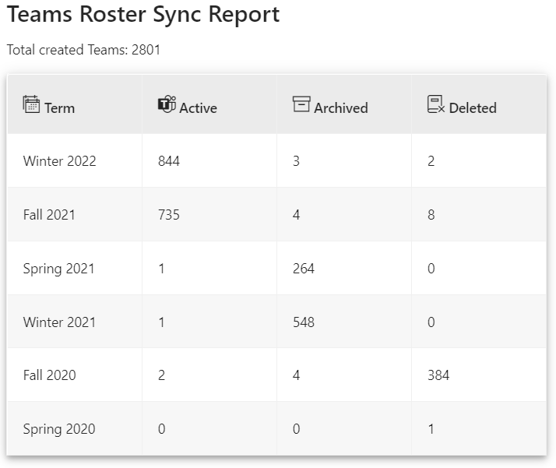
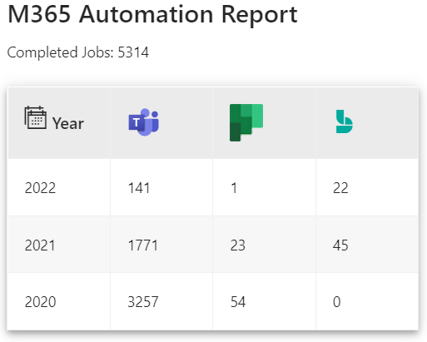
UW Teams History
We started using Microsoft Teams, a robust collaboration tool, that was introduced to the UW community in July 2018. The overall usage of Teams has expanded greatly since then. After we introduced our automation platform in Feb 2020, as of Feb 10, 2022, there have been 8047 Teams created.

Slide 4
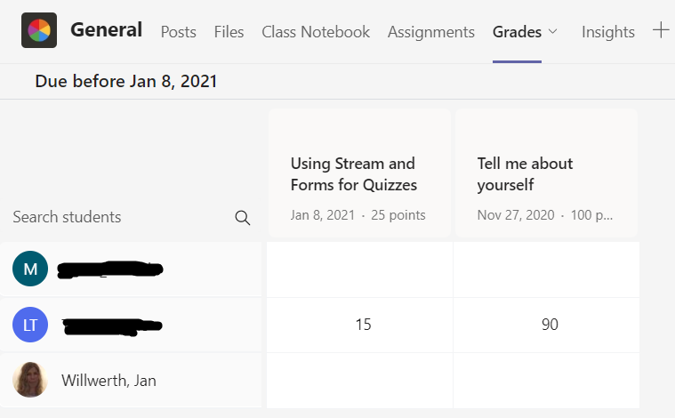
Classroom Teams Investigation
In December 2019 we received our first request to create a specific purpose-built Classroom Team. Classroom Teams are the same core as a standard Team with a few differences in default settings* and includes additional Apps, such as Assignments, Grades, Insights, and a Class OneNote Notebook.
* ALL settings in either situation can be adjusted as necessary to fit the operation of the Team

Slide 5
School Data Sync
This investigation led us to the Microsoft provided School Data Sync (SDS) tool that is used to synchronize class rosters into Classroom Teams*. SDS was originally designed by a 3rd party to implement connections to various Student Information Systems (SIS) via API or CSV to automatically create Classroom Teams and synchronize the rosters. This was completed either using the APIs (our SIS is not included in the list of supported systems) or via Power Automate to publish updated CSVs.
A small pilot took place with a handful of professors to just provide Classroom Teams to determine the use case for Classroom Teams themselves and continued to investigate SDS and how it could be implemented.
* Classroom Teams cannot be used without SDS

Slide 6
Pandemic
As we neared the end of the Winter 2020 term, the world was hit with the global pandemic (not sure if you were aware of this?). Overnight, our investigation into Teams as a companion LMS product to LEARN became an immediate priority.

Slide 7
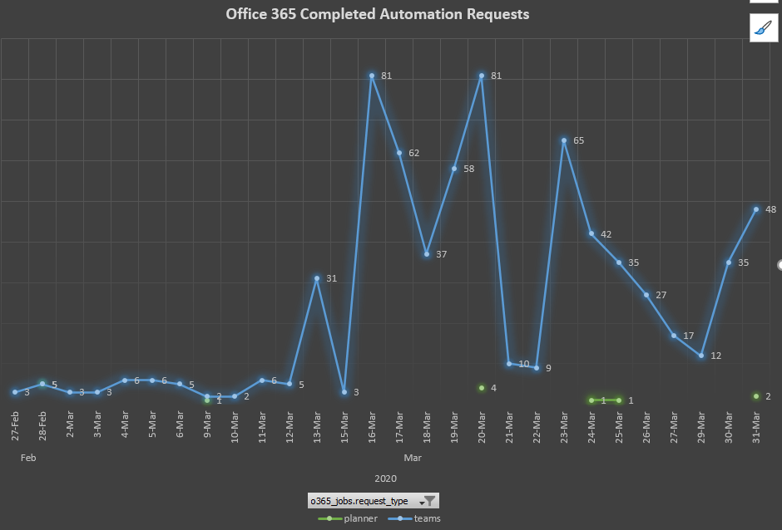
The Birth of Teams Roster Sync
Between March and May of 2020, an extremely extensive deep-dive took place into the SDS system as Teams usage exploded as the University transitioned to primary online classroom instruction. While there was a push and a hope that a system could have been in place for the start of the Spring 2020 term, there just was not enough time to fully understand the platform and implement something that would not already stress out and an extremely stressed-out community.

Slide 8
The Birth of Teams Roster Sync
After completing our investigation into utilizing SDS, we ran into many complications. As we had recently gained a lot of experience utilizing the Microsoft Graph API for our standard Teams automation, that led to three (3) possibilities:
Full transition to SDS for creating and managing Classroom Teams and their rosters
Hybrid SDS which involved using the Graph API to perform many of the functions that the SDS online portal completed, but allowed us to greater customize it to fit UW learning needs
Custom built system that best mimicked SDS, using only standard Teams

Slide 9
The Birth of Teams Roster Sync
Issues we experienced with Classroom Teams and SDS, regardless of a full or hybrid model:
The roster sync process was extremely slow
Issues with roster syncs were difficult to address without affecting all other active Classroom Teams
Unless setup correctly, Forms used for assignments or quizzes were easily taken over by students and significant amounts of cheating took place as students had full access to the Form
This issue has since been addressed by Microsoft, but not until early/mid-2021.
End of Term cleanup procedures were overly complicated and not very customizable to fit our current guidelines with our existing LMS (LEARN)
The general uptake and requests for Classroom Teams was not present as by May 2020 professors became comfortable and confident in the use of standard Teams for class instruction
Classroom Teams and SDS was primarily focused for the K-12 space, so was missing a lot of information that would apply to post-secondary institutions
Teachers could not be students and vice-versa which would have affected TAs

Slide 10
The Birth of Teams Roster Sync
With all this in mind, a recently formed “SDS Project Team” evaluated the 3 options and ended up with the custom-built solution utilizing standard Teams. One of the primary goals and key reasons this was selected was that Teams was to be an expansion of our existing LMS solution, not another LMS on top of another LMS.
This group consisted of members from the following areas of IST:
ITMS (for feedback from the learning side and existing LMS experience)
TIS (for architecture, logic design, and product development)
ISS (for integration with Registrars’ Office for section and class rosters and general security sign-off)
ERP (for integration with the existing LEARN Tools solution)
Notable mention: DCA (for Paul’s random thought programming help)

Slide 11
Architecture
Once a process was designed in how we would complete this, we started to build out the system, mostly from the ground-up while utilizing as much existing infrastructure as possible to reduce complexity. This process is still in place today, only with modifications made to improve the operation of the system.
Professor requests a course in LEARN
During the request process, a button is available for the professor to request a roster synced team with their LEARN course
LEARN Tools submits request to web API to request a Team to be created
The request contains the D2L OU, the name of the course, the term, its scheduled start and end date, a list of professors, and the list of QUEST sections
Existing IST Automation system picks up the pending requests, generates an RT for tracking with the primary professor of record, and creates the Team, sets all the default permissions, and adds all professors (if more than one assigned)
The morning of the start date of the course, a process enables the Team for syncing
At 4:30am daily, a change-log sync is completed by collecting an up-to-date list of all students from each section assigned to a course via Grouper* and is compared to a list from the previous day to determine whether a student needs to be added or removed. This is completed using an SQL MERGE statement and outputting the results to a current task table.
The day after the course is scheduled to end, syncing is disabled resulting in all students being removed
* Grouper receives updated enrollment data from the RO once per day at 3:25am

Slide 12
Architecture
Except for Grouper and LEARN Tools, the entire automation platform – including TRS, was initially built using:
A suite of Microsoft dotnet core 3.1 worker services written the C# language
Front-end portal using a Microsoft Server-Side Blazor web application
Back-end storage utilizes our existing Microsoft SQL cluster
Multiple Microsoft Azure Applications were setup to manage the communication with Azure and the Graph API to provide just the right level of permissions to our tenant where required

Slide 13
Architecture
Change-Log Sync – First Day
Example of a single Roster Sync Team with one section
Previous Day
Today
Paul
Dave
Collect
Merge
Output

Slide 14
Architecture
Change-Log Sync – First Day
Previous Day
Today
Paul
Dave
Task List
Add
Add

Slide 15
Architecture
Change-Log Sync – Changes
Previous Day
Paul
Dave
Today
Paul
Jan
Task List
Remove
Add

Slide 16
Architecture
Change-Log Sync – Term Completed
Previous Day
Paul
Jan
Today
Task List
Remove
Remove

Slide 17
First Launch
Between May and August 27, 2020, the first release of the TRS system was built. This allowed us to be ready for the first day of class in September 2020. Due to the timelines, we did not have a relatively significant number of Roster Sync Teams (390) created for this term since most professors already had their LEARN courses and standard Teams created for use during that term. A good handful of standard Teams were converted to TRS for those that missed the opportunity but wanted to take advantage of this new system.
On September 9th, 2020, the first major sync was attempted with ~46000 sync tasks to complete. It was determined the system halted after 1 hour of sync activity. While significant effort had been spent to account for a very large number of tasks that could be happening, we reached a bug in the TRS sync code where the token used to access the MS Graph API had expired, halting its use. We are talking milliseconds of difference between commands in the application. Even though we considered this token needing to be refreshed, how this was implemented was affected by a millisecond difference.

Slide 18
First Launch
Mitigation steps were implemented to just get the first sync running so classes could take place. Within a couple weeks a full replacement of the token system was implemented, fully removing any potential for long running tasks to be affected by expired tokens.
1. Do we have a token?
a. If not, get one, putting the result into the token model
i. This includes adding an additional expiration time of the received expiration time minus 5 minutes
ii. If the token request returns unauthorized, generate an RT for support to resolve
- this can happen if our service account password or the azure application password expires
2. If we have a token
a. Has it reached expiration? If the current time is >= the calculated token expiration time, request a new token
b. Does the token work? We check this with a simple Graph API call to ensure it does not return invalid and if so, request a new token
3. If we have reached this point, the token is considered valid, and the requesting function will run

Slide 19
First Launch
Also addressed quickly was that Roster Sync Teams were not created until the first day of class, also presenting further issues to professors to be ready to go for the first day. This was updated to create the Team immediately upon an approved request from LEARN Tools giving professors sometimes weeks of preparation time to get the Team setup to their liking before the students were added. Albeit a minor issue, was well received by the learning community.

Slide 20
End-Of-Term Cleanup
Once the initial sync bugs were addressed, the race was on to determine how we would now handle the end-of-term cleanup of all roster sync teams. Based on the existing standards and policies used by LEARN, we knew the following:
Courses are archived after 30 days past the end date of the course
Courses are deleted after 365 days past the end date of the course
All it took was implementing further worker services within the TRS service to use our existing data and perform the required action at the required time frames as already determined.
This brought out the release of TRS v1.5 in early November 2020.
Changes to the Teams Roster Sync process | Information Systems & Technology | University of Waterloo (uwaterloo.ca)

Slide 21
Operation Warp Speed
The use of TRS as an addition to LEARN effectively doubled for the Winter 2021 term. This was great news for all of us a whole, but the next portion of the system that needed a serious overhaul was the sync procedure itself. We were quite happy that we had built a system that worked, with little to no issues (2020 -> 99.4% success rate on syncing), professors and students were not happy that they were not put in their respective Teams until, on some occasions, after the first day of class.
V1 of the TRS was able to complete ~3853 sync tasks per hour, but when you need to sync 40000+ students, this time adds up. In these early stages it took 8 hours and 41 minutes to complete 46557 tasks. Due to the significant pressure from the learning environment, we made a simple change to activate Teams for syncing the day before the scheduled course start date to ensure that all students would be in their required Teams for the start of the first day of class.

Slide 22
Operation Warp Speed
In January 2021, work now began on how we could significantly improve the performance of synchronization by utilizing parallel task handling, or the task parallel library (TPL). V1 compiled the list of tasks and looped through one-by-one. Implementing TPL would allow us to start many tasks at once without waiting for the previous one to complete.
As this requires more “power” (CPU threads) and the act of doing this presented Graph API throttling, much testing was spent determining the right threshold of parallel tasks we could run without taking up too much CPU or having to deal with Graph API throttling often. The magic number was determined to be 25 tasks at a time.
It was required then to implement an additional Graph API throttling detection mechanism to determine if a sync request failed due to throttling and how to manage it. When throttling occurs, you are locked out for 2 minutes. Therefore, all affected sync tasks pause for 2.5 minutes and retry. If the request was throttled again, we just wait another 2.5 minutes and try again. At most you would have 25 sync tasks in this state waiting for the throttling limit to be lifted, limiting longer wait times or repeated throttling.

Slide 23
Operation Warp speed
Before the end of the month, Operation Warp Speed was fully tested and implemented into the platform. This completed sync batches 19.2x faster!
Old: 40000 tasks, 8 hours
New: 40000 tasks, 25 minutes

Slide 24
Continuous Improvement
At multiple points during the current lifetime of the TRS, we have met with and taken feedback from the learning community at various levels. From conversations with professors directly, to engaging the Learning Environment Operations (LEO), and handling every crazy idea that Jan Willwerth had. These discussions are what have led to many of the continuous improvements that have been implemented into TRS since its inception. Continually engaging and collaborating with everyone involved has contributed to the success of this program and leaves the door open to make every part of this better.
Whether they are minor changes to make the professors and students experience better, to major changes to allow for operation of the system by the right people (not by me making changes in databases), everything was done with a successful learning experience in mind.

Slide 25
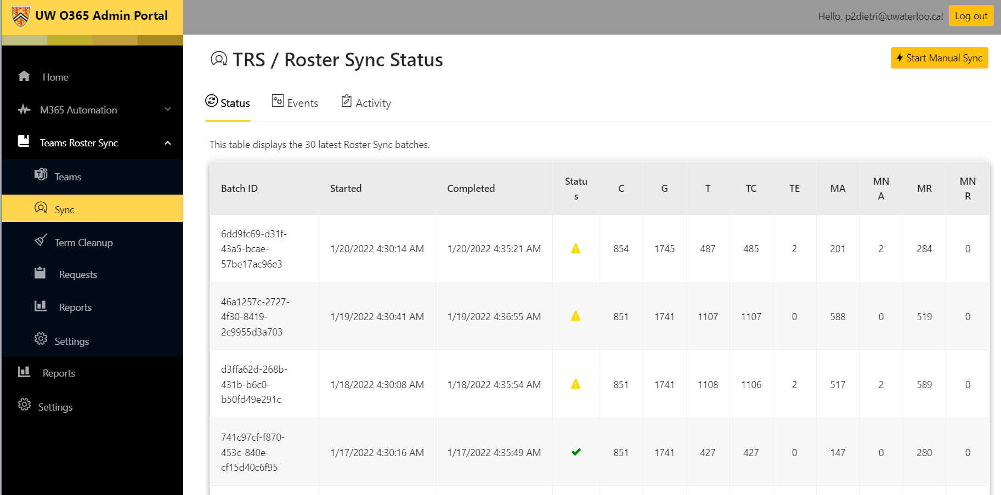
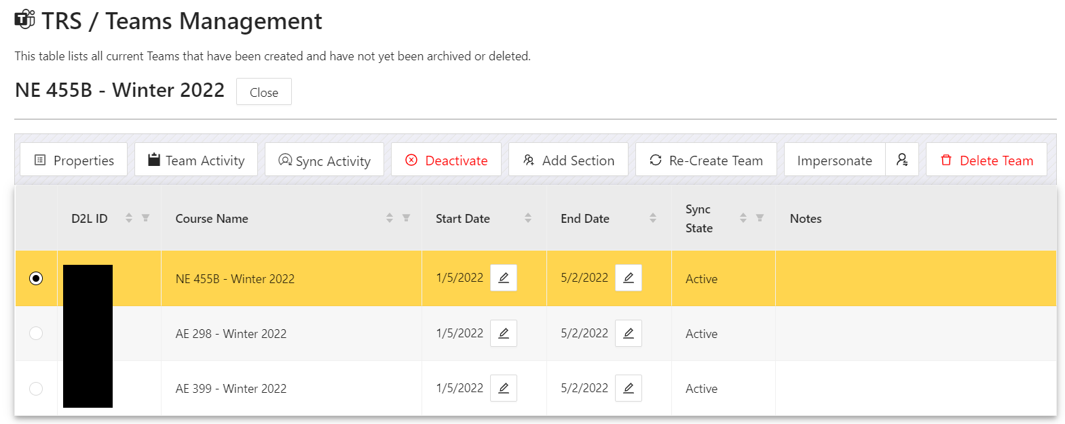
Continuous Improvement
The custom-built admin portal was created so that the entire management of the system could be done by the people who need it most, the LEARN support specialists. On a regular basis we have added many new features and data sets to expose as much of the environment as possible while extending management capabilities within the portal. Almost every single aspect of the TRS platform can be fully viewed and managed from this portal.
We recently migrated the entire platform to the newly released dotnet 6 (providing us 3 years of support - LTS) and the entire admin portal had its user-interface overhauled from the MatBlazor UI library to now utilizing the Ant Design UI library to provide a consistent, clean, UW themed look and feel.

Slide 26
TRS Reports! (as of Feb 7, 2022)

Slide 27
TRS Reports!
2,808 Roster Sync Teams Created
623,113 sync tasks completed
1,359 task errors
Completed our largest sync batch of 82,037 tasks in 56 minutes on Jan 6, 2022
99.74% overall success rate in syncing
Most of the failures contributing to this value were experienced in September 2020
Error identification needs some updating as technically an error could be considered an error in the application (or Graph API), or such as a Team having been deleted. Both are considered errors, but the latter is not an error of the system that needs to be addressed or one that would affect a success rate calculation.
Only once has a sync batch not run as per scheduled in 543 days of the application running, during which 584 sync batches have been run
190 code commits to git for the TRS specific application
14 releases (currently at version 2.0)

Slide 28
Name drop!
Everyone in this list from IST has specifically contributed in some way to the success of this project - whether they know it or not by just listening to me or providing valuable input to generate the result. There are probably many others from outside IST as well, but then I would be here until Monday listing them. None of this would have been possible if it was not for the open communication and strong collaboration between everyone.
ITMS: Jan Willwerth, Andrea Chappell, Sean Warren, Funmi Onikan
TIS: Adam McFarlane, Dave Hinton, Steve Bourque
CS: Carol Lu
ISS: Sean Mason, Mark Gaulton
ERP: Gina Reichard
DCA: Joe Radman, Pavol Chvala

