Slide 1
CO-OP 2.0 CSC MEETING
Presented by: Co-op 2.0 Project Team

Slide 2
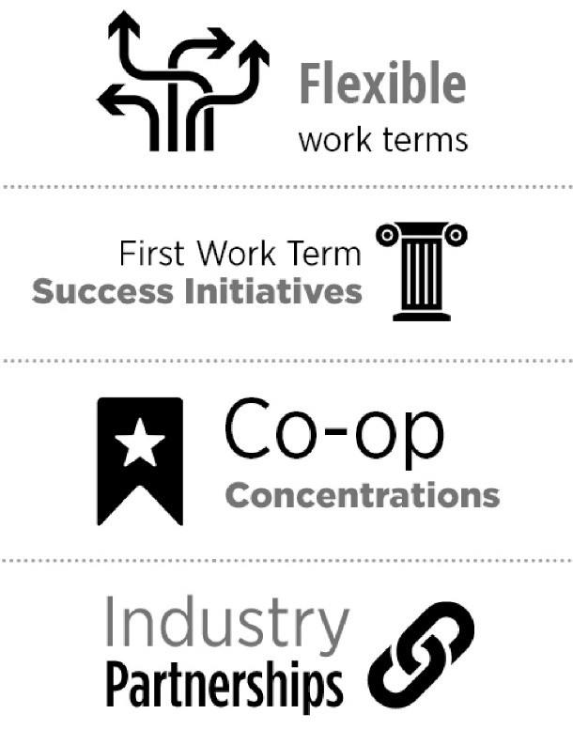
TODAY’S PRESENTATION
Provide update on Co-op 2.0
Research Certificate: Approved for fall 2018 calendar
Flex Terms: Approved for fall 2018 calendar
Flex Term Pilot
First Work Term Success
University- Industry Partnerships

Slide 3
CO-OP 2.0 PROJECT OBJECTIVES
Expand and enhance traditional Waterloo co-op experience
Provide flexibility and relevance for students and employers
Formalize current non-traditional practices and elements
Integrate current and new elements into Waterloo co-op
flexible terms
co-op certificates
first work term success initiatives
university /industry partnerships

Slide 4
CO-OP RESEARCH CERTIFICATE
Students would gain an additional credential for work done primarily through co-op:
Complete three work terms in research
Complete a ‘Meta-Research’ PD course (in place of an existing PD requirement)
Participate in a capstone research event
Framework, once approved, can be replicated for additional concentrations: Entrepreneurship, Humanitarian, International (approved for Fall 2018 as of June 2017)

Slide 5
CO-OP RESEARCH CERTIFICATE – STUDENT INPUT
Surveyed 2215 current co-op students
30.2% response rate (668 students represent all faculties)
86.1% of respondents overall indicated interest in pursuing co-op designation
Just over 40% of respondents reported that a research work term sparked their desire to pursue a future research work term and a similar number of respondents’ interest was sparked to pursue research following graduation

Slide 6
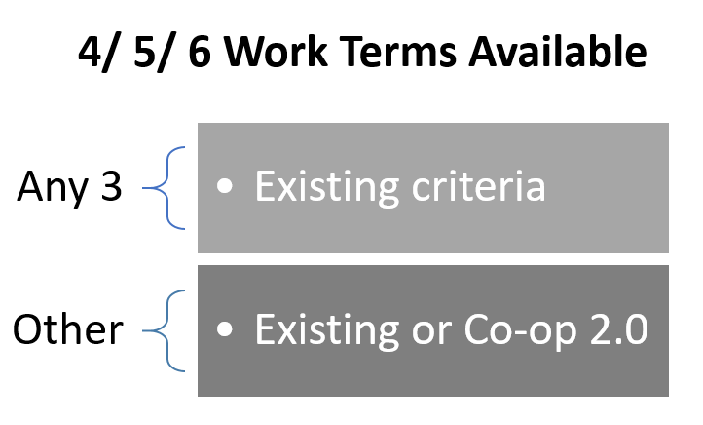
Allow students more choice on some work terms
Expand our network of employers and relationships

Slide 7
CURRENT CO-OP REQUIREMENTS
 | Existing Work Term Criteria
✓ | 16 weeks (12 by exception) and full time
✓ | Have a supervisor
✓ | Be compensated (or approved with alternative remuneration)
✓ | Have an evaluation (and someone to do it)
✓ | Related to your field of study (defined by program)
✓ | Gaining relevant skills for further employment
✓ | Single employer

Slide 8
FLEXIBLE CO-OP REQUIREMENTS
 | Flexible Work Term Criteria
✓ | Students arrange employment and submit for approval, with rationale provided for how the work term meets their specific goals
✓ | Be a minimum of 420 hours of work (within 16 week timeframe)
✓ | Not include extended breaks or periods off
✓ | Have a supervisor or coordinator who must evaluate student performance and submit evaluation
✓ | Combined experience (one or two employers)
✓ | Receive compensation or meet the requirements of an alternative remuneration arrangement.

Slide 9
FLEXIBLE WORK TERMS – STUDENT INPUT
Surveyed 5,232 students nearing graduation who are in co-op or were in co-op at one time
26.7% response rate (1,397 students representing all Faculties)
21.6% of respondents (302 students) missed work terms (most missed only one work term)
44.0% of respondents (143 students) who missed a work term could have benefited from flexible works
72.9% of respondents indicated openness to pursuing a flexible work term
71.3% of respondents felt the value of Flexible Work Terms is at least on par with Standard Work Terms and 24.02% of respondents were undecided

Slide 10
STUDENT CONSULTATION FOCUS GROUP
Conducted focus group with 14 senior students, representing 4 of the faculties.
What are the benefits provided by Flex Terms? Why would you pursue a Flex term?
“More advantageous in circumstances that don’t currently qualify for co-op”
“To explore both halves of my program, Math/Bio – would be nice to set up a first WT doing two jobs at once, half in Math and half in Bio. After all, first WT is so critical: sets us on a track and it can feel like we get locked in once you have that first experience.”
“To explore seasonal fieldwork, where it may be easier to get employed as these are often shorter term opportunities”
“Would be great for a returning opportunity or working on a project that doesn’t meet regular length requirements. (i.e. short-term intensive projects)”

Slide 11
FLEXIBLE WORK TERM PILOTS
Current students are eligible do complete one flex work term through the pilot
Pilot will help inform flex work term operationalization
Five phases to flex work term pilot from Spring 2017 to Fall 2018
Already approved some flexible work terms
Collecting feedback through post work-term survey
Encourage students to speak to their student advisors
https://uwaterloo.ca/co-operative-education/co-op-2-0/flexible-work-terms-pilots

Slide 12
FIRST WORK TERM SUCCESS
What would 100% success on a first work term look like?
Students find jobs through CECA posting/match process
+ Students finding jobs on their own and submitting for credit
+ Students working in ‘industry fundamental’ experiences
+ Students working in ‘coordinated multi-experience’ positions

Slide 13
INDUSTRY FUNDAMENTAL EXPERIENCES
Expand ‘industry fundamental’ experiences
Work with Faculties and programs to identify relevant industry fundamental experiences
Experiences are often necessary foundations for more senior jobs
Socialize these as regular, expected first work term jobs

Slide 14
COORDINATED MULTI-EXPERIENCE MODELS
Expand model already used by BETs and Greenhouse
Co-ordinated by program co-ordinator who matches students to employers
Typically students matched to 3-4 short term work placements
Employers are in the same geographic region
Alternative remuneration
Program Co-ordinator writes student’s final work-term evaluation based on placement evaluations, training and check-ins

Slide 15
UNIVERSITY/INDUSTRY
PARTNERSHIPS
Education sponsorships
Company financial support for post employment commitment
Custom/ commissioned design teams…
Capstone projects
Senior and grad consultancies

Slide 16
CO-OP 2.0: SUCCESS WILL LOOK LIKE….
More flexibility
More variety
Less saying ‘no’
Remain accredited
Increase student success
Broad stakeholder support
Still the world leader

Slide 17
INVITE FEEDBACK
Questions? Comments? Please connect with us at coop2.0@uwaterloo.ca
Visit Co-op 2.0 website:
uwaterloo.ca/co-operative-education/co-op-2-0

Slide 18
