Slide 1
Science CnD Business Model Results

Slide 2
Monthly Bank Balances
(May 2016 – March 2017)
Date | Expenses | Revenue | Monthly Closing Balance | Status | Deviation
1-May-16 |  |  | 5258.7 | ACTUAL | 0%
1-Jun-16 | 1651.01 | 1329.1 | 4936.79 | ACTUAL | 0%
1-Jul-16 | 95.21 | 838.75 | 5680.33 | ACTUAL | 0%
1-Aug-16 | 366.68 | 0 | 5313.65 | ACTUAL | 0%
1-Sep-16 | 1099.68 | 1440.2 | 5654.17 | ACTUAL | 0%
1-Oct-16 | 3272.34 | 4236.45 | 6617.28 | ACTUAL | 0%
1-Nov-16 | 4377.03 | 5266.91 | 7507.16 | ACTUAL | 0%
1-Dec-16 | 1062. 85 | 2345.3 | 6796.8 | ACTUAL | 0%
1-Jan-17 | 478.89 | 1161.75 | 7479.66 | ACTUAL | 0%
1-Feb-17 | 1306.37 | 2909.6 | 9082.89 | ACTUAL | 0%
1-Mar-17 | 3500 | 5000 | 10582.89 | PROJECTED | 100000%

Slide 3
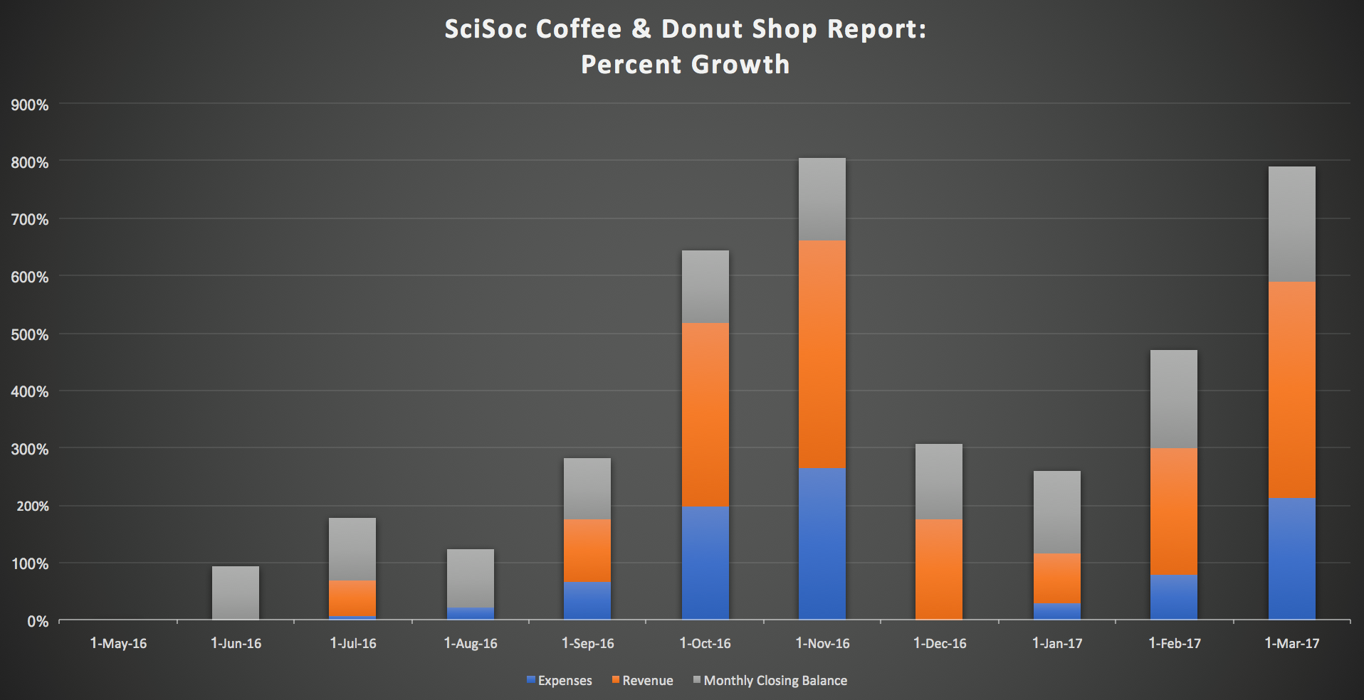
Graphical Representations of Retained Bank Earnings

Slide 4
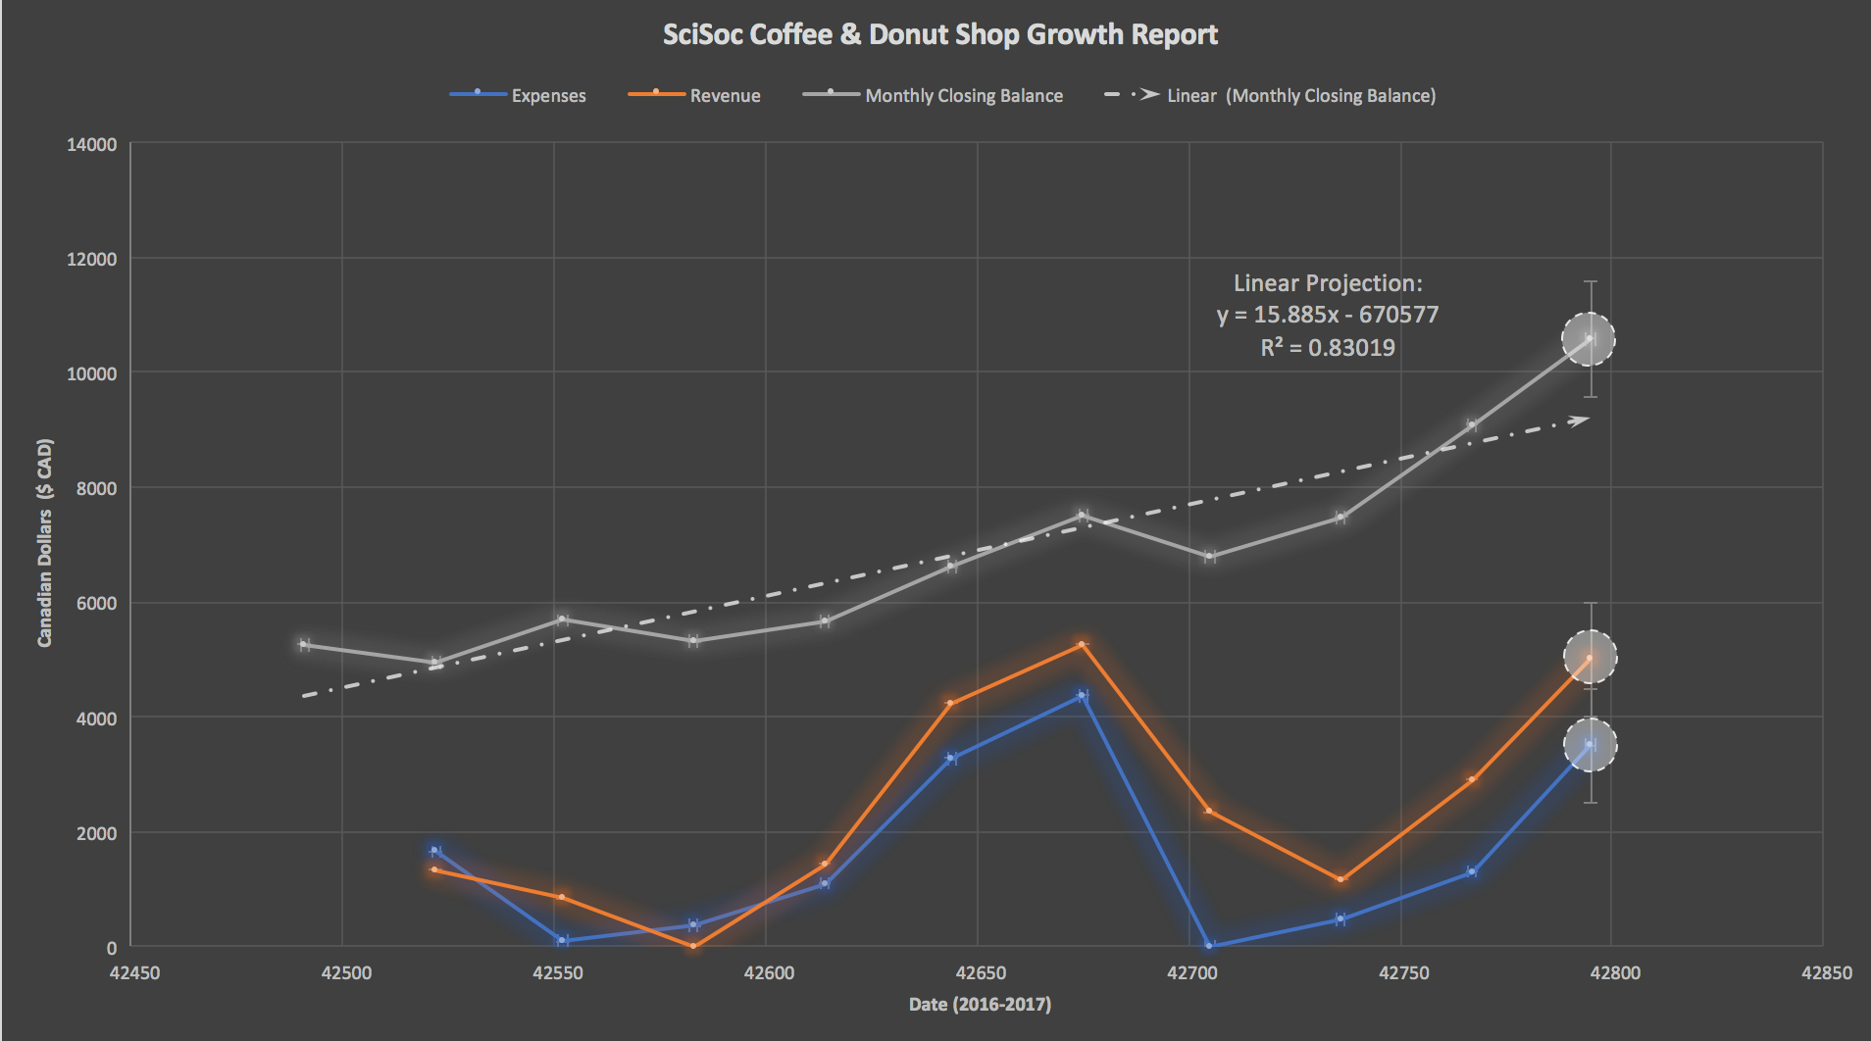
Graphical Representations of Retained Bank Earnings

Slide 5
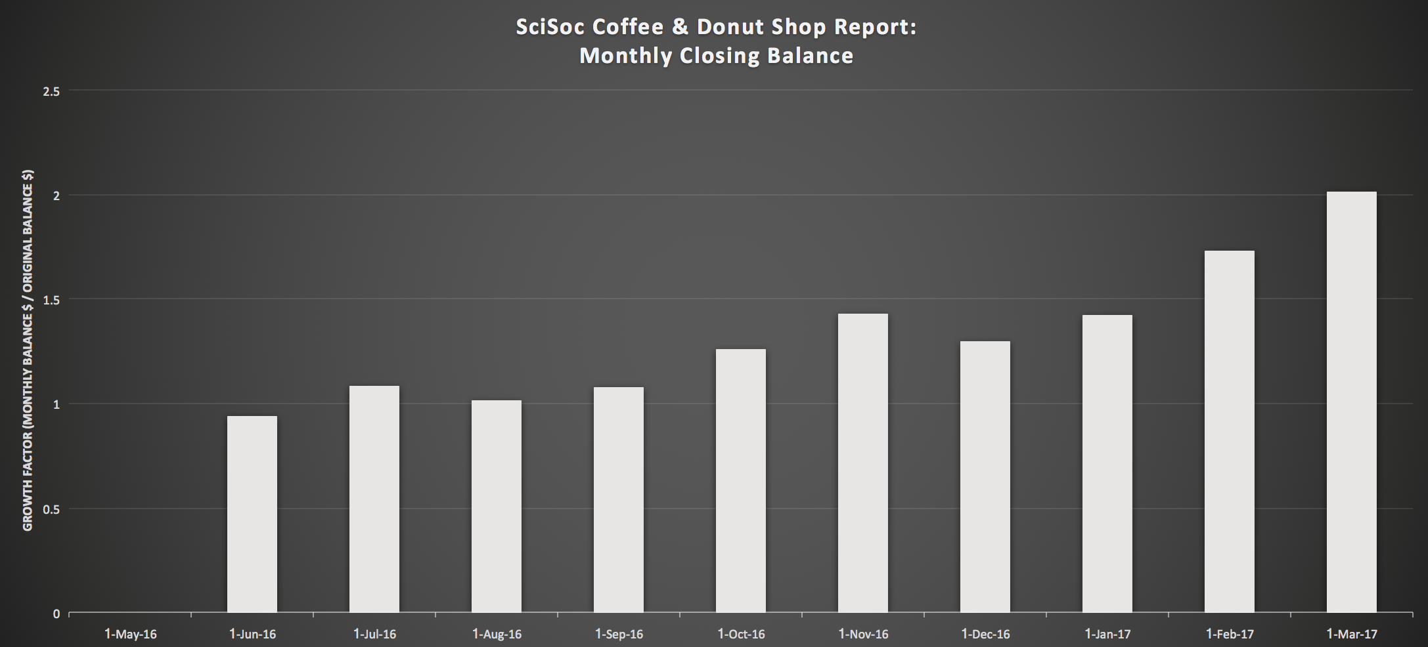
Monthly Closing Balances
(May 2016 – March 2017)
Notes:
Monthly Closing Balance for May 2016: $5258.70

Slide 6
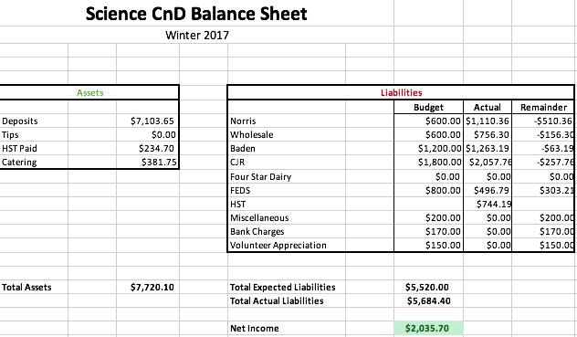
Science CnD Balance Sheet
(Winter 2017 Actuals)
Notes:
The Net Income of ~$2,035.70 is a rough estimate, as FEDS has not billed all their invoices as of yet.

