Slide 1
Screen Templates
March 2019

Slide 2
Saving Templates
These slides are formatted to be exported as a PNG or JPEG for the 1920px*1080px screens.
First, make all appropriate changes to the slide. Ensure all instruction text boxes are deleted. Then, export.
To export:
Click ‘File>Export…’
Name the file
Select PNG or JPEG format
Click the ‘Save Current Slide’ option
Adjust width to 1920 pixels; height will populate automatically
Click Export

Slide 3
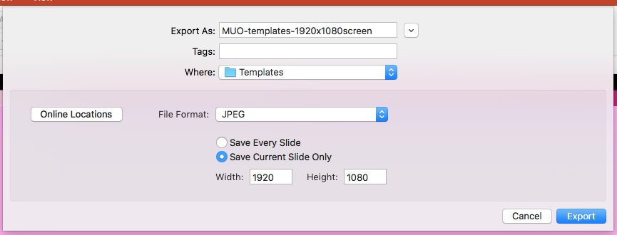
‘Options’ window should look like this before clicking OK and SAVE
File Name Here

Slide 4
Submitting Images
To submit your image, specifications and contacts are provided
MC/M3 screens: Email math.display@uwaterloo
Ensure images are saved as .png or .jpg
Ensure images are 1920 pixels wide by 1080 pixels high
CS Screens: Email Joe Petrik (joe.petrik@uwaterloo.ca)
Ensure images are saved as .png or .jpg
Ensure images are 3400 pixels wide by 1700 pixels high

Slide 5
Additional Resources
Not sure about the changes you’re making to the template, or what other colours you can use? Find it in the University’s branding guide under Faculty of Math: https://uwaterloo.ca/brand/visual-expression
Looking for creative commons pictures for your screen? Check out Flickr: https://www.flickr.com/creativecommons/

Slide 6
MONDAY
APR
18
Announcement w/ date
Font: Impact, white, centered
Link/room number – font : Verdana, centered

Slide 7
MONDAY
APR
18
Announcement - font: Impact, white, centered. Room for two lines of text here.
Link/room number – font : Verdana, centered

Slide 8
MONDAY
APR
18
Announcement/ title here
Font: Impact, white, centered
Let picture take up all of background, leaving bars and text on top (insert picture, select it, right-mouse click, Align > Send to Back)

Slide 9
MONDAY
APR
18
Let picture take up all of background, leaving bars and text on top (insert picture, select it, right-mouse click, Align > Send to Back)
Link for more info/website - font: Georgia, left-aligned

Slide 10
Announcement - font: Impact, left aligned
MONDAY
APR
18
More info about the event can go in this space. Font: Georgia Regular. Leave some space above the pink colour bar.
Let picture fill this box (insert picture, select it, right-mouse click, Align > Send to Back). Resize photo to fill this space between date and website link colour bars.
Link for more info/website - font: Georgia, left-aligned

Slide 11
MONDAY
APR
18
Announcement/Title - font: Impact, left aligned
More info about the event can go in this space. Font: Georgia Regular. Can fill this text box to the bottom of the page.

Slide 12
Let picture take up all of background, leaving bars and text on top (insert picture, select it, right-mouse click, Align > Send to Back)
Link for more info/website - font: Georgia, left-aligned

