Slide 1
Module #4:
Feedbacks and Evaluation
Teamwork Skills Project

Slide 2
Learning Objectives
Understand the benefits of feedbacks.
How to properly provide and interpret feedbacks.

Slide 3
Acknowledgement
Some of the slides are adapted from
  Teamwork Skill Clinic, Faculty of Engineering, University of Waterloo.

Slide 4
What is Feedback?
Information about reactions to
an event, a decision, a product, an individual’s performance of a task, etc., that is used to support improvement
or confirm success.

Slide 5

Benefits of Feedback - Self
Learning & Self Development
Developing leadership skills
by supporting others
Growth Mindset & Resilience
Notes:
Feedback makes one better.
The benefits of receiving feedback includes the growth potential from integrating others’ perspectives into one’s own work, an opportunity for learning, and encouraging resilience through a mindset that is open to continuous improvement
The benefits of giving feedback includes the opportunity to develop leadership skills as well as to develop interpersonal and communication skills
Why is it important for the instructor to emphasize the benefits of feedback?
‘Where students were able to identify potential benefits from engaging in peer assessment at the start, they appeared able to focus more on this and less on their anxiety….

Slide 6

Benefits of Feedback- Team
Support team members in achieving shared goals
Enhanced performance of others on a team
Motivation for others
Helps to generate diverse ideas
  Each member can make a unique
  contribution to the team
Creative process and team efficiency is
enhanced by feedback and difference
  Inviting in differences in knowledge, opinions,
  ideas, etc. may create tension but this tension
  supports innovation and creativity
Notes:
Feedback also makes the team better.
Reiterate the value of inviting in others with different knowledge, opinions, ideas, perspectives or experiences than yourself or your team to provide feedback in order to gain increased creativity. This can also be considered from the perspective of creating a diverse team to capitalize on this concept of heterogeneity throughout all aspects of the team process/experience.

Slide 7
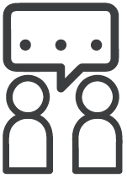
Benefits of Feedback -Professional
Part of the process as a professional
  Sharing work with colleagues/clients
  Revising and improving work
  Staff development in leadership roles
Engaging multiple perspectives
  Innovation & collaboration
Notes:
Why is it important for the instructor to emphasize the benefits of feedback?
Linking the exercise more closely with the students’ future professional practice also appears beneficial in this context by stressing the ‘real-life’ need to share their work in a professional context’ (Cartney, 2010)
Anecdotal example: hurt/hamper career development
Possible Example:
As a co-op or new hire in industry you may encounter reluctance or even push back when presenting new ideas/suggestions. This can be the result of previous new hires having suggested/implemented ideas with great enthusiasm, but without taking the time to get buy-in from various stakeholders, or from not having analyzed the situation effectively enough to design an appropriate solution. Both of these problems can be avoided by having a better understanding on interpersonal communication and, more specifically, by spending time in the Interpretation and Evaluation stage of the feedback process that will be taught in this module in order to create a thoughtful design that is supported by facts.

Slide 8
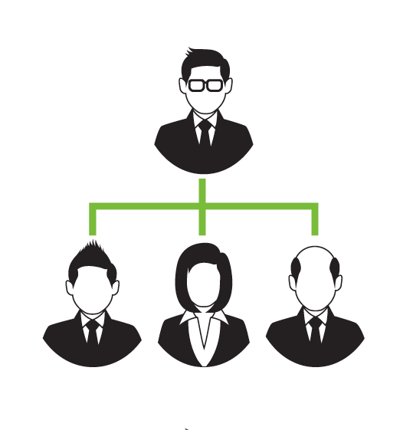
Hierarchical relationships
If presenting feedback to someone that is higher up than yourself in power, knowledge, experience etc.
TIP:
Back-up your feedback with examples to support your position and establish your credibility
Notes:
Most feedbacks are from up top, or from peers. But if you are to provide feedback to the top, you do need to exercise some strategy.

Slide 9
Hierarchical relationships
If presenting feedback to someone that is lower or equal in hierarchical ranking than yourself….
TIP:
Emphasize the supportive nature of your feedback and pay attention to your body language
Notes:
A more common form of feedbacks. Still need some strategy to make them more effective.

Slide 10
Accepting and Resisting Feedback
You may be worried that feedback will:
distinguish you from your peers
portray you as incompetent
offend another person
Or, perhaps you already value feedback as an important part
of your individual or collective development!
Positive feedback is often desired
→ but may limit potential for growth and development
Constructive feedback can negatively impact self-perception
→ but provides opportunity for innovation and growth
Notes:
But types of feedbacks, positive and negative, have their places.
No one likes to be criticized. It is human nature to resist negative feedback (albeit contructive). But they are necessary for growth.
Points for discussion:
Reiterate the importance of learning about feedback and the communication skills that impact it.
Reiterate the Importance of open mindedness when engaging with feedback, especially feedback coming from an opposing viewpoint.
Reiterate that people who are willing to spend time giving constructive criticism are interested in seeing you progress and develop; it is not meant to be a negative experience

Slide 11
Components of Feedback
Interpretation:
Ask clarifying questions to expand your understanding
Summarize or paraphrase to check understanding
Evaluation:
Provide an assessment of the idea
  Begin with a positive evaluation and follow with constructive
Recommendation:
Provide further information or suggestions
  Focus on closing the gap between the design’s current state and its desired state

Slide 12
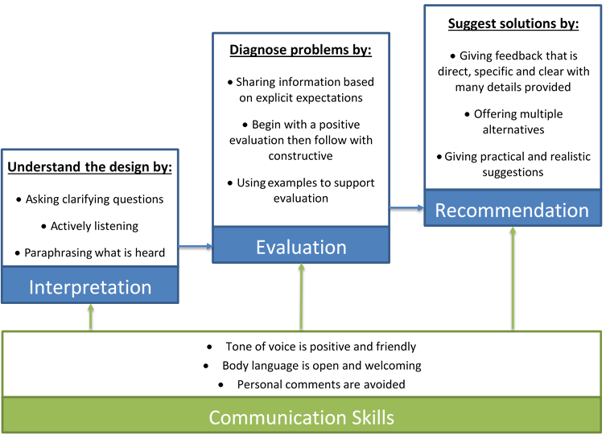
Giving Feedback
Notes:
Walk through each type of feedback (Interpretation, Evaluation, Recommendation) and explain that communication skills are the basis for all types of feedback (found in the rectangle at the bottom of the image).
By beginning with interpretation students are encouraged to gather additional information and check their understanding of the material presented to them.
They can then follow up by providing positive and constructive evaluation of the material and using examples to support their evaluation.
Finally, in the recommendation phase students are prepared to provide practical and realistic suggestions that are based on a thorough understanding of the material presented and guide the design from its current state toward the desired state. They should be encouraged to provide their recommendations with specific and clear details that are supported by facts.
If you prefer to deliver this module in 2 sessions, stop at this point in the slide deck and continue with the Gallery Critique explanation and corresponding activity in the next lesson. This benefit of this approach is that it will allow more time for the activity/feedback portion of the module.

Slide 13
References
Cartney, P. (2010). Exploring the use of peer assessment as a vehicle for closing the gap between feedback given and feedback used. Assessment & Evaluation in Higher Education. 35(5), 551-564.
Cusing, A., Abbott, S., Lothian, D., Hall, A., & Westwood, O. (2011) Peer Feedback as an Aid to Learning – What do we want? Feedback. When do we want it? Now! Ed Teach. 33, 105-112.
Ada Hurst, Oscar Nespoli. A Two-Dimensional Typology for Characterizing Student Peer and Instructor feedback in capstone design project courses –
Nicola, B., Thomson, A., and Breslin, C. (2014). Rethinking Feedback Practices in Higher Education: a Peer Review Perspective. Assessment & Evaluation in Higher Education. 39(1), 102-122.
Direkova, N., Google Sprint Masters. Design Sprint Methods. 22 December 2016, https://developers.google.com/design-sprint/downloads/DesignSprintMethods.pdf
University of Waterloo. (n.d). Unit 07: Innovative and Creative Teams. In Professional Development 4 Online: Teamwork.

Slide 14
We Value Your Input
If you spot an error, have an idea of improvement or just some comments, please send them to
Michael.Liu@uwaterloo.ca
Notes:
We value your inputs. Feedbacks and comments are greatly appreciated. Let’s week together to make the learning better!

