Slide 1
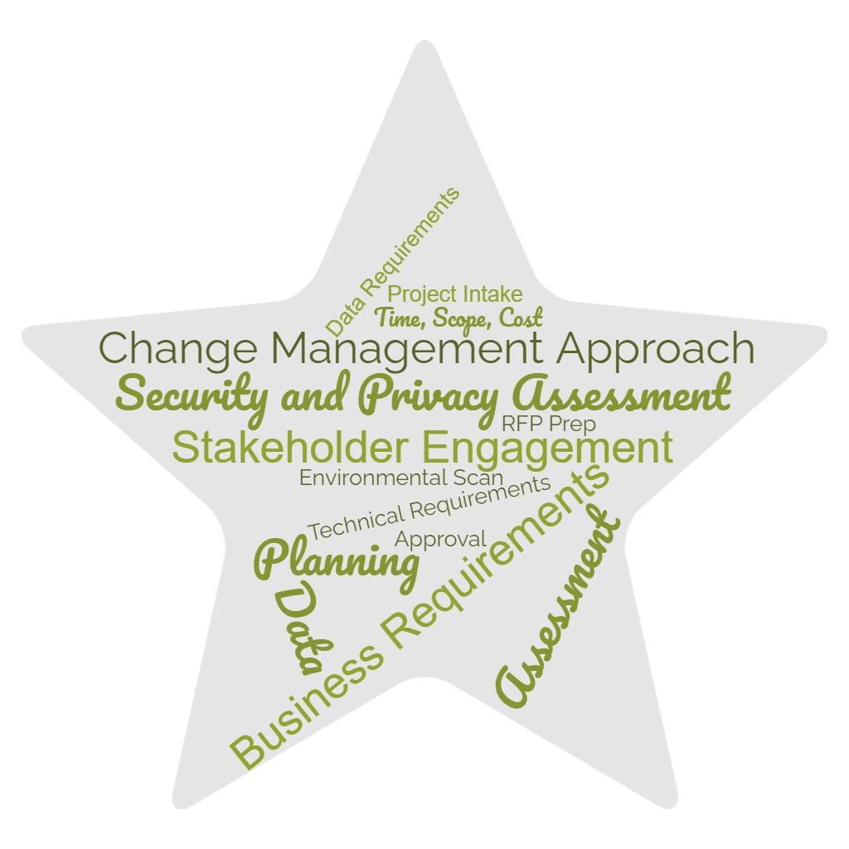
Continuous Improvement:
A Project Manager’s View
The Challenge
A department on campus requests support to implement a new information system and requests project lead support from the Project Management Office.
How do we manage a complex process and balance engagement, expediency and quality? If we manage this process well, we see positive outcomes:
Identify the right requirements
Engage the right stakeholders
Attract the right vendors to respond to the RFP
Get to the implementation phase with the right amount of time
Information Systems: From a Project Request to RFP Preparation
The Stakeholders
Who are the stakeholders in this process?
Business client and management
Requirements
Approvals
Information Systems & Technology
SSO
Integrations
Data management
Procurement
Security/Privacy
Finance (Financial Systems Assessment Committee (FSAC))
Change Management
Accessibility (WCAG 2.0)
Additional depending on the project
The Path Forward
Continuous Improvement Questions:
Do we consider an environmental scan of what systems are currently on campus and how we can leverage these or collaborate?
What stakeholders do we engage and when? Once we identify stakeholders, do we leverage a stakeholder register?
We always use a project charter but should we also consider drafting a business case?
How do we effectively obtain project approval (stage-gates to begin project; to post RFP etc.)?
How do we communicate timelines to different stakeholder groups in order to ‘sync’ participation towards common goals?
Do we inform procurement on our progress ongoing in building out procurement documentation?
Do we consider a phased approach (two phase project approach (Phase 1: Project request to RFP and Phase 2: Contract signing to Go Live))
The Tools / Approach
What do we use to help move from start to RFP?
Project/Initiative Request form (UWaterloo Help Portal)
RFI or general market research
Project charter (Scope, Time, Cost)
Planning software (Jira, MS Project)
Business case
Requirements documents
Business process review
Procurement documentation such as RFP written/demo requirements, bid table, statement of work
Information Risk Assessment
Change Management Assessment
uwaterloo.ca/pmo

