Slide 1
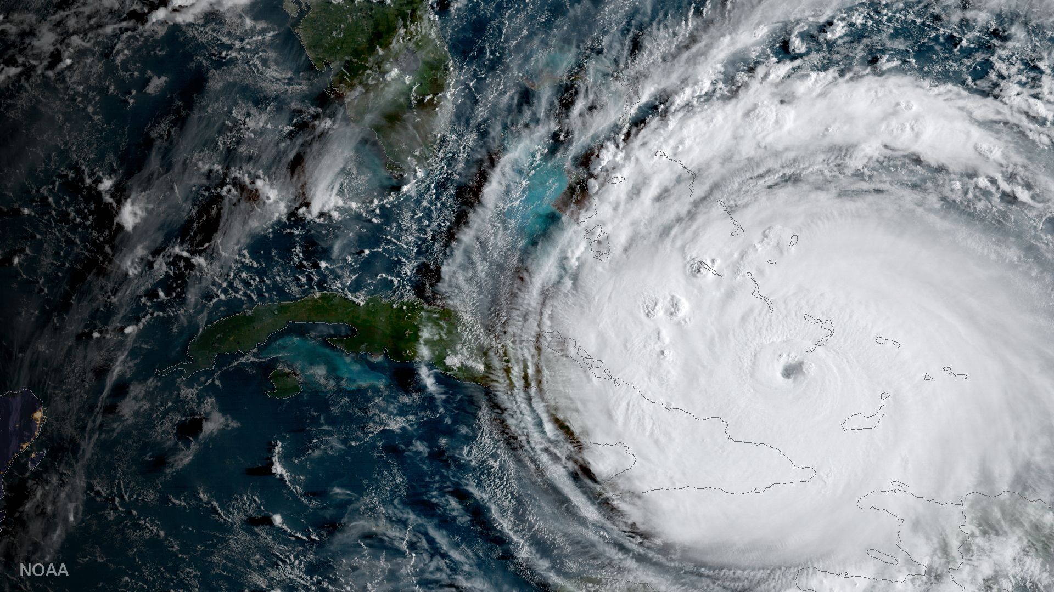
Who’s on First?: Exploring Jurisdictional Complexities in the Climate Emergency
Clarence Woudsma, Ph.D., MCIP, RPP
School of Planning, University of Waterloo
Pragma Council Spring 2022

Slide 2
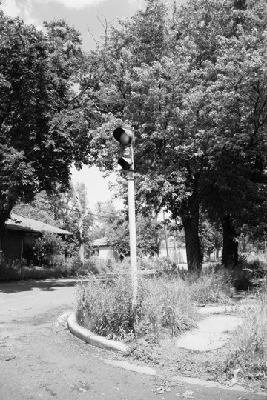
Outline
A career perspective
The jurisdictions
Discussion points
Outline
Notes:
Labour force/population 15 and over (excluding institutional residents)
Students, homemakers, retired before 65

Slide 3

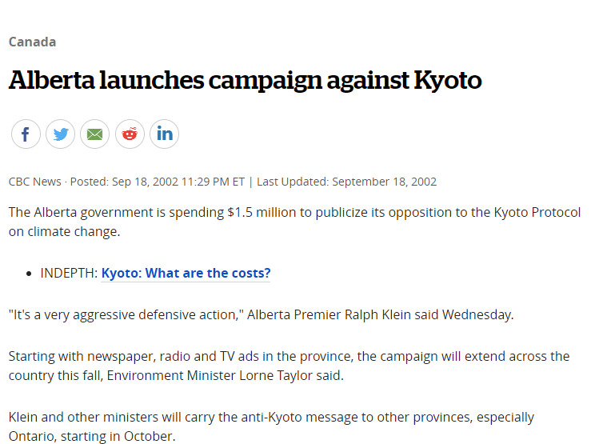
A Career Perspective
Early 2000s - Roundtables on emissions reduction related to Kyoto Protocol
…in Calgary ….Ralph Klein era..
Axle grease to PM 10 in diesel

Slide 4
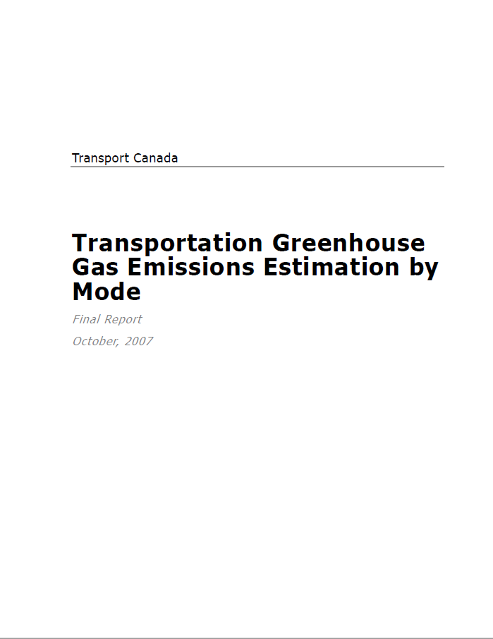
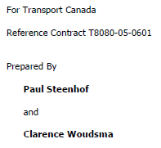
A Career Perspective
2004 – Transportation GHG Emissions forecast Transport Canada
The dance between NRCAN, Environment Canada and Transport Canada

Slide 5
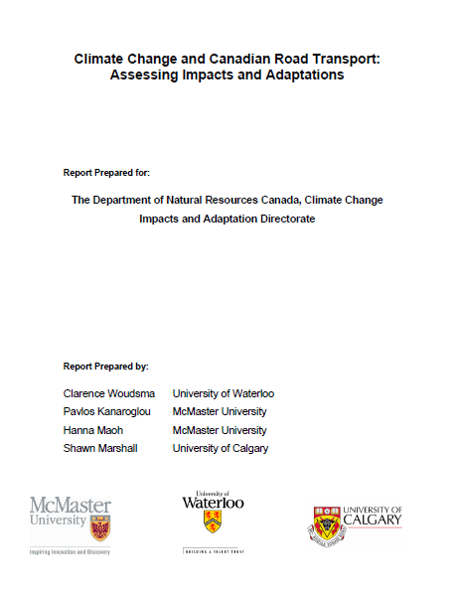
A Career Perspective
2006 – Surface Freight Impacts and Adaptation (NRCAN)
Tackling the “costs” to the economy
Dusty tools on the shelf of history!

Slide 6
A Career Perspective
2017 Transportation Sector specific adaptation assessment NRCAN
Province of Ontario with local case study exemplars
Impacts vary! (spoiler alert)

Slide 7
Consistent Career Themes..
Challenges of connecting to the local level
Interrelationships and interdependencies throughout the climate analysis
Jurisdictional transferability of case studies and pilots
Determining best approaches in a multilevel governance context
  Add in departmental and intergovernmental silos

Slide 8
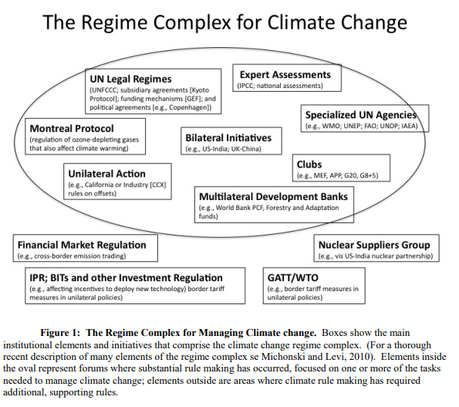
2. The Jurisdictions
Global
Considerations of influence, control, power
Concept of “Regime Complex” of institutions and elements (Keohane and Victor, 2010)
Rule making for the tasks to manage climate change

Slide 9
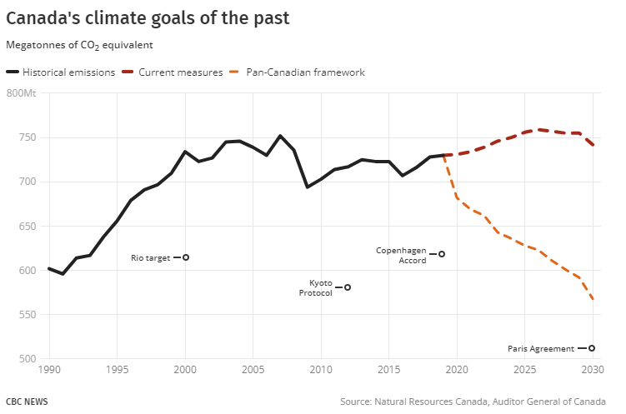
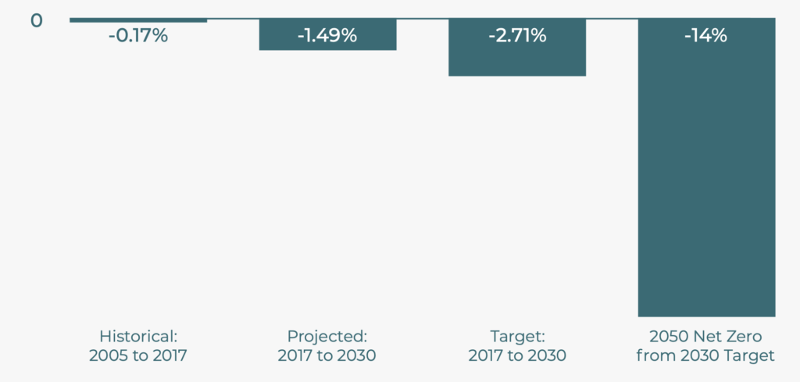
The Federal Commitments
What the Federal Level has “signed” up for in terms of global commitments
2050 Net Zero ACT:
Average Annual Change in Carbon Emissions that we need to achieve to meet 2050 Net Zero

Slide 10
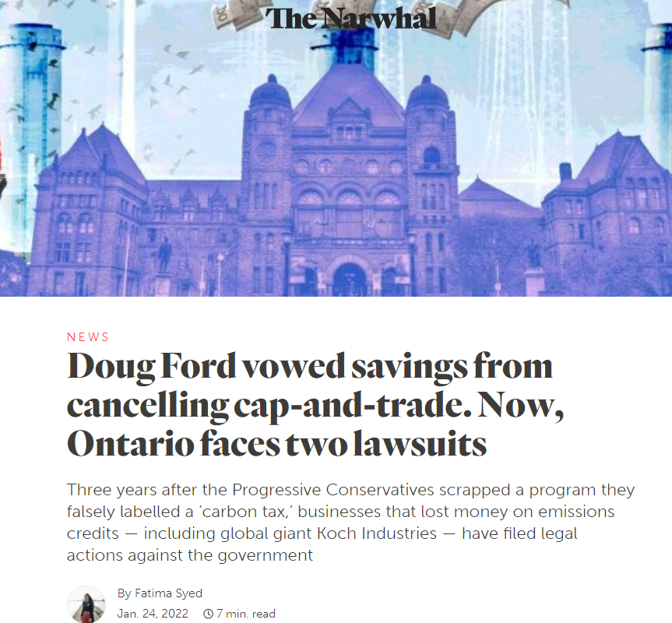
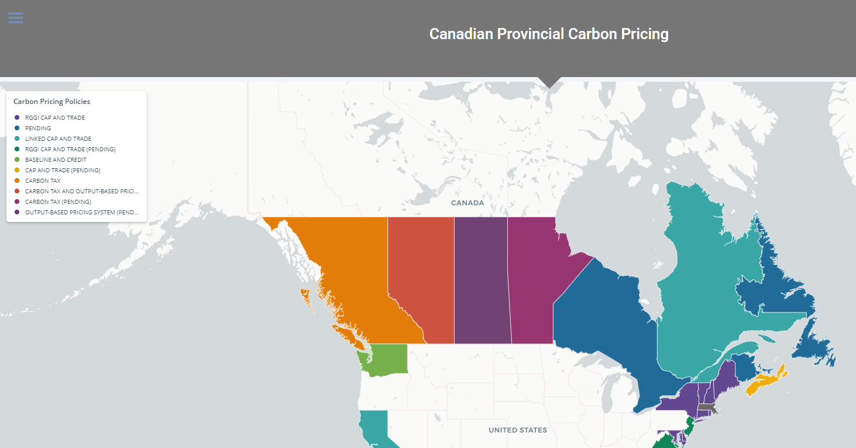
The Provinces
Traditional power sharing and fiscal relationships with Federal government
  And cities
Character of our decentralized federalism
  Efforts for intergovernmental coordination
  Feds decide…Provinces implement
And the politics…
  Current Ford government cancels previous government plans immediately upon taking office..

Slide 11
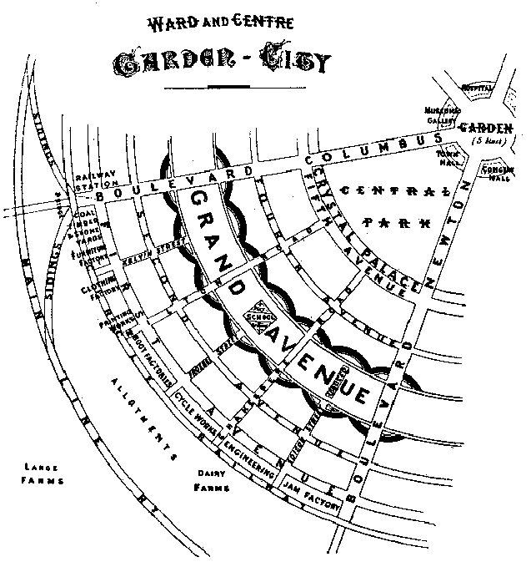
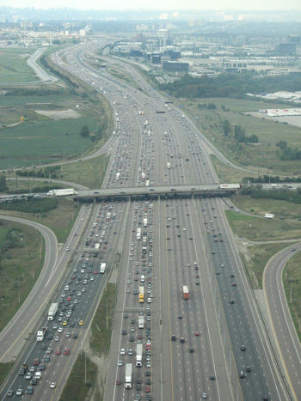
The Municipal
Really creating the places we live –
Significant role in emissions – significant need for adaptation
  Built form – the character of our living environments
  Transportation systems and integration with built form
The long game of intensification and “the 15 minute city”
    Fiscal reality of development charges and the property tax base

Slide 12

The Partnership Organizations
The NGOs, Agencies and Clubs
Efforts to support policy and program implementation and the efforts on the ground

Slide 13
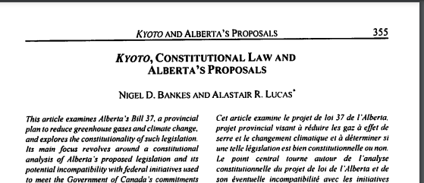

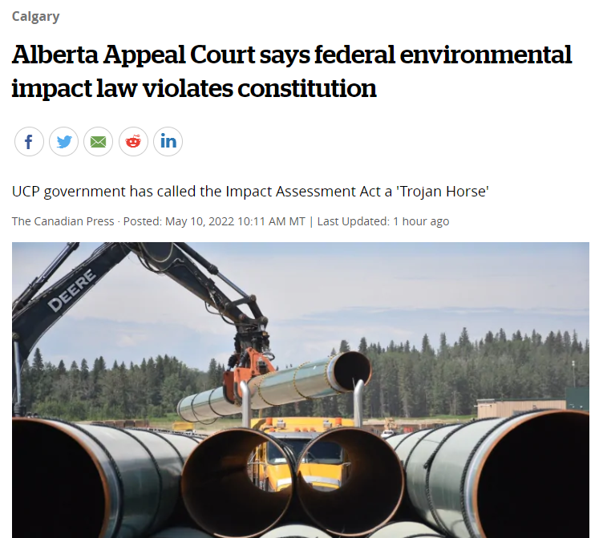
3. Discussion points
Who’s on First…
the control, influence, and outcomes of decades of government efforts
The Constitution
  Provinces fighting for the legality of their climate legislation
2004
Today

Slide 14
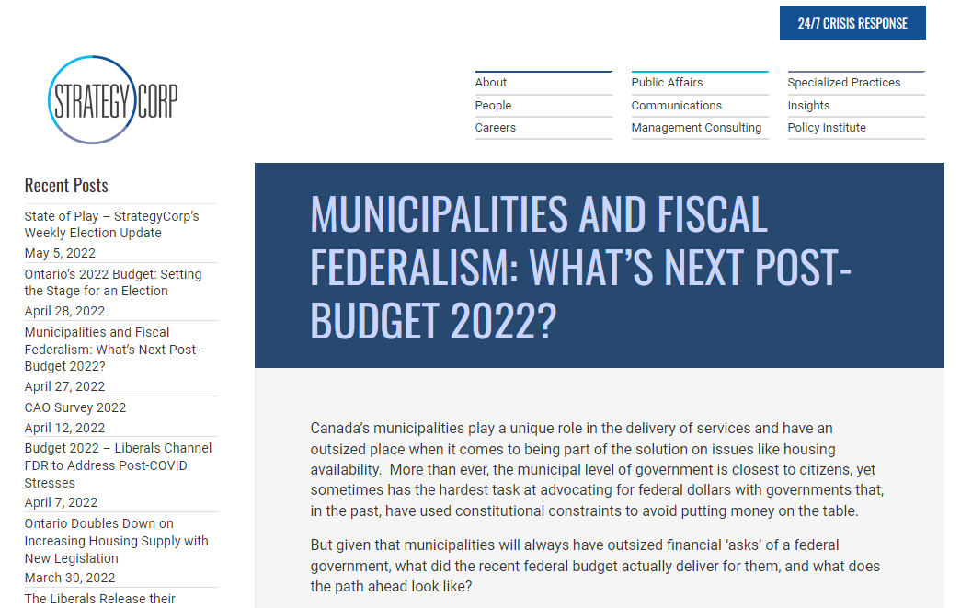
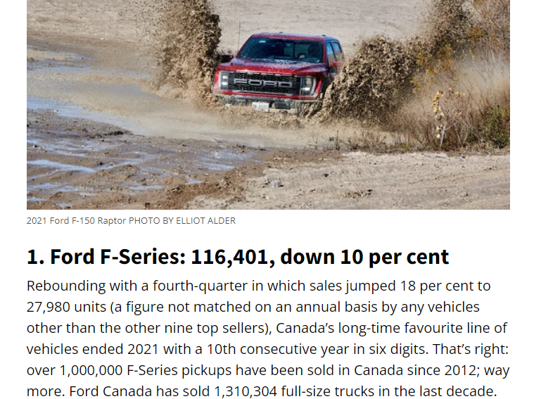
3. Discussion points
The Constitution
  Cities as creatures of the province
  Cities as nexus for CC emissions, adaptations and solutions
  Another imbalance added to the current fiscal imbalance
    The emissions/adaption added to taxes (revenues) and cities and services

Slide 15
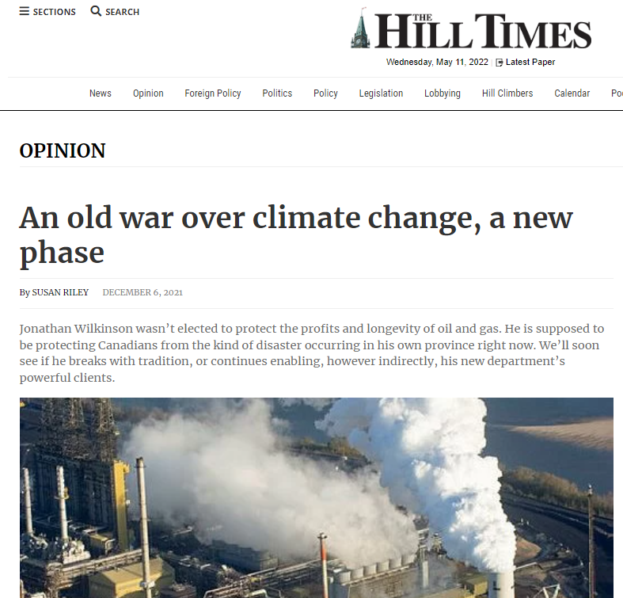
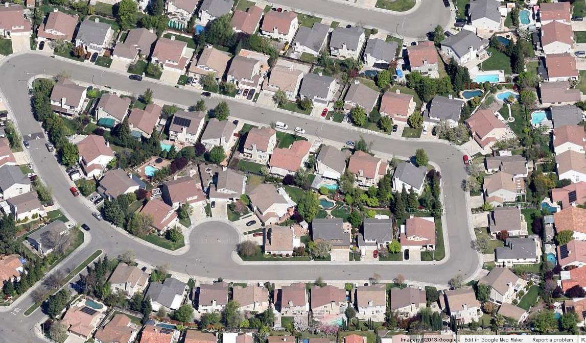
The Climate Emergency Conversation…
Key challenges
  Canada’s decentralized structure of governance and shared jurisdiction over climate policy will require careful navigation of a sensitive intergovernmental landscape. (CICC 2020)
  Overlap among provincial, territorial, municipal, Indigenous, and federal governments
    Influence vs control – policy vs regulatio
  The growth narrative
    And consider recent PPS from an environmental standpoint

Slide 16
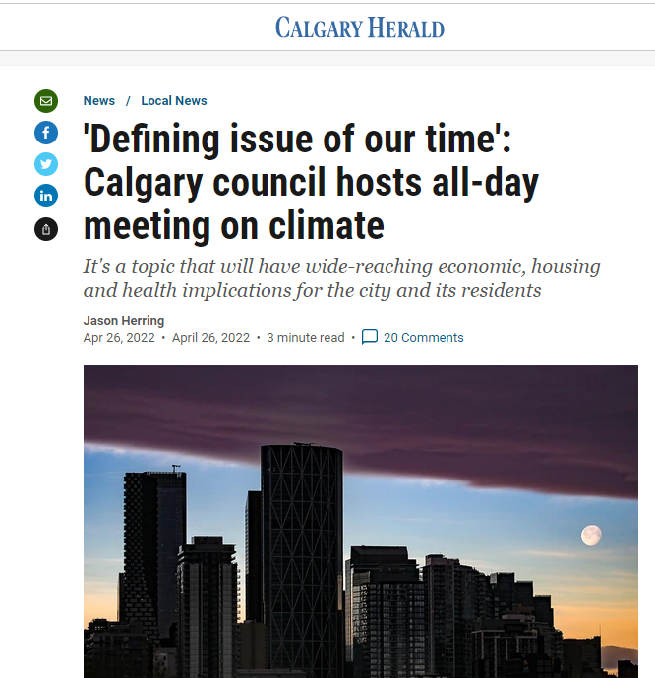
The Climate Emergency Conversation…
  local autonomy at the municipal level to go above and beyond the Provincial/Fed climate policy directives
  What should that autonomy look like?
  Official Plans and Climate Action Plans etc.
    Timelines?

