Slide 1
TransformWR:
Waterloo Region’s Transition to an Equitable, Prosperous, Resilient Low Carbon Community

Slide 2
About ClimateActionWR
Coordinate
Measure
Engage

Slide 3
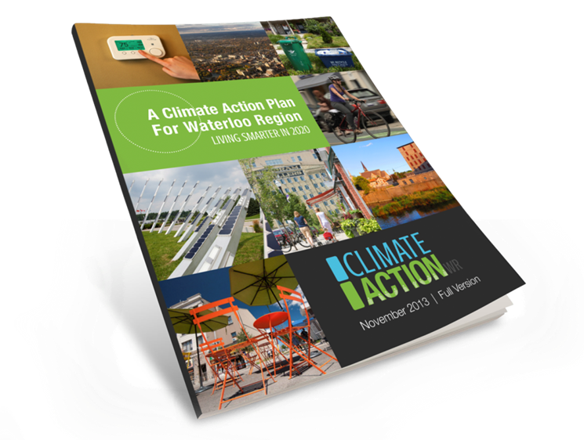
GHG Emissions Breakdown (2010)

Slide 4
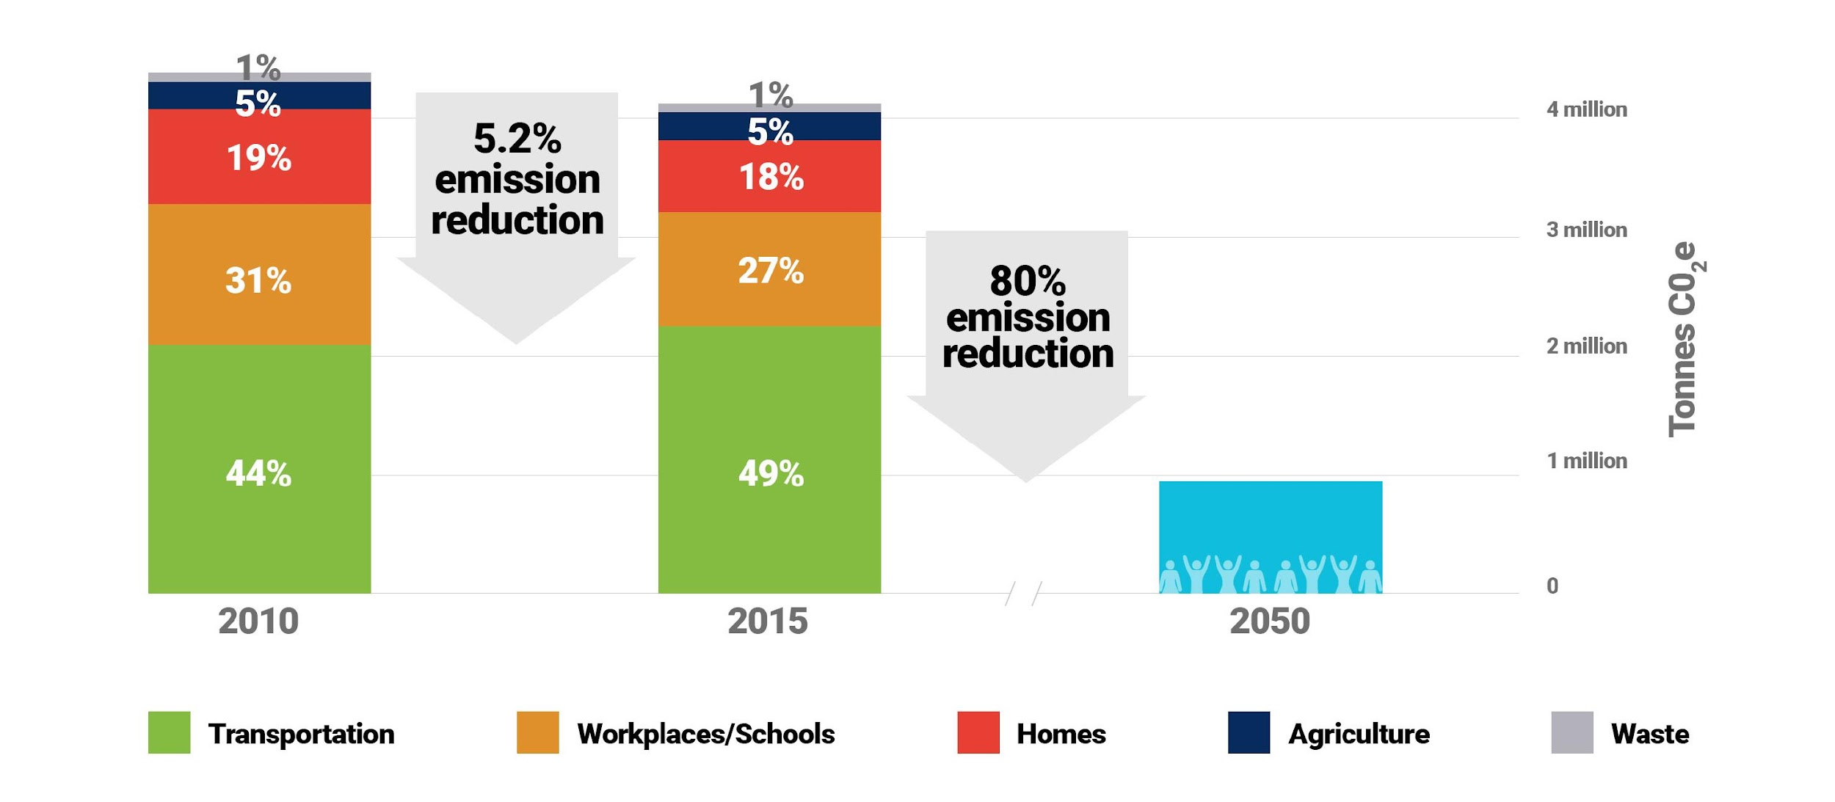
Long-term Target
All 8 municipalities unanimously endorsed 80% GHG reduction target by 2050!
Develop long-term strategy

Slide 5
TransformWR: Waterloo Region’s Long-Term Community Climate Action Strategy
8
Municipalities endorsed TransformWR
5
Major carbon emitting sectors
6
Transformative Changes:
The big changes that need to occur by 2050
78
Measurable action areas

Slide 6
Calls to Action
Transform The Way We Move:
Transform The Ways We Produce, Consume, and Waste
5 strategies with 19 total actions
2 strategies with 8 total actions
2 strategies with 10 total actions
4 strategies with 6 total actions
Transform The Ways We Build & Operate Our Spaces
Transform The Ways We Relate
2 strategies with 19 total actions
5 strategies with 16 total actions

Slide 7
INGREDIENTS FOR A SUCCESSFUL COMMUNITY CLIMATE ACTION MODEL
Collaborative Leadership & Engagement
Clearly Defined Goals and Calls to Action
Sustained Climate Action Support to Empower Community Owners
Robust and Resilient Frameworks

Slide 8
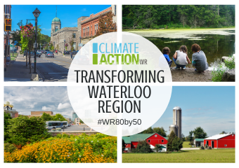
QUESTIONS?
Link to TransformWR:
https://climateactionwr.ca/transformwr/
Devon Calder
ClimateAction Plan Manager
ClimateActionWR
www.climateactionwr.ca
@ClimateActionWR
/ClimateActionWR

