Slide 1
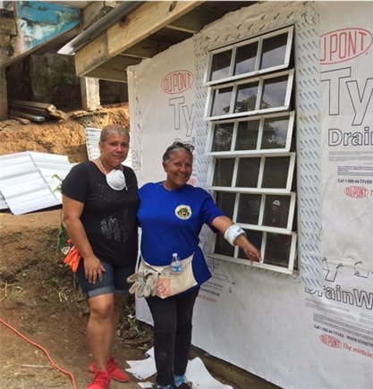
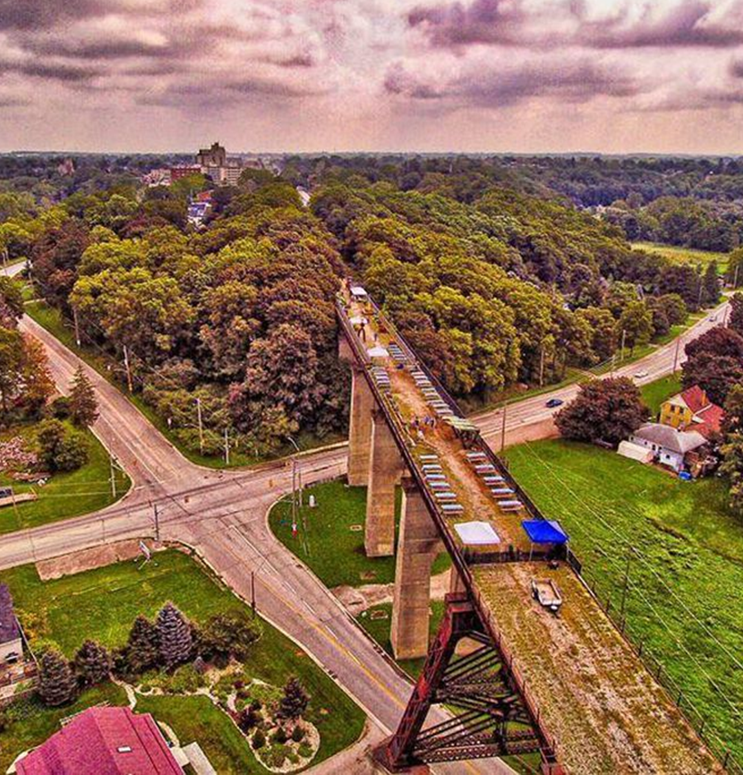
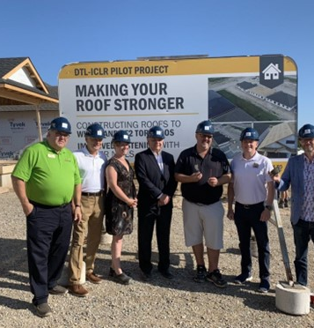
Campsite Rule
1

Slide 2
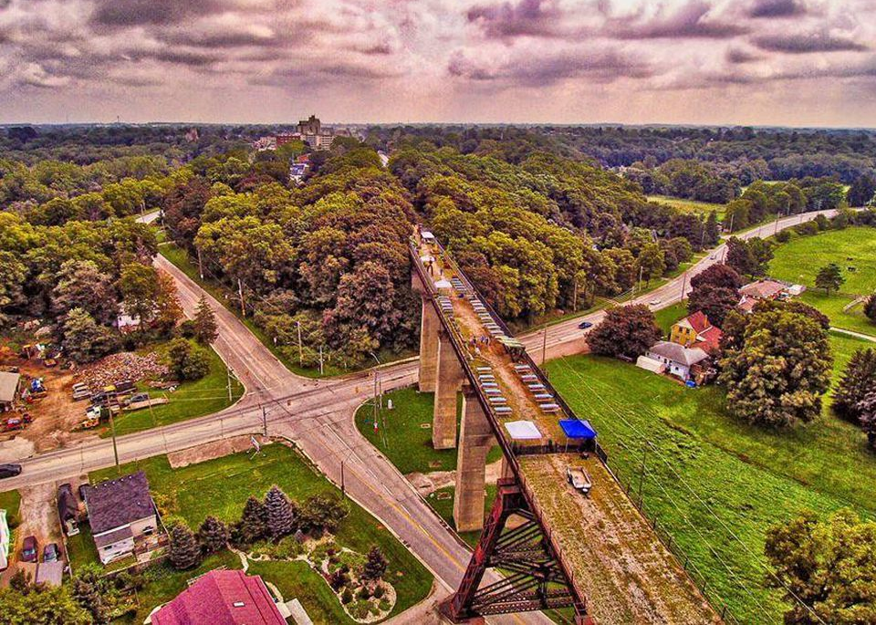
Always leave the campsite better than you found it
This sentiment needs to extend to more than just the site, our employees, or those able to purchase our product.
Notes:
A guiding principle for our company is the saying “always leaving the campsite better than we found it”
And we truly believe that this sentiment should extend to more than the site. More than our employees. More than those who can afford to purchase our product.

Slide 3
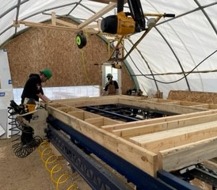
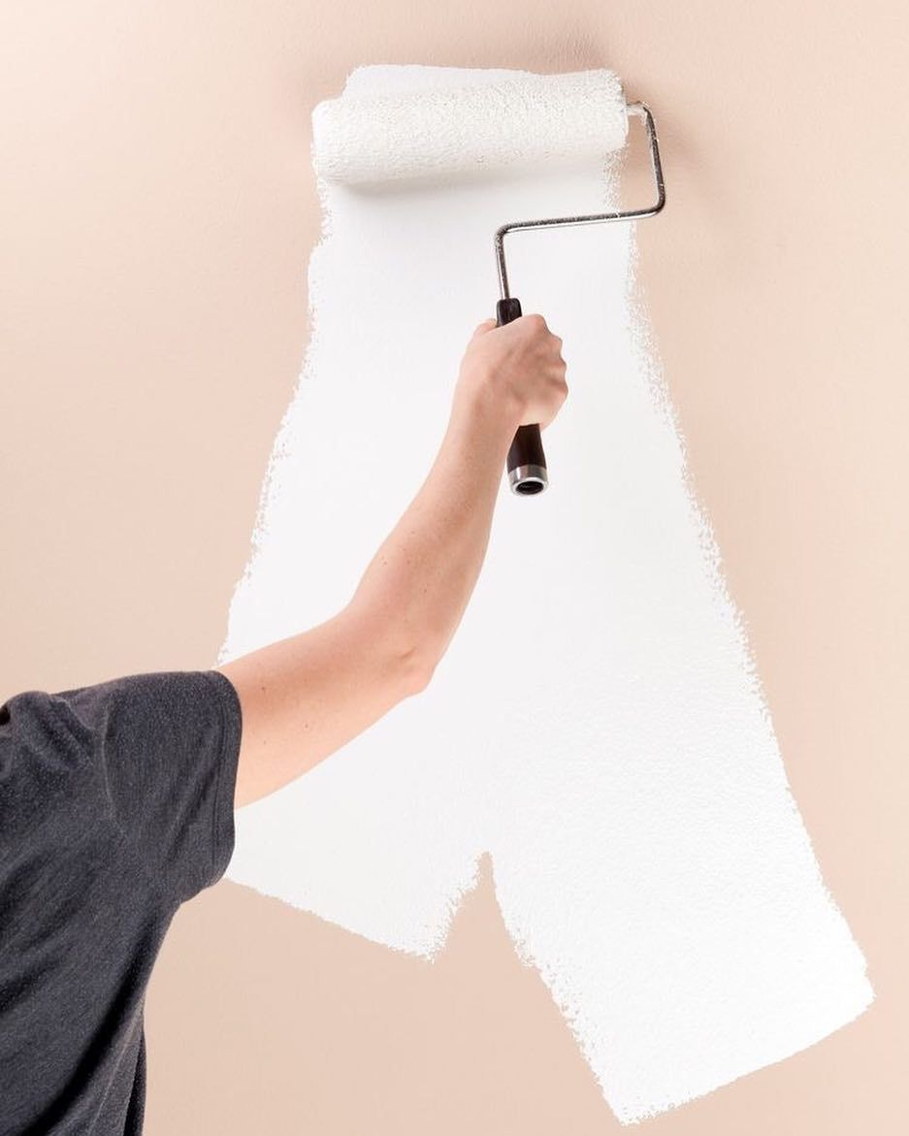
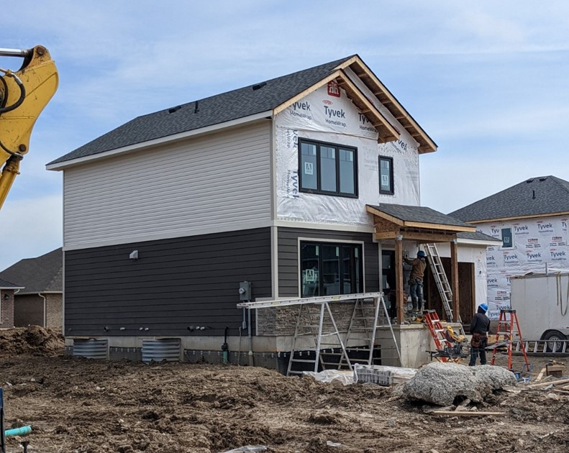
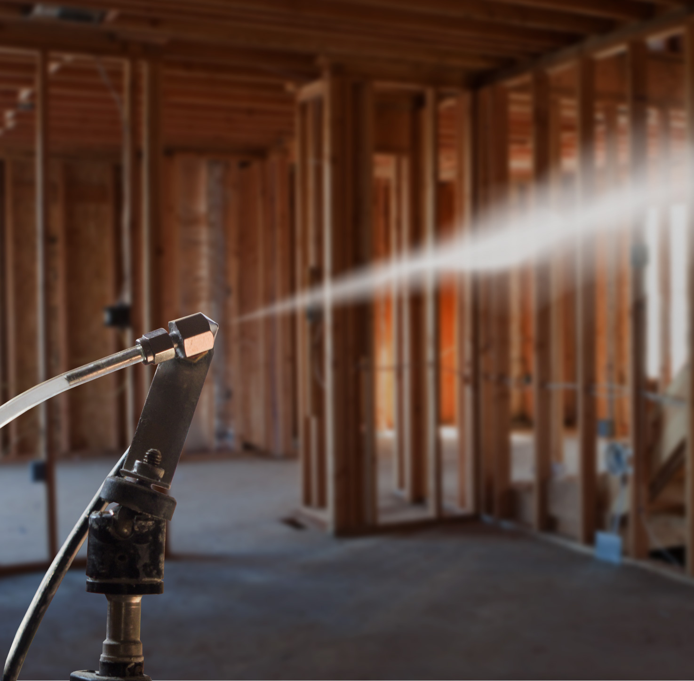
Who We Are
Award-winning builder based out of St. Thomas, ON specializing in low-rise and mid-rise high-performance buildings
Net Zero Ready as standard as of 2019
We are not JUST a builder!
Mobile panelization company (LC Manufacturing)
AeroBarrier Company
HVAC Company (Abode)
Graphenstone Zero VOC Paint & Specialty Coatings

Slide 4
Why Write A Book on Net Zero?
Commissioned by NRCan to write a Guide to help demystify and simplify the path to building Net Zero
DTH’s painful journey – from walking on a “knife edge” to finally mastering the techniques and materials to become “leading edge” and more profitable
It’s a philosophical look at the “Why” and the “How”
Looking beyond Net Zero – an expensive proposition we must do cost effectively
Better business practices, look at where the industry is going, LifeARK™

Slide 5
Water Management Strategy
4 PRINCIPALS of
Modern Design
2 FUNDAMENTALS
Occupant Comfort
Indoor Air Quality (IAQ)
Total Carbon Footprint
Construct Climate Resilient buildings
Air Tightness Plan
Notes:
I believe Net Zero is the wrong goal. Or perhaps its better to say, it’s an incomplete goal. There is concern that if we focus solely on Operational Net Zero we could actually be making our carbon footprint worse.

Slide 6
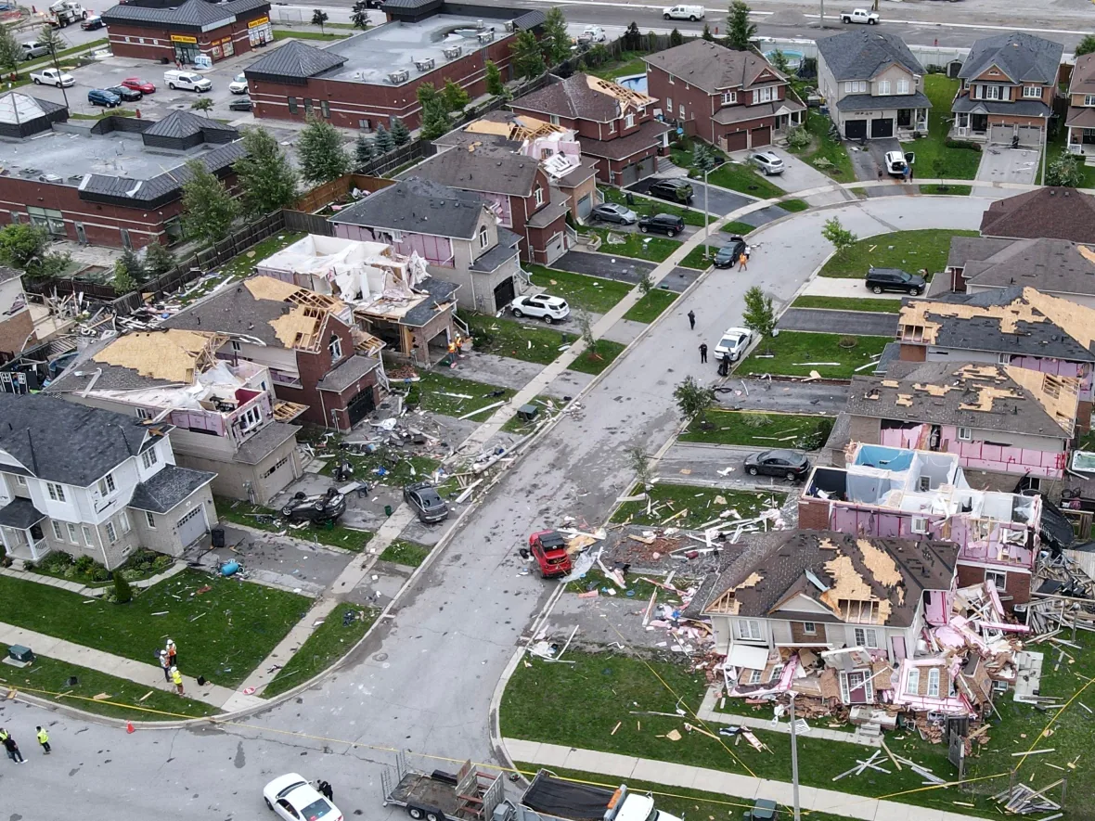
There’s a need for climate adaptation
Notes:
Globally, we are experiencing an increase extreme weather events due to climate change.
We’re seeing an increase in hundred-year floods, power outages, and high wind load events like the picture on the left. In 2021 Barrie experienced an EF2 tornado with winds up over 200 km/hr damaging over 150 homes.

Slide 7
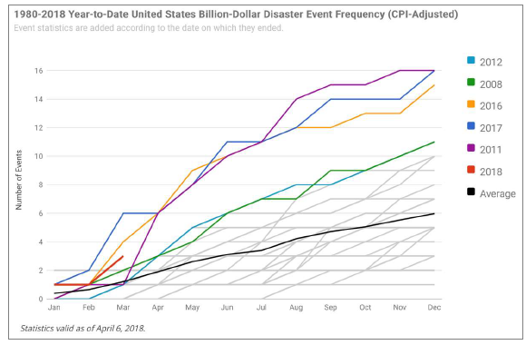
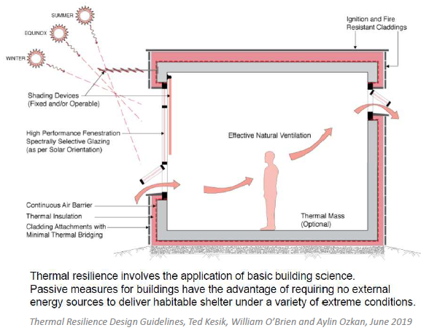
“Sustainable Survivability”
We feel that more emphasis must be placed on:
Adaptive Design
Storm, hurricane, flood protection
Passive Design
Thermal autonomy
Backup Power and Critical Operations
Includes understanding of the need for a balance between energy and carbon
Notes:
We’re focusing on “Sustainable Survivability” because we feel that more emphasis must be placed on:
Adaptive design - to protect from things like 100 year storms or high wind load events
Passive design – to provide thermal autonomy and enhanced occupant comfort
Backup power for critical operations, and a balance between energy and carbon reduction

Slide 8
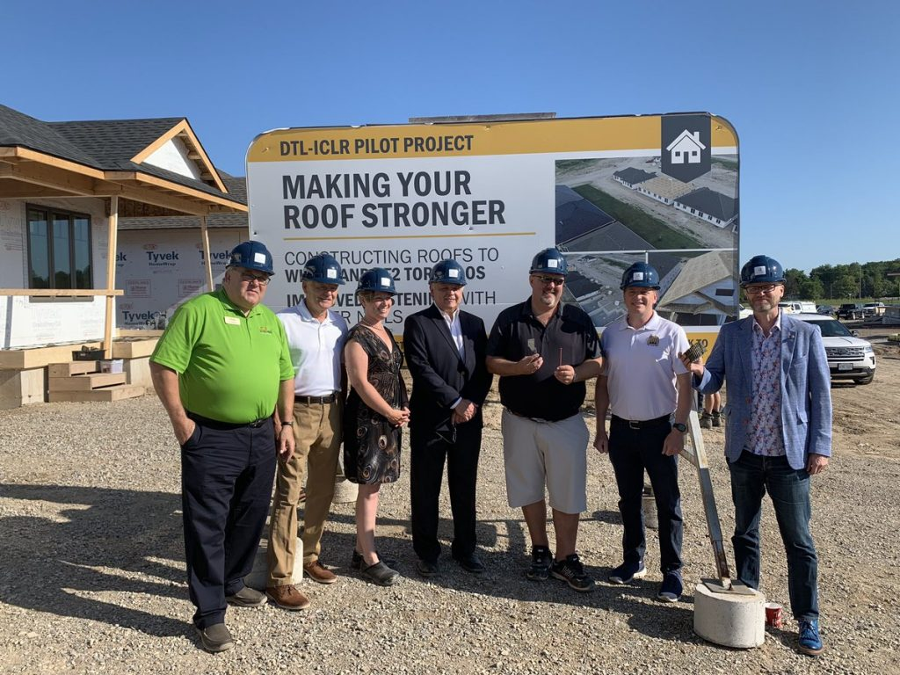
Climate Resilient Design
Builder partner to ICLR and University of Western in research work surrounding high wind load design
Notes:
Back in 2019, ICLR and Western co-authored and published a report on Increasing High Wind Safety for Canadian Homes: A Foundational Document for Low-Rise Residential and Small Buildings.
This report provides the basis for the development of a set of commonly acceptable, relatively straightforward wind risk reduction measures that can be incorporated into new single-family home construction. The measures were intended to reduce risk from high winds associated with tornadoes, hurricanes, and other types of extreme weather events by focusing on the elements in the continuous vertical load path.

Slide 9
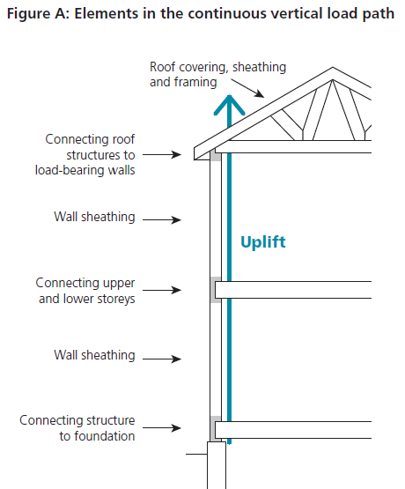
Next Steps
In partnership with ICLR and UW, develop a “builder-led solution” based on additional research to support other key areas that are essential to the creation of high wind load design, including:
Bracing and securing of gable end walls
Sheathing size and orientation at the ridge lines
The wall to floor connection
Develop an application for existing buildings
Source: Increasing High Wind Safety For Canadian Homes: A Foundational Document for Low-Rise Residential and Small Buildings (2019)
Notes:
Despite pushback from industry, we want to continue to work with ICLR and Western to define measures that have not been researched in detail but have been identified as integral to the development of a “builder-lead solution” to high wind load protection. These include:
bracing and securing of gable end walls,
sheathing size and orientation at the ridge lines, and
the wall to floor connection
We plan to openly share our “builder-lead solution” with industry to promote resilient design in new home construction and in a future third phase, work on a solution for existing housing

Slide 10
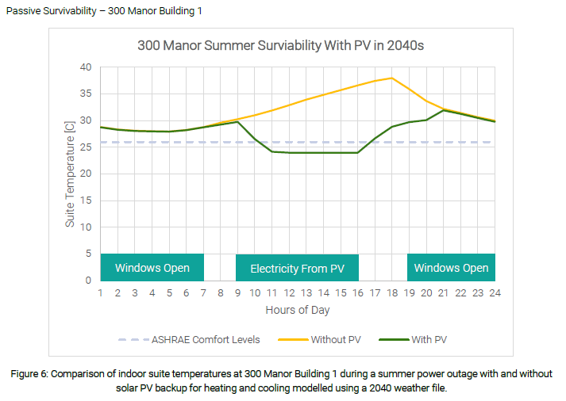
Thermal Autonomy, Critical Loads and Backup Power
EQ Building Performance performed a Passive Survivability analysis on 300 Manor (part 3, midrise)
Using this data to define our critical loads and explore opportunities to provide backup power to our buildings.
Notes:
Discuss impact of envelope – especially SHGC on survivability given longer-term power outage event. If compared to a worse-performing design, or one with high SHGC, you see a lengthened period of comfort in both heating and especially cooling seasons.

Slide 11
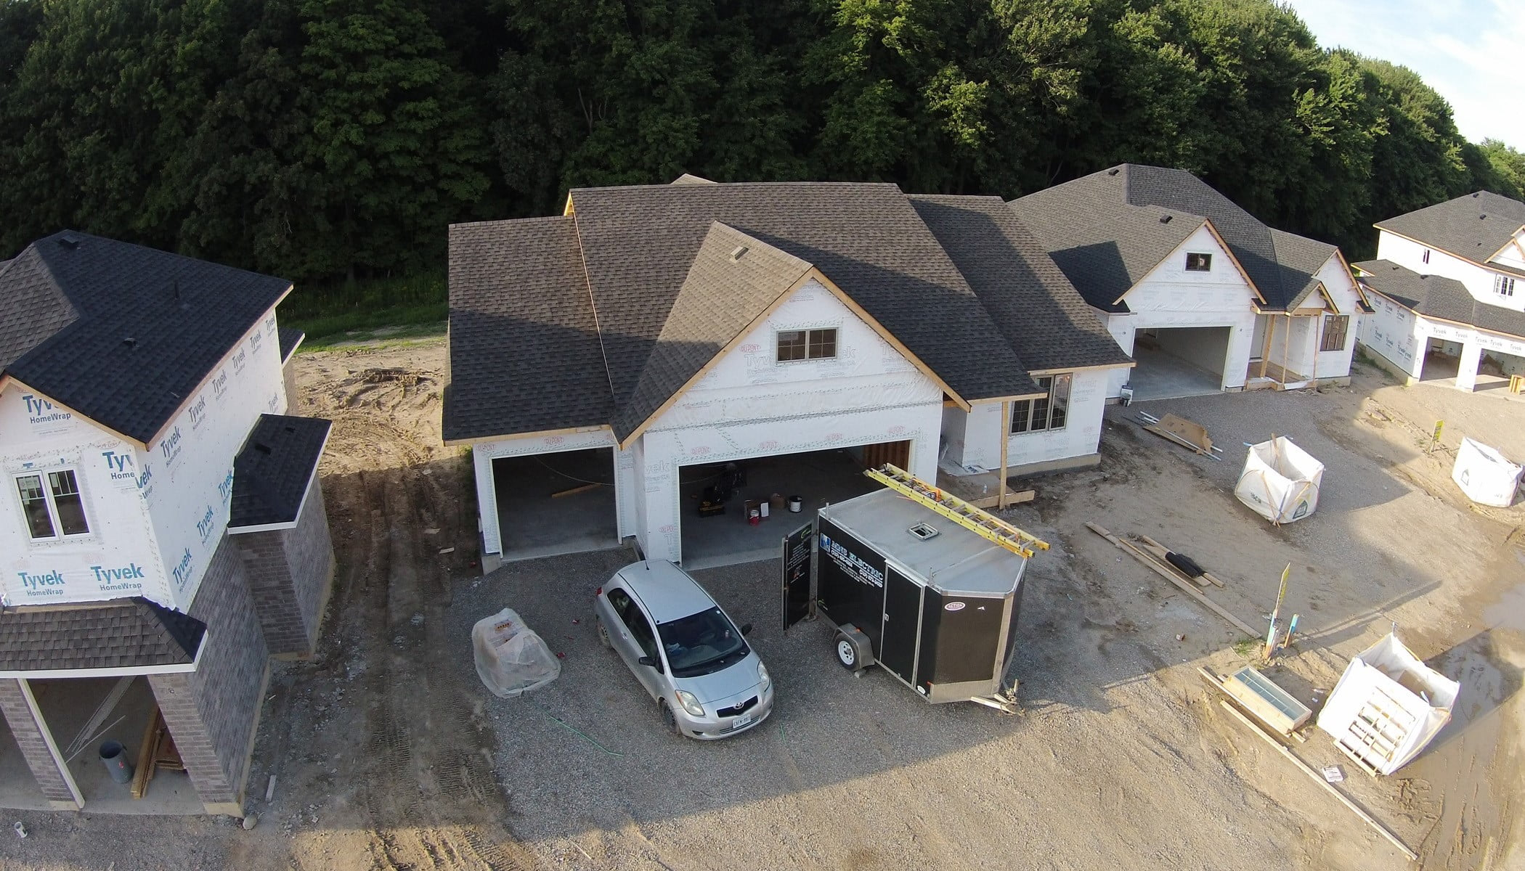
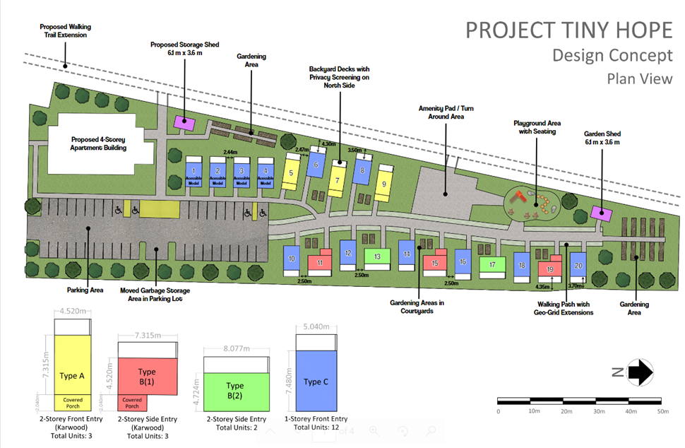
Application of the Campsite Rule
We’re working with RWDI to create a sustainable survivability framework for resilient design, called LifeARKTM.
We plan to incorporate this framework into all of our low-rise and mid-rise products.
Notes:
Describe concept of “Sustainable Survivability” and why we’re working on this under LifeARK
-Why is it essential to your company
-What does it focus on
-How does that play into future sites
-This extends to even the most vulnerable members of our community – example Tiny Hope
Affordable housing community

