Slide 1
Sustainability: A challenge and an opportunity
A developers perspective

Slide 2
Our Job
Create a safe and rewarding workplace
Build communities that are desirable and livable
Be a net positive contributor to our community
Provide positive financial returns for our ownership

Slide 3
How do we do our Job
Create a safe and rewarding workplace – this is generally something we can manage well, but ‘rewarding’ is becoming more of a challenge
Build communities that are desirable and livable – we know how to do this but we do continually fight competing forces - what the market wants does not always equal what governing bodies want. In the end the market will win, its dictated by the voters, and they always have the last say in the long run.
Every year the gap between wage growth and housing costs widens, so more and more people are priced out of the type of housing they desire – from singles, to multis, to ownership vs rental
Keep revenues higher than costs – a varying challenge depending on market forces

Slide 4
Competing Forces
Affordability
Sustainability
These work against each other
Lack of consensus on how to solve both problems
The risk of uncertainty

Slide 5
Starting point
The Ontario building code

Slide 6
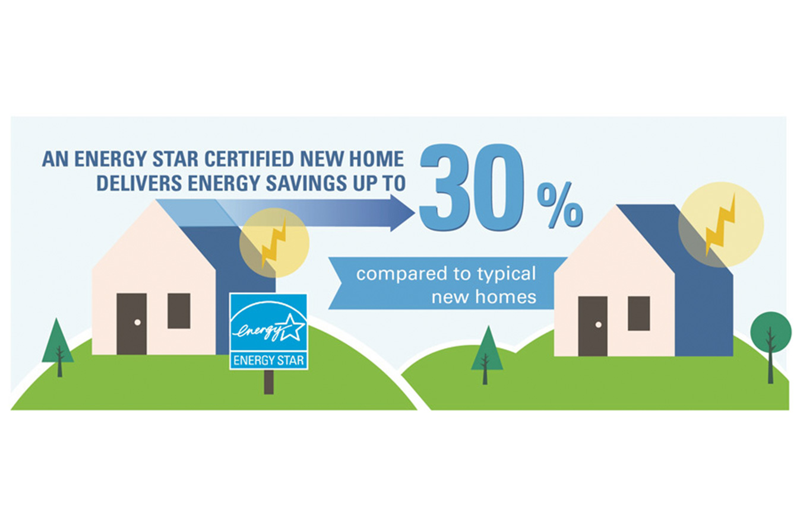
Our starting point
An ENERGY STAR home is on average 20% more energy efficient than a home built to the local building code. It includes - Well Sealed Building Envelope + Blower Door Test to Confirm Air Tightness, HRV System, Triple Pane Windows, LED Lights, Tankless Water Heater, Advanced Wall System, High Efficiency Furnace, Extra Insulation
20%

Slide 7
Net Zero Ready and Net Zero Features
AeroBarrier Air Sealing
Dual Fuel Furnace & Air Source Heat Pump
Under-Slab Insulation
Drain Water Heat Recovery System
Tankless Water Heater
Energy Recovery Ventilation System (ERV)
Extra Insulation in Walls & Ceilings, with Higher R-Value
Triple Pane Windows
Home Monitoring System
Solar Panels

Slide 8
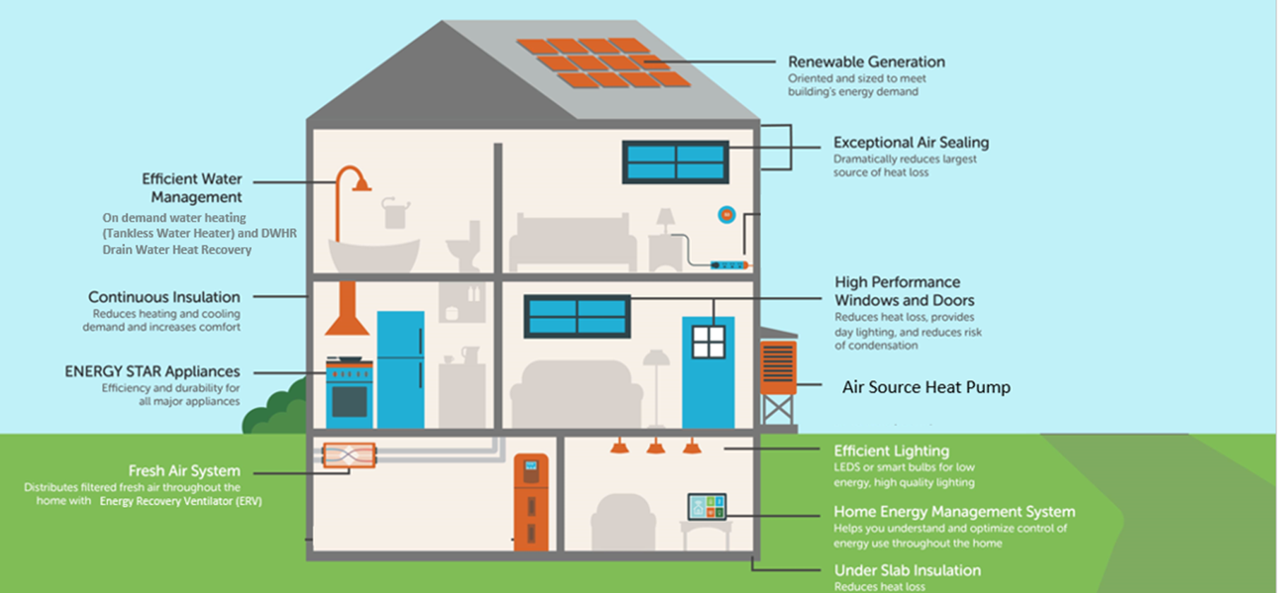
Net Zero Features

Slide 9
Costs, the bad news and the good (kind of) news
A 36’ single detached home
Energy Star
Add Net Zero Ready $20-25K
Add Full Net Zero $40-45K
From Energy Star to Full Net Zero will cost a consumer over $70K
The good news is this incremental cost is now a much smaller portion of the overall cost of the home compared with 5 years ago, but…

Slide 10
Our Plan
All new buildings will need to be built to Net Zero energy ready standards by 2030. Activa is leading the way, building homes to this standard years ahead of plan
Activa has committed to building all single detached homes to Net Zero Ready - a designation one step away from full Net Zero. Activa homeowners can upgrade their homes to full Net Zero with the addition of solar panels that provide sustainable energy back into the home.
As a leader in the community, Activa is working on building approximately 130 new Net Zero Ready homes in the Waterloo Region this year alone, and another 150 in 2023!
Activa is also pursuing sustainability on a much larger scale with the goal of full Net Zero, self powered, zero emission communities. This is in the research phase.

Slide 11
Net Zero Model Home

Slide 12
The Challenge
Costs
No help or incentives (buyer or builder)
Hard choices for consumers
Builders – in good markets we can force this, in challenging markets (our current market as of last 30 days) this becomes a cost problem

Slide 13
The Opportunity
By 2030 our industry has to do this, why wait for the future
Create a differentiator
Do the right thing
Sustainability at the community/sub division/area level – localized Net Zero
https://west5.ca/

Slide 14
Here’s an idea
If driving the adoption of sustainable housing is important, then offer a DC exemption for Net Zero homes. A single detached home in Waterloo region has an average DC of $60K+. This exemption would allow a builder to absorb the Net Zero upgrade costs and not pass that cost on to the consumer. It could also be offered as a rebate directly to the home buyer.
So I guess it really boils down to how important is sustainable development?

Slide 15
Partings words
Please understand the math/economics of development and the risks that need to be taken with substantial capital

Slide 16
Dual-Fuel Furnace &
Heat Pump

Slide 17
DUAL-FUEL FURNACE & HEAT PUMP
Marketing Messaging
WHAT
This hybrid system pairs an electric heat pump and a gas furnace. The heat pump works like an A/C in the warmer months; in colder months, it pulls warm air from outside and moves it indoors to heat your home. The furnace takes over when the temperature takes a significant dip outside, converting fuel into heat.
BENEFITS
The system automatically switches between the furnace and the heat pump depending on the temperature, season, and function needed to maximize efficiency heat/cool your home year-round.
YOUR IMPACT
Since the best device is always used to heat/cool the home, time, energy and money is saved.

Slide 18
Energy Recovery Ventilation System (ERV)

Slide 19
ENERGY RECOVERY VENTILATION SYSTEM
Marketing Messaging
WHAT
An ERV acts as the lungs of the home year-round, replacing stale indoor air with fresh outdoor air while controlling humidity levels.
BENEFITS
A comfortable humidity level eliminates excess moisture in the home and discomforts caused by dry air such as static electricity, dry skin, and sore throats.
YOUR IMPACT
Energy is saved by reducing the load on the heat pump and dehumidifier and results in a cleaner, healthier, more comfortable home.

Slide 20
Drainwater Heat Recovery System

Slide 21
DRAINWATER HEAT RECOVERY SYSTEM
Marketing Messaging
WHAT
As warm water from your shower flows down the waste drain, incoming cold water flows through a spiral copper tube wrapped tightly around the copper section of the waste drain. The heat from the warm water (that would otherwise naturally go down your drain) is recovered to preheat the incoming cold water.
BENEFITS
By capturing the heat from wastewater, the amount of energy needed to preheat the water and the load on your water heater is greatly reduced.
YOUR IMPACT
Don't send money down the drain - reducing energy used to heat your showers also reduces your monthly utility bills!

Slide 22
Insulation in Walls & Under Slab

Slide 23
INSULATION IN WALLS
Marketing Messaging
WHAT
1 1/2" thick codeboard on exterior walls
Higher R-Value (i.e. better thermal performance) of batt and blown-in insulation in walls and ceilings
+ 10" thick basement walls
BENEFITS
Provides the ultimate resistance to heat loss, better soundproofing, and results in a tighter, more comfortable home.
YOUR IMPACT
Improved insulation reduces the amount of energy needed to heat and cool the home, lowering your utility bills!

Slide 24
INSULATION UNDER SLAB
Marketing Messaging
WHAT
1 1/2" thick codeboard on exterior walls
Higher R-Value (i.e. better thermal performance) of batt and blown-in insulation in walls and ceilings
+ 10" thick basement walls
BENEFITS
Provides the ultimate resistance to heat loss, better soundproofing, and results in a tighter, more comfortable home.
YOUR IMPACT
Improved insulation reduces the amount of energy needed to heat and cool the home, lowering your utility bills!

Slide 25
Tankless Water Heater

Slide 26
TANKLESS WATER HEATER
Marketing Messaging
WHAT
A tankless water heater (i.e. no water storage) uses an electric element to warm the water coming through the pipes as soon as you open the tap.
BENEFITS
Enjoy unlimited instant hot water while using less energy - plus it's less bulky & lasts longer!
YOUR IMPACT
A water heater that is 25% more energy-efficient is good for you, your wallet, and the planet!

Slide 27
Triple Pane Windows

Slide 28
TRIPLE PANE WINDOWS
Marketing Messaging
WHAT
Windows with three sheets of glass, two air spaces filled with argon gas and low-E coatings separate the inside of your home from the outside.
BENEFITS
Enjoy extra peace and quiet with the reduction in sound transmission, and more consistent temperatures during the summer and winter months with just as much sunlight!
YOUR IMPACT
Double the insulation in the windows means better thermal control and a comfortable humidity level that stops moisture - for even further energy savings and a healthier home. Bonus, with a better-insulated home, your HVAC equipment will run more efficiently and last longer!

Slide 29
Solar Panels, Battery, Invertor & Reinforced Roof Trusses

Slide 30
SOLAR PANELS, BATTERY, INVERTOR & REINFORCED TRUSSES
Marketing Messaging
WHAT
Installed on your roof, solar panels convert light energy from the sun to usable electricity which can be used to power your home and appliances. In this home, extra energy is saved in the battery bank to pull from as needed; when the battery is full, electricity is sent back to the grid for a credit against the utility bill.
BENEFITS
Have peace of mind knowing there will always be enough energy to power your lifestyle! With the addition of solar panels, your home will be designated as Net Zero, producing as much energy as the average family consumes over the course of a year.
YOUR IMPACT
Using a renewable and carbon-free energy source to power your home is better for you and the planet!

Slide 31
Low Flow Plumbing

Slide 32
LOW FLOW PLUMBING
Marketing Messaging
WHAT
Low flow plumbing uses a high-pressure technique to create
the same water pressure while
limiting the amount of water expelled per minute.
BENEFITS
You won't be able to tell the difference! Enjoy the same water pressure in your showers, baths and faucets.
YOUR IMPACT
These plumbing fixtures conserve water by using less per minute, lowering your water bills and your energy usage.

Slide 33
LED/CFL Lighting

Slide 34
LED/CFL LIGHTING
Marketing Messaging
WHAT
LED bulbs produce light using light-emitting diodes.
BENEFITS
No toxic ingredients means these lights are better for you and the environment!
YOUR IMPACT
LED lighting uses approximately 75% less electricity than regular lightbulbs while lasting 25x longer, resulting in substantial energy savings and less waste!

Slide 35
Home Monitoring System

Slide 36
HOME MONITORING SYSTEM
Marketing Messaging
WHAT
A home monitoring system helps you track energy consumption in real-time.
BENEFITS
Pinpoint which appliances are consuming electricity, how much it's costing you & when they turn on and off.
YOUR IMPACT
Identify trends by day, week, and month or billing cycle so you can save money on energy.

Slide 37
AeroBarrier

Slide 38
AEROBARRIER
Marketing Messaging
WHAT
After drywall goes up, an aerosol sealant called AeroBarrier, and a blower door is used to pressurize the home and seal gaps in the building envelope that are not visible to the human eye.
BENEFITS
Less air leakage, protection against unwanted moisture and better indoor air quality results in a healthier, durable and more comfortable home.
YOUR IMPACT
Plus, with an airtight home, save money on heating and cooling costs!

