Slide 1

Adapting to the Climate Emergency in the Development Industry:
A (Slow) Work In Progress
PRAGMA COUNCIL 2022 ANNUAL SPRING CONFERENCE
May 10, 2022
Presentation by Jeanhy Shim
Housing Lab Toronto | Crosswalk Communities | TASH Design Co.

Slide 2
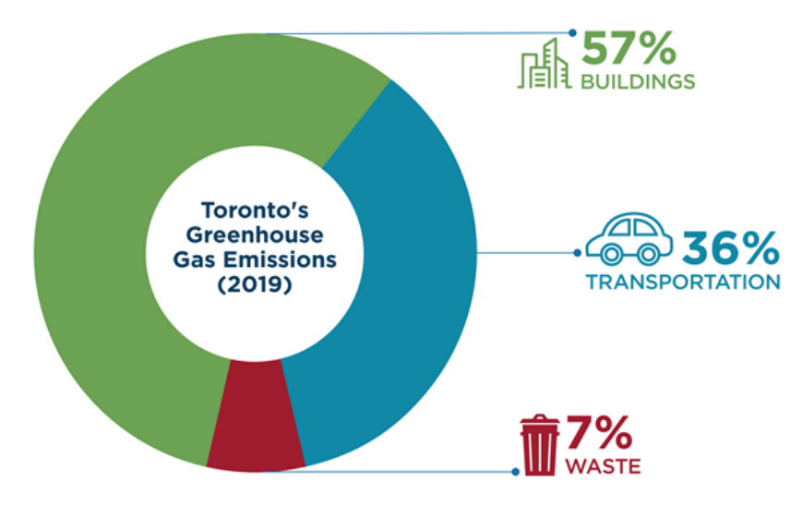
What do developers have to do with the climate emergency?
60% from residential buildings & homes
40% from commercial & institutional buildings
Source: TransformTO – City of Toronto 2019 Greenhouse Gas Emissions Inventory

Slide 3
Residential Development Activity in Ontario since 1990
Toronto CMA accounted for:
53% of total residential construction (1,096,164 homes)
71% of total apartment construction (499,891 homes)
44% of total low-rise construction (596,273 homes)
Apartment dwellings are increasing:
24% of new home completions from 1990 to 1999
22% of new home completions from 2000 to 2009
42% of new home completions from 2010 to 2019
50% of new home completions from 2020 to Q1-2022
74% of new homes under construction at end Q1-2022
* Includes 37,027 low-rise homes under construction in Q1-22
** includes 108,016 apartments under construction in Q1-22
Source: CMHC, Statistics Canada

Slide 4
Development Impact Timeline – Apartment Buildings in Toronto
1991
TAF*
2005
TAF
Act
2006
TGS** (v)
2010
TGS v1
T1 (m)
T2 (v)
2014
TGS v2
T1+ (m)
T2+ (v+)
2017
‘Trans-formTO Climate Action Plan’
2018
TGS v3
T1++ (m)
T2++ (v+)
ZEBF***
2021
‘Net Zero by 2020 Climate Strategy’
2022
TGS v4
T1++ (m)
T2++ (m-)
ZEBF
2025
TGS v5
T1++ (m)
T2++ (m)
ZEBF
2028
TGS v5
Net-Zero Designs
Blissful Ignorance
Resistance $
Reluctance $
(low hanging fruit)
Early Adopters:
(marketing edge, branding, CSR)
Tridel
Minto
Compliance
(checklist)
Compliance +
(commitment)
Leaders (CSR)
Adaptation v1
(checklist)
Adaptation v1+
(commitment)
Leaders (ESG)
Adaptation v2
(checklist)
Adaptation v2+
(commitment)
Leaders (ESG)
Success?
> Winner of Inaugural BILD Green Home Builder Award 2007
* Toronto Atmospheric Fund ** Toronto Green Standards *** Zero Emissions Building Framework

Slide 5
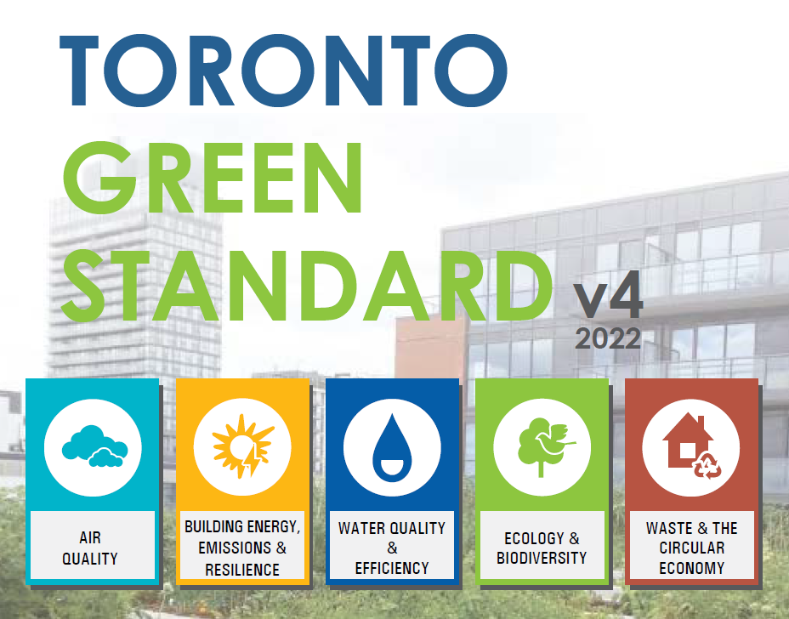
Toronto Green Standard v4 (effective May 1, 2022)
Building Energy, Emissions & Resilience
Operational emissions reductions (Tier 1 only)
Embodied emissions in materials
Operational energy & emissions (Tier 1 only)
Operational systems verification
Water Quality & Efficiency
Managing stormwater
Water efficiency
Ecology & Biodiversity
Tree canopy
Landscape & biodiversity
Natural heritage protection
Climate positive landscapes
Bird collision deterrence
Waste & The Circular Economy
Waste collection & storage
Building material re-use
Sourcing of raw materials
Construction waste management
Air Quality
Cycling infrastructure
Pedestrian infrastructure

Slide 6















Current State of the Union
Patchwork of Funding Mechanisms
Patchwork of Measurements and Metrics
Patchwork of Compliance and Reporting Standards
Patchwork of Policies across municipalities

Slide 7
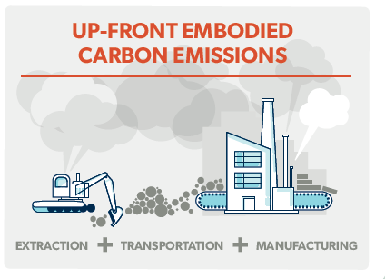
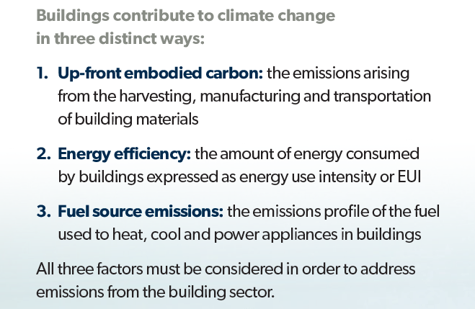
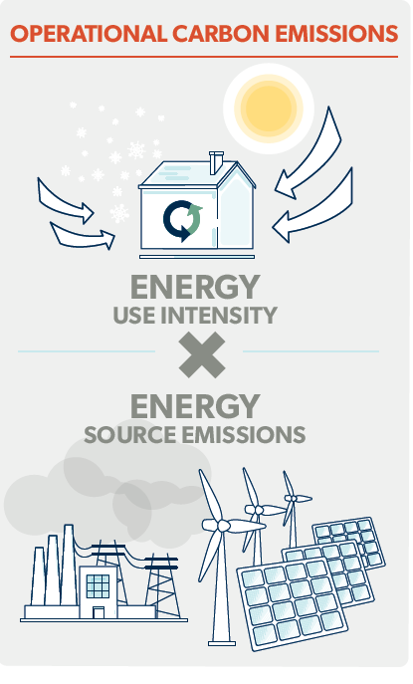
Are we on the right path?
Source: Builders for Climate Action: Low-Rise Buildings as a Climate Change Solution, 2019

Slide 8
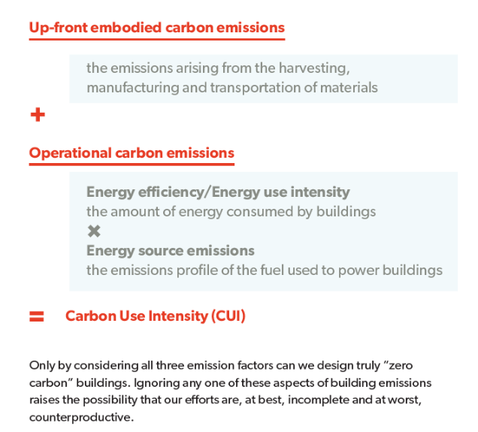
A new metric – Carbon Use Intensity (CUI)?
Key Findings:
‘Available, affordable material options can reduce net up-front carbon… Material selection is the most impactful intervention at the individual building level’
‘Fuel switching to clean, renewable electricity provides the largest overall emission reductions’
‘Energy efficiency beyond current code minimum in Ontario is the least effective and most costly means of reducing building emissions’
‘Feasible, affordable material options can be used to achieve net carbon storage in buildings’
Source: Builders for Climate Action: Low-Rise Buildings as a Climate Change Solution, 2019

Slide 9
Looking Forward
We need more:
Policy – the optimal way to compel change in a timely manner
Education
Supply chain capability & resources
Operations & execution – training, maintenance
Measuring – learning, improving
Functionality – ‘build human spaces in a climate responsible way’

Slide 10
The undiscovered opportunity for affordable housing
Can truly net-zero carbon building construction make affordable rental housing more financially feasible to build?
Reduces building operating costs
Reduces long term building maintenance & repair costs
Reduces utility costs for tenants

