Slide 1
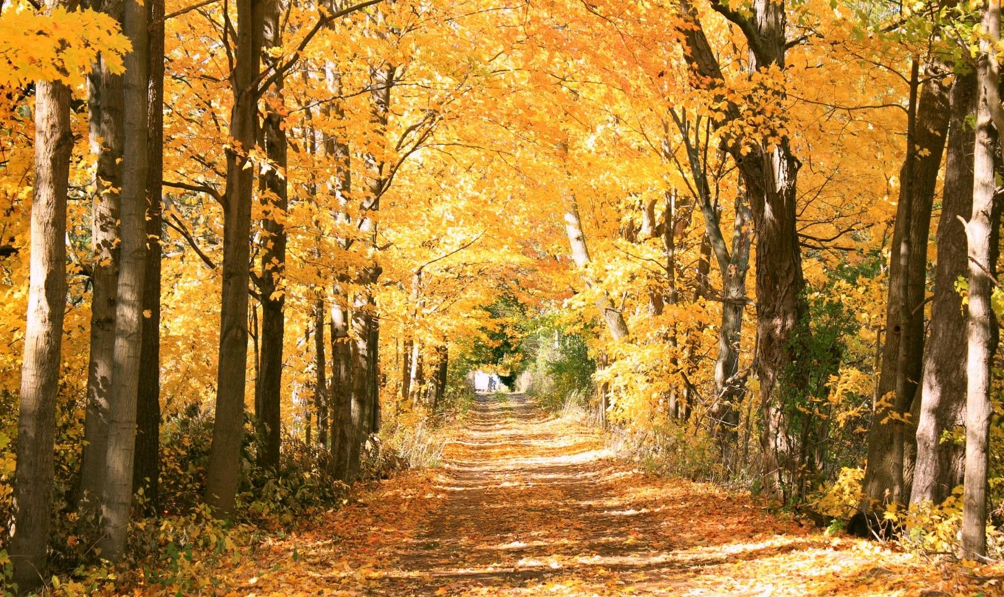
The Low-Carbon Transition Strategy:
A community pathway towards net-zero by 2030

Slide 2
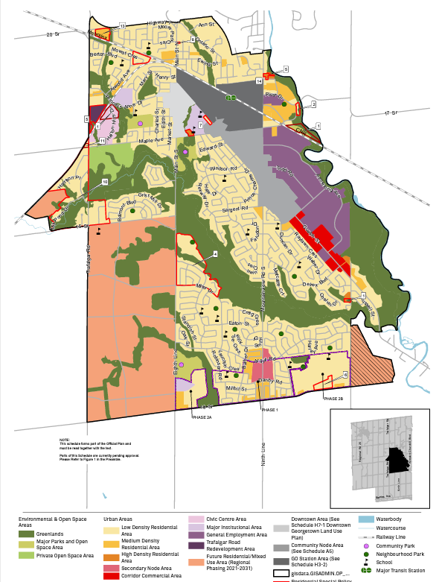
Town of Halton Hills
Lower tier municipality
Population about 61,000
Georgetown and Acton – two urban areas
Halton Hills Premier Gateway – employment area
Three hamlets – Glen Williams, Stewarttown and Norval and several smaller settlements.
Georgetown, Halton Hills
Notes:
Car dependency – especially given distance from rest of GTA and lack of mass transit insfrastructure
Lots of post-war single family detached housing
Employment lands not connected to other areas – clustered on 401
Growth pressures

Slide 3
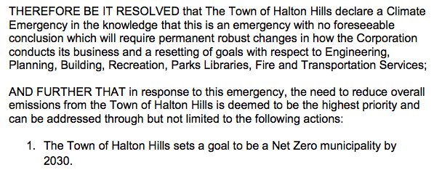
Notes:
2019 climate emergency declaration –
CAO office – Office of Climate Change and Asset Management
New thinking and disruptions

Slide 4
Low Carbon Resilience Framework
Low-Carbon Resilience Framework
Low-Carbon Transition Strategy
Climate Change Resilience Strategy (CCAP)
Outreach & Education
Corporate Energy Management
Emergency Preparedness
Green Development
Resilient Infrastructure
Community Retrofits
Resilient Neighborhoods
Low-Carbon Mobility
Natural Asset Management

Slide 5
Low Carbon Transition Strategy

Slide 6
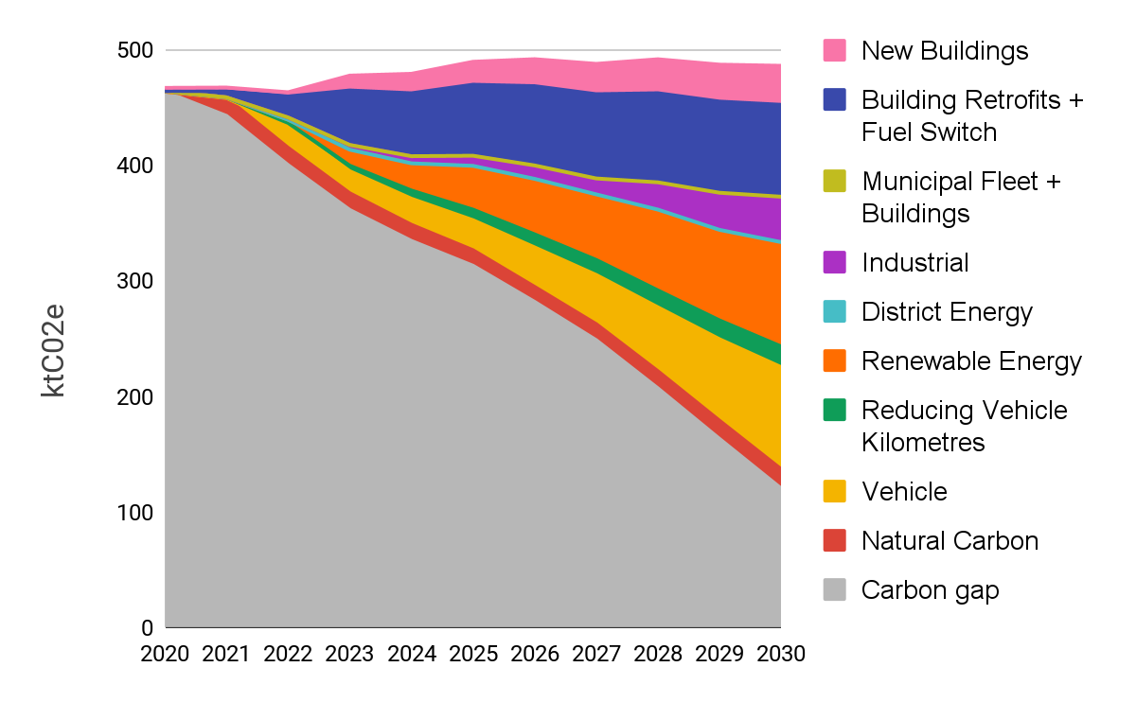
LCTS – Priority Action Areas
Energy Efficiency & Green Development
Local Renewable Energy
Low-carbon Mobility
Carbon Gap
Natural Assets
Carbon Gap
Notes:
General Flow: reduce demand (i.e. increase efficiency), fuel switch, deploy renewable energy sources
Energy Efficiency and Green Development
New Buildings
Green Development Standards to support net zero buildings by 2030
assumes no natural gas use in new buildings
Building Retrofits + Fuel Switch
50-65% of existing residential and 50% commercial buildings are retrofitted
Municipal Fleet + Buildings
new municipal buildings are net zero after 2025
municipal vehicles replaced with EV or RNG (for half of heavy vehicles) at end of life
Industrial
industrial buildings and processes use 30% less energy by 2030
30% of remaining industrial energy use replaced with RNG by 2030
Local Renewable Energy
By 2030, install 30% of feasible rooftop solar PV potential (46 MW based on roof analysis)
By 2030 , install 445 MW of solar capacity. Assuming 4 ha/ MW, the land required would be 1,780 ha, which is about 13% of available land (undeveloped settlement land and cropland)
procure enough RNG to displace remaining natural gas use in 2030
New developments in Vision Georgetown to be powered by a 4 MW geothermal district energy system by 2030
Low-carbon Mobility
reduce home to work trips by 30% due to work from home
shift vehicle trips to active modes (walk or bike) and transit
allocate 10% of remaining vehicle trips to shared EVs
all new personal use vehicles and medium commercial vehicles are EVs by 2030
new heavy commercial vehicles are EV/RNG by 2030 with 50/50 split
50% of new off-road vehicles are electric by 2030
Natural Assets
Starting in 2022, plant 50,000 trees in Halton Hills per year
15% increase in land under sustainable soil management practices by 2030

Slide 7
LCTS - Turning to Action...
TOWN: as trailblazer, administrator, educator & communicator
NGOs + INSTITUTIONS: partnerships & collaborations
PRIVATE SECTOR: Innovative partnerships & internal target setting
OTHER LEVELS of GOVERNMENT: funding & supportive policies
COMMUNITY: participating in programs & oversight

Slide 8
LCTS Programs and Initiatives
Corporate Energy Management
Corporate Energy Plan
Low Carbon Design Briefs
Green Development
Green Development Standards
Low Carbon Vision Georgetown
Community Retrofits
Retrofit Halton Hills
Low Carbon Mobility
EV Charging Network
Fleet Electrification
EV Promotion Campaign

Slide 9
Unknowns and External Dependencies
Other Levels of Government
Electricity Grid
Labour Market, Supply Chains, technology transition
Innovative Delivery Mechanisms
Notes:
Programs, policies, and regulations are required to drive the transition. Examples like the building code, transformation of the energy system, financial support for municipalities, enforcement of targets…
Electricity Grid
Ontario has a very low carbon grid; this enables action on various levels by making switching to electricity a very effective climate mitigation strategy. Projections show carbon increasing on the grid as nuclear power is replaced by natural gas. We will need a strategy to move in the other direction. At the same time, we will have to manage the transition to a smart grid, more renewables, higher demand from electrification etc. – there are many challenges here.
Labour Market, Supply Chains, technology transition
Need much more skilled labour to do retrofits, clean energy, green buildings. Also supply of equipment, materials etc. will need to change to meet these new demands.
Things like the transition to electric vehicles will rely on a broader market transformation that the town has little to no control over
Innovative Delivery Mechanisms
Traditional program delivery mechanisms are not sufficient to meet the needs of the LCTS – bulk retrofits, capitalization, etc needs to happen

Slide 10
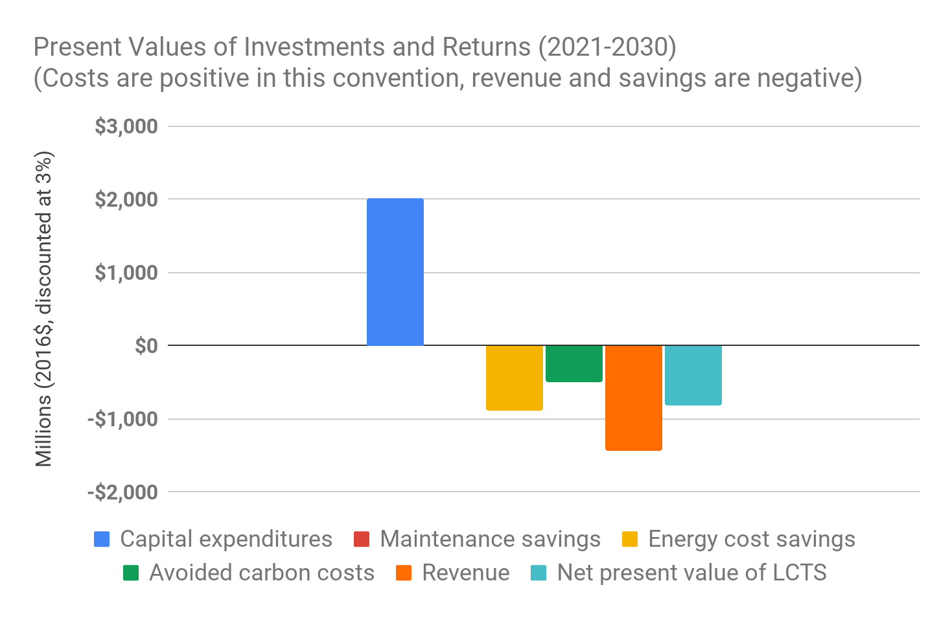
Scale and Capacity
Investment from the:
Town,
other levels of government,
private sector,
institutions, and
residents
$218 million/year
$850 million NPV
43% ROI
Notes:
We cant do this ourselves – need to scale up rapidly – find ways to transform markets, bring investment, new mechanisms, etc.

Slide 11
Governance & Implementation
Communities that undertake to implement a CEP with a business-as-usual approach will have limited success.
Communities that have introduced new governance models to oversee and implement their plans have consistently proven that doing so will ensure that the CEP remains top-of-mind for elected officials, local government staff and community stakeholders.
-QUEST CANADA, Community Energy Plans: Getting to Implementation
https://questcanada.org/project/getting-to-implementation-in-canada/

