Slide 1
Psych 499 WELCOME! Undergraduate Thesis
January, 2022
Tim Ireland
Liaison librarian Psychology

Slide 3
Overview
Why am I here?
Session objectives
Access resources from off campus
Library catalogue –getting material from catalogue
Research tools (databases)
PsycINFO
Scopus
RefWorks
Contact info

Slide 4
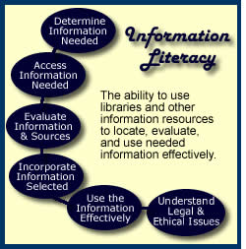
Information Literacy…
The information literate student shall…

Slide 5
Tim’s translation
Students should be able to find relevant
items
Students should be able to get relevant material
Students should be able to evaluate relevant material
Students should be able to cite material properly & avoid plagiarism

Slide 6
ASK QUESTIONS!!!
Tell me and I forget
Teach me and I remember
Involve me and I learn

Slide 7
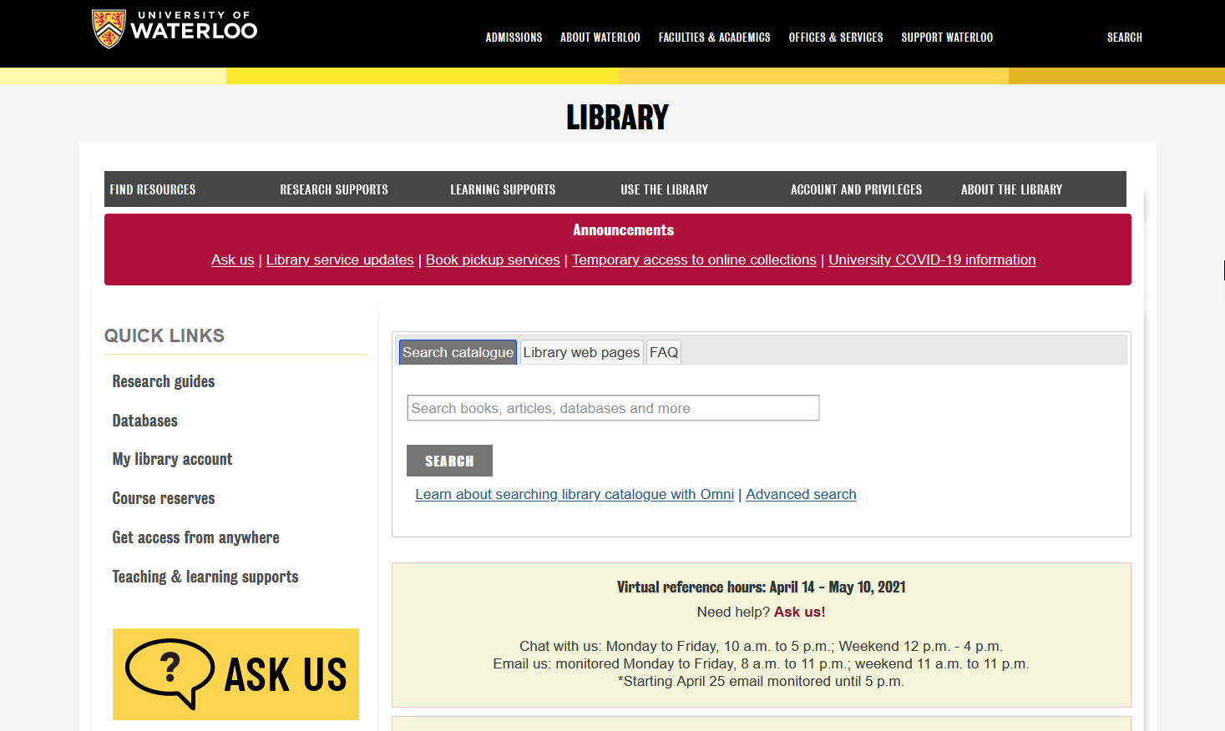
The virtual library

Slide 8
Any questions about getting access from off campus?

Slide 9
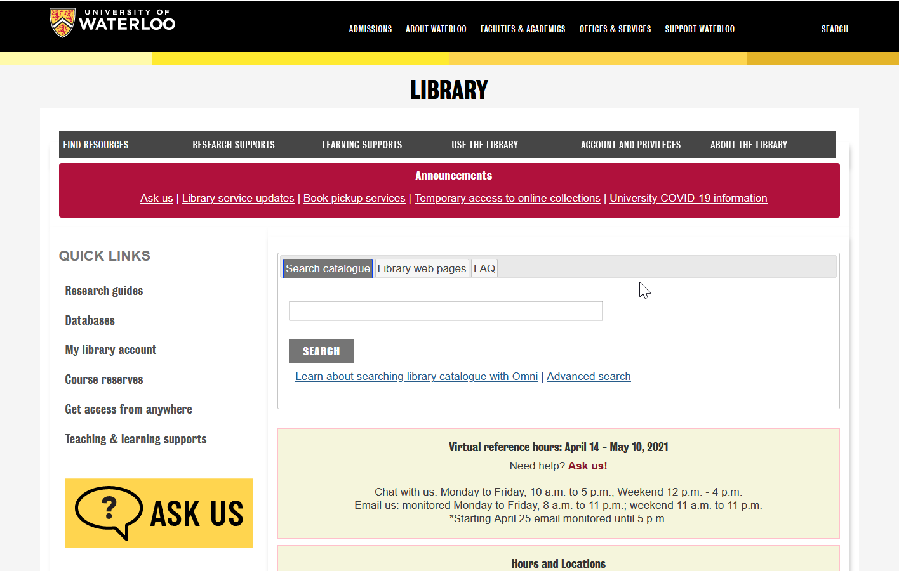
The Library Catalogue
Undergraduate Writing Psychology

Slide 11
New Catalogue -Omni
Loan period for books –Increased may borrow up to 500 item in total with loan periods of 120 days for books and two weeks for journals.
You have access to licensed electronic resources.
You can use interlibrary loans (ILL) to request materials from another library free of charge. In the case of books we will mail them to you and include a return slip so you do not have to pay to get them back to us (ONLY IN CANADA).

Slide 12
If the book is not in the system

Slide 13
Inter Library Loan
Circulating books from anywhere in the world
Journal articles from anywhere in the world
5-10 Business days
Journal articles arrive as links in your e-mail

Slide 14
Any questions about the Library Catalogue or Inter-library loan system?

Slide 15
Databases

Slide 16
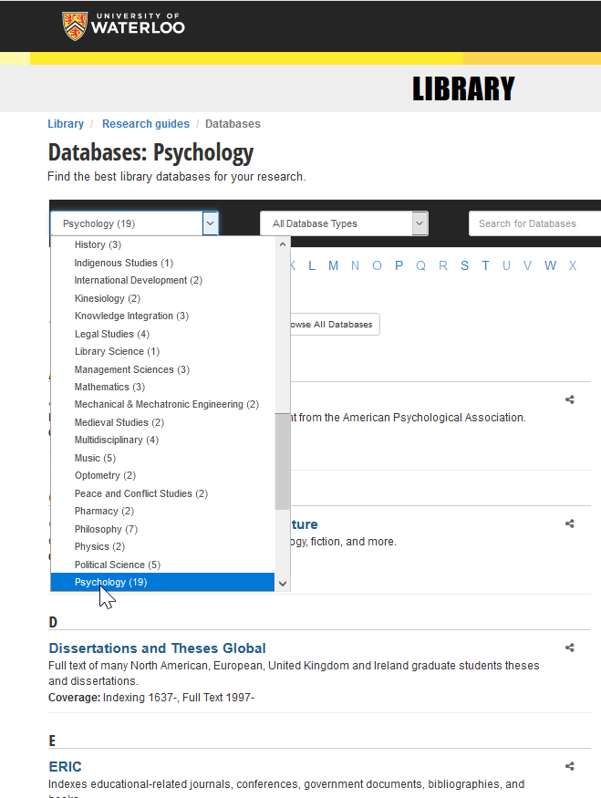

Slide 17
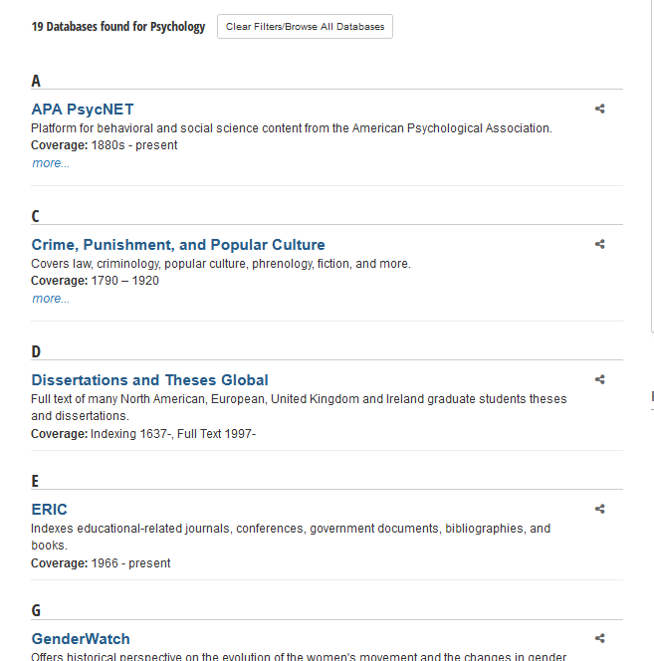

Slide 18
Research Guides

Slide 19
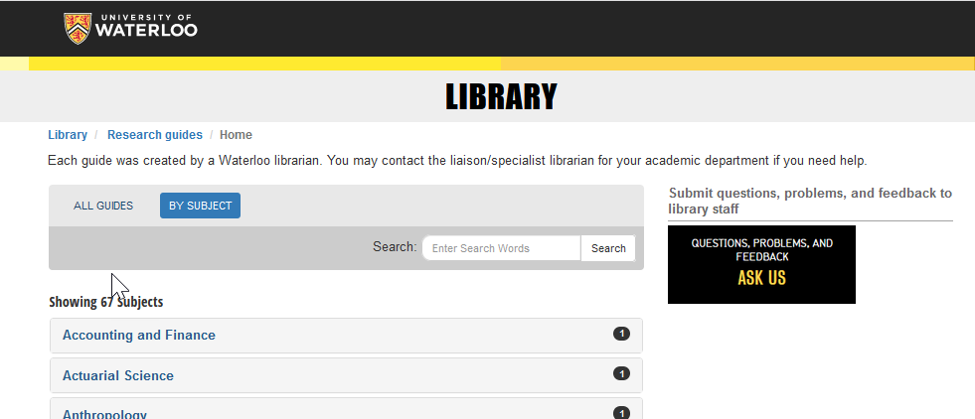

Slide 21
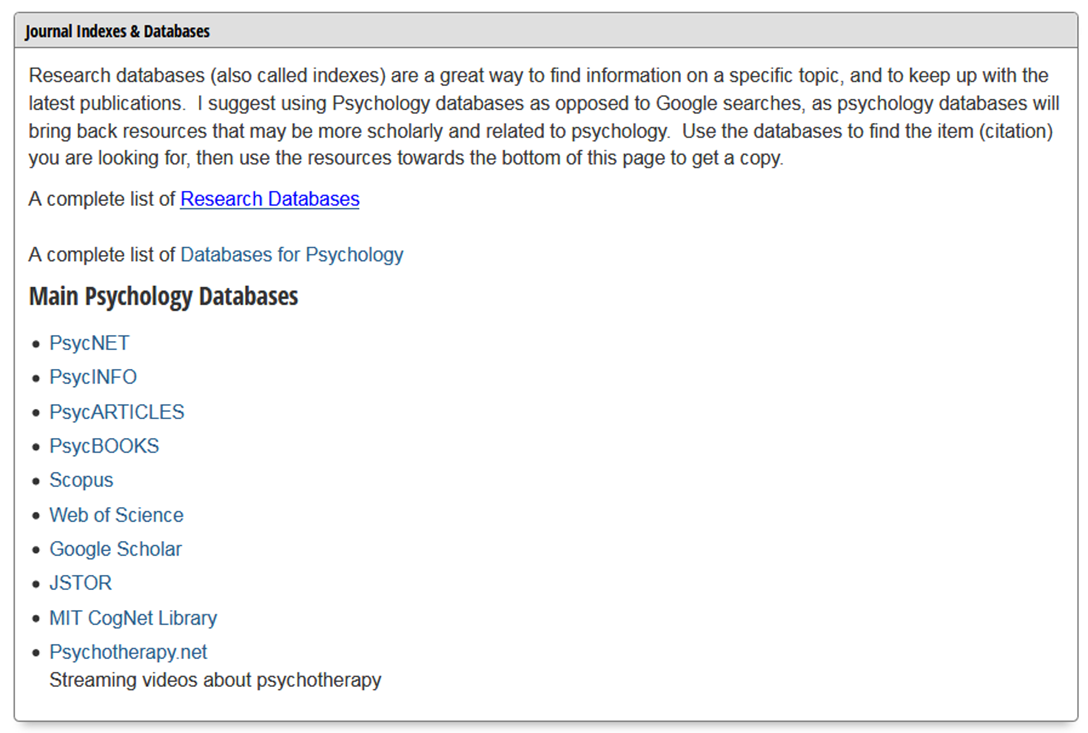

Slide 22
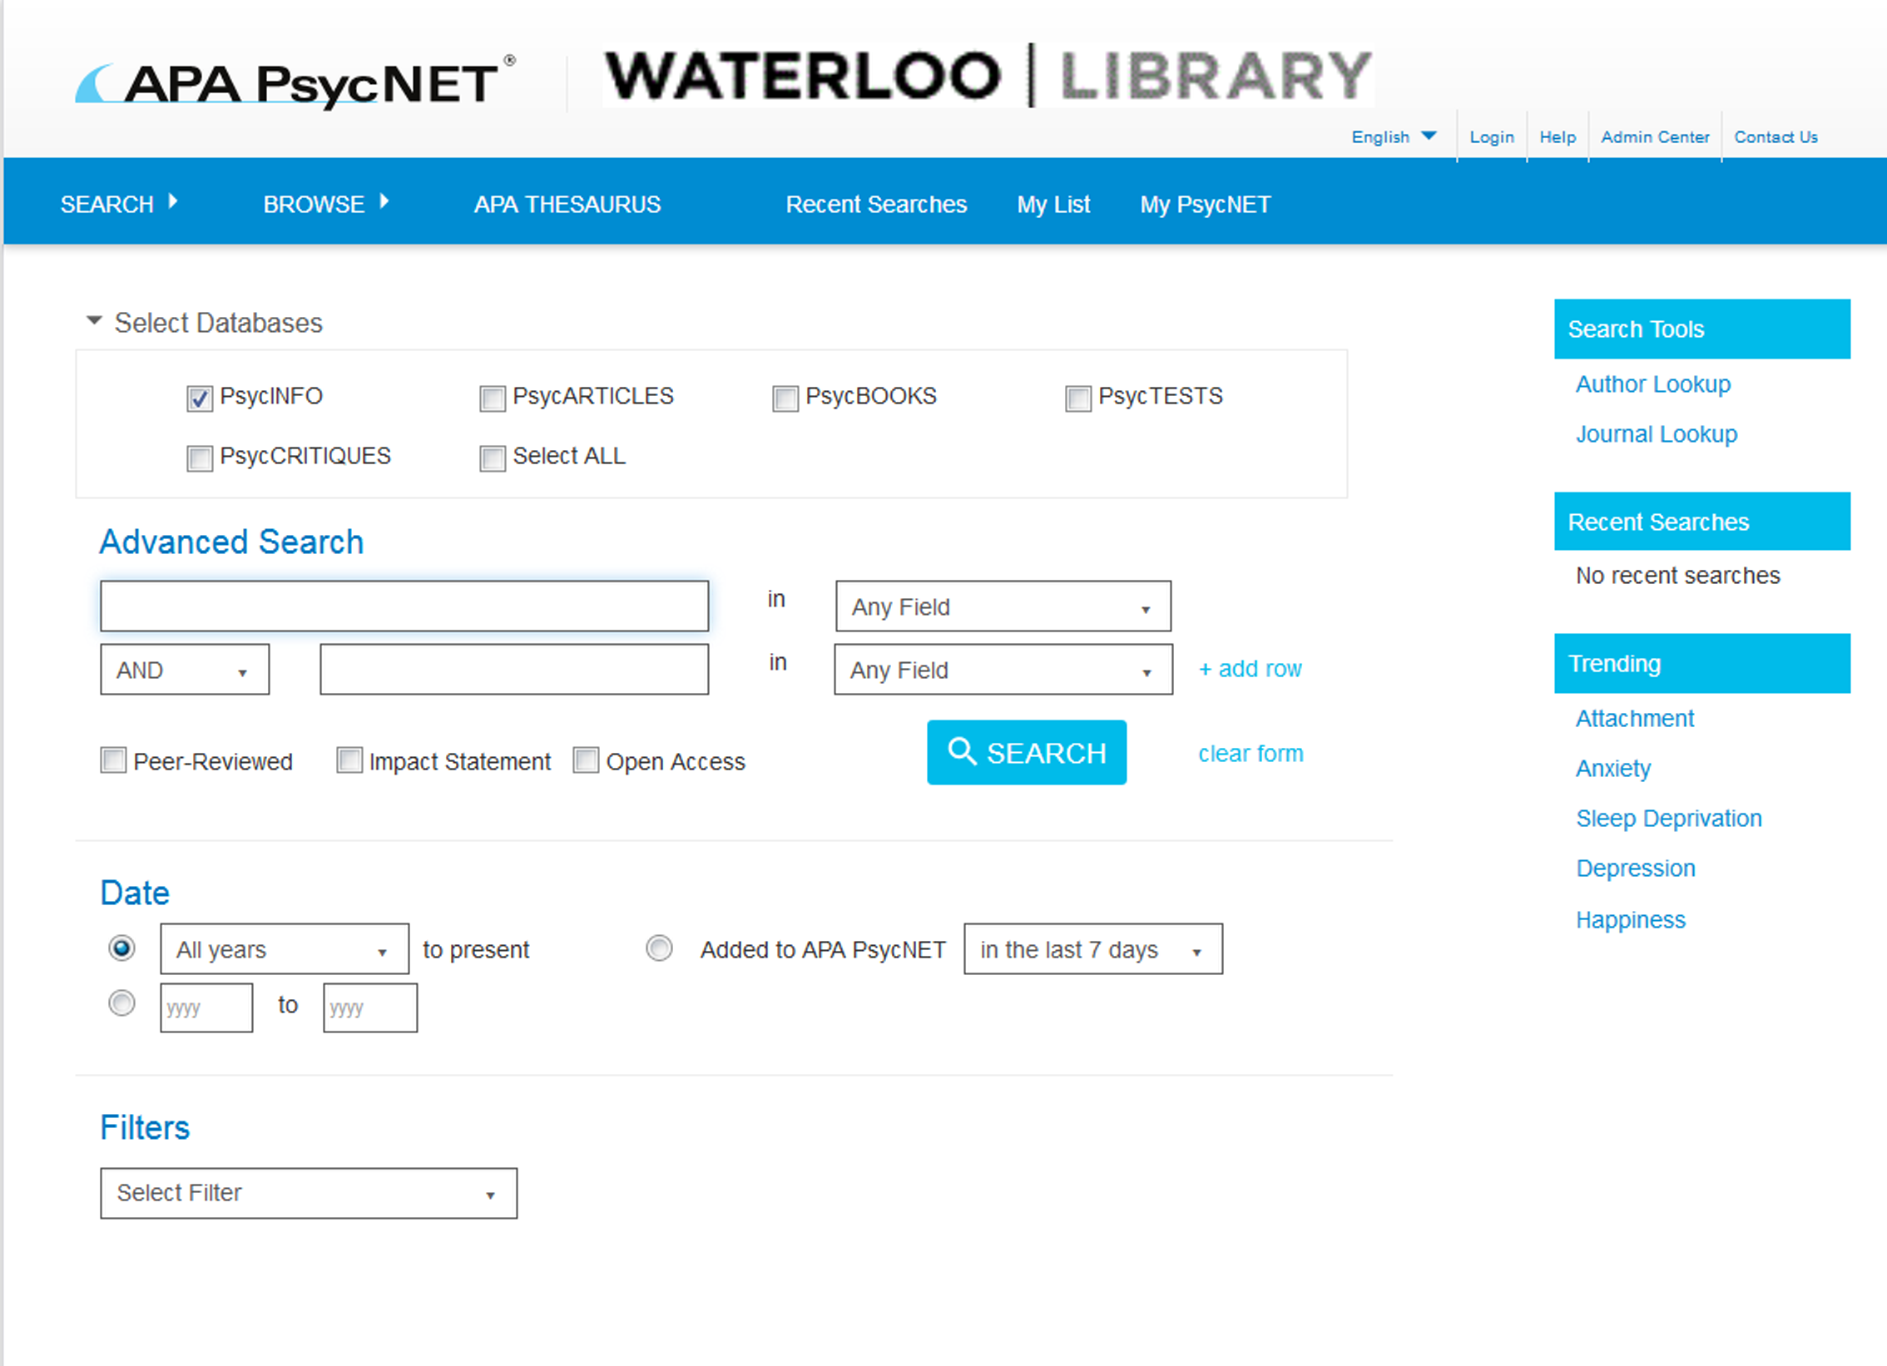
Writing a journal article

Slide 23
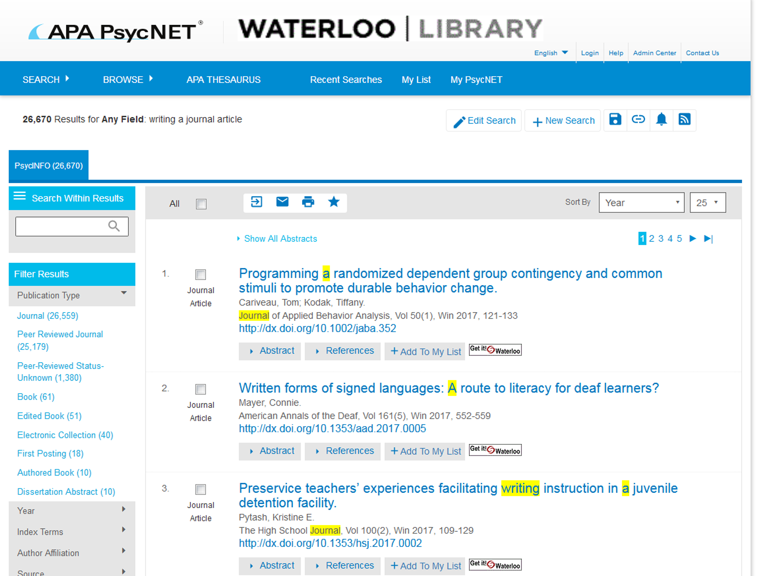

Slide 24
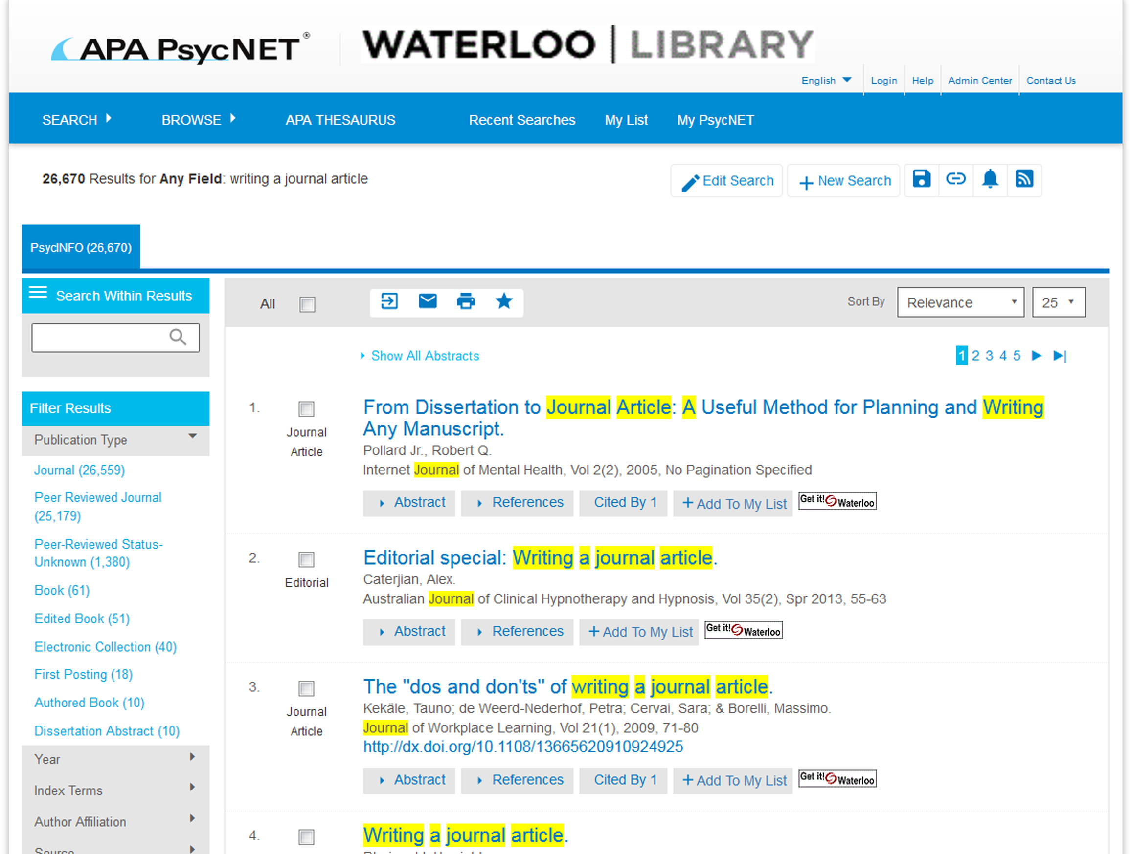

Slide 25
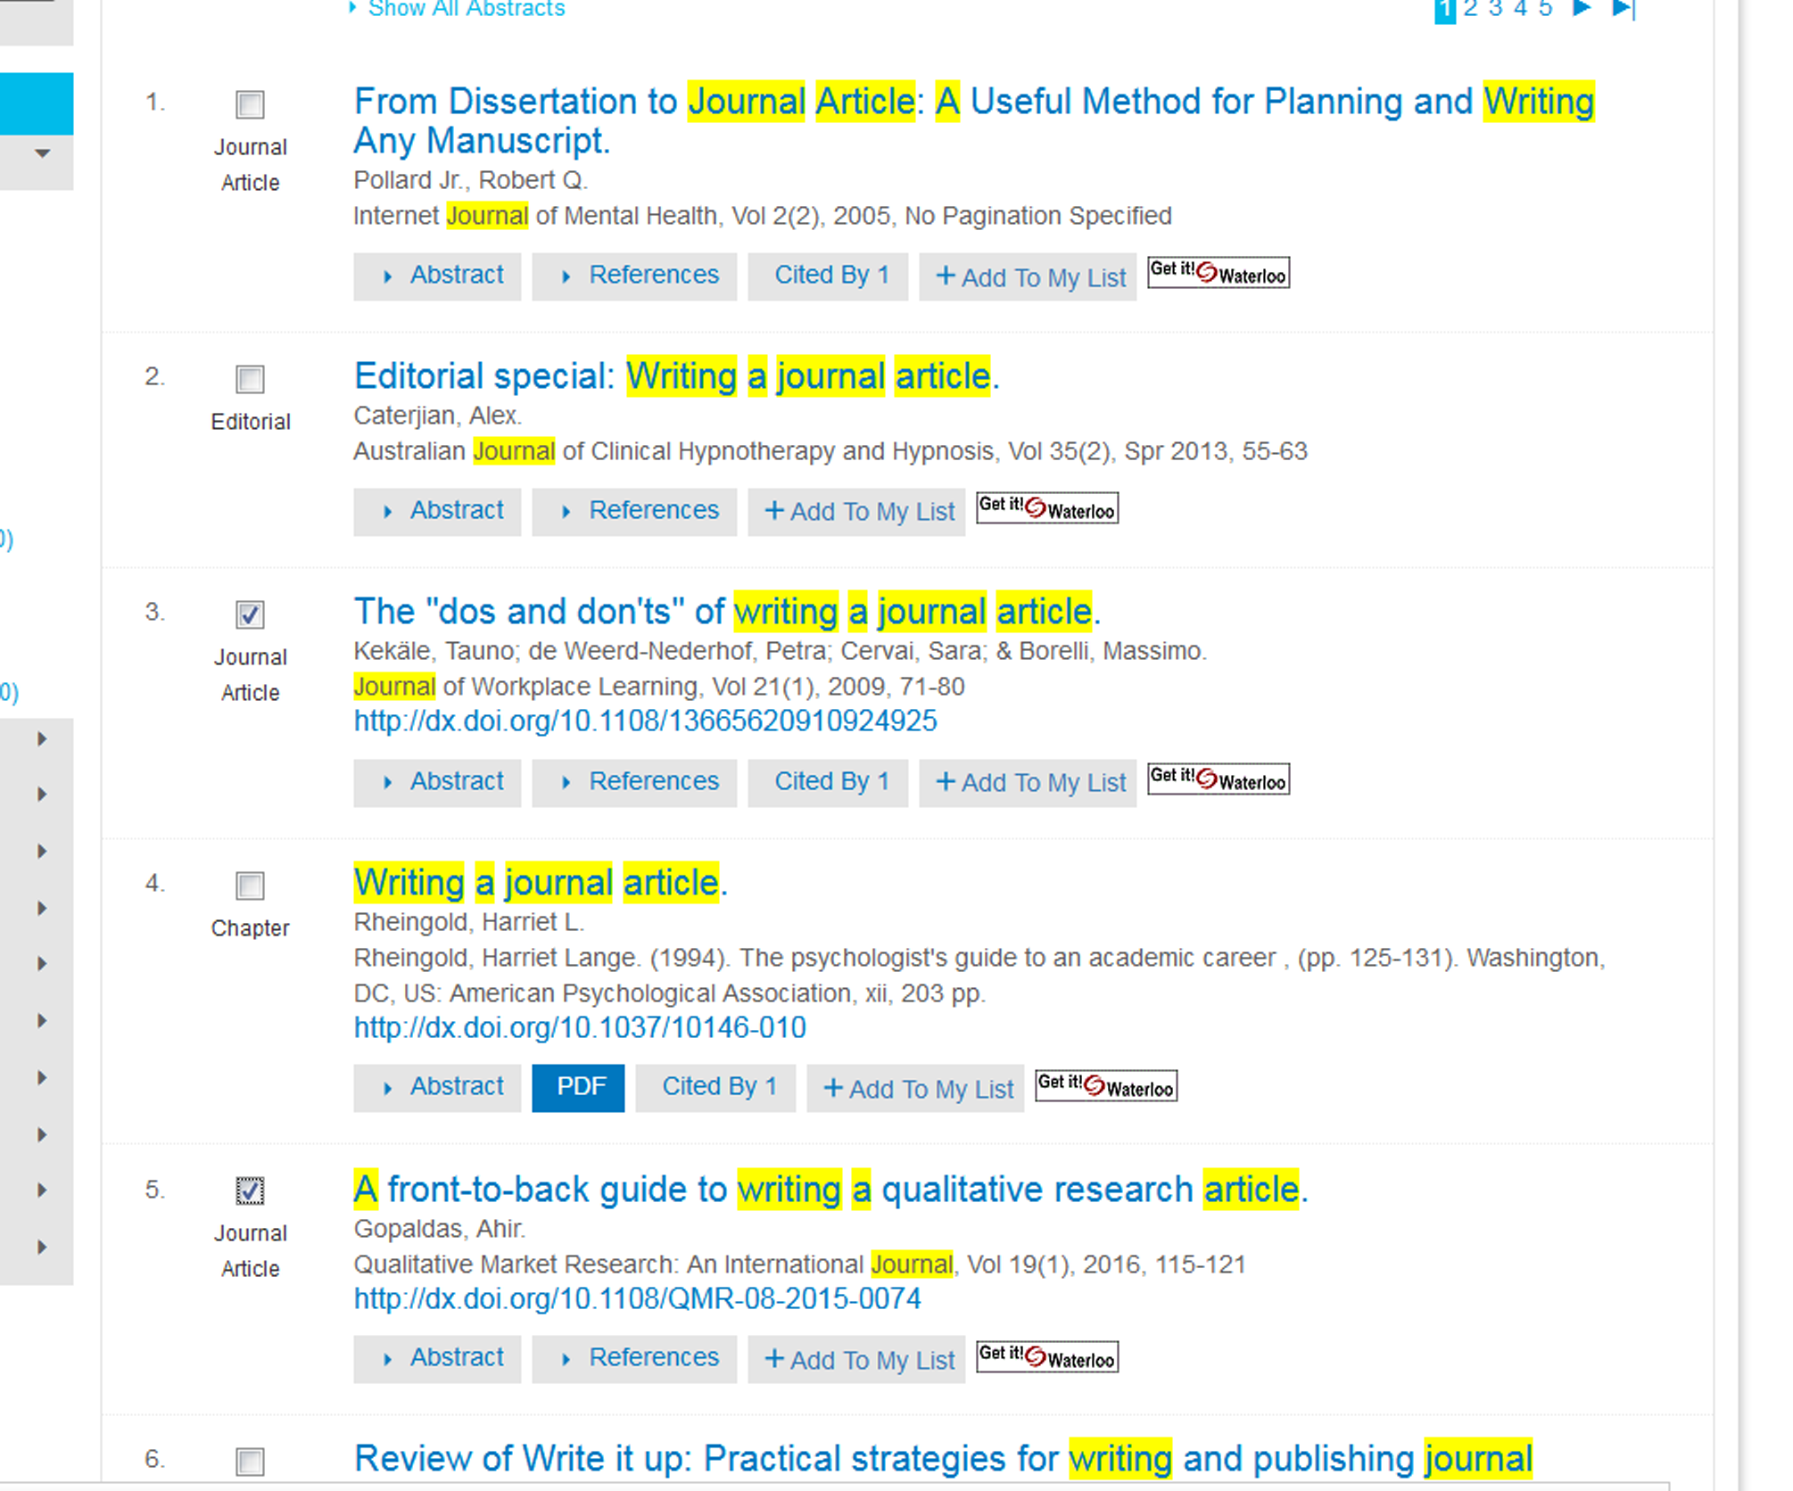

Slide 26
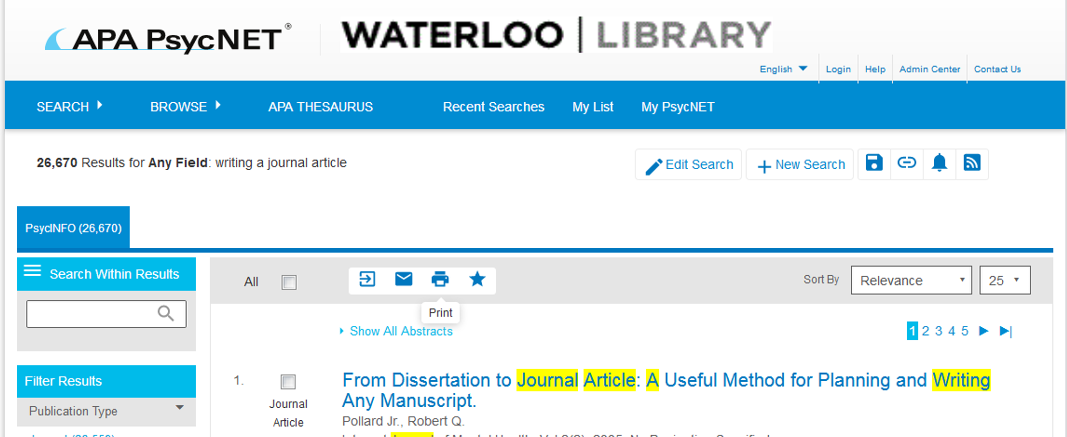
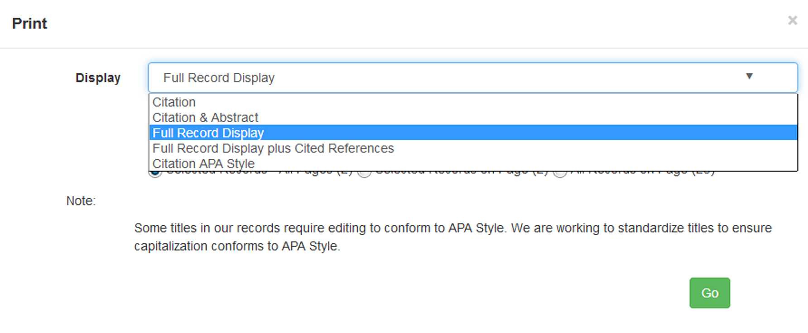

Slide 27
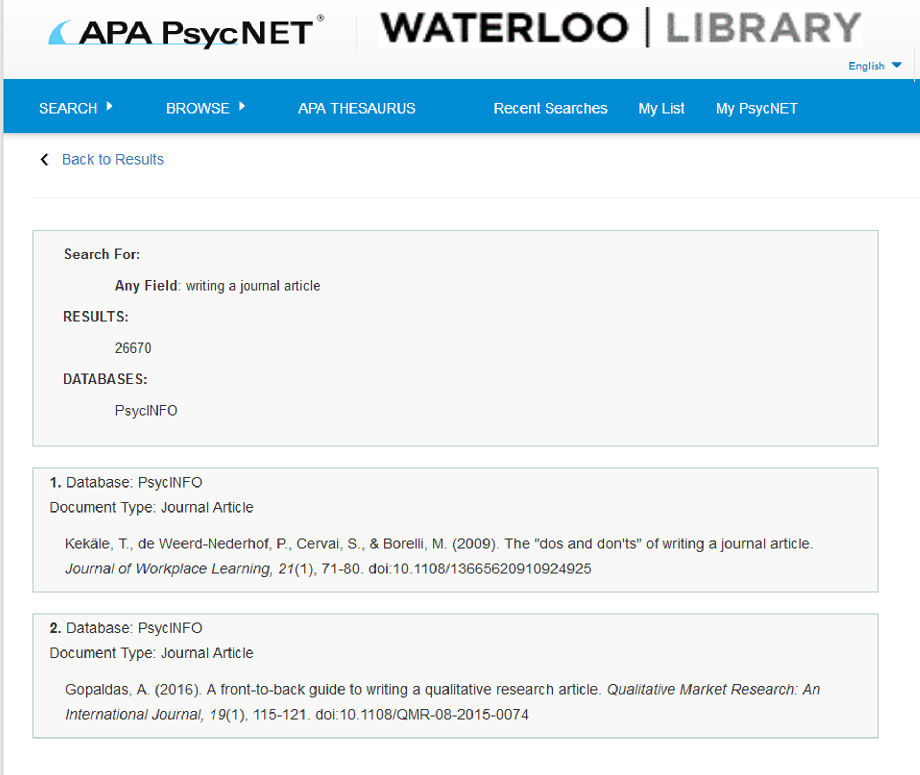

Slide 29
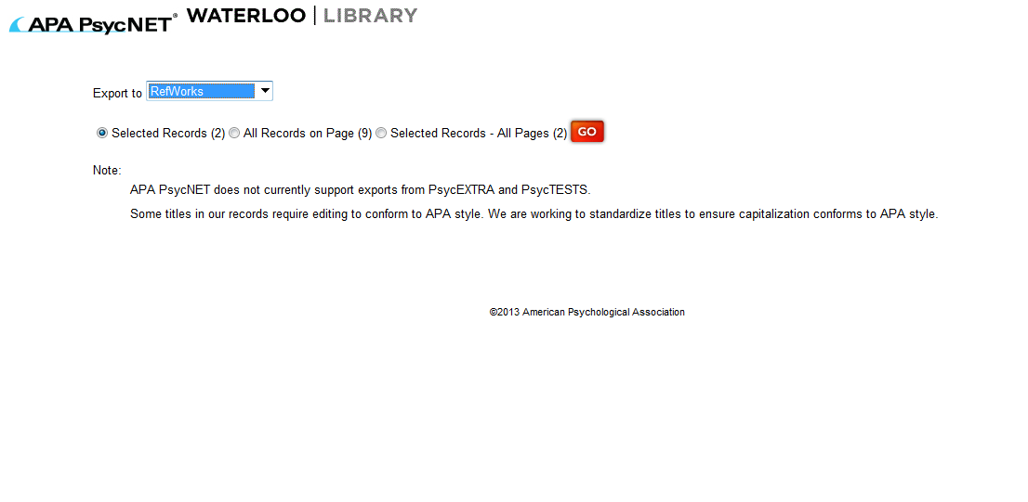

Slide 30
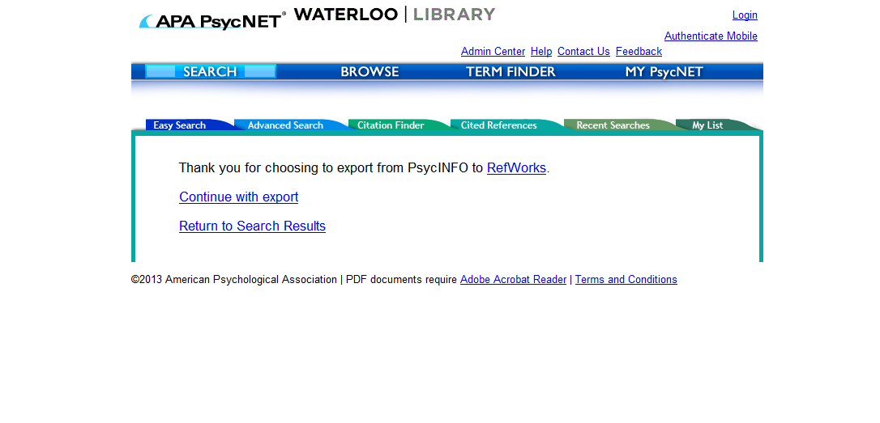

Slide 31
Psych
ooooo

Slide 32
Online Citation manager
Free to current students and faculty
Keeps track of citations
Helps you “get” the article
Helps you in the writing process

Slide 33
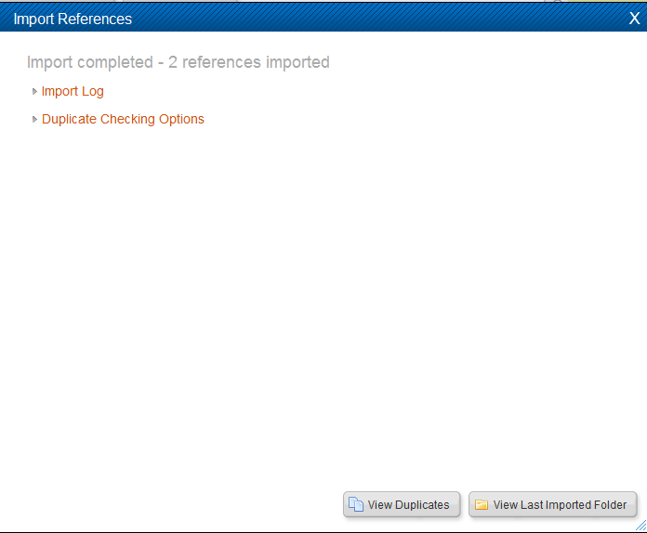

Slide 34
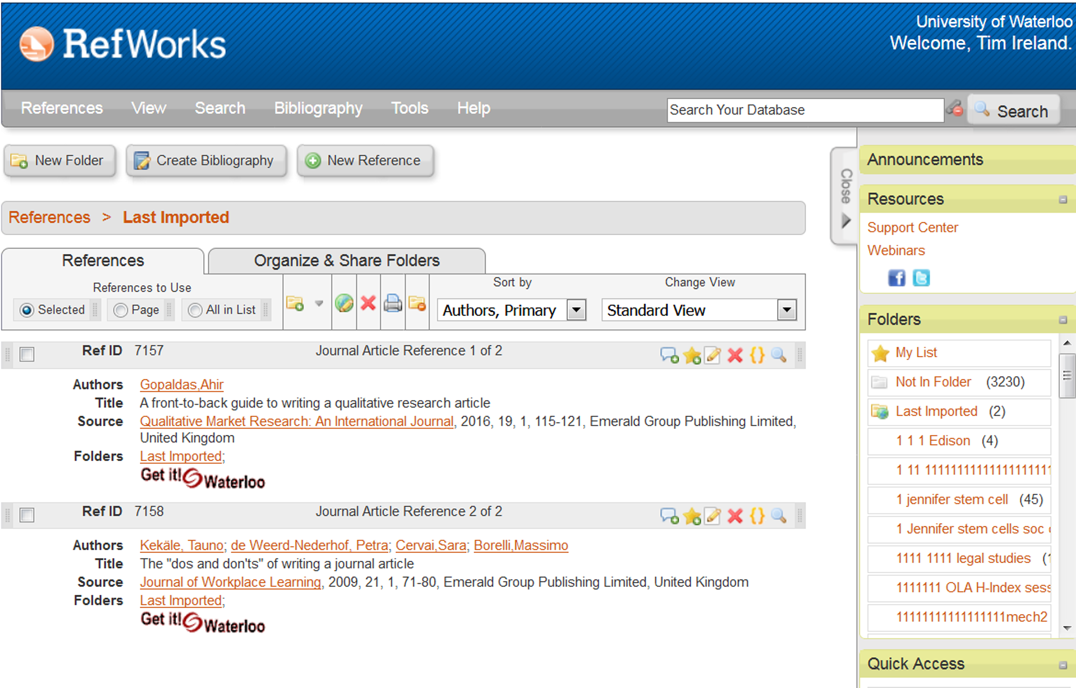

Slide 35
Lets see what we can do…
WARNING-TEASER

Slide 38
You then type your paper and when you get to a location where you are including an idea or thought that is not yours, you insert a citation.

Slide 39
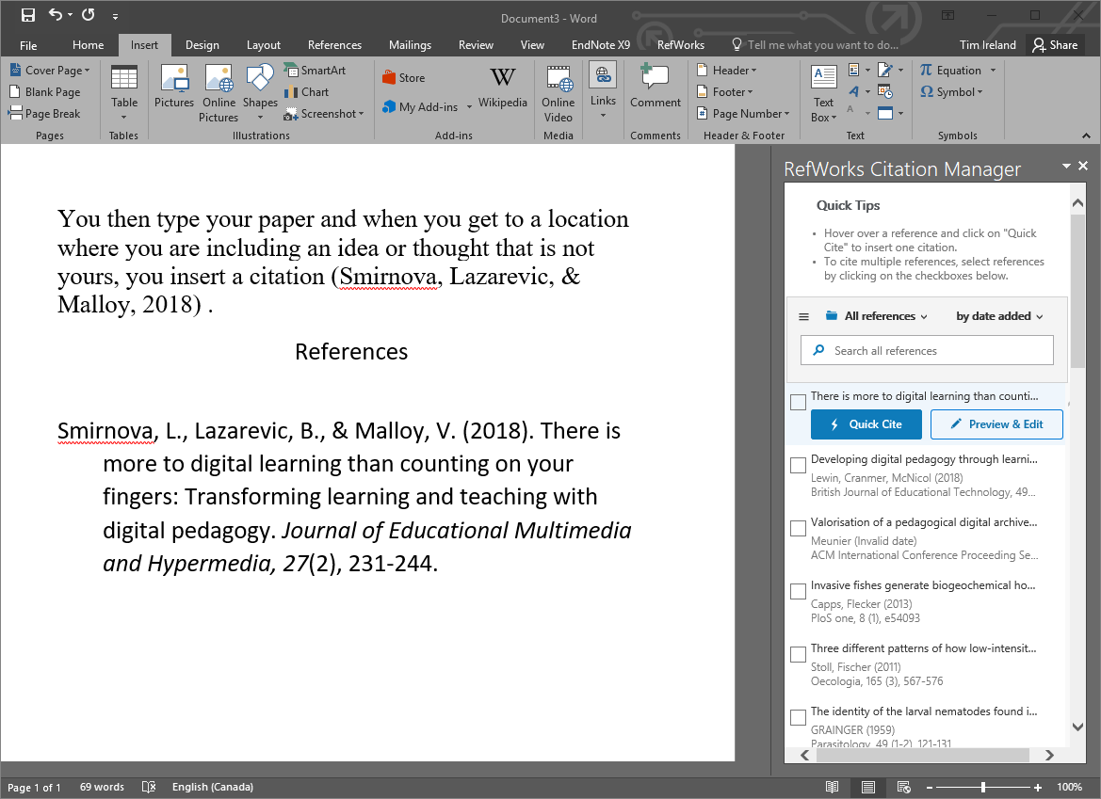

Slide 40
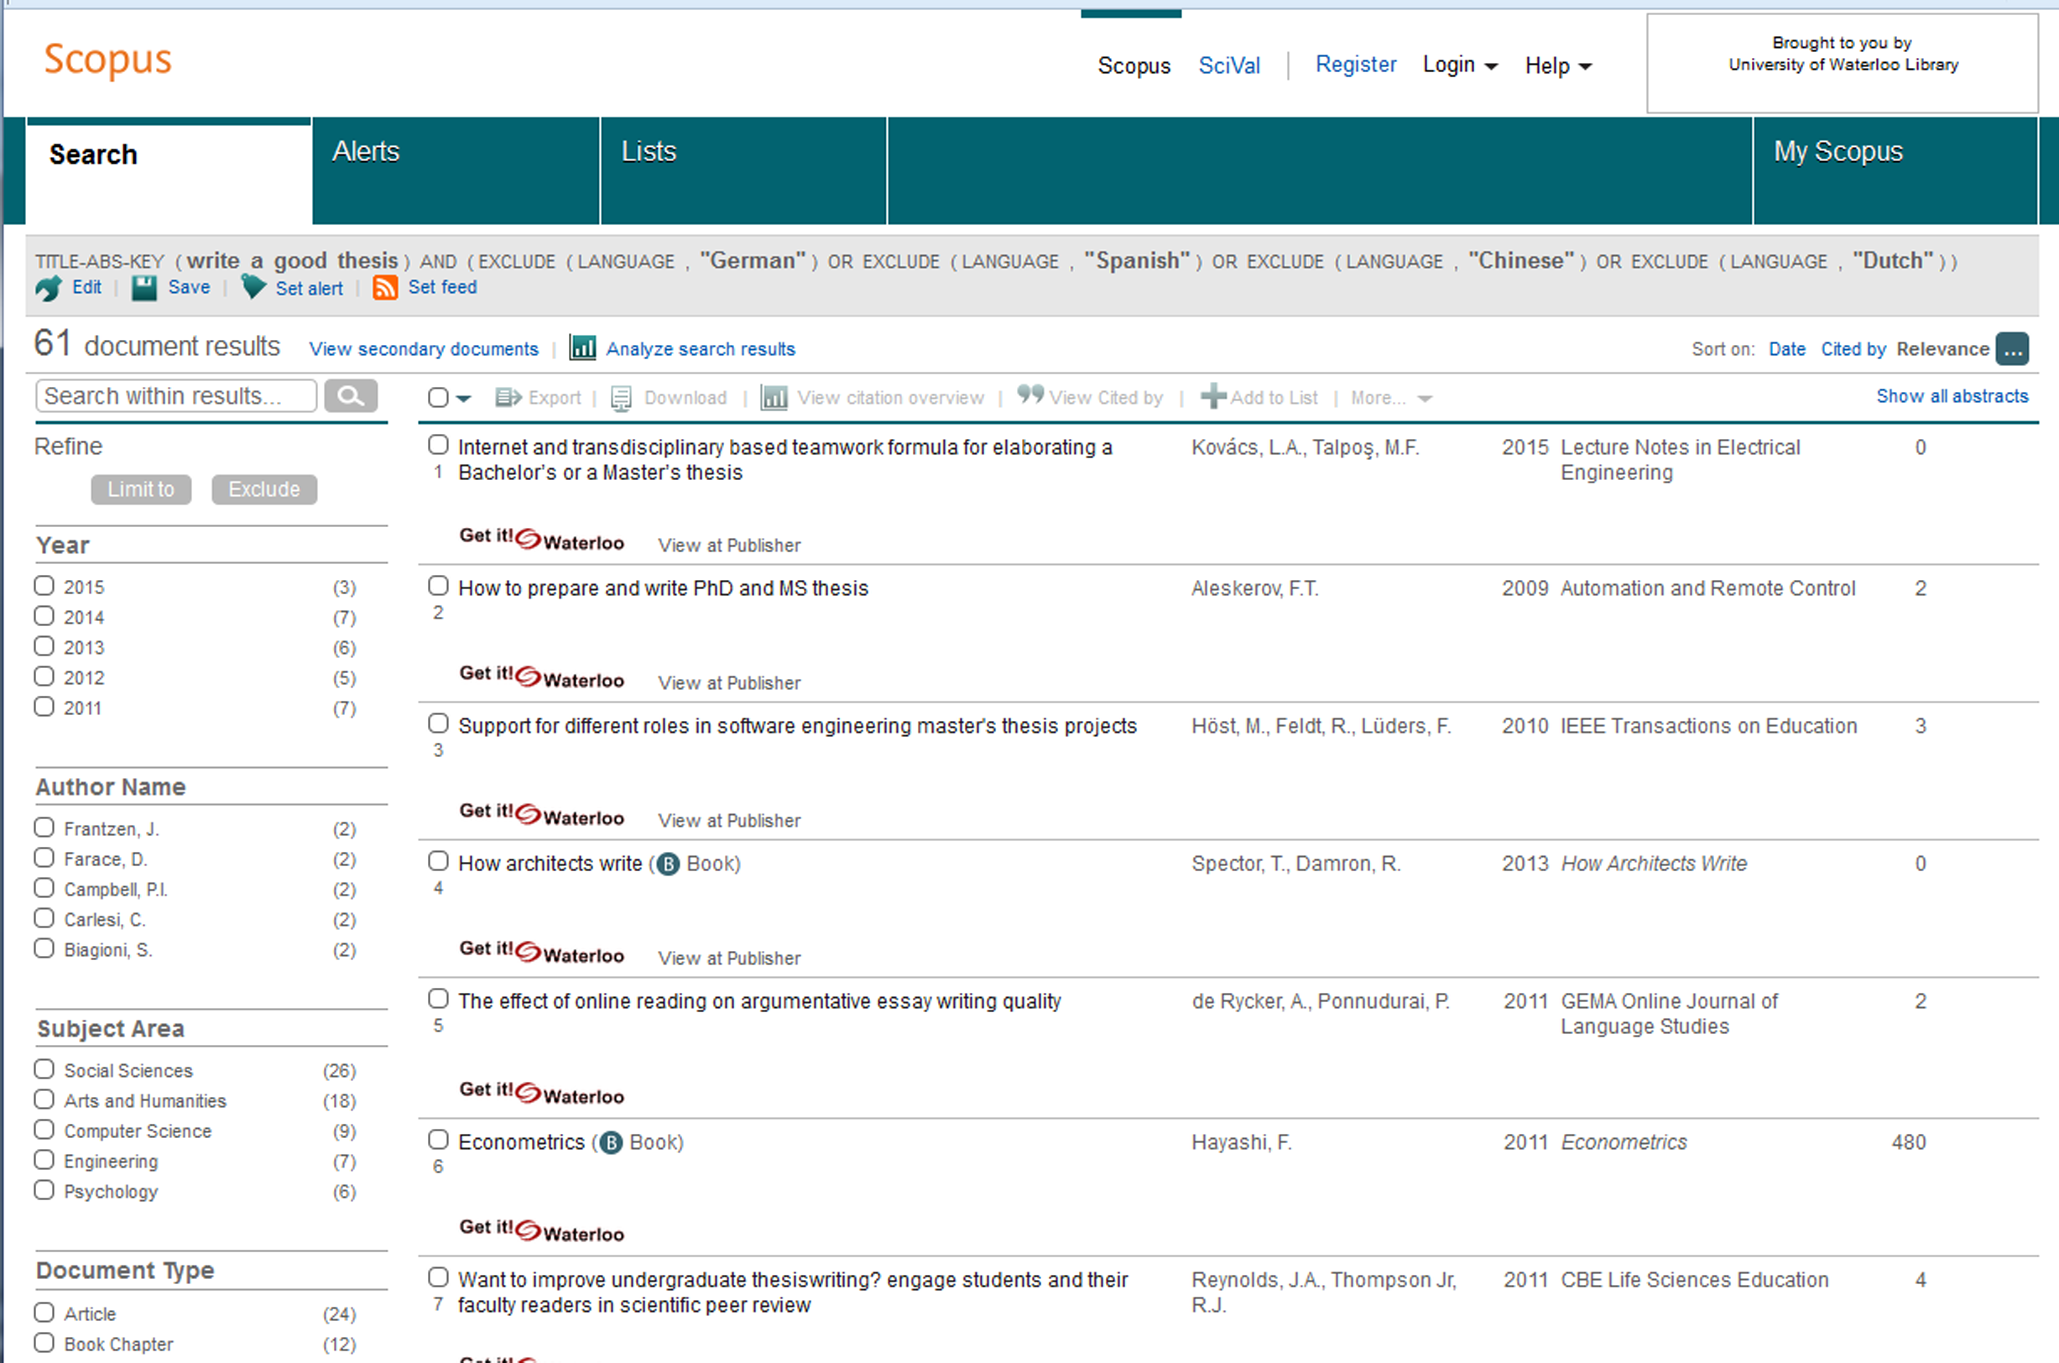
Scopus

Slide 41
PsycINFO vs Scopus
PsycINFO | Scopus
2395 Journals | 24008 Journals
Search Methodology | Times Cited
Focus on Psychology | Multidisciplinary
APA | Elsevier
Excellent controlled vocabulary | Inherited controlled vocabulary
Can specify peer review | All journals peer reviewed

Slide 42
Contact me!
Let me know if you would like to book an appointment with me for an hour (or more)!
Tim Ireland
tireland@uwaterloo.ca
519-888-4567 X 45061
MS Teams
Skype
Zoom
Phone
WebEX

