Slide 1
Welcome! Psych 499 Undergraduate Thesis
May 2023
Tim Ireland
Liaison Librarian Psychology

Slide 2
CONGRATULATIONS!!!!!!!!!!!

Slide 3
Overview
Who am I and why am I here?
Session objectives
Access resources from off campus
Library catalogue –getting material from catalogue
Research tools (databases)
PsycINFO
Scopus
Zotero (citation software)
Contact info

Slide 4
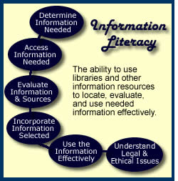
Information Literacy…
The information literate student shall…

Slide 5
Tim’s translation
Students should be able to find relevant
items
Students should be able to get relevant material
Students should be able to evaluate relevant material
Students should be able to cite material properly & avoid plagiarism

Slide 6
ASK QUESTIONS!!!
Tell me and I forget
Teach me and I remember
Involve me and I learn

Slide 7
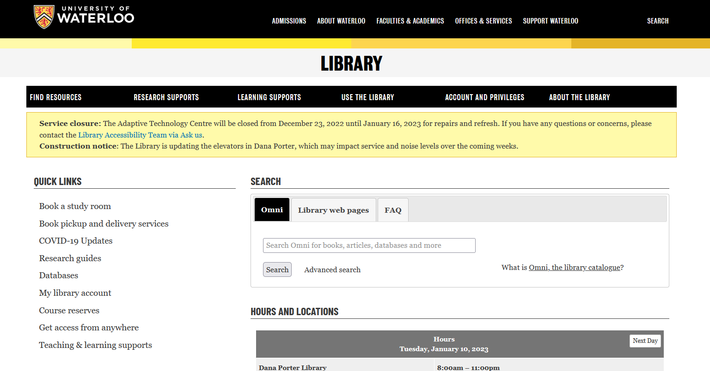
The virtual library

Slide 8
Any questions on getting updated information about library services? Any questions about getting access from off campus?

Slide 9
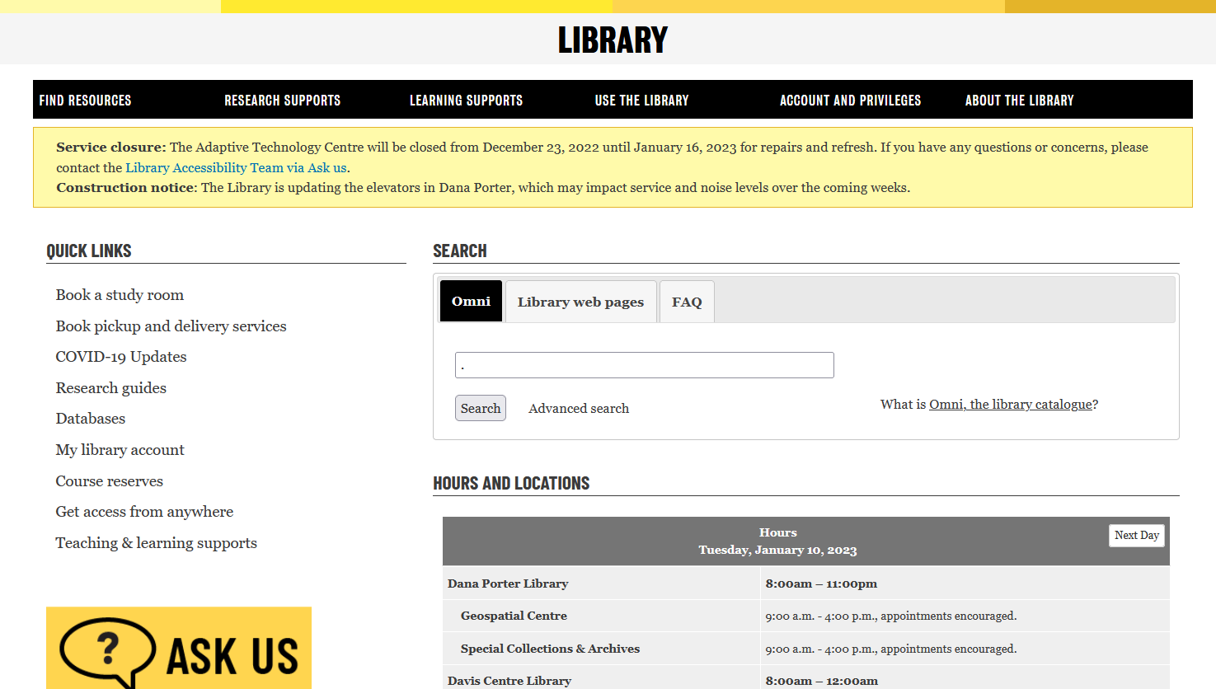
The Library Catalogue
Undergraduate Writing Psychology

Slide 10
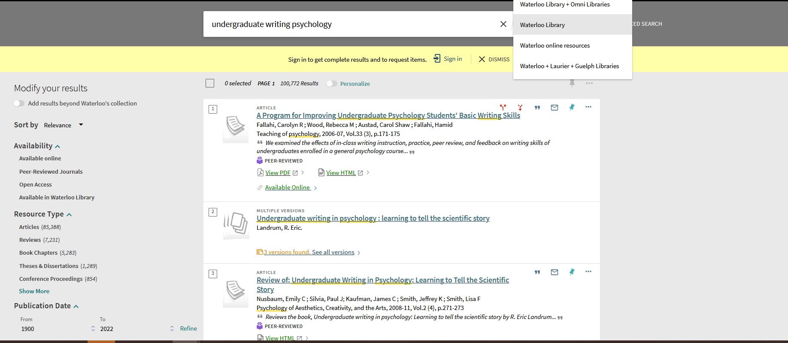

Slide 11
Catalogue -Omni
Loan period for books –Increased may borrow up to 500 item in total with loan periods of 120 days for books and two weeks for journals.
have access to licensed electronic resources.
use interlibrary loans (ILL) to request materials from another library free of charge.
Can have a portion of a book scanned/digitalized 10%
Can have any of the circulating items mailed to you with free return postage.
Can have your item sent to any library location (including non-UW).

Slide 12
If the item is not in the system

Slide 13
Interlibrary Loan
Circulating books from anywhere in the world
Journal articles from anywhere in the world
5-10 Business days
Journal articles will appear as e-mail links from your e-mail

Slide 14
Any questions about the Library Catalogue or Interlibrary loan system?

Slide 15
Databases

Slide 16
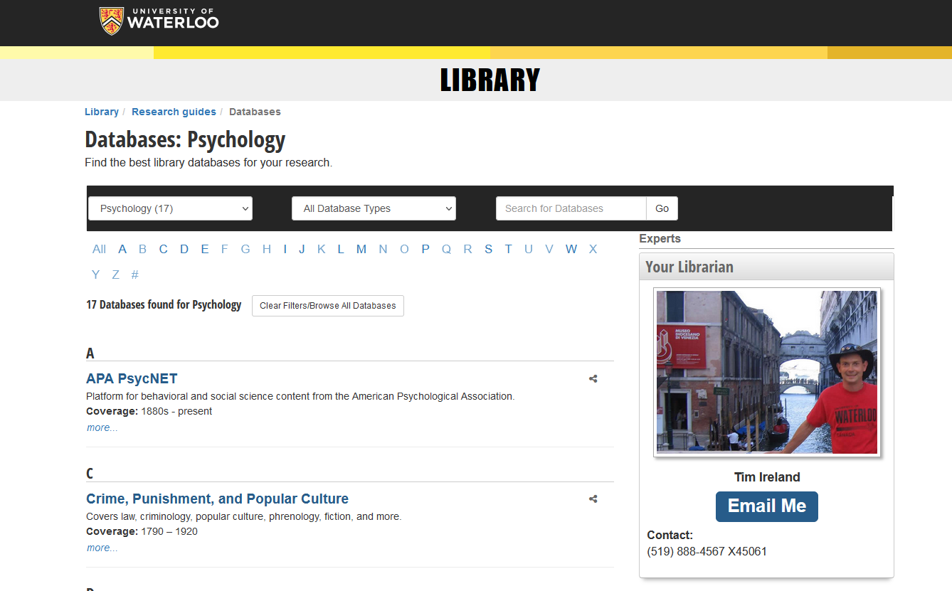

Slide 17
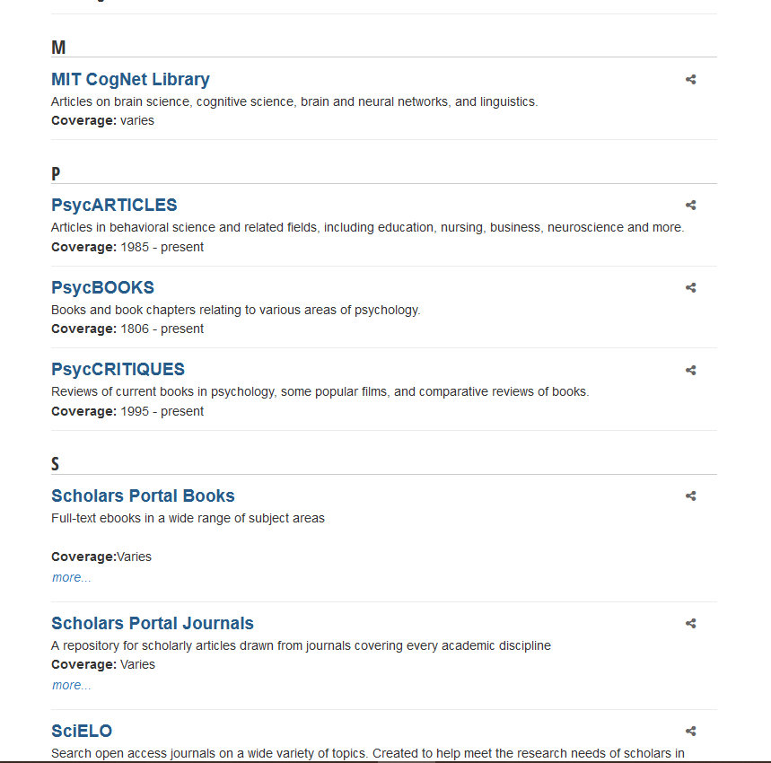

Slide 18
Research Guides

Slide 21
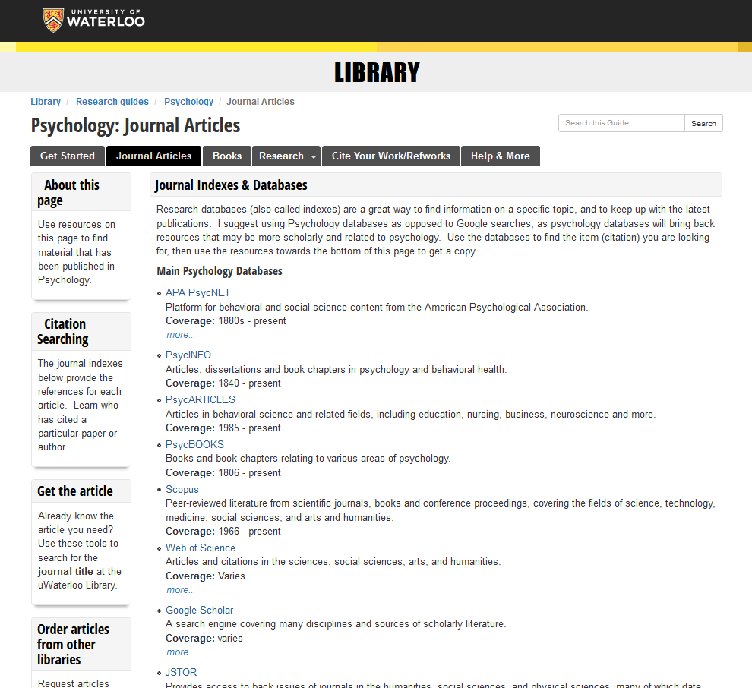

Slide 22
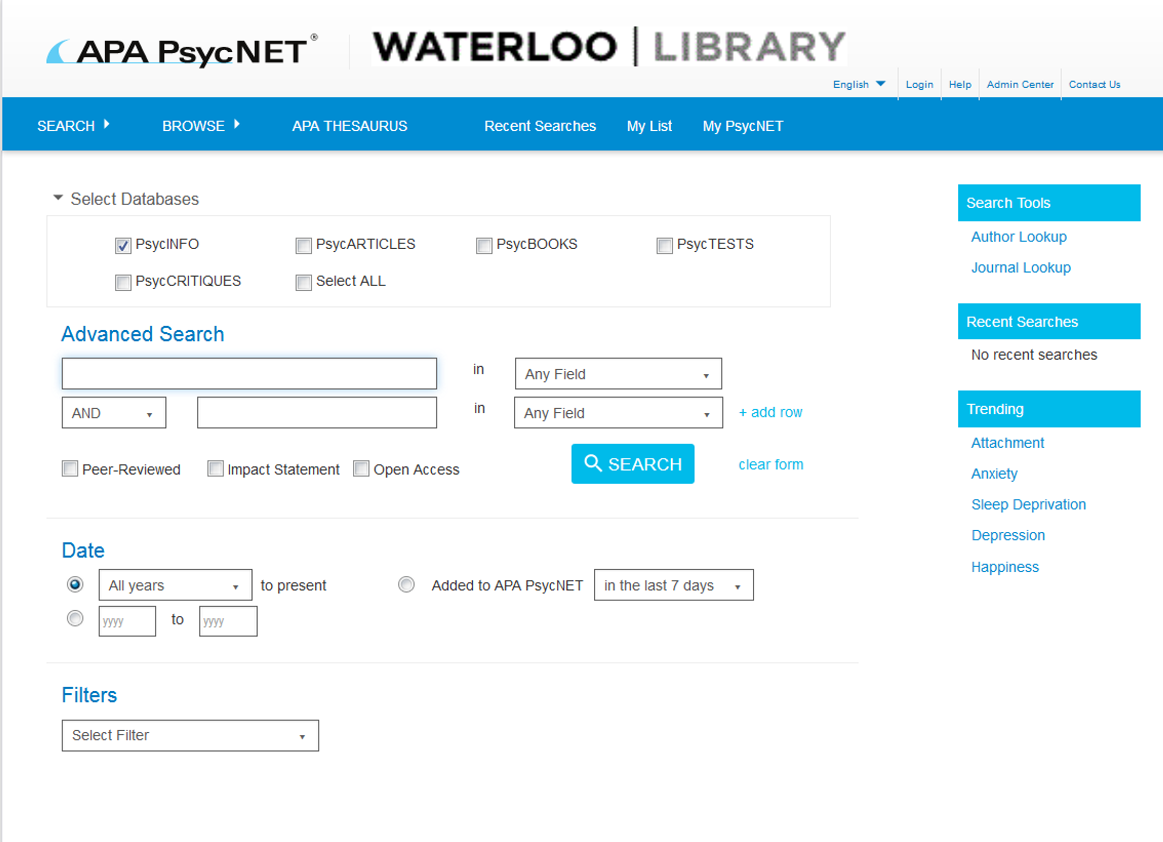
Writing a journal article

Slide 23
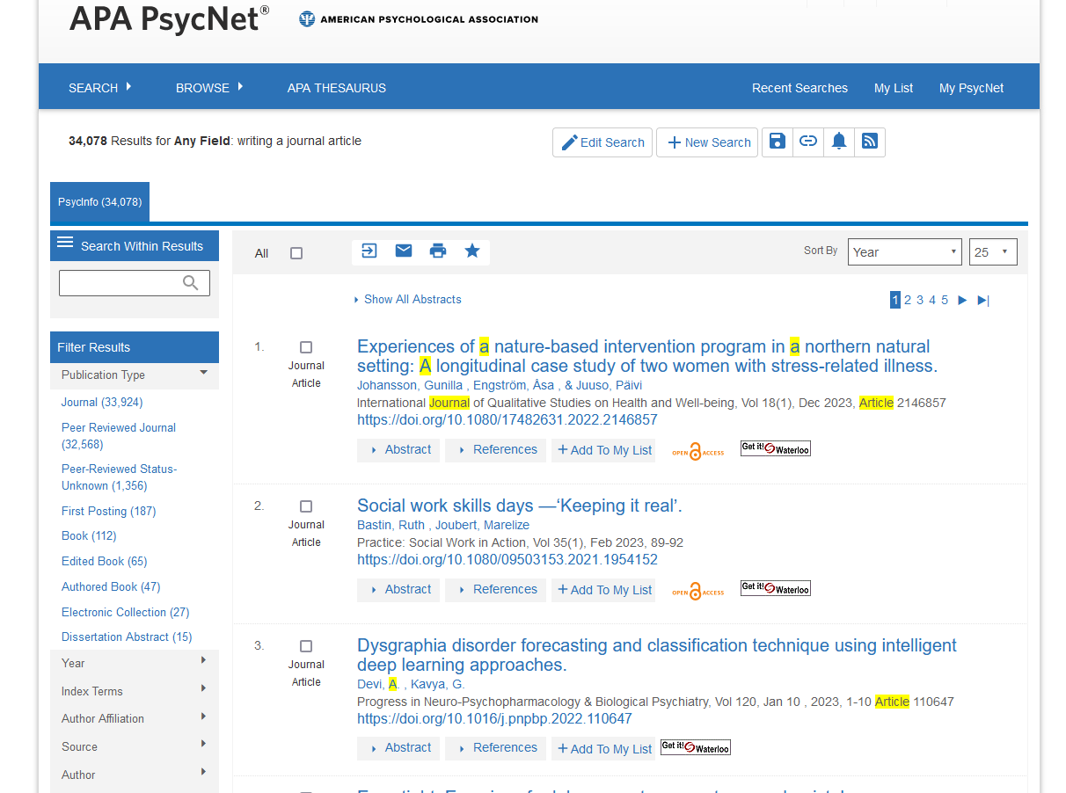

Slide 24
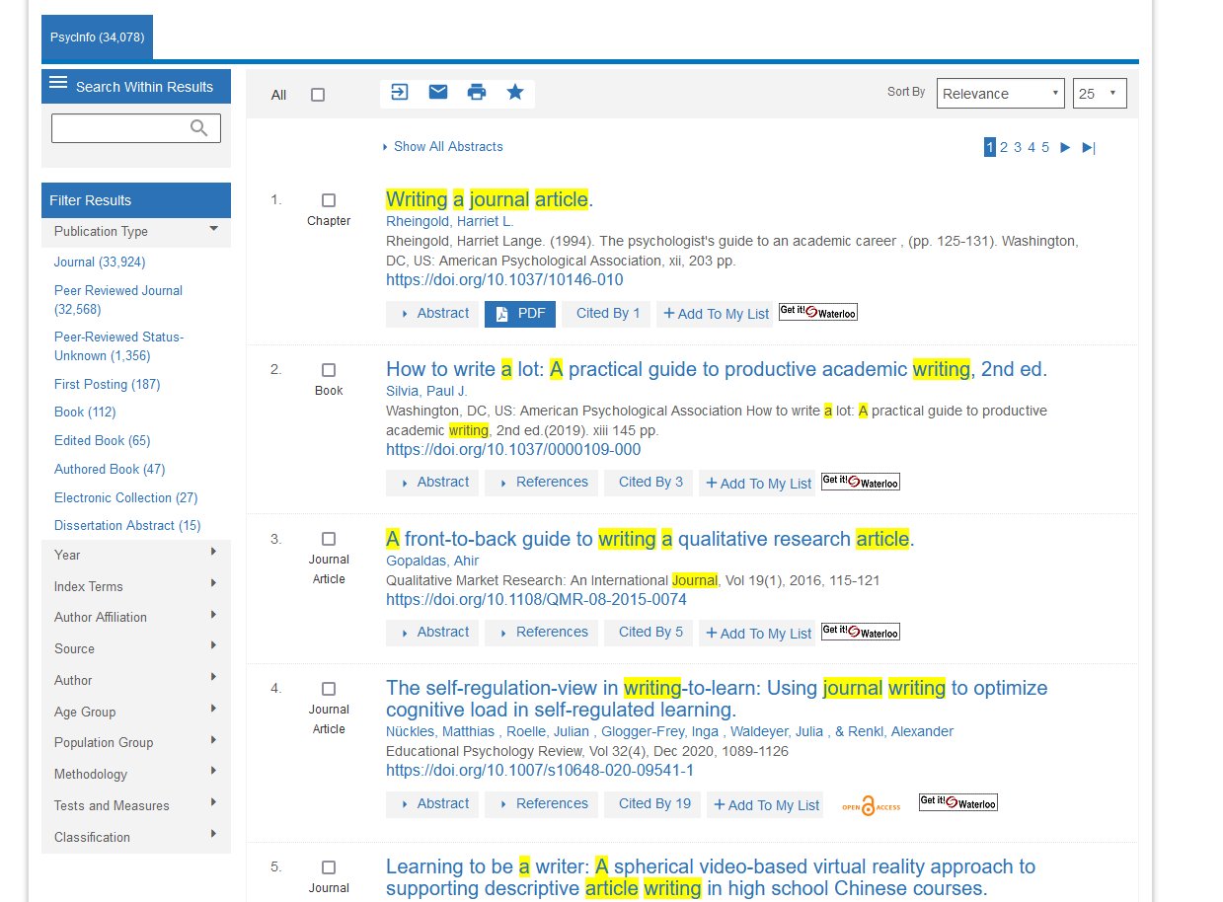

Slide 26
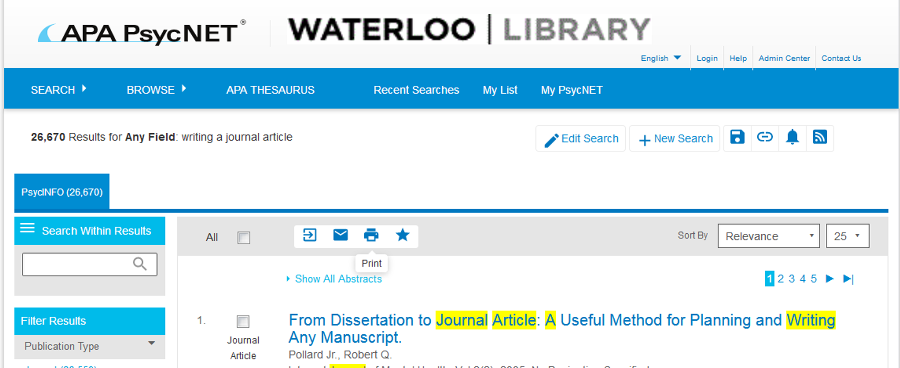
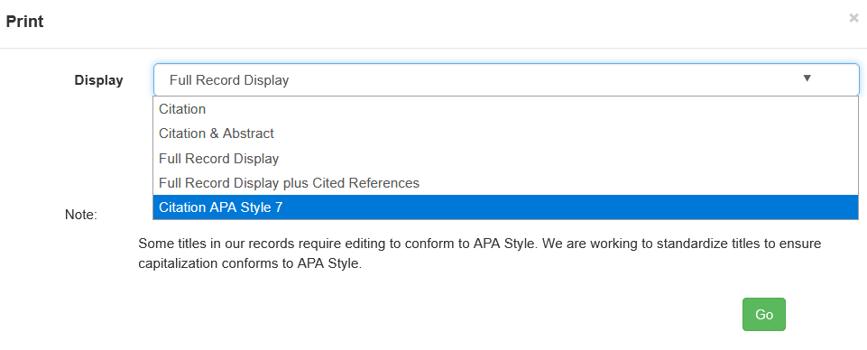

Slide 29
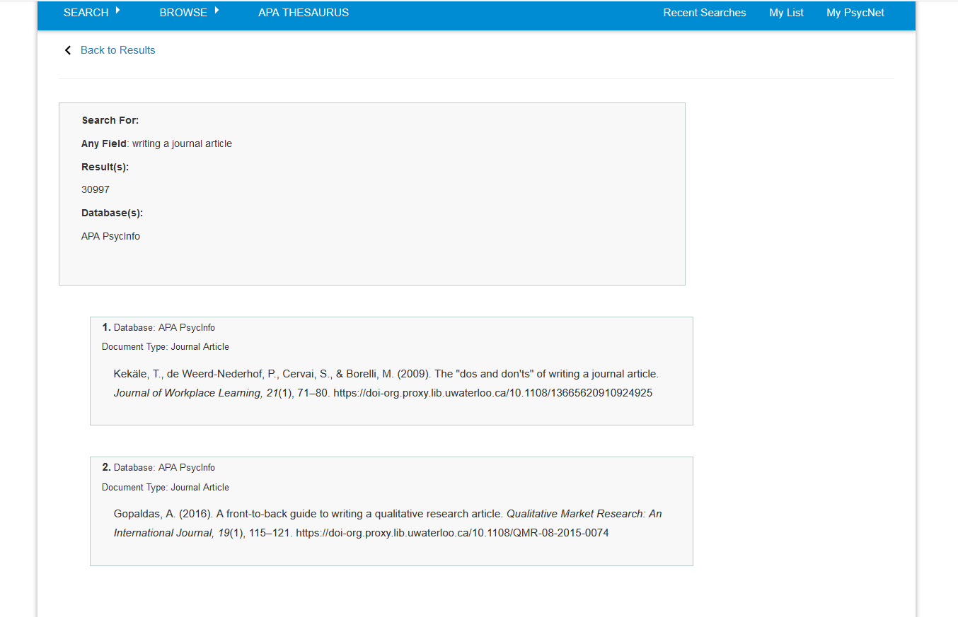
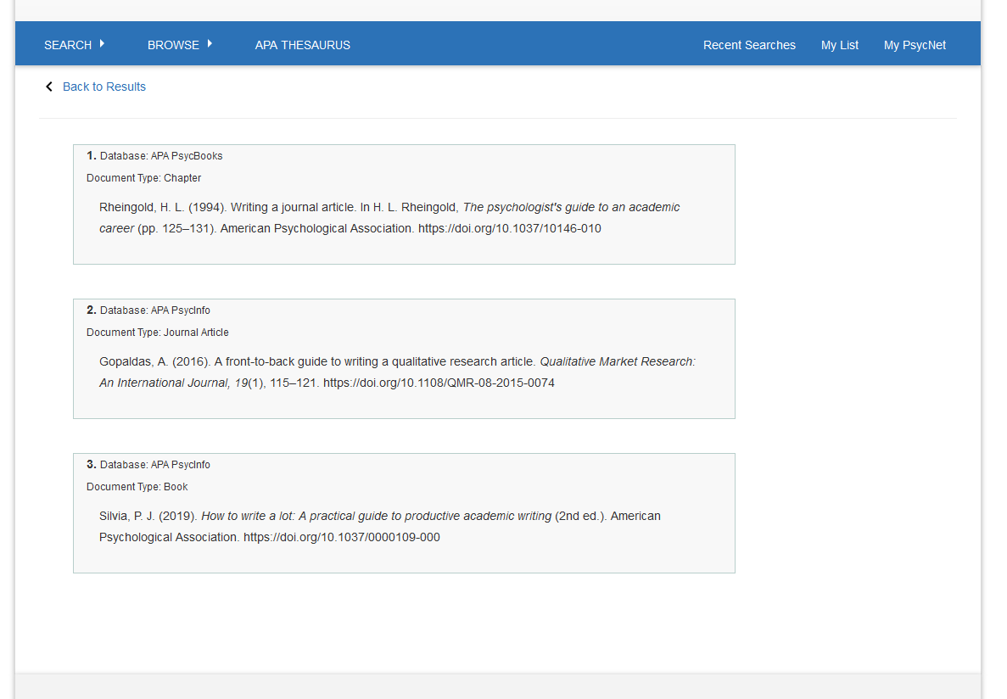

Slide 30
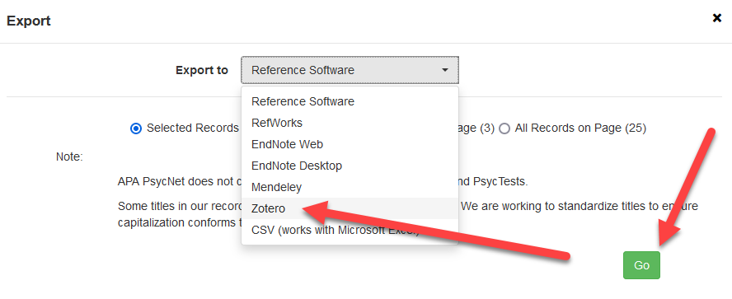

Slide 31
Downloads a RIS file

Slide 34
Lets see what we can do…
WARNING-TEASER

Slide 35
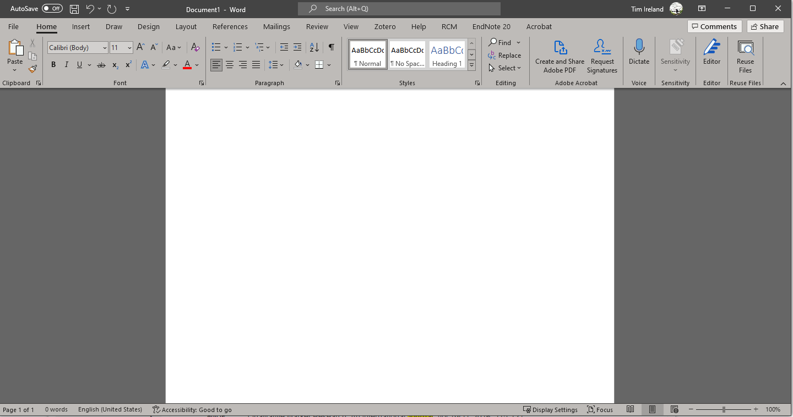

Slide 36
You then type your paper and when you get to a location where you are including an idea or thought that is not yours, you need to insert a citation.

Slide 37
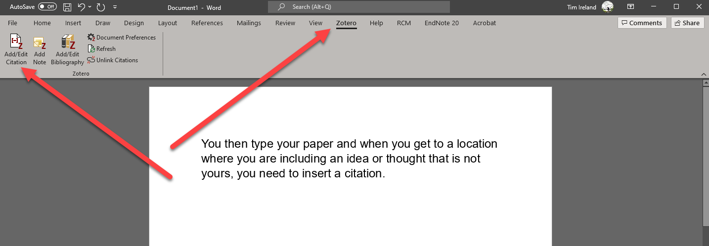

Slide 40
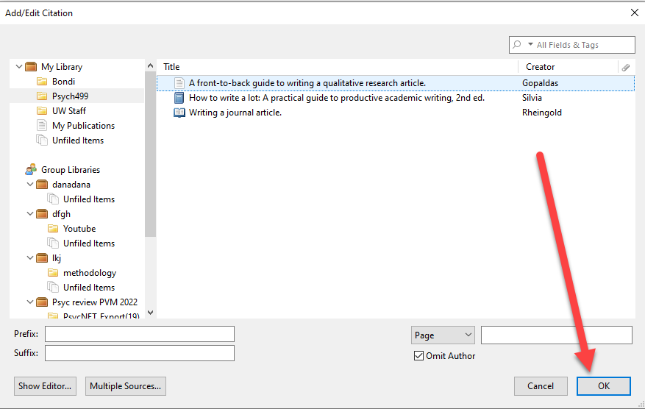

Slide 44
We need a bibliography!!!

Slide 45
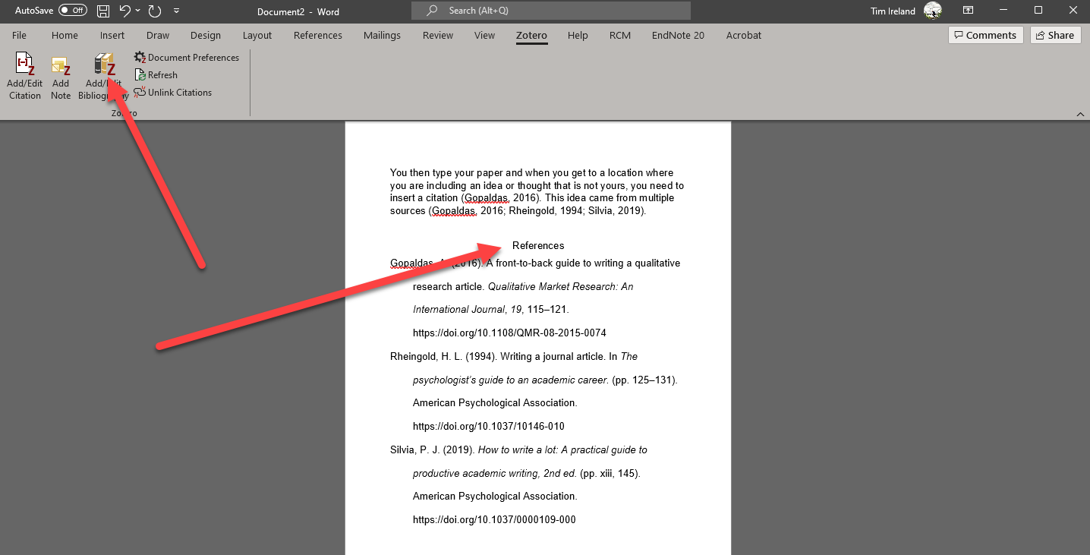

Slide 46
Zotero
Seems easier to pick up and use
Contact me if you would like me to help you get set up.
University has purchased Institutional Storage!

Slide 47
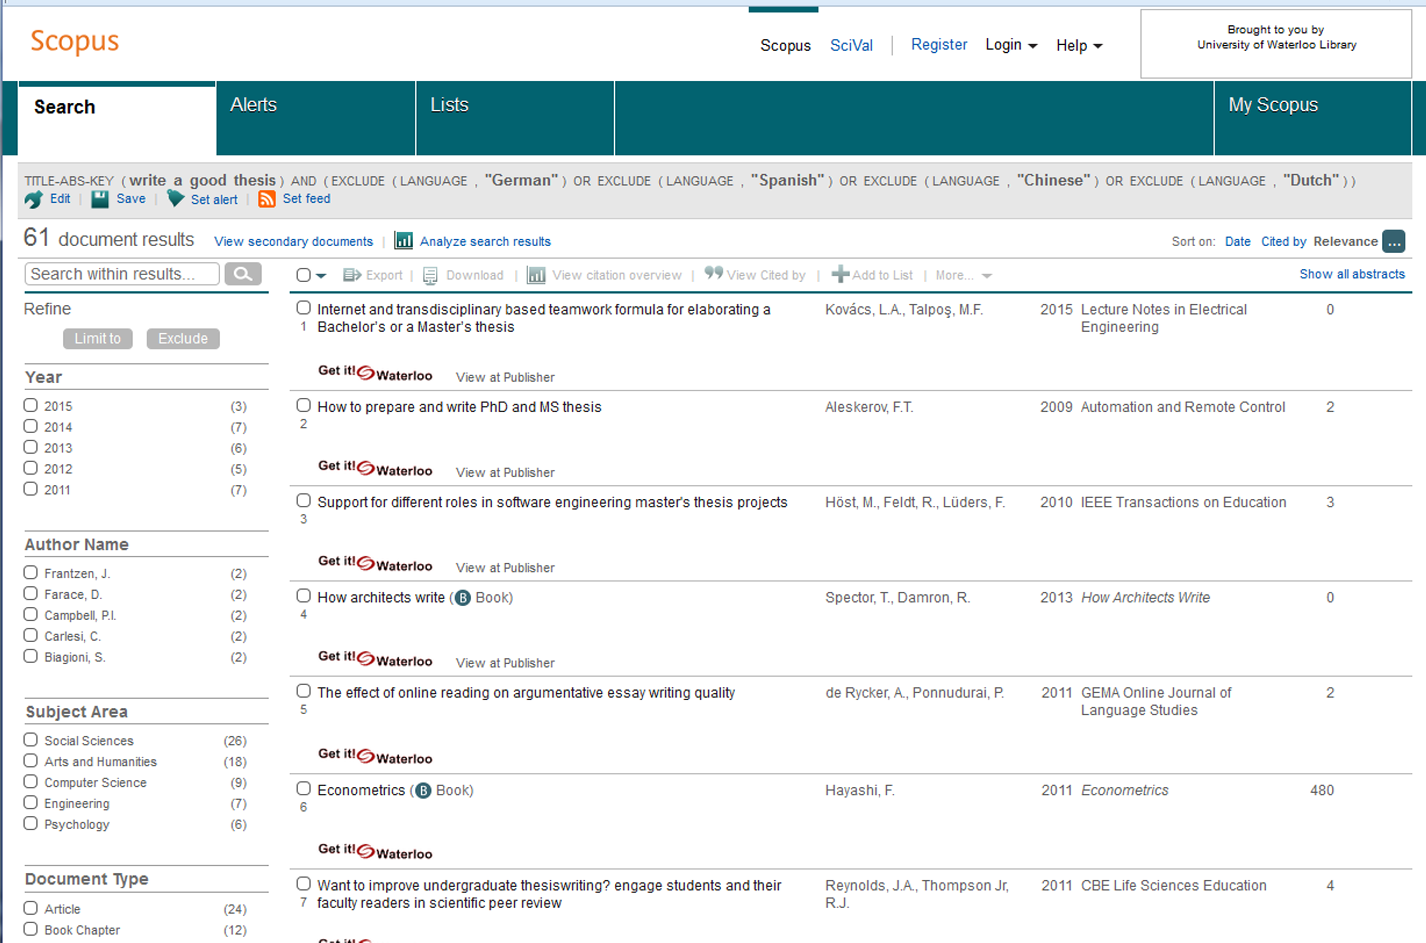
Scopus

Slide 48
PsycINFO vs Scopus
PsycINFO | Scopus
2395 Journals | 24008 Journals
Search Methodology | Times Cited
Focus on Psychology | Multidisciplinary
APA | Elsevier
Excellent controlled vocabulary | Inherited controlled vocabulary
Can specify peer review | All journals peer reviewed

Slide 49
Contact me!
Let me know if you would like to book an appointment with me for an hour (or more)!
Online tutorial
https://lib.uwaterloo.ca/online_learning/sites/default/files/learnings/Psych_499_final/#/
Tim Ireland
tireland@uwaterloo.ca
519-888-4567 X 45061

