Slide 1
Ethics Applications for Honours Thesis

Slide 2
Research Ethics
Information Session
June 11th – PAS 4032
10 – 11 am
If you have questions about research ethics
How to start an application
What resources are available
A question specific to your study
This session may be of help

Slide 3
Have more questions?
Beginning May 15th there will be
Drop-In Sessions
held every Wednesday
throughout the term until July 31st
10 am to 12 pm
at the
Dana Porter Library
study booth

Slide 4
Checklist for submitting your Ethics Application (see Honours Thesis Handbook)
~
Step 1 TCPS2 (CORE) Ethics Tutorial
Step 2 Create an ethics application
Step 3 Research Proposal
Step 4 Oral Presentation
Step 5 Receive Full Ethics Clearance
Step 6 Amendments

Slide 5
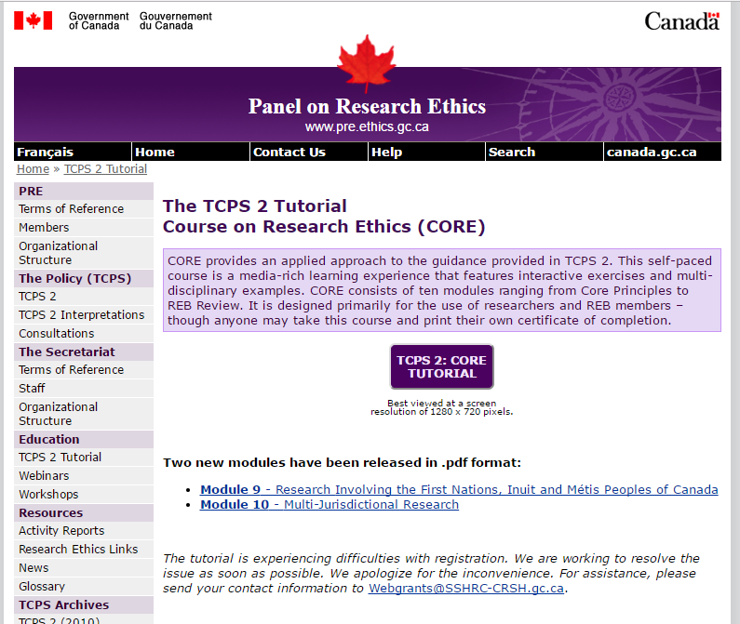
Step 1
TCPS2 (CORE) Ethics Tutorial
http://www.pre.ethics.gc.ca/eng/education/tutorial-didacticiel/
Go to the URL above and click on this link to start tutorial
This tutorial must be completed BEFORE an ethics application is submitted.

Slide 6
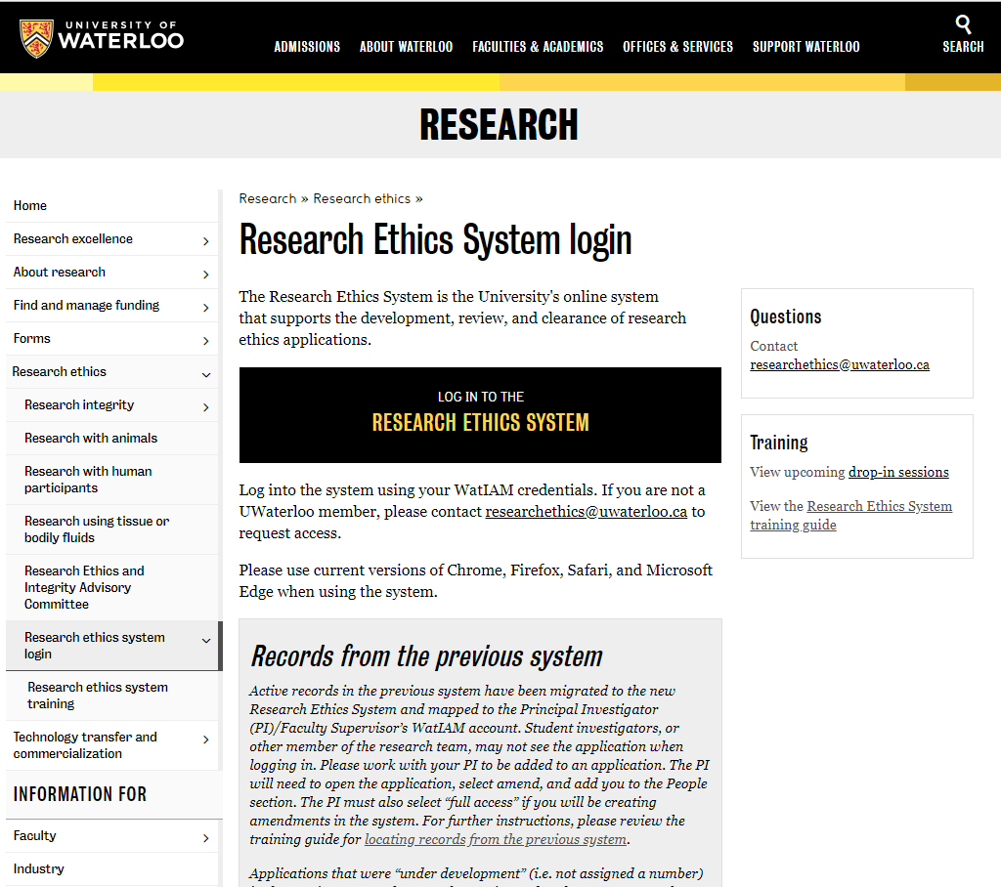
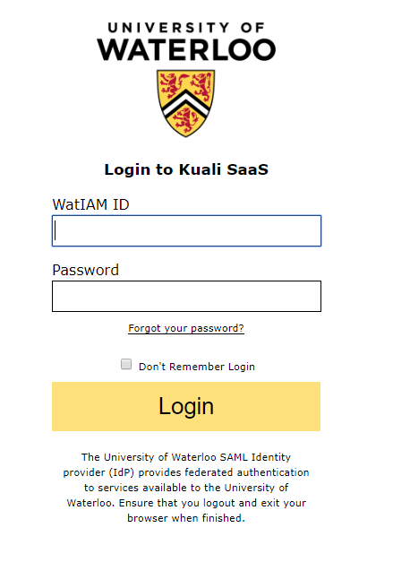
Step 2 – Create an ethics application (previously a Form 101)
You must received Full Clearance before data collection can start
NEW
To gain access to Kuali (the ethics system) you will need to log in using your WatIAM credentials, then log out.
You will then be able to log in and start an ethics application/amendment.
Log in at the Office of Research Ethics’ website at:
https://uwaterloo.ca/research/office-research-ethics/research-ethics-system-login
A training guide is also available from this web page.

Slide 7
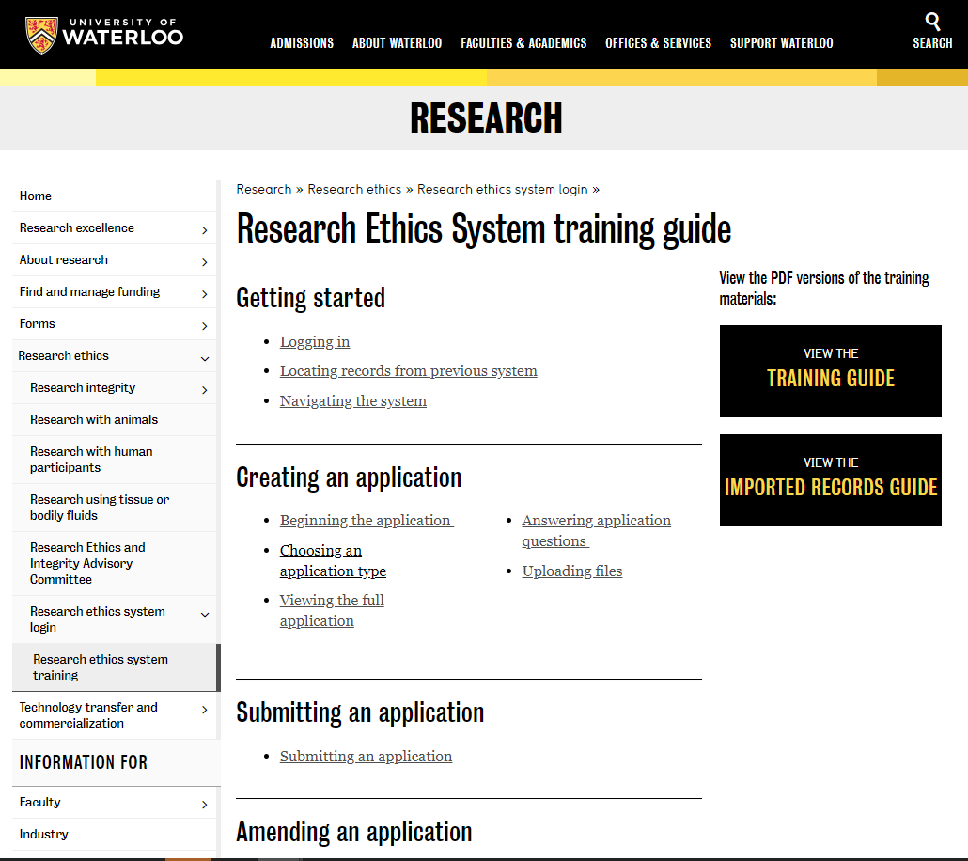
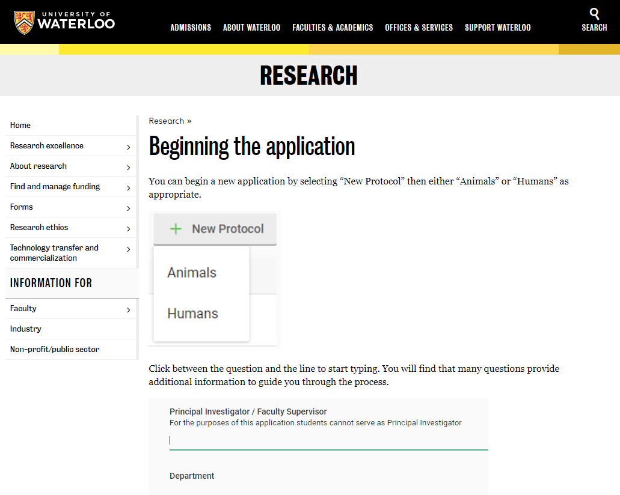
Step 2 – The Research Ethics System training guide
The training guide for the New Research Ethics System (available at https://uwaterloo.ca/research/office-research-ethics/research-ethics-system-login/research-ethics-system-training-guide) provides information on getting started in the system, creating an application, and amending an application.
The Faculty Supervisor is to be listed as the Principal Investigator and needs to submit the application/amendment for review.
NO MORE PAPER

Slide 8
Step 2 – Submitting the ethics application (previously a Form 101)
The Faculty Supervisor submits the application. Please contact them when this process is ready to be completed.
If there are any errors, the Faculty Supervisor will be notified at the top of the application.
Once the application has been submitted by the Faculty Supervisor (listed as a Principal Investigator), the DERC Officer will assign it for review.
Once submitted, you can check the status of the application at the top of the application.

Slide 9
Step 3
Research Proposal
Reviewed/approved by Supervisor
Step 4
Oral Presentation
To receive departmental approval of project
Step 5
Receipt of ORE Full Clearance
Data collection may begin
WARNING!! Allow 3 – 4 weeks to obtain Full Ethics Clearance

Slide 10
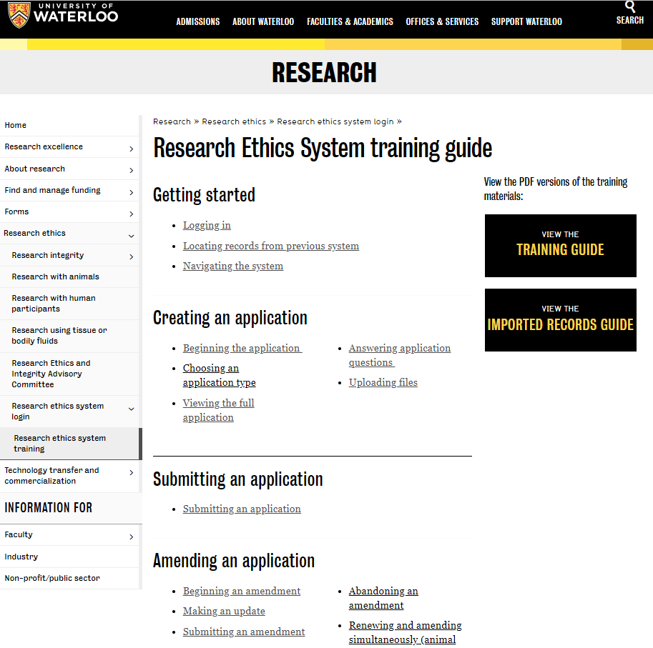
Step 6 – Submitting an Amendment (previously a Form 104 or Modification)
Amendment – used if revisions are necessary after Full Clearance obtained.
An Amendment involves updating the application on the system.
Instructions can be found in the training guide at https://uwaterloo.ca/research/beginning-amendment .
All revised materials must be uploaded to the system in the appropriate section(s).
Add a line and then drag and drop the documents.
If you are replacing a previous document or submitting a revised document please make sure you click ‘replace’ so that only the correct/updated document is approved.
It is requested that the documents be in PDF format.

Slide 11
Exemptions
NEW
We no longer offer exemptions to an existing protocol.
A new application IS REQUIRED even if the project involves supplemental or re-analysis of existing data.
You must be identified as a ‘Student Investigator’ and your Faculty Supervisor is to be identified as the ‘Principal Investigator’.
For the level of research select ‘Undergraduate (honours) thesis’ in the ‘General details’ section of the application.
Please contact the DERC Officer is you have any questions.

Slide 12
REG/Sona
If you will be using the Sona Participant pool you will need to:
Step 1: Complete TCPS2 (CORE) Ethics Tutorial
http://pre.ethics.gc.ca/eng/education/tutorial-didacticiel/
Step 2: Complete the Sona Full Researcher Training Session
(see REG website https://uwaterloo.ca/research-experiences-group/researchers/reg-dates )
Submit your email requesting session date to regadmin@uwaterloo.ca
Include your supervisor’s name and identify that you are an Honours Thesis student
Step 3: Create your Study on Sona
Guidelines posted at
https://uwaterloo.ca/research-experiences-group/researchers/sona-study-creation-approval-visibility
NOTE:
Do you need REG/Sona Prescreen question(s) and/or Mass Testing scale(s)?
Discuss this with your supervisor (i.e. - need to recruit specific groups)
Advise/discuss with REG Coordinator early on
Don’t wait until the term when you are planning to collect data as these surveys are created in advance of each term

Slide 13
Contact Info
REG/Sona (credit/pay studies)
REG Coordinator/Sona Administrator
Michelle Manios regadmin@uwaterloo.ca
REG Researchers’ Homepage
https://uwaterloo.ca/research-experiences-group/researchers
Full Researcher Training Sessions (mandatory even if completed RA training)
Email the REG administrator requesting session date (at regadmin@uwaterloo.ca)
Psych Delegated Ethics Review Committee (DERC)
DERC Officer: Michelle Manios mamanios@uwaterloo.ca
Office of Research Ethics (ORE)
ORE Research Ethics: Joanna Eidse jeidse@uwaterloo.ca
Vanessa Buote vanessa.buote@uwaterloo.ca
PSYCpool (pay studies)
PSYCpool Coordinator: Michelle Manios, psycpool@uwaterloo.ca

