Slide 1
NSERC McDonald Fellowship Information Session
Alfred Yu Waterloo Awards Committee

Slide 2
Meeting Agenda
Opening Remarks by Waterloo Awards Committee Co-Chairs
General Information About McDonald Fellowship
Dialogue with Prof. Aiping Yu – 2020 NSERC Steacie Fellow
Overview of UW Internal Review Protocol

Slide 3
Opening Remarks by WAC Co-CHAIRS

Slide 4
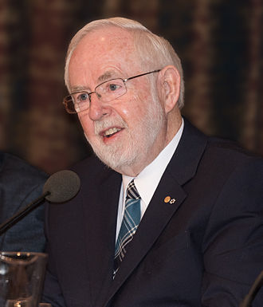
Arthur B. McDonald Fellowship: General Overview
Recipient of Nobel Prize in Physics (2015)
“for the discovery of neutrino oscillations, which shows that neutrinos have mass”
Professor Emeritus, Queen’s University
Recognizes early-stage academic researchers in the natural sciences and engineering and support them to enhance their research capacity, so that they can become leaders in their field and inspire others.
NSERC awards up to six McDonald Fellowships each year
Award package: 1) $250,000 research grant; 2) full teaching & internal service release for two years
Previously called the E.W.R. Steacie Memorial Fellowship (1965-2021)

Slide 5
Self-Nomination Process: Eligibility and Requirements
Eligibility criteria: 1) Holds NSERC grant(s) in PI capacity, 2) Within 10 years of the first independent appointment (on or after June 1, 2013 for the current round)
Eligibility period can be extended if there were career delays (e.g., 1-month delay ➔ 2-month extension)
NSERC’s definition of independent academic position:
University faculty appointment (including adjunct and non-tenured)
Doing research not under the direction of another individual
Authorized to supervise / co-supervise research students (including undergrads) and postdoctoral fellows
Only self-nominations are accepted. The dossier comprises these components:
6-page self-nomination letter (3 pages for “candidate statement” + 3 pages for “future directions”)
NSERC Form 100 (i.e., the NSERC applicant CV for Alliance Grant applications; not the CCV)
Other forms such as Form 101, suggested referees, etc.

Slide 6
Key Dates for the Current Round
Internal application deadline: October 16, 2023
Internal adjudication needed: Each institution may only submit 6 self-nominations to NSERC
Sponsoring institution is required to certify a candidate’s eligibility
All received nominations will be engaged in an in-depth internal review process founded on the three evaluation criteria set forth by NSERC
Internal review results will be announced in mid-November
External application deadline: December 14, 2023
Applicable to the six UW-selected candidates

Slide 7
NSERC’s Evaluation Process
NSERC determines the winners via a two-stage selection process
Stage 1: Peer review assessment on three criteria: 1) Research Achievements and Impact (40%), 2) Outreach, Mentorship and Leadership (30%), 3) Future Directions (30%)
Stage 2: Committee discussion and ranking of applicants based on the external review reports
Success rate: <5%
6 winners are selected from >100 applicants in the national competition
U15 institutions typically use their full quota of 6, plus there are other applicants from smaller universities

Slide 8
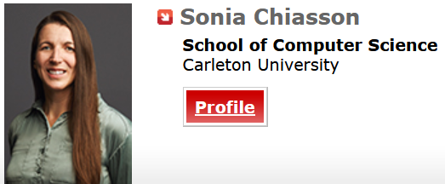
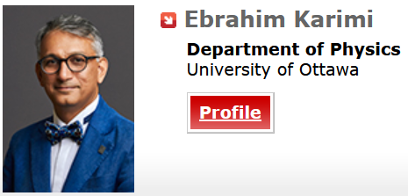
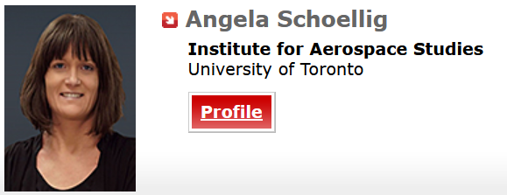
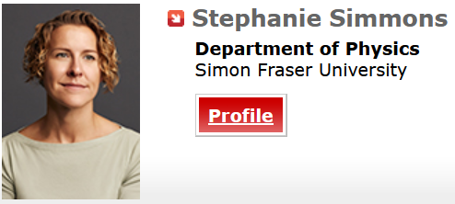
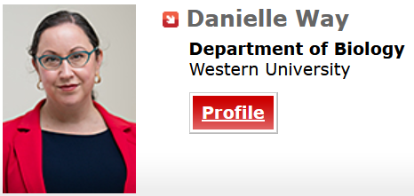
McDonald Fellowship Recipients in 2022

Slide 9
Dialogue with Prof. Aiping Yu
NSERC Steacie Fellow (2020)
University Research Chair
Professor of Chemical Engineering

Slide 10
Guiding Questions for Discussion
How has the Steacie Memorial Fellowship helped to accelerate your research program and your career development?
Why should we still consider applying for the McDonald Fellowship even though the success rate is not high?
How to best demonstrate one’s achievement and impact in a self-nomination dossier?
What other advice do you have for prospective applicants?

Slide 11
2023/24 Internal Adjudication at UW: The Key Elements
Adherence to NSERC evaluation criteria
Reviewers will each provide a written report on a candidate’s strengths and weaknesses in 1) Research Achievements and Impact (40%), 2) Outreach, Mentorship and Leadership (30%), 3) Future Directions (30%)
Standard-based evaluation
Reviewers will not be asked to rank applicants (since it is a norm-based evaluation method)
Reviewers will give an initial rating to each criterion (for the purpose of setting discussion order)
All eligible applications will receive full review (written feedback + committee discussion)
Mitigation of reviewer bias
Inappropriate use of bibliometrics will be discouraged: Impact does not refer to quantitative indicators such as the impact factor of journals or h-index
Every committee member must complete UW’s EDI training module

Slide 12
2023/24 Internal Adjudication at UW: The Key Elements
Conflict of interest management
Any of the following non-arm's length relationships constitute a perceived conflict of interest:
Past supervisors, past students, past labmates, and/or relatives
Co-authors of publications and/or co-applicants of funded grants in the past 5 years
Co-supervisors of graduate students in the past 5 years
Colleagues from the same department (not considering cross-appointments)
Colleagues who used to be affiliated with the same department in the past 5 years (whether at UW or elsewhere)
Committee members in conflict will not review or have access to the application in question, and they will be placed in the lobby before the discussion on that candidate begins

Slide 13
Stage 1 – Reviewer Assignment
Reviewer Assignment
Written Assessment
Committee Meeting
Score Compilation
Decision Notification
Each application will be assigned to 3 reviewers
No fewer than 1, but no more than 2 reviewers will be from the applicant’s home faculty
Conflict of interest relationships will be declared before reviewer assignment takes place
An online pre-meeting will be organized with the committee members
Purposes: 1) To inform reviewers of the internal adjudication protocol, 2) To go over the evaluation criteria to be used

Slide 14
Stage 2 – Written Assessment
Reviewer Assignment
Written Assessment
Committee Meeting
Score Compilation
Decision Notification
Each reviewer will provide written comments to an assigned application
Critique will focus on evaluating a candidate’s strengths and weaknesses in each of the three NSERC evaluation criteria (1. Research Achievements and Impact; 2. Outreach, Mentorship and Leadership; 3. Future Directions)
Reviewers will give a preliminary rating to each evaluation criterion
Ratings will correspond to descriptors (no explicit numerical scoring)
Example: Rating descriptors for the Research Achievement and Impact criterion
1) Inadequate (Premature), 2) Emerging (Good Potential), 3) Strong (Demonstrated Achievements), 4) Excellent (Convincing Evidence of Impact), 5) Outstanding (Likely Best in the Field)

Slide 15
Stage 3 – Committee Meeting
Reviewer Assignment
Written Assessment
Committee Meeting
Score Compilation
Decision Notification
Before the committee meeting, award officer compiles the average preliminary rating for all applicants to determine discussion order
Preliminary ratings and algorithm for discussion order will not be disclosed to the committee (to mitigate reviewer bias)
Each application will be given 15 minutes for discussion
10-minute summary discussion by the three reviewers
5-minute open discussion by the committee (members not in conflict will have access to the application)
Co-Chairs will take meeting notes to summarize the discussion

Slide 16
Stage 3 – Committee Meeting
Reviewer Assignment
Written Assessment
Committee Meeting
Score Compilation
Decision Notification
At the end of discussion:
Reviewers 1, 2, and 3 each give an overall merit rating to provide a voting rating range
Other committee members vote confidentially within the rating range
Out-of-range voting is only allowed if it is disclosed to the committee at the time of voting
Co-Chairs also vote for the record, but the vote is not counted unless tiebreaker is needed
Committee members send all scores to the Award Officer at the end of all evaluations

Slide 17
Stage 4 – Score Compilation
Reviewer Assignment
Written Assessment
Committee Meeting
Score Compilation
Decision Notification
Award officer compiles all scores and generate a ranked list
The top-6 candidates are selected for the national competition
In the case of a tie, the following tiebreaking rules will be applied
First tiebreaker: Priority is given to an applicant from an FDG group
Second tiebreaker: Preference is given to an applicant from an underrepresented faculty
Third tiebreaker: Preference is given to an applicant who is in their final year of eligibility
Forth tiebreaker: Preference is given based on the Co-Chairs’ vote

Slide 18
Stage 5 – Decision Notification
Reviewer Assignment
Written Assessment
Committee Meeting
Score Compilation
Decision Notification
Award officer will inform applicants of the internal adjudication decision
Verbatim feedback from the 3 reviewers will be released to the applicants
Summary notes on the committee’s discussion will also be provided

