Slide 1
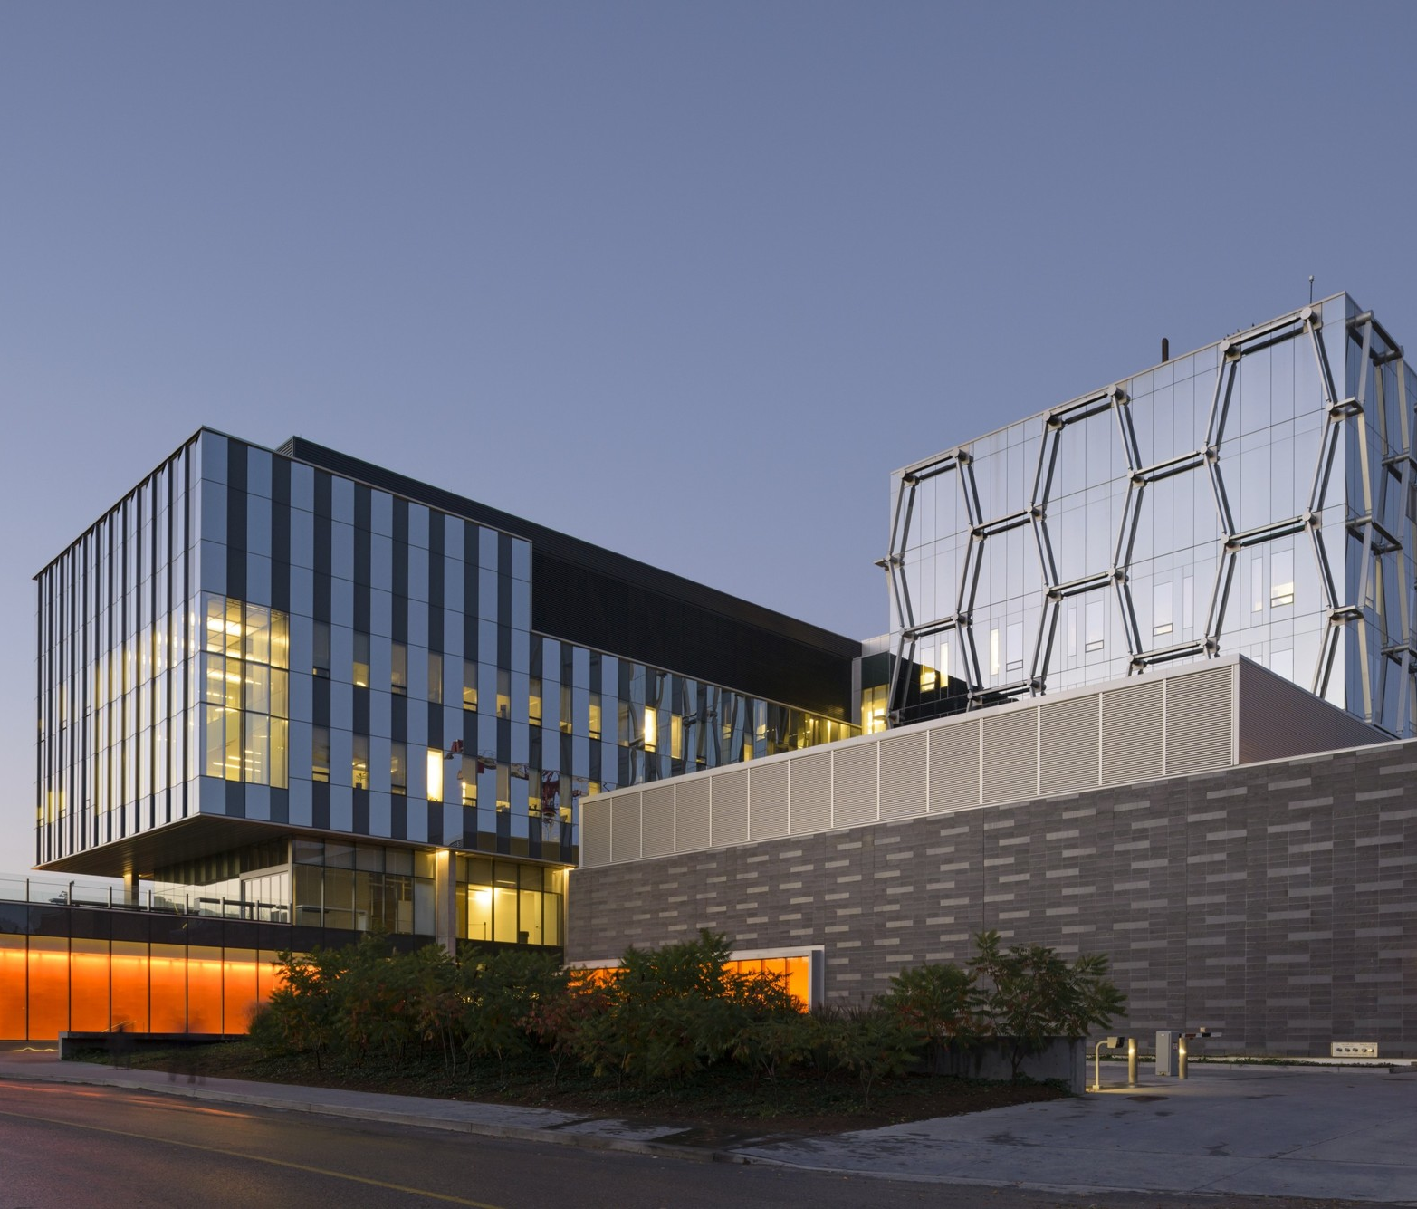
NSERC Alliance International Grants
Michele Van Dyke
Corporate Research Partnerships Manager
Office of Research
mvandyke@uwaterloo.ca
Aug 25, 2022

Slide 2
Alliance International grants
https://www.nserc-crsng.gc.ca/innovate-innover/AllianceInternational-AllianceInternational/index_eng.asp
Very different type of grant compared with regular NSERC Alliance grants
Grant is only for academic collaborations
NO partner organization required and should not be included
Must include international academic collaborator who holds a regular faculty position at a university or degree-granting institution
Collaborator cannot be located at a government laboratory or research institute
Apply for any NSE research area
Apply anytime, NSERC provides 100% of direct costs for Canadian researcher(s)
Additional info available from NSERC and at Office of Research SharePoint site

Slide 3
Alliance International grants – 2 options
Option 1 –International Catalyst grant
For initiating and developing new research collaborations with international academics
$25,000 for 1 year
Limited to one application per year (as applicant or co-applicant)
Option 2 – International Collaboration grant
Provides funds for Canadian academics to participate in international projects
Higher value; up to $100,000 per year for 1 - 3 years
Limited to one application per year (as applicant or co-applicant)

Slide 4
Alliance International Catalyst grant - purpose
Intended for initiating and developing new research collaborations with international academics, and to serve as foundation for larger partnership in later years
Can apply with a current international collaborator if initiating a new project area (cannot use for pre-existing project or area of research)
Not intended to be used solely for a stand-alone research project; but to serve as basis for larger project/proposal opportunities with collaborator
Support for meetings, training, student exchanges, exploratory research activities
Travel and travel-related subsistence
Meeting costs
Salary for research trainees (undergraduates, graduates and postdoctoral fellows), technicians, research professionals
Materials and supplies, knowledge mobilization

Slide 5
Alliance International Catalyst grant - criteria
Proposals are only 3 pages long (+ budget/justification; CCV; collaborator bio[s]).
Can include other Canadian academic co-applicants
The applicant and each co-applicant must hold an active peer-reviewed grant from NSERC at the time of application (e.g. Discovery grant)
Limited to on Catalyst grant application per year as applicant or co-applicant
If applicable - can apply for both one Catalyst and one Quantum Catalyst grant per 12−month period
Proposals are reviewed by NSERC file managers (not sent out for peer review)
2 - 3 months for decision

Slide 6
Alliance International Collaboration Grant
Up to $100,000 per year for 1 - 3 years (100% from NSERC)
Will match up to the value of a proposal submitted by international collaborators to their national funding agency
International grant must be funded by government funding organization (similar to NSERC) with no partner organizations involved
Alliance applicant must be named and role defined in the international grant proposal
International proposal must have total value at or above amount requested from Alliance
Must provide copy of the international grant proposal with Alliance submission

Slide 7
Alliance International Collaboration Grant
You have up to 3 months after international grant is awarded for Canadian PI to apply to NSERC for ‘Alliance International Collaboration’ grant
Remains a 3-page Alliance proposal (same template at Catalyst grant)
Can include other Canadian academic co-applicants
The applicant and each co-applicant must hold an active peer-reviewed grant from NSERC at the time of application
Limited to one Collaboration grant application per year as applicant or co-applicant
Proposals are reviewed by NSERC file managers
2 - 3 months for decision

Slide 8
Alliance International grantS – application process
International grant application instructions and template at this link
When applying using NSERC on-line system - ensure that you select correct ‘type of call’ from the drop-down menu. Note that there is also a quantum-specific Catalyst option – do not select unless your project is in quantum area.
Application must include a training component (undergraduate, graduate and/or postdoctoral trainees) – cannot be used only for research professional costs.
Funding can only be used for NSERC eligible direct project costs incurred by Canadian applicants
Follows Tri-agency guide on financial administration.
Cannot be used to pay for costs incurred by international collaborator(s)

Slide 9
Alliance applications – tips
Equity diversity & inclusion (EDI) section is very important
Application instructions including proposal template (Word document) are available on each program websites
Must include and adhere to the section headings provided in the template
Must use same formatting (font, margins etc.) as the template
Proposal length depends on grant type & value (refer to tables shown in on-line instructions)
Contact Office of Research early to indicate you will be applying for a grant
Ensure you get signatures and submit an Office of Research Cover Sheet ahead of proposal submission
NSERC security screening form not required (only required if project involves a private sector partner)

Slide 10
Office of Research contacts
Ibi Brown (ibi.brown@uwaterloo.ca)
Joanna Cleary (jldcleary@uwaterloo.ca)

Slide 11
Michele Van Dyke
mvandyke@uwaterloo.ca
Tel: 226-339-2927

