Slide 1
Microinsurance in International Development
University of Waterloo
Webinar: 8 February 2018
EXPERTS IN CREATING
INCLUSIVE DIGITAL
INSURANCE MARKETS

Slide 2
Agenda
What is microinsurance and the current state of play
Barriers to growth and how they can be overcome
What actuaries get wrong
Concluding thought

Slide 3
What is microinsurance?
Implications arising from target segment
Definition:
Microinsurance is a means of protecting low-income people against specific risks in exchange for a regular payment of premiums whose amount is proportional to the likelihood and cost of the relevant risk.
Source: Microinsurance Network
1. Never before insured
Trust
2. Small ticket insurance
Premium must be affordable
Understanding
Financial and insurance education
How to create a sustainable business AND provide customer value?
?
How is microinsurance different from “inclusive insurance”?
Inclusive is broader – cover previously excluded
Not necessarily low income
MI viewed as developing world

Slide 4
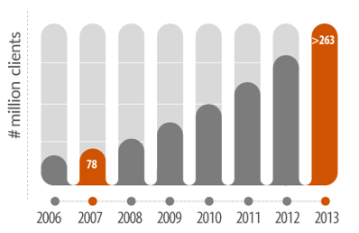
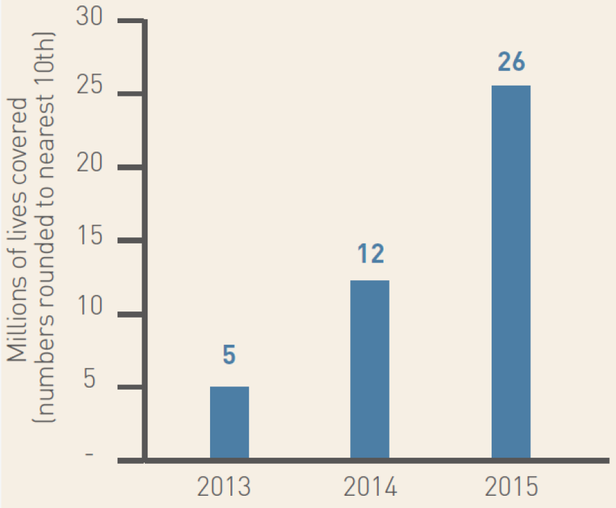
Rapid microinsurance growth
Driven by government, compulsion and free offerings
Asia MNO growth (# of lives) :
128% pa
Worldwide growth (# of risks):
22% pa
3 growth drivers
1
Government subsidies
2
Compulsory membership
3
Aggregator partnerships
Source: Microinsurance Network
Source: Munich Re Foundation
Source: Cenfri

Slide 5
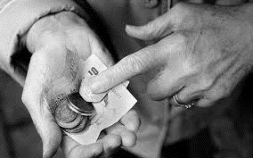
5 Barriers to growth
1. Trust
2. Financial literacy
3. Affordability
4. Distribution
5. Payment channels

Slide 6
How to overcome barriers?
1. Trust
4. Distribution
Balance high touch with low touch
Data analytics
Allow customers to experience insurance at low or no cost
Meet claim expectations
Partner with strong brands (e.g. MNO)
2. Financial literacy
Engaging customers as much as possible. (e.g. Juntos)
5. Payment channels
Partnerships (e.g. MNOs for mobile money and airtime)
3. Affordability
Understand customer willingness and ability to pay
Smart, technology enabled customer engagements (distribution, maintenance and claims)
Extremely simple products (3 text messages test)

Slide 7
What actuaries get wrong
Context of microinsurance
Both customer (risks faced, financial realities) and product provider (generally low skill levels)
Particularly when coming from developed insurance market
Taking a technical approach vs. business approach
Most challenges relate more to business issues than technical actuarial issues
Namibia direct mailing example
IAA – IAIS project on proportional actuarial services in microinsurance
When are actuarial skills required?
What level and type of skills are required?

Slide 8
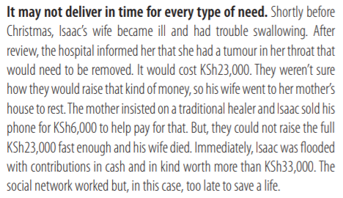
Conclusion
Huge potential for development, but need to overcome some big challenges
Source: Kenya Financial Diaries

Slide 9
Nigel bowman
Product & Distribution Executive
nigel@inclusivitysolutions.com
EXPERTS IN CREATING
INCLUSIVE DIGITAL
INSURANCE MARKETS

