Slide 1
UW NanoTool Instructional

Slide 2
Introduction
Outline of Process
The risk assessment involves examining material properties and intended activities.
The resulting information is combined in a meaningful way to obtain a risk.
The risk is associated with an appropriate control.
The next slide is a flowchart that outlines the decisions made by the tool

Slide 3
Introduction
Outline of
Process

Slide 4
Introduction
Structure of the tool
There are 4 sections in this tool
Section A: Enter material name and a brief description
Section B: Hazard Assessment
Section C: Exposure Assessment
Section D: Results of the Assessment – including required controls

Slide 5
Introduction
Overall Process
The risk assessment involves examining material properties and intended activities.
The resulting information is combined in a meaningful way to obtain a risk (calculated using the spreadsheet).
The risk is associated with an appropriate control.

Slide 6
Section A
Section A
View the description below:
Write any unique description for your process
The material name can be entered here

Slide 7
Section B
Section B: Is where you enter the properties of both the Nanomaterial and its Parent material.
In many cases, only information on the parent material is available – which is why each field has the option to select “Unknown”.
Below is a screen shot of Section B

Slide 8
Section B
Entering Data: All fields are drop down lists. Makes entry easy, quick, and standardized.
Example of drop down listing
Hazard calculated on worst score from parent or nano. If neither are possible worksheet gives error.

Slide 9
Section B
Entering Data: Buttons on top allow for quick entry.
Pressing this button sets these values to “Unknown”
Pressing this button sets all values in this table to “Unknown”
This button resets entire sheet.

Slide 10
Section B: Entry Fields
There are 5 Nanomaterial Fields:
Particle shape
Water Solubility
Diameter of particle
Size of agglomerate
Toxic effects
There are 2 Parent Material Fields:
OEL
Toxic effects

Slide 11
Section B: Entry Fields
Hazard ratings appear if sufficient data is entered.
Rating is based upon whichever is worst (parent or nano).

Slide 12
Section B: Entering Data
Entering Data: “Unknown”
Entering “Unknown” for all fields yields a “High” rating
There are two reasons for this:
To be protective.
To encourage researchers to find and understand the properties & hazards of the materials they are using.

Slide 13
Section B: References
It is not acceptable to make up data. You must have references for the values you enter. If you do not, then the risk assessment is invalid.
For example, indicating that a substance is not a carcinogen when there is no evidence to suggest it is or isn’t is not acceptable. In this case, you must enter “Unknown”.

Slide 14
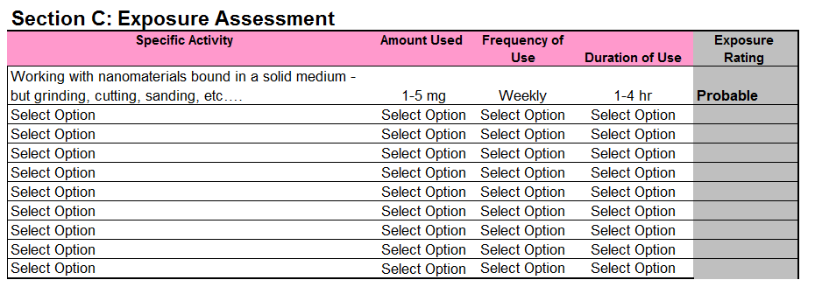
Section C: Exposure Assessment
The Exposure Assessment
This section is found immediately after the hazard assessment. It allows a user to enter multiple activities, and to assess each of these activities individually.

Slide 15
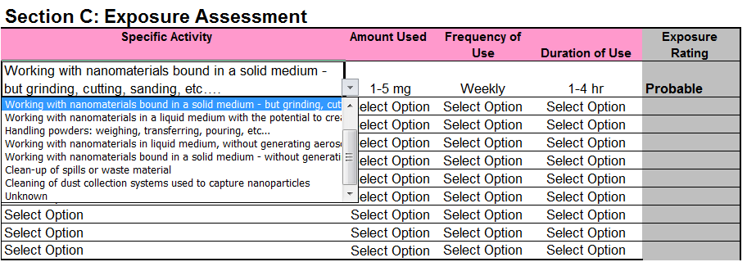
Section C: Entering data
The Exposure Assessment
Just like in Section B, all values are drop down lists. Each option will have a score associated with any choice that is made. The end result is an exposure score.

Slide 16
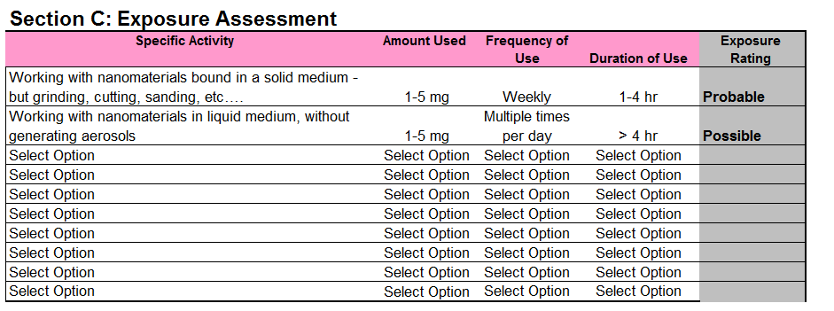
Section C: Multiple Activities
This sheet provides the ability to assess multiple activities. This way there is guidance through more of what the researcher may want to do.

Slide 17
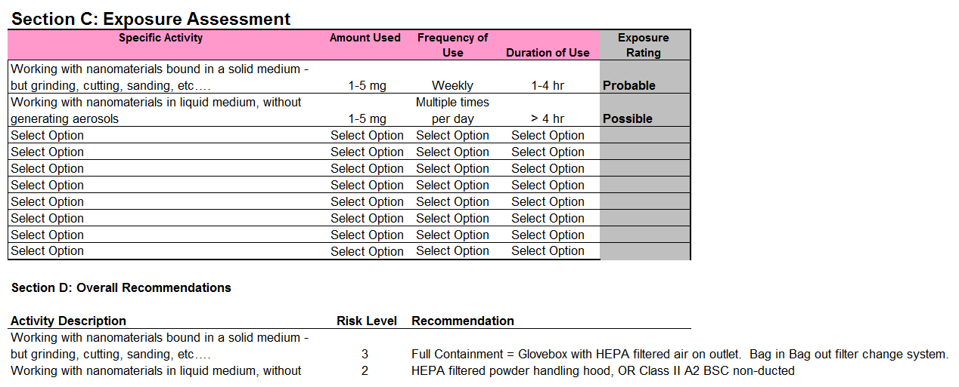
Section D: Results
Section D will recommend controls for EACH activity for this material
Recommended controls

