Slide 1
Aligning Assessment for Aspiring Actuaries
AFRIC Conference
July 25, 2023
Diana Skrzydlo

Slide 2
Alignment
Assessment is Curriculum
Authentic Assessment
Backwards Design:
  First, what do we want actuarial students to be able to do?
  Then, how will we assess them on these skills?
  Finally, how will our instructional practices prepare them?
Learning Outcomes
Assessments
Instructional Practices
Notes:
What we teach, what we ask students to demonstrate, and what they will actually need to do in the workplace should be well aligned & authentic
Authentic assessment is something meaningful, realistic
Backwards design takes the usual course design process (open the textbook and decide what topics to cover) and flips it around – start with the end in mind (what do we want them to be able to do), then figure out how we’ll know they can do it (assessments), and then decide the instructional practices that will guide them to be able to succeed on the assessments.
In this very brief presentation I’ll give some ideas for how authentic assessments can address the skills we want future actuaries to have. But what are those skills?

Slide 3
Learning Outcomes for Actuaries
Professional Skills
Technical Skills
Teamwork
Technical writing
Oral presentations
Give/receive feedback
Reflection
Data validation
Build/document models
Justifying assumptions
Actuarial judgement
Use data ethically
Anything else?
Notes:
Actuaries need both professional skills and technical skills (I don’t like the terms “hard” and “soft”)

Slide 4
Assignments/Tests/Exams
Explain whether a model is appropriate for a situation
Logically justify why mathematical results make sense
Describe how results obtained, justifying assumptions
State conclusions in context
Clean data and build/document model
Answer hypothetical client emails
Best practices
  Ask these kinds of questions consistently

Slide 5
Group Projects
Design and pitch a P&C Insurance product
  E.g. rideshare, social media liability, satellite, e-device
Build stochastic model to simulate VA gtee risk
  Incorporating different interest rate models, policy designs
Pick a topic, find data, and forecast using models
  E.g. unemployment, university enrollment, tourism, temp
Best practices for group work
  Accountability – within- and between-group peer evals
  Guidance on effective team work, meetings

Slide 6
Reports
Choice of articles to read and summarize
Discussing pros and cons of using rating factors
Memo presenting findings and recommendations of technical analysis
Summarizing product and making recommendation
Best practices for writing assignments
  Early-bird deadline to get feedback and resubmit
  Exemplars
Notes:
In addition to group projects

Slide 7
Presentations
Regular in-class questions
Persuasive
Individual research project
Summarizing material from other sources
Debates (genetic tests, vendor vs in-house models)
Best practices for presentations
  Make material part of curriculum
  Guidance on effective structure, slide design, delivery
Notes:
In addition to group projects

Slide 8
Reflective Writing
Reflect on goals and/or what they have learned
  Summarize important course concepts in plain language
  Describe a problem you struggled with but now understand
  Discuss what made you want to study this topic
  Explain whether you achieved your goals for the course
  What did you learn from an in-class activity or project
Best practices for reflections
  Give a framework: “What? So What? Now What?”
  Respond authentically

Slide 9
Oral Exams
Focus on explaining conceptual ideas in words
Able to ask for clarification
My format: 15-minutes, 5 questions
  Definition, Advantages/Disadvantages, Compare/Contrast, Describe a Process, Predict the Impact
Best practices for oral exams
  Clear expectations, rubric for fair grading
  Give students time to practice
Notes:
Define: captive insurer, CSM, universal life ins,
Adv/Disadv: using reinsurance, longevity swap, stochastic modelling, charging risk premium
Compare: Long vs short tail bus, PUC vs TUC, UL vs par vs VA, actuarial reserve vs hedge portfolio, one vs two factor mortality improvement model
Describe procedure: calculating normal cost for pension, building hedge portfolio,

Slide 10
How Can You Use These Ideas?
What are the skills future actuaries will need?
Design assessments that test those skills
Use instructional practices to help students succeed
Inspiration tips:
  Use what is happening locally and globally
  Keep a list of ideas and use when needed
  Let students drive the curriculum with their interests

Slide 11

dkchisho@uwaterloo.ca
@ActSciProf on Twitter
uwaterloo.ca/scholar/dkchisho/blog

Slide 12
Appendix - Additional examples and assessment types

Slide 13
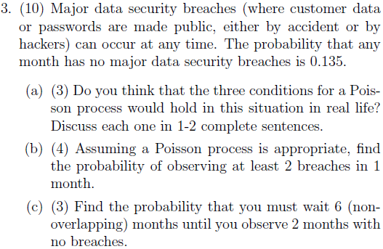
Example 1 – Probability (STAT 230)

Slide 14
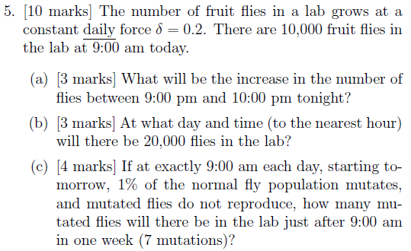
Example 2 – Financial Math (ACTSC 231)

Slide 15
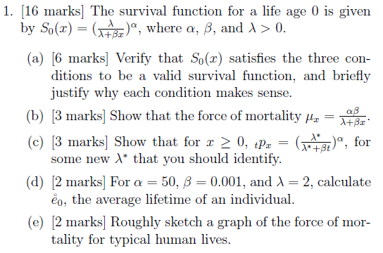
Example 3 – Life Cons 1 (ACTSC 232)

Slide 16
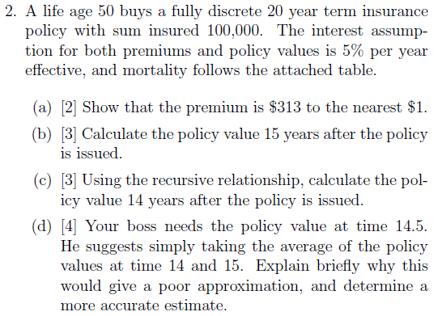
Example 4 – Life Cons 2 (ACTSC 331)

Slide 17
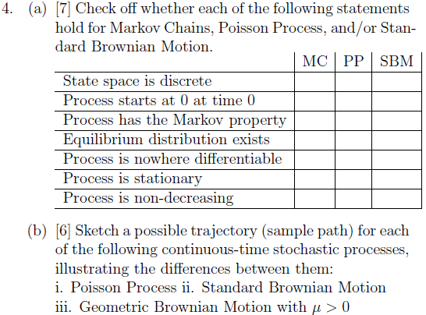
Example 5 – Probability Models (STAT 334)

Slide 18
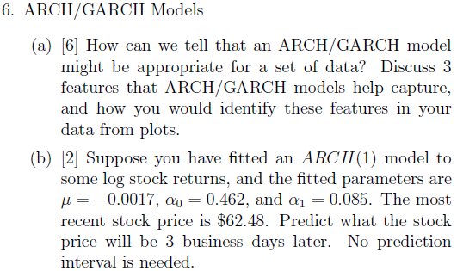
Example 6 – Time Series (STAT 443)

