Slide 1
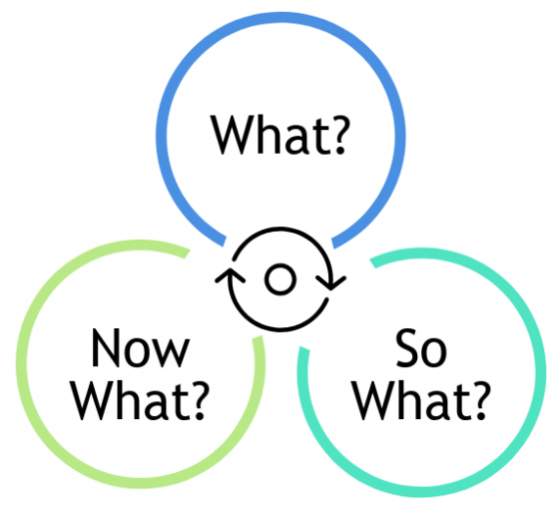
Resilience Through Reflection
Canadian Mathematics Society
November 30, 2024
Diana Skrzydlo

Slide 2
Why Encourage Students to Reflect?
Make their learning visible
Give opportunities to act on feedback
Improve resilience!

Slide 3
Reflection Prompts – from here
STAR Model (Situation, Task, Action, Result → Learning)
Gibbs’ Reflective Cycle (Description, Feelings, Evaluation, Analysis, Conclusion, Action Plan)
DEAL Model (Describe, Examine, Articulate Learning)
Bain’s 5Rs (Reporting, Responding, Relating, Reasoning, Reconstructing)
Integrated Reflective Cycle (Experience, Reflect on Action, Theory, Preparation)
CARL Framework (Context, Action, Results, Learning)
Four F’s (Facts, Feelings, Findings, Future)
What? So What? Now What?

Slide 4
Examples of Integrating Reflection
Level | Course | Pre/Post Test | Reflective Questions | Exam Wrapper | Multiple Attempts | Final Reflection
2nd year | Intro to Probability |  | X | X | X
2nd year | Intro to Life Contingencies |  | X |  |  | X
3rd year | Stochastic Processes | X | X |  | X | X
4th year | Advanced Life Contingencies | X |  | X |  | X
Grad | Actuarial Risk Management |  |  | X | X
Grad | Actuarial Communication |  | X |  | X | X

Slide 5
Pre/Post Test
Rate confidence in answers on first day
Give the same test on the last day and compare
Include metacognitive as well as content questions

Slide 6
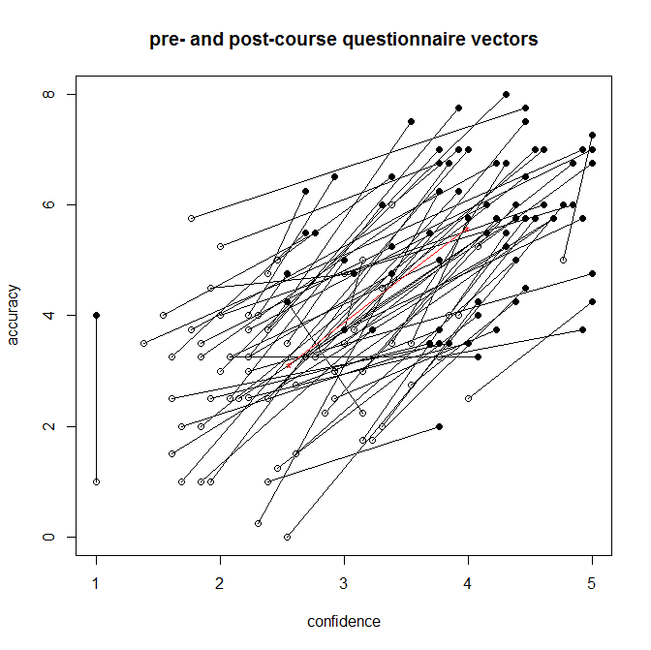
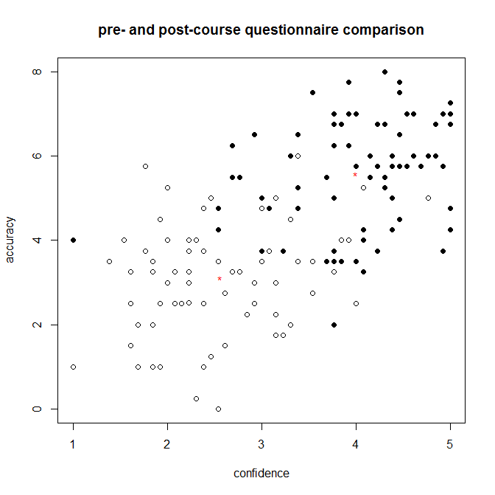
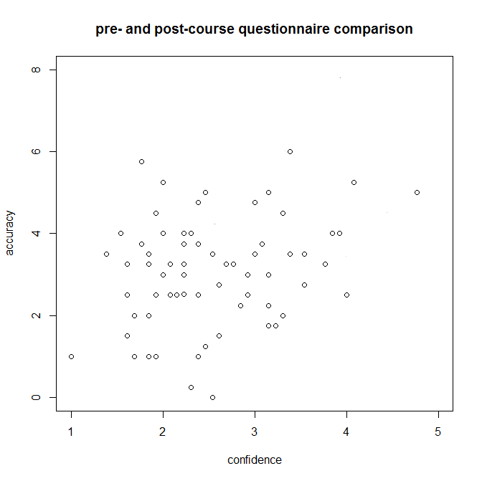
Pre/Post Test
Data:

Slide 7
Reflective Assignment Questions
Could be a separate assignment or integrated
Question types
  What important things did you learn this month/unit?
  Explain a course concept in plain language
  What do you still not understand?
  What now makes sense that didn’t before and what helped you?

Slide 8
Exam Wrappers
When returning marked tests, have students answer questions on:
  What they got wrong and why (not understanding what to do, not understanding how to do it, careless errors, running out of time)
  How they prepared
  How they will prepare in the future

Slide 9
Multiple Attempts with Feedback
Auto-graded online quizzes
Self-check questions with answers
Ungraded quizzes in class
Early-bird deadlines for assignments (resubmit draft)
Repeated presentations
Two-stage testing

Slide 10
Final Reflection
Have students look back over their portfolio of activities and reflect on growth and learning
Lovely insights from students!

Slide 11
Let’s Reflect Now!
What?
  Describe what you have thought, done, or experienced.
  What were you trying to achieve?
  What was good or bad about the experiences?
So What?
  What have you learned from this?
  What is important about this?
  What more do you need to learn?
Now what?
  Now what could you do?
  How can you draw upon this learning in the future?
  Where can you get more information?

Slide 12
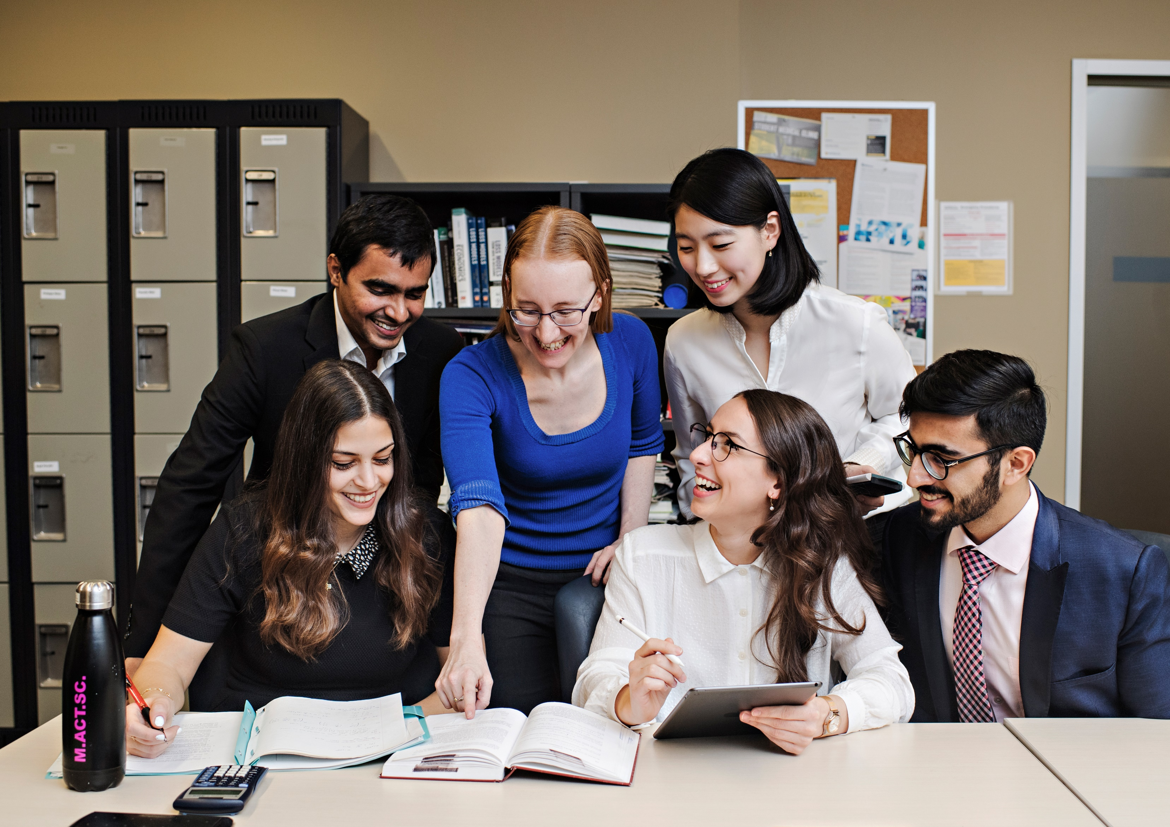
dkchisho@uwaterloo.ca
@ActSciProf on Twitter
uwaterloo.ca/scholar/dkchisho/blog

